Slide 1
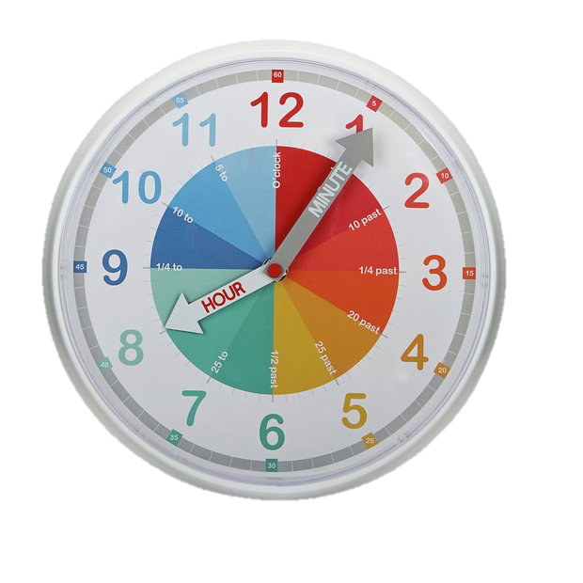
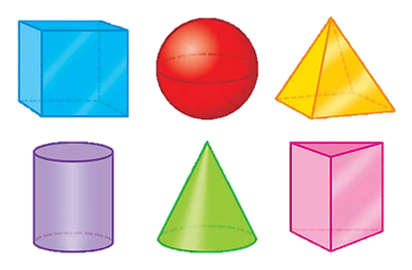
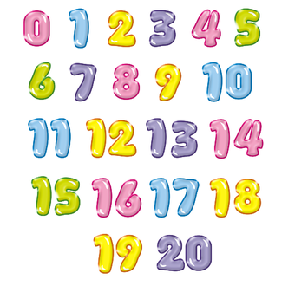
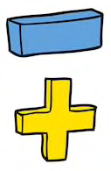
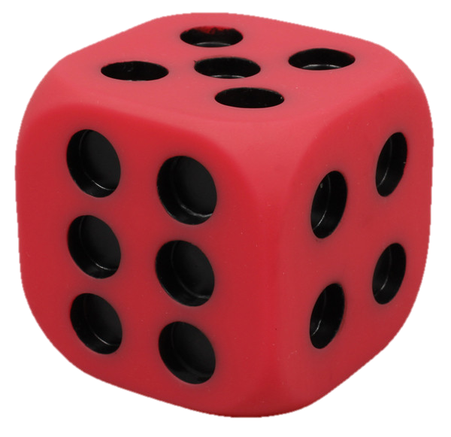
Reception
Maths and Munch 2019

Slide 2
ELG – Shape, Shape & Measure
Children use everyday language to talk about size, weight, capacity, position, distance, time and money to compare quantities and objects and to solve problems. They recognise, create and describe patterns. They explore characteristics of everyday objects and shapes and use mathematical language to describe them.

Slide 3
ELG - Number
Children count reliably with numbers from one to 20, place them in order and say which number is one more or one less than a given number. Using quantities and objects, they add and subtract two single-digit numbers and count on or back to find the answer. They solve problems, including doubling, halving and sharing.

Slide 4
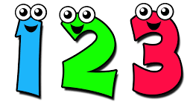
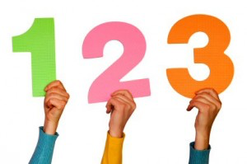
Counting
Up to 20 – don’t stop them from going further.
One-to-one correspondence – being able to match an object to the corresponding number.
Understand that numbers are symbols to represent an amount.
Achieved through practise, demonstrations and slowing down.
Nursery rhymes: 1, 2, Buckle my Shoe.

Slide 5
Number Recognition and Ordering
Identify numbers and name them – can use a number line to help identify numbers.
Know the order they come in.
Understand that teen numbers are made up from a 10 and 1s.
11, 12, 13, 15 – hardest numbers to learn – does not contain a clue in their name for what they look like.
E.G. fourteen 14 sixteen 16
Practise! Practise! Practise!

Slide 6
Addition
Understand addition means to combine – “all together”
Start with one more.
E.G. “Look, a number 7.”
“Great, do you know what one more than 7 is?”

Slide 7
Addition – With Objects
Introduction of number sums – add and equals symbols.
Groups of objects representing numbers.
Count each group and represent the group with a number.
Then count how many all together.

Slide 8

+
=
“1, 2, 3, 4, 5, 6, 7, 8, 9”

Slide 9

Addition – With Objects
Counting On
Count each group… keeping the first number in their head… counting on the second number of objects.
+
=
“4 … 5, 6, 7”

Slide 10
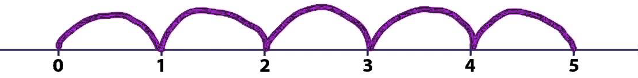
Addition – Counting On
Introduction of number lines.
Look at a sum … identify starting number … identify number counting on.
Understand the last number landed on is the answer.
0 + 5 =

Slide 11
Subtraction
Understand subtraction means to take away.
Start with counting backwards.
Nursery rhymes: 10 Green Bottles.
Children need to know what number comes before.
Followed by one less.

Slide 12
Subtraction – With Objects
Introduction of subtraction symbol.
Identify starting number and get correct amount … identify number subtracting and take them away … understand amount remaining is the answer.
On paper with objects – cross off number taking away, count remaining objects.

Slide 13

6 – 3 =
x
x
x

Slide 14
Halving, Doubling Sharing
Halving - Splitting an amount in half equally.
“You can have the bigger half.” There is no bigger half!
Doubling – Having 2 lots of the same number.
Ladybirds have the same amount of dots on each wing.
Sharing – Splitting something equally

Slide 15
Bring in the Children!
Get a biscuit and select an activity to do with your child.
Choose from:
Counting – one-to-one correspondence.
Ordering - numbers to 20.
Addition – counting on using a number line.

