Slide 1

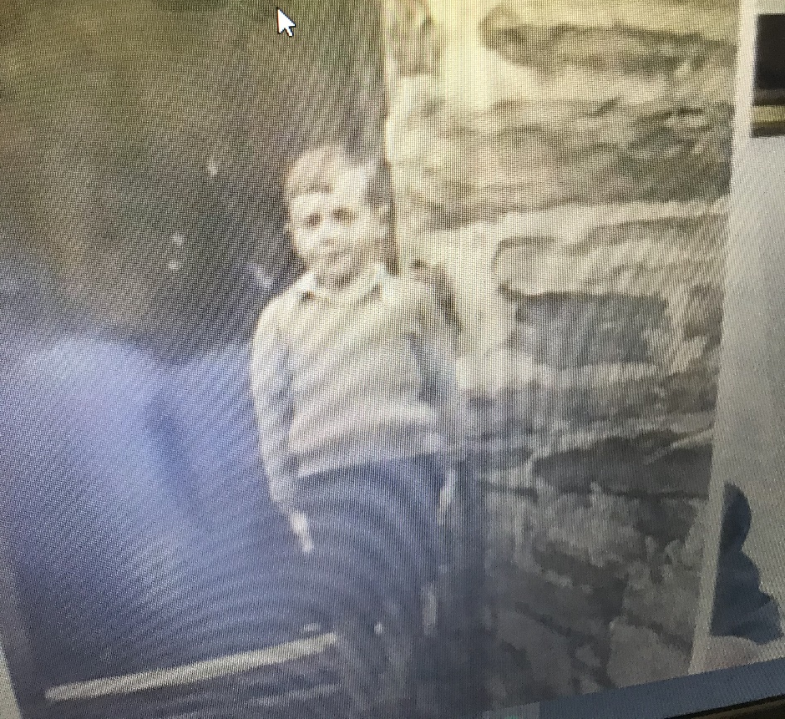
MY GRANDAD’S MEMORIES of WORLD WAR II - By Luke J

Slide 2
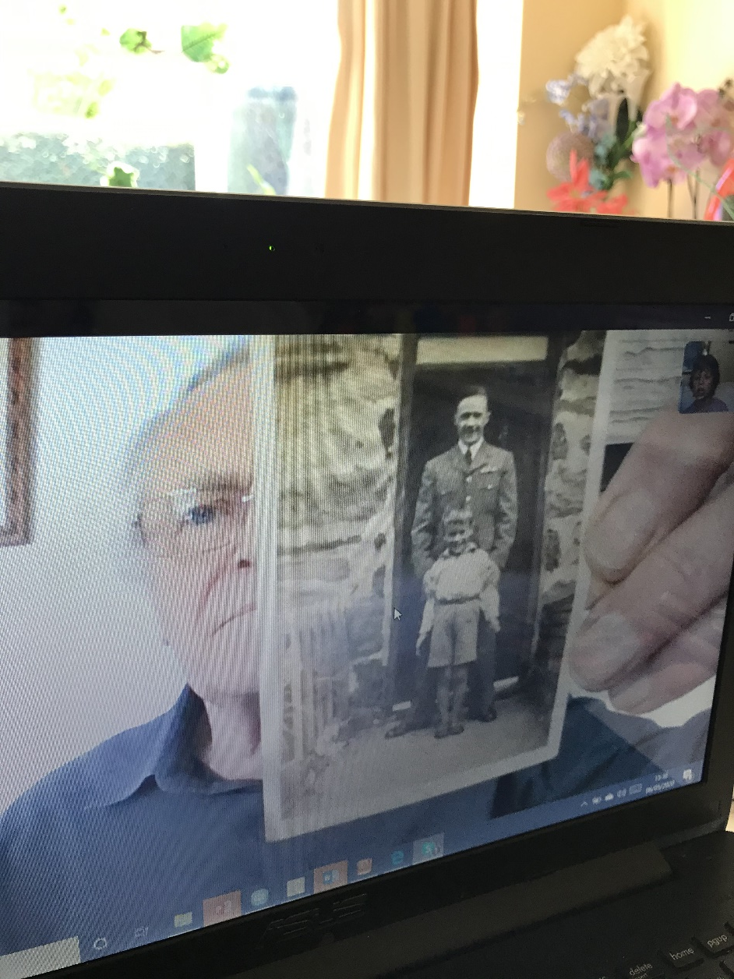
I talked to my grandad on Skype about his childhood in WW2 and we took pictures of the screen.

Slide 3
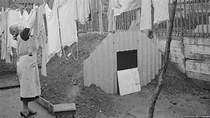
My Grandad lived in Birmingham at the beginning of the war.
He remembers being in an Anderson Shelter during the air-raids.

Slide 4
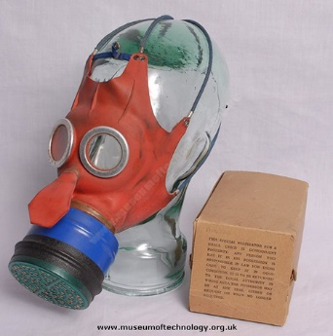
He remembers having to carry around and sometimes wear a gasmask for children that looked like Mickey Mouse.

Slide 5
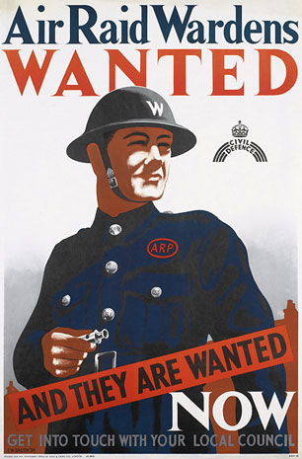
Some of his family moved to Porthmadoc in Wales to escape the bombing.
His dad stayed in Coventry as an ARP warden.

Slide 6
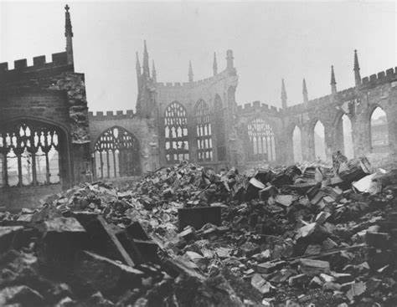
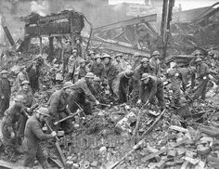
Coventry was badly bombed during the war.
His Dad’s knowledge as a builder helped him to do this job.

Slide 7
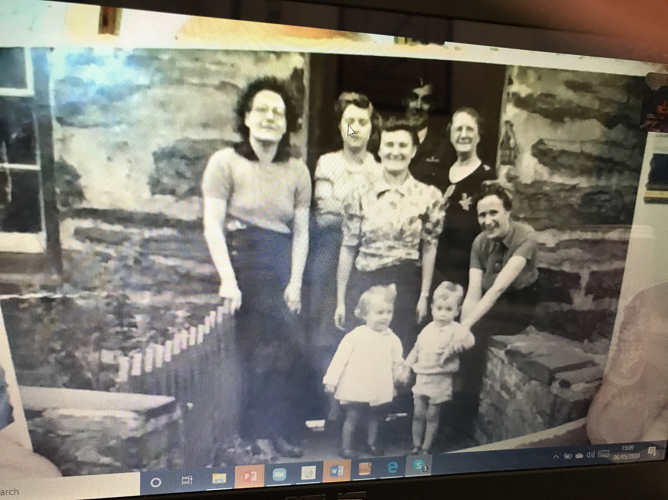
He lived with his mum, his aunt Audrey and his grandma Wales.
Their cousin, Valerie, and her daughter lived nearby.

Slide 8
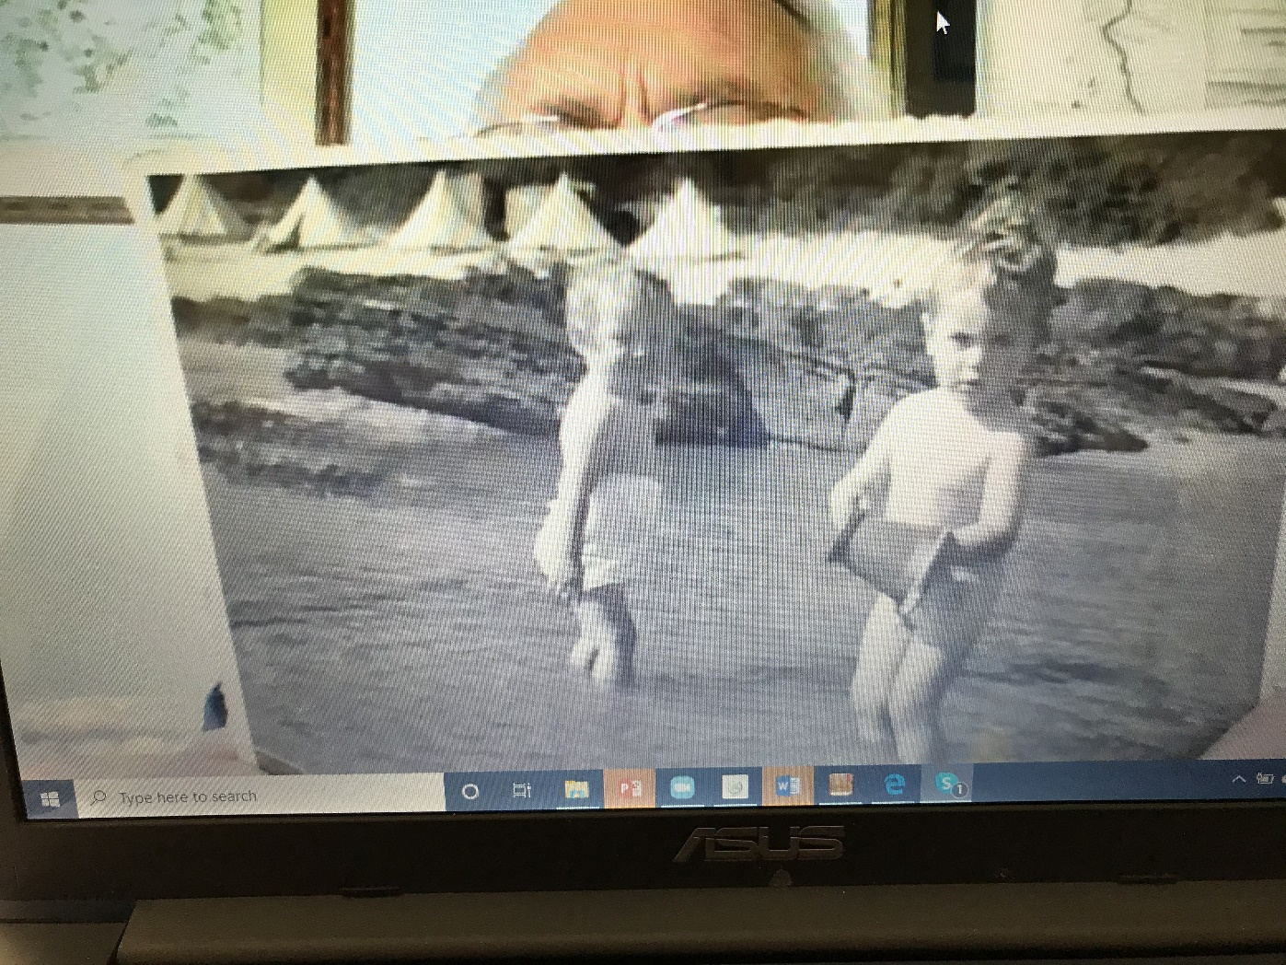
This is a photo of my grandad and his second cousin, Janet. We went to stay with her in October 2019. She lives in Devon now.

Slide 9
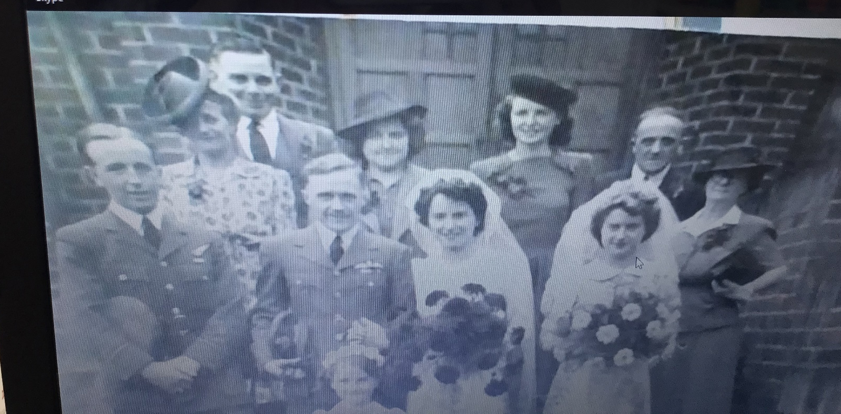
His Uncle Dennis was enlisted as an RAF pilot.
He did his basic training in India and Canada and Wiltshire.
He met his wife-to-be in Wiltshire at a dance.
This is a photo from their wedding day.

Slide 10
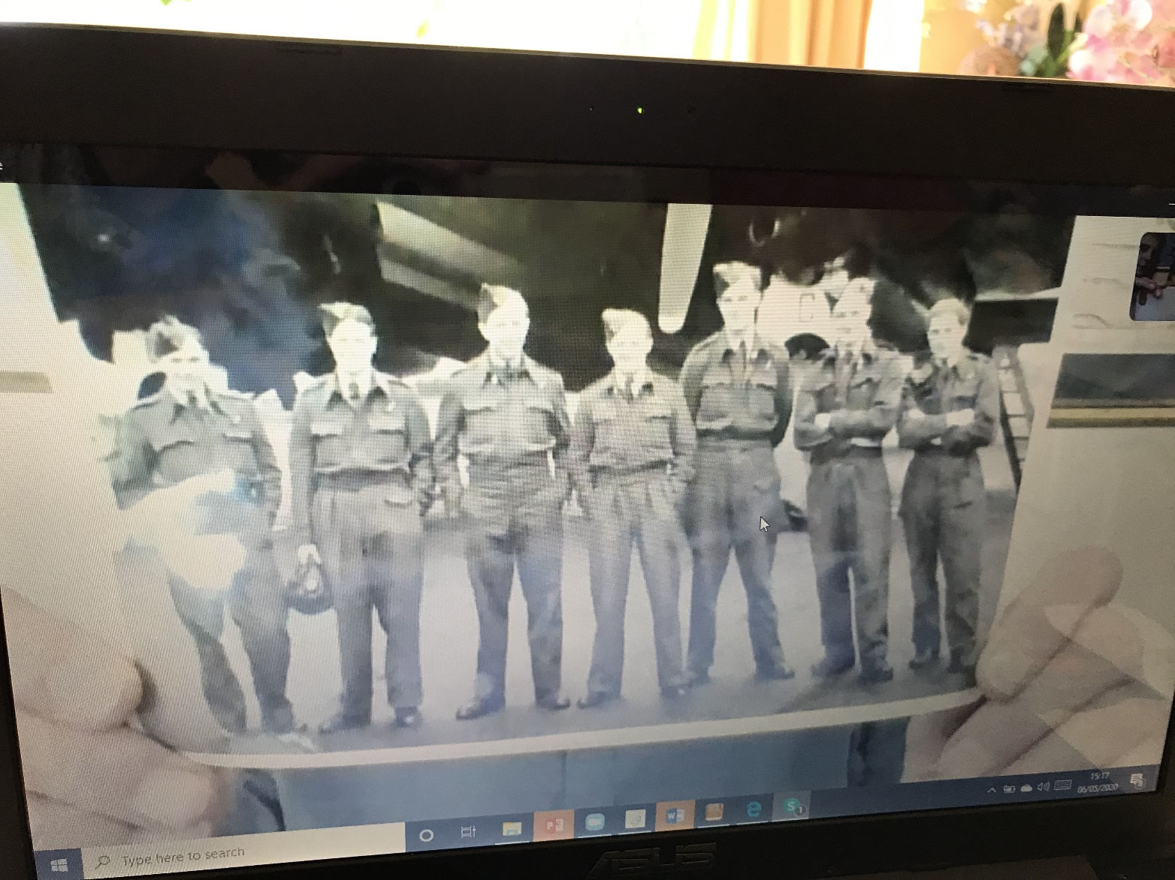
He was the captain of a Halifax bomber.
This is his crew and his plane. It had 4 engines.
His Navigator, Philip Bentley, was his Best Man. They stayed good friends.

Slide 11
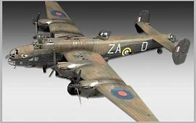
This is a Halifax Bomber.

Slide 12
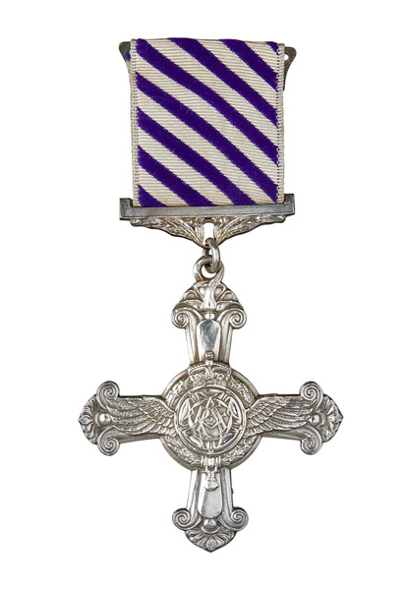
Denis flew more flights than he was supposed to.
He was awarded the Distinguished Flying Cross.

Slide 13
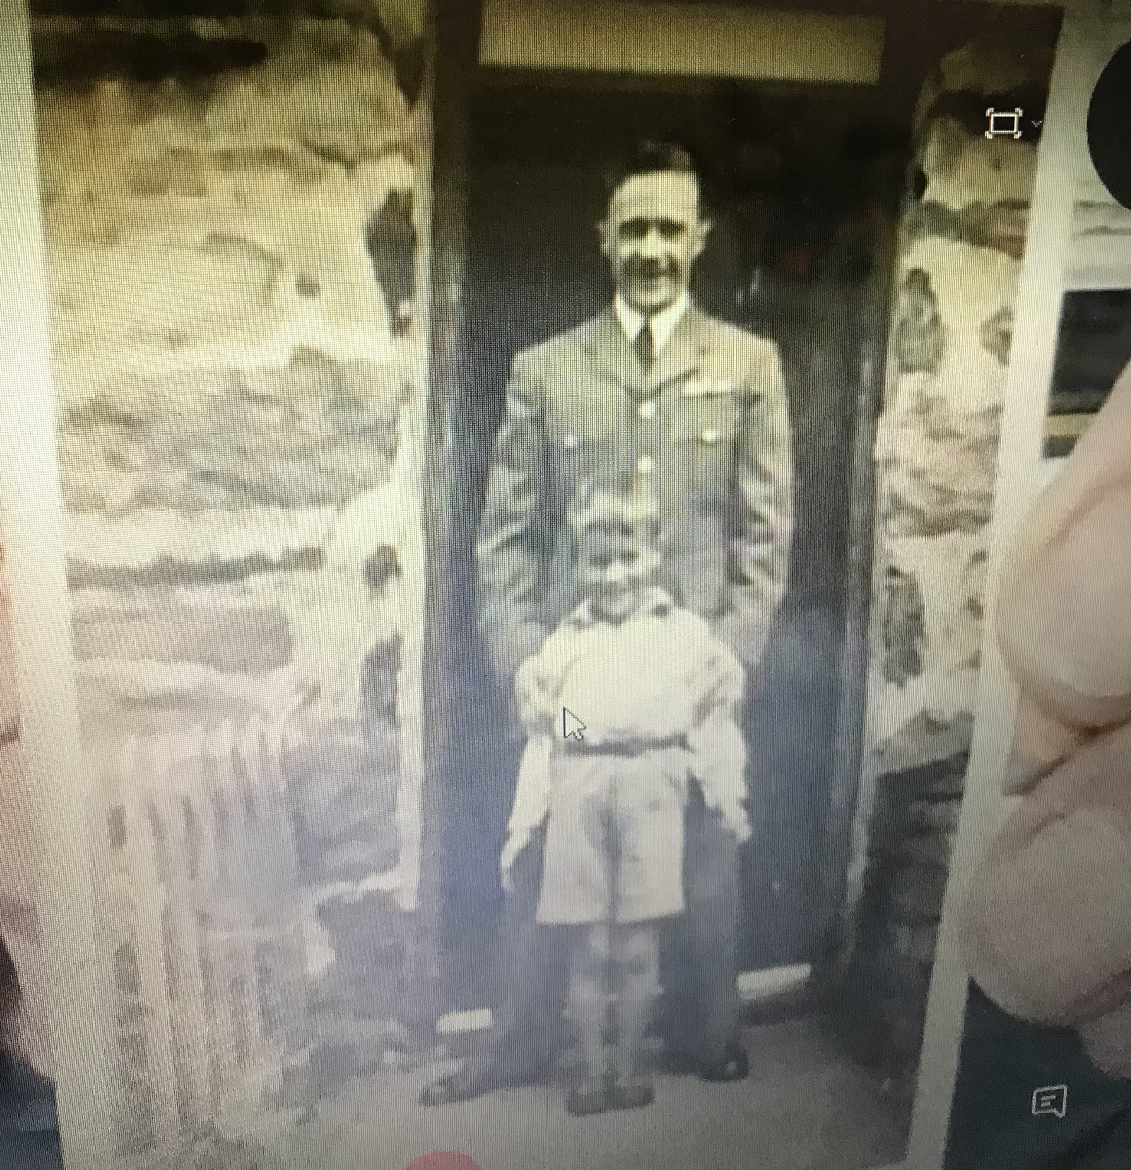
My Dad loved Uncle Denis having leave and coming to stay with them.

Slide 14
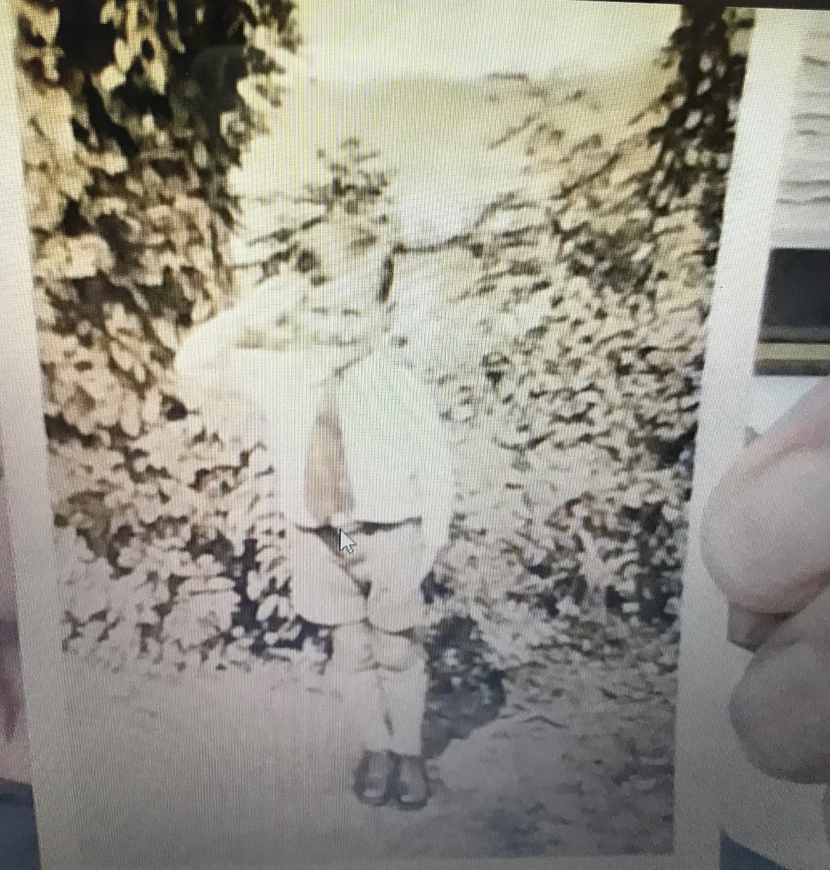
My grandad sent Denis a salute.

Slide 15
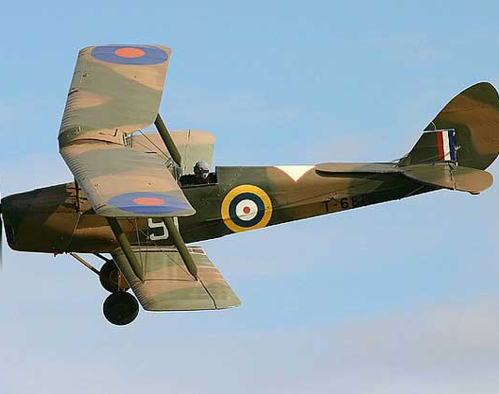
After the war, Denis flew for the Voluntary Reserves.
He used to fly Tiger Moths over their house in Birmingham.
He dipped the wings as he flew over.
He moved to Ireland to be a pilot for Aer Lingus.

Slide 16
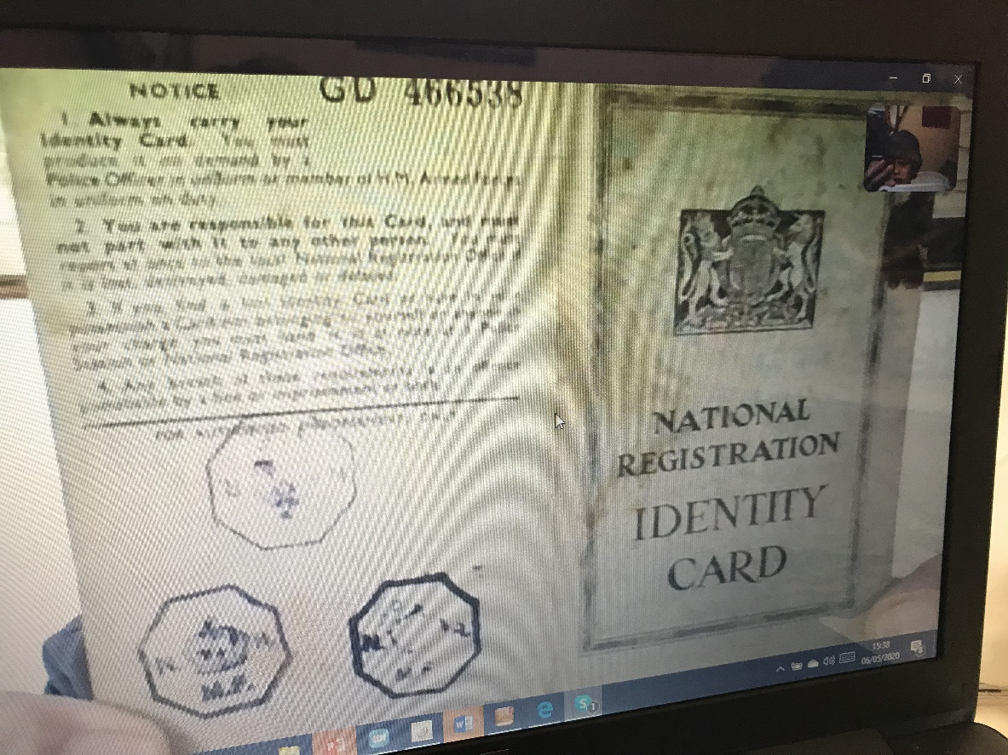
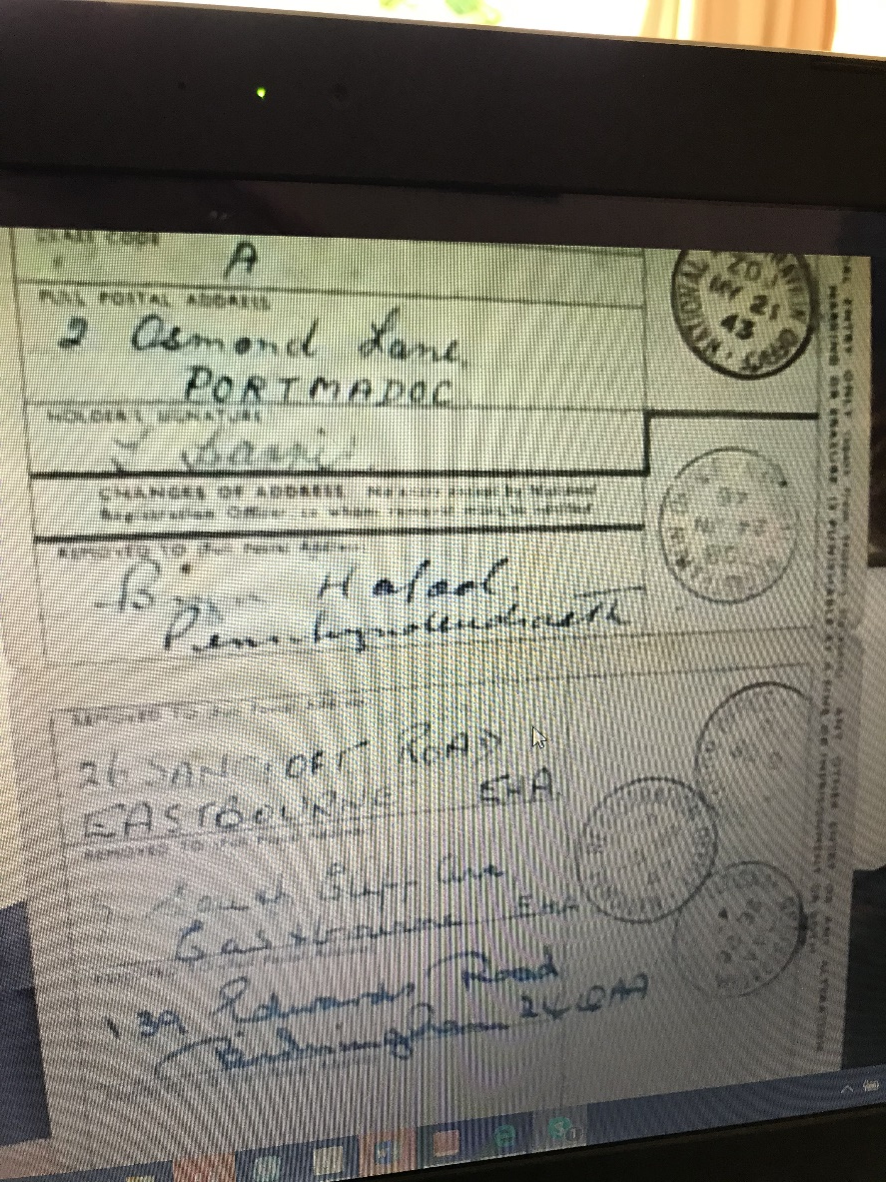
This is my great-nan’s ID card.

Slide 17
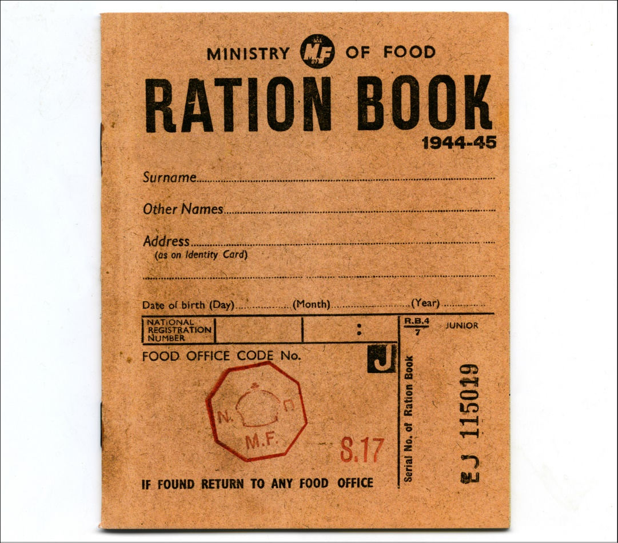
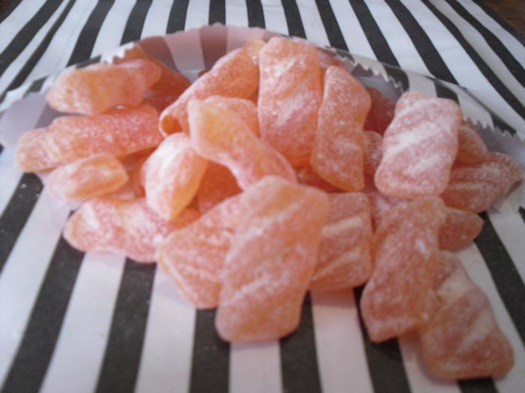
Grandad remembers sweet rationing. He sucked barley sugar at night that made his teeth bad!

Slide 18
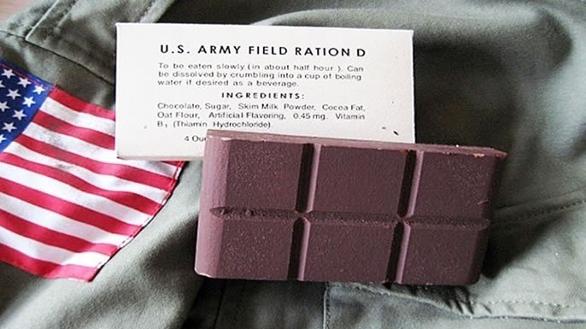
US soldiers at a local base gave chocolate and sweets . It was like gold!

Slide 19
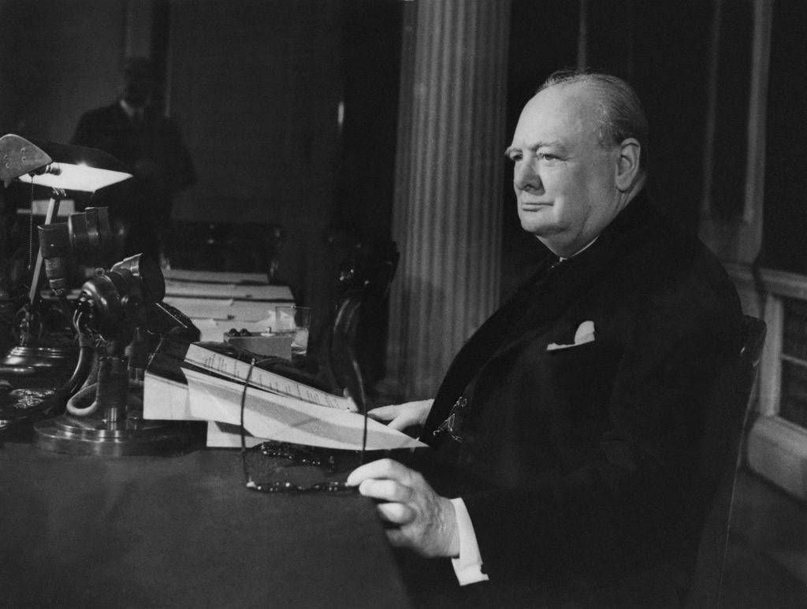
Grandad remembers listening to the radio with everyone when Churchill announced VE Day. Everyone went BANANAS!

