Slide 1


Slide 2
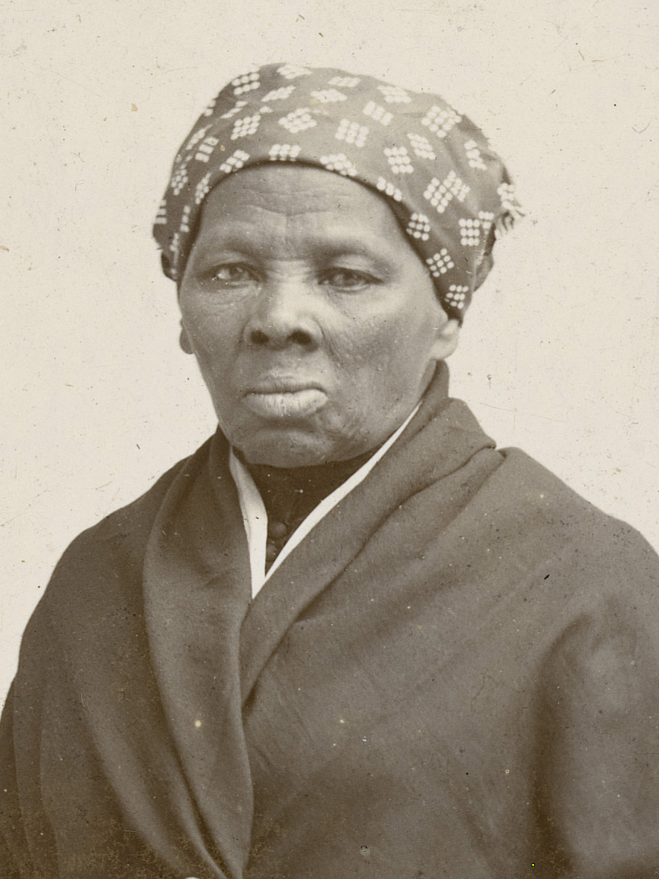
Harriet Tubman

Slide 3
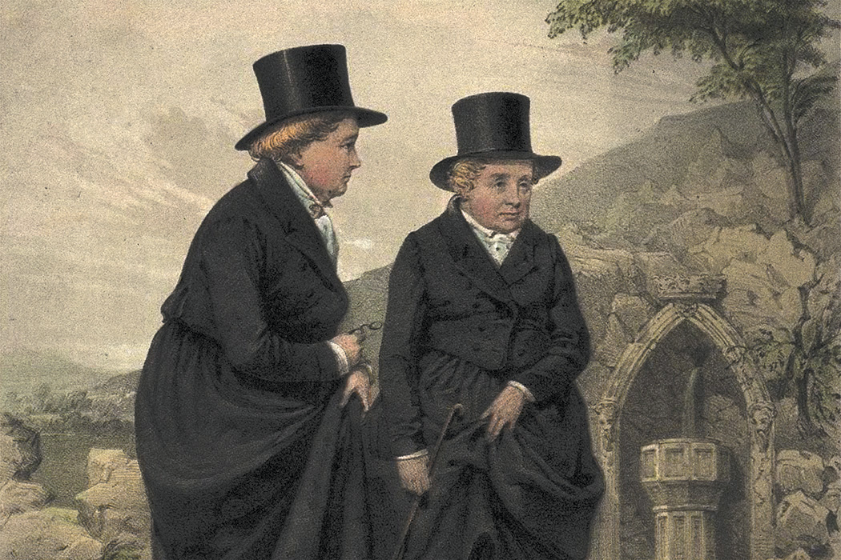
Ladies of Llangollen

Slide 4
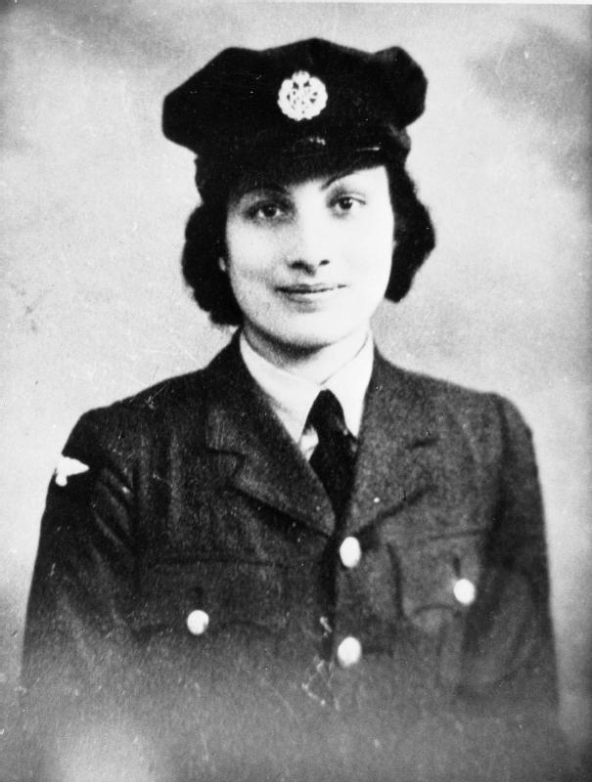
Noor Inayat Khan

Slide 5
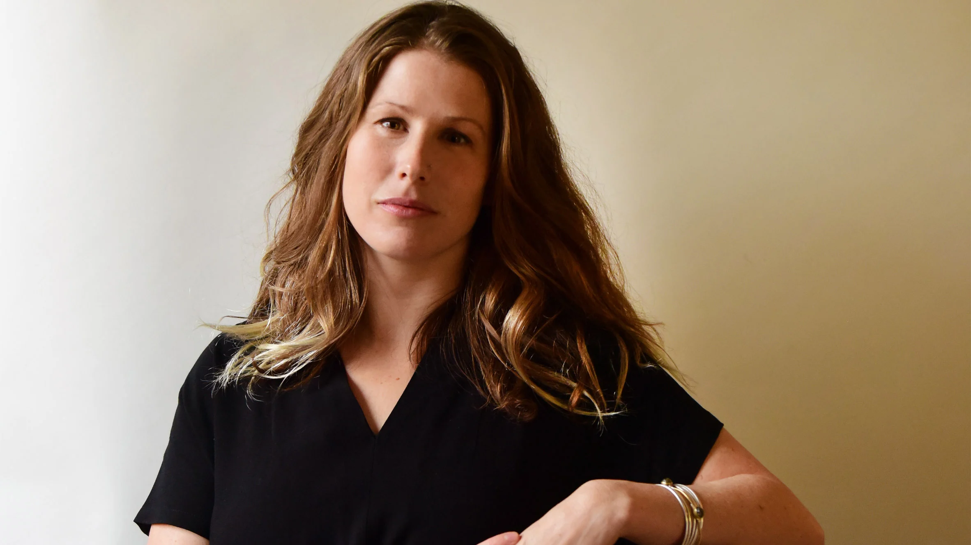
Caroline Criado Perez

Slide 6
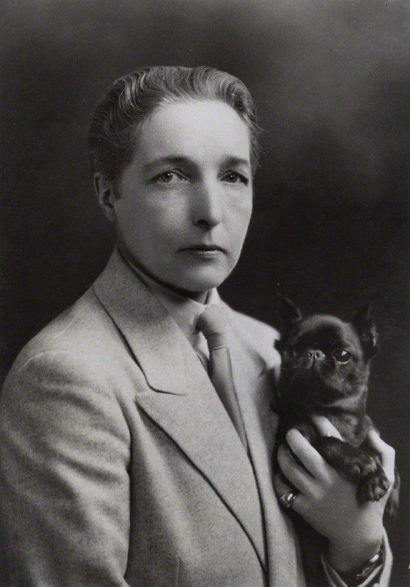
Radclyffe Hall

Slide 7


Let’s vote!

