Slide 1


KS1 Writing Workshop
Mrs Woodward and Miss Baird

Slide 2
Purpose of today
We will be showing you how we teach your children during their writing lessons. We will take you through the steps of understanding, exploring grammar in context and applying this learning to a final independent writing piece.

Slide 3


A structured, text-led literacy programme for primary classrooms.
How it works
Immerse in a model text
Investigate the craft
Rehearse ideas
Compose independently
Revise with intention
What it aims to achieve
A tighter link between reading and writing
Stronger vocabulary and grammatical confidence
Clear models of genre and purpose
A predictable structure that helps teachers scaffold progress
Notes:
What it is-
A structured, text-led literacy programme for primary classrooms. Each unit begins with a high-quality book, poem, or nonfiction text and then guides pupils through reading, thinking, and crafting their own writing.
How it works
Immerse in a model text. Pupils explore vocabulary, structure, voice, and purpose, often through drama, discussion, and retrieval tasks.
Investigate the craft. Lessons zoom in on grammar, sentence patterns, and authorial techniques drawn directly from the model.
Rehearse ideas. Children try out mini-writes, shared writes, or paragraph-level experiments that warm up their narrative or nonfiction muscles.
Compose independently. The path leads toward a final piece where pupils apply what they’ve learned, supported by planning frames and success criteria.
Revise with intention. Editing and improving are baked into the process, encouraging pupils to see writing as something sculpted, not spilled.
What it aims to achieve
A tighter link between reading and writing
Stronger vocabulary and grammatical confidence
Clear models of genre and purpose
A predictable structure that helps teachers scaffold progress

Slide 4
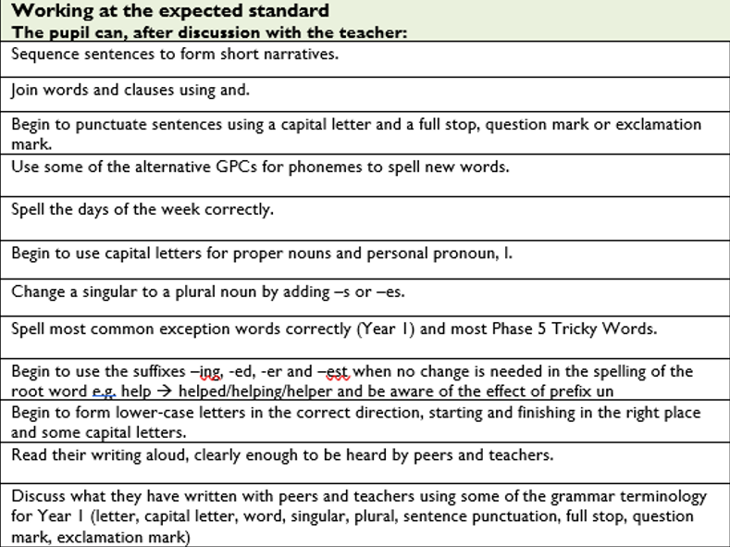
The assessment framework Year 1
Notes:
Teacher assessment frameworks (TAFs) Year 1

Slide 5
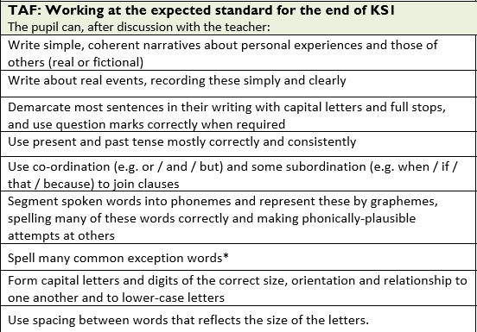
The assessment framework Year 2

Slide 6
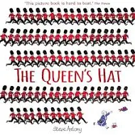
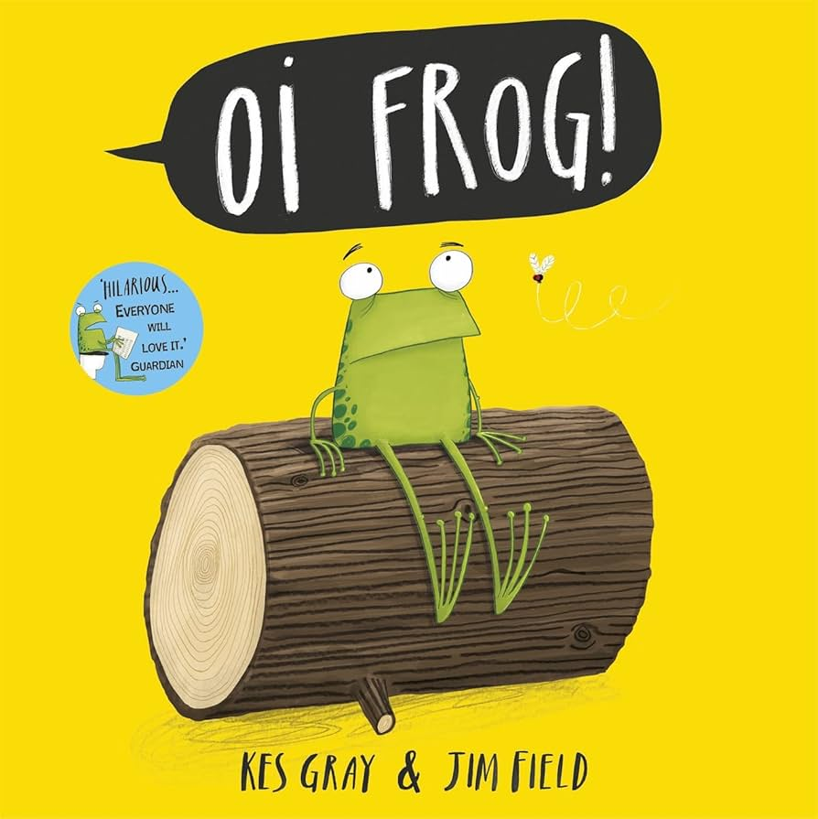
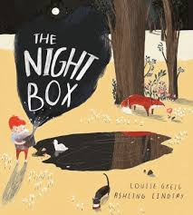

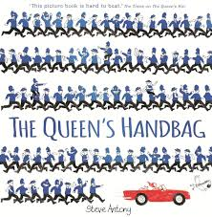



Texts this year - Year 1

Slide 7
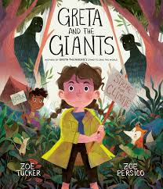
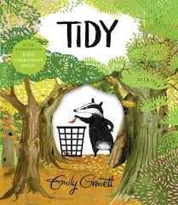
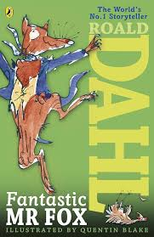
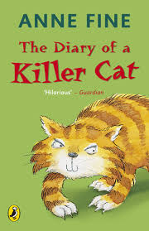


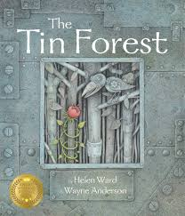
Texts this year - Year 2

Slide 8
How we build up to writing
Book talk
Vocabulary building
Sentence practice with a grammar focus
Looking at the layout
Shared/ guided writing
Independent writing
Edit and improve

Slide 9
Ways to help at home
Regular reading
Rich talk – talk before the pencil lands
Celebrate the idea over accuracy
Use books as springboards
Short low-pressure bursts
Display their work
Write for real purposes
Notes:
Reagular reading - Read more. Stop and gasp when you read something beautiful. Stop and laugh when you read something funny. Stop and groan when you read something goofy. Your child will pick up on craft moves and amaze you because they will show up in his/her writing. Make the question “How did the writer do that?” part of your repertoire as you read with children.
Ask your child to tell you stories, and help them structure the stories into a beginning, middle, and end format. Your interest will inspire him/her to want to add the details that make it a story, and telling stories is an important precursor to writing stories. Tell your child stories–ones from your childhood, ones about your day. They will love hearing about your life, and listening to stories will help develop the understanding of how to tell stories. Give your child opportunities to tell you about what they know. If your child is an expert at Legos, encourage them to tell you about it. The more organized the explanation, the better, as this practice will help them develop informational writing pieces.
Encourage your child to celebrate their ideas over the accuracy of the writing. Don’t let them be put off from trying because they don’t know how to spell a word. Model what we can do if we can spell a word, we can try then we can search it up in a dictionary or google. Show them its ok to not know the answer at first.
Books as spring boards
Short low pressure bursts
Display their work be proud
Share any form of writing you do with your child–lists, notes, letters–they all help children realize the importance of writing. Children love being given a job or being helpful use that to your advantage

Slide 10
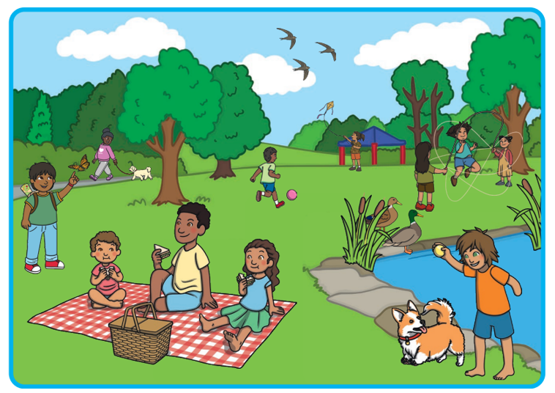
Year 1 task
Writing a descriptive sentence using description and ‘and’.
Year 2 task
Writing a descriptive sentence using expanded noun phrases and ‘because’.

Slide 11
Example
Year 1
I can see a short dog and a tall tree.
Year 2
The dog is playing fetch.
The little orange dog is playing fetch because that is his favourite game.

Slide 12

Editing in year 2
Once we have completed a piece of writing, we go back through it using our purple pens to make corrections to improve our writing. This may be through better word choices, correcting punctuation, spelling corrections and handwriting improvement.

Slide 13

We hope you found it useful

