Slide 1
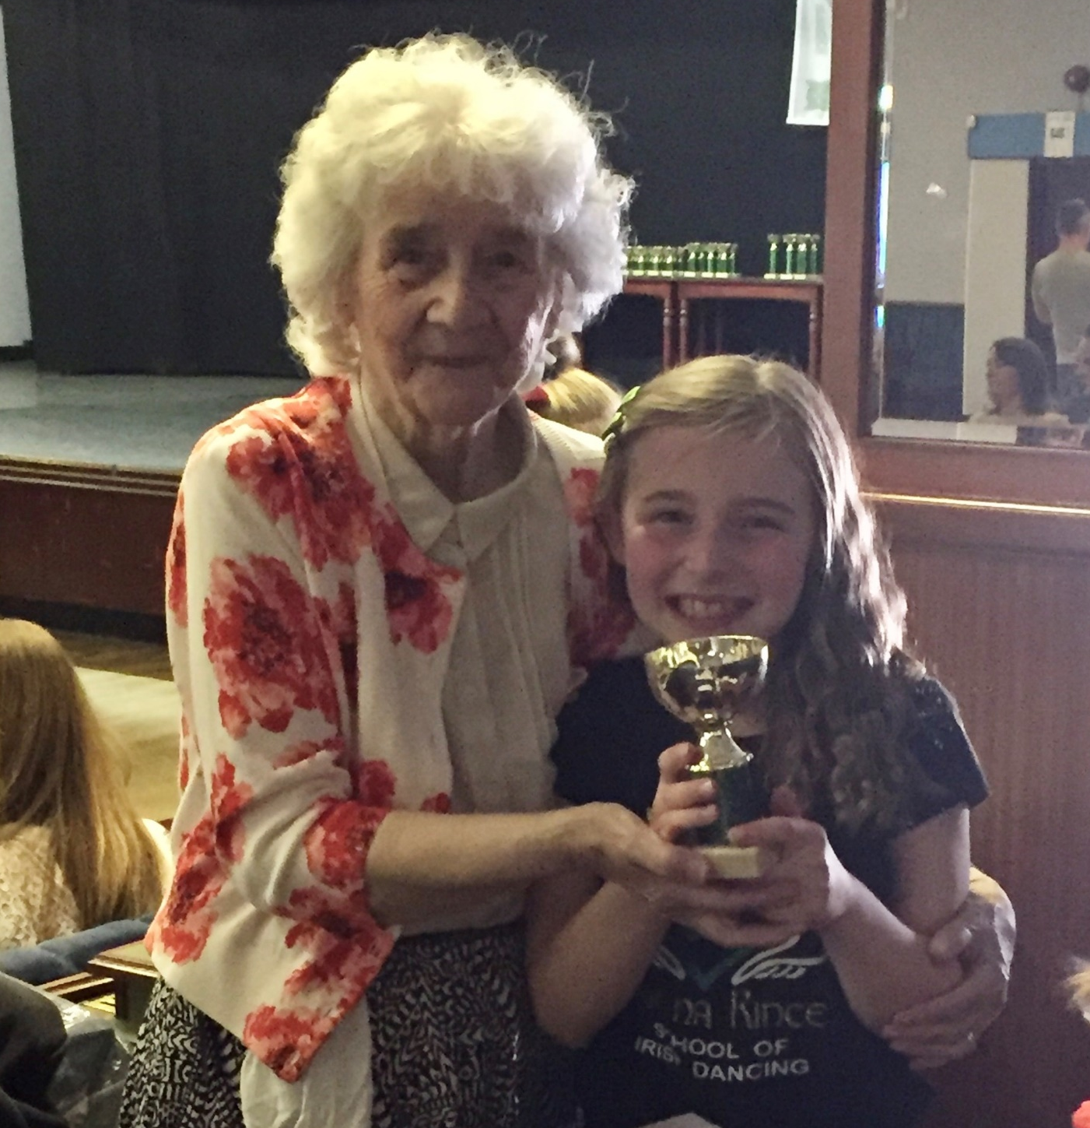
Nanny Daly’s WW2 Memories
Nanny Daly was born in Dublin, 1934.
She was 6 years of age when the war started.
She was 12 years of age when it ended.
Whilst Ireland was not directly at war, they were still massively impacted by it.
Nanny said that her two Uncles joined the Royal British Airforce and the Army, in order to fight the Germans.
My Grandad (Nanny’s Husband), who was also born in Dublin, was also impacted by the war, as his Dad, my Great Grandad Daly, fought for the British Army.
Nanny Daly remembers that she was rationed with food and heating as a child.
The rationing was: 1 Egg per person per week, 2 Oz's of Tea and Sugar, 10 Potatoes and 10 pieces of Wood for the fire.
No sweets or biscuits were available.
Her Dad was a Master Baker and did not go to war, as he made bread for the family and local community.
Air raid shelters were in place, but no one ever bombed Dublin.
My Great Grandad Daly, whilst being Irish went to fight for the British Army, against Germany.
He served for 16 years.
Whilst in the Army he was based in England and travelled throughout the UK.
He was in London to help during the Blitz.
His role in the army was to dig the trenches.
He was injured in the war and had Lung and Kidney issues for the rest of his life.
After the war had finished he returned to Ireland for a few months.
He then came back to work in Huddersfield, England in a chemical factory.
He received a British Army pension until he died.
He retired to Ireland in 1955 and died in 1985.
My Great Nanny Daly (Great Grandad Daly’s Wife), would always make everyone stood up when the British National Anthem was played. She would say “Lizzy (Queen Elizabeth) looked after us during the war”. She was referring to the pension that they got from the Army.

