Slide 1


Phonics
Information for Reception Parents

Slide 2
Learning the letter sounds
The most important thing you can do is help your child learn the correct letter sounds.
Do not teach the letter names – they do not need to know them for reading and writing at this stage. Don’t worry if you have already taught them these, the children will still be exposed to them and will be learning them, but they are not our main priority at this stage.
Watch: https://www.youtube.com/watch?v=jPVbJ-IaHIw
You can also find videos showing how to pronounce these sounds on our website. Tany's Dell Primary School - Help your child with phonics
The common mistakes are f, p, h, l, m, n, r. Say a word with that sound in – how do you actually say the sound?

Slide 3
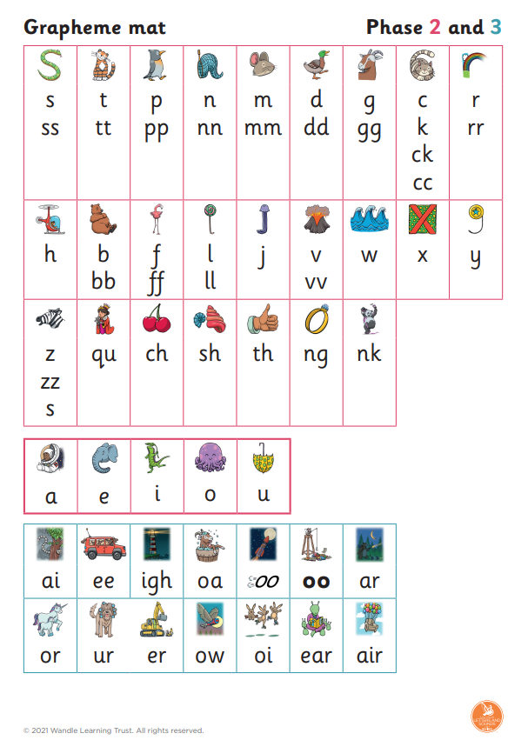
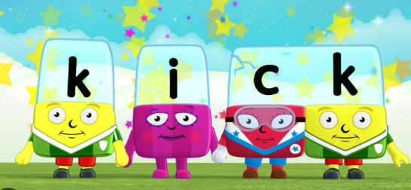
We teach the sounds in phases. These have been given to you already. The sounds are not taught in alphabetical order. We are currently learning the phase 2 sounds.
The children are learning uppercase and lowercase letters but when writing, the children need to be writing lower case letters at this stage.
The sounds include diagraphs (two letters making one sound eg sh) and trigraphs (three letters making one sound eg igh)
Alphablocks is a good way of helping children to learn phonics. It helps them understand blending and digraphs (when two characters join together to make one sound).

Slide 4
Blending
This is how we read words.
Blending is recognising the letter sounds in a word, eg
c-a-t
and blending them together in the order they are written to say the word ‘cat’.
For example, in a 3 letter word, say each sound separately, then join the first two sounds together, then together a bit quicker, and then add the last sound.
For longer words, we chunk the syllables and blend it in smaller bits eg
l-igh-t/n-i-ng. Their favourite one is f-a-n/t-a-s/t-i-c!

Slide 5
Segmenting
This is the opposite of blending!
Segmenting is ‘chopping up’ the word to spell it out, breaking the words into their individual sounds.
This is used when the children are writing words.
Think about what the first sound is. This is quite hard for some children at the start of the year; games like I-spy are great for helping the children learn to do this. Then say the word slowly. Count how many sounds they can hear and write one sound at a time. At the end, read back the word they have written to check they have remembered all the sounds.
At this stage we are not expecting children to be able to write every word correctly. If they have made a good attempt at writing down the sounds that they have heard / know that is OK, for example shoo for shoe. It is also OK to show them what the actual word looks like, and to say that they will learn more sounds as they move on up through the school. However, it is really important that they feel they are being successful, so just be mindful of what / how much you say.

