Slide 1
Welcome to Year 4!
The classes are Marine and Topaz
Topaz adults: Mrs Wakelin and Mrs Etienne
Marine adults: Mrs Collinson, Mrs Hales

Slide 2
Introduction
Mrs Wakelin – I have been working at Tany’s Dell since 2000, before that I was a parent volunteer.
I am the phase leader I ensure the smooth running of years 3 and 4.
Mrs Collinson - I have been working at Tany's Dell since 2014, both my children attended the school…and so did my dad!
Any collection, dinner or illness information please contact the school office by email or phone.

Slide 3
School timetable
8:30-8:45 through the main gates
10:45 – 11:00 break time
12:20-1:20 – Children alternate with year 3 to go out first or eat first and then get called for lunch in the dining hall.
3:15 - Pick up from the middle playground – please be patient whilst we get to know your faces ☺

Slide 4
Key days
Monday - Topaz – Reading books and Library books
- Marine PE
Wednesday - Marine Library books
Thursday – Topaz PE
Friday – Both classes PE and home learning will be checked.
Read 3 times, 20 minutes TTRS and time on Spellzone

Slide 5

PE Kit
All children to come to school in the new school PE uniform on their designated PE days.
Please label ALL PE kit with your child’s name.
If your child wears ear-rings, please ensure they know how to safely remove them. Adults/ peers are not allowed to help.

Slide 6
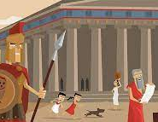
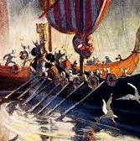

Topics this year
Autumn 1 - Performance
Autumn 2 – Ancient Greece
Spring 1 - Vikings
Spring 2 - All change
Summer – Rainforest and chocoloate

Slide 7
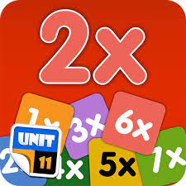
Year 4 expectations according to the national curriculum
By the end of Year 4, children must know all their times tables up to 12x12. The must recall each one at speed. The government provide an online test in the Spring for this. The MTC – Multiplication Test Check.
There are 25 questions and they have 6 seconds to answer each question. This is very similar to the ‘Soundcheck’ section on TT rockstars.
By the end of Year 4, they must know how to spell the majority of year 3/4 statutory spellings.
By the end of Year 4, all handwriting must be joined and
we hope as many children as possible have a pen licence.

Slide 8
Class rewards
In Marine class, we have a Wow jar. If a child impresses an adult in any way, they put their name in the jar. I pull 3 names out on a Friday to win a prize. They can also earn rewards as a table with prizes given on Friday.
In Topaz class, earn gems in the jar for the team, these are then counted at the end of the term and they get to choose their reward as a team. Children can also earn a Star in the Jar for themselves for doing something outstanding.
Whole school rewards are made up of different tickets and tokens given by other adults in the school. These are collected in the banks. Once a certain number is reached, a whole class reward is given. Last year we saved our tokens to go to the park.

Slide 9

What will it be like in Year 4?
High expectations – ‘Reach for the Stars’.
Promote independent Learners.
To develop a good Growth Mindset – I can’t do it YET!
Motto - Practice makes perfect.
Learning will be fun and linked to topics. First topic is based on our performance.
Work towards the computerised times table assessment in Spring

Slide 10

Library time and books
Coloured sticker books will be changed weekly unless an adult moves them up a colour band.
This will be on a Monday – Topaz and Wednesday - Marine.
Free readers have a choice of 100 suitable year 4 books. It is expected for Year 4 ability children to be free readers by the time they leave Year 4.
They will also have a library book of choice too.
You or your child can write what they have read in their reading record.
When children read to an adult, it must be out loud and a range of questions asked about the text to ensure they have understood it and to aid their comprehension.

Slide 11

E- Safety
It is really important that both teachers and parents are keeping the children safe online. Online safety is something that we all need to be aware of at all times. To help keep the children safe online we follow these tips for SMART thinking online: S: stay safe, don’t give out personal information. M: don’t meet up, never meet someone you don’t know from the internet. A: accepting files, do not accept files as this could cause problems. R: reliable, is the person or website telling the truth? T: tell someone, tell an adult if you are worried or upset.

Slide 12

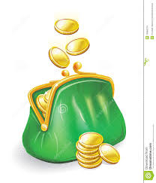
Parent Pay
Throughout the year, paid educational visits may be added to Parent Pay. Remember you can always add money into your account to build up credit. This can then be used later throughout the year for paid educational visits.
This can include events such as:
School Trips/visits
Further information to follow.

Slide 13

Any questions?

