Slide 1
Communication
MAKING SURE YOU KNOW HOW TO ASK FOR SUPPORT

Slide 2
When might you need to contact a member of staff?
If you need academic support such as:
If you are struggling with the work that has been set
If you need to clarify instructions
Access issues – you cant find a resource or it wont work
If you need pastoral support:
If you need support with your mental health and wellbeing
You would like to speak to or see your PBM

Slide 3
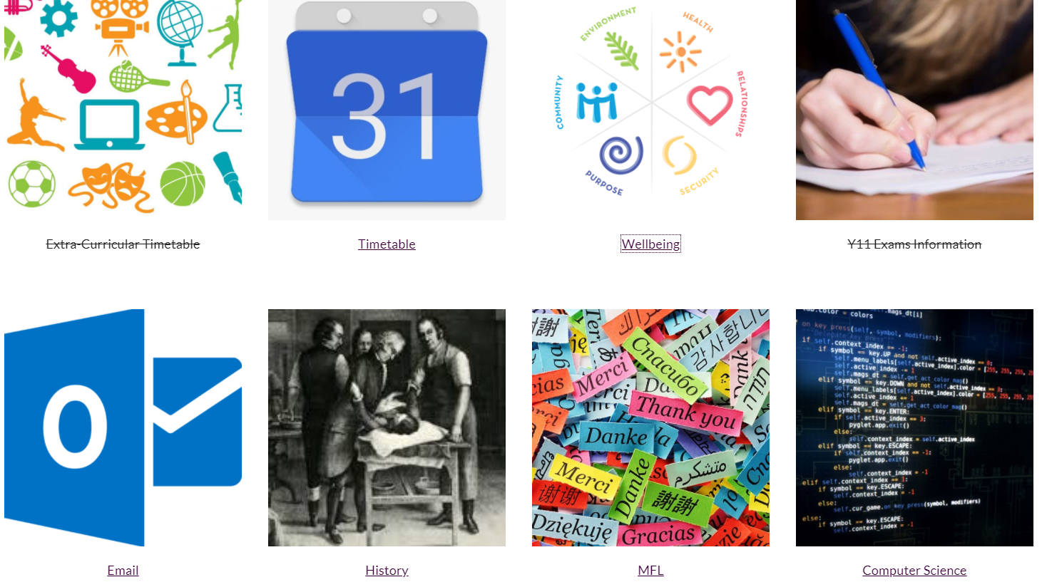
How can you contact us?
Student Worry Box
School email

Slide 4
Wellbeing support and Worry Box
Access the ‘Wellbeing’ section on the Student Portal – this can be found by accessing via our school website via ‘useful links’ on the bottom of the home page

Slide 5
Accessing PDC
DO NOT ATTEND PDC unless you have been asked to do so.
Should you need to see a PBM use the Worry Box to inform your PBM and they will come and get you as soon as they are available

Slide 6
Student Email
OFFICE 365 AND HOW IT CAN WORK FOR YOU

Slide 7
Why do students at Tarleton Academy have an email account?
So that your teachers can contact you
So that you can contact your teachers. This may be useful if you need support with your work, for example.
To give students access to Microsoft Office 365 (This includes web based Word, Powerpoint, excel and many more!)

Slide 8
As students we expect you to:
Check your email account every day
Ensure it is only used for school related mail
DO NOT open or share any suspicious looking emails
Report any instances of misuse or potential phishing attack emails to Mr Marsh by emailing n.marsh@tarletonacademy.org

Slide 9
There are different ways to check your email…
On your Chromebook (its bookmarked for you on the top left of the task bar!)
On the Student Portal (accessible vis the school website)
On your phone (via the Office 365 App)

Slide 10
How to Access Your Email Account via The Student Portal
Log onto the school website www.tarletonacademy.org
Scroll to the bottom of the home page to fine ‘Useful Links’

Slide 11
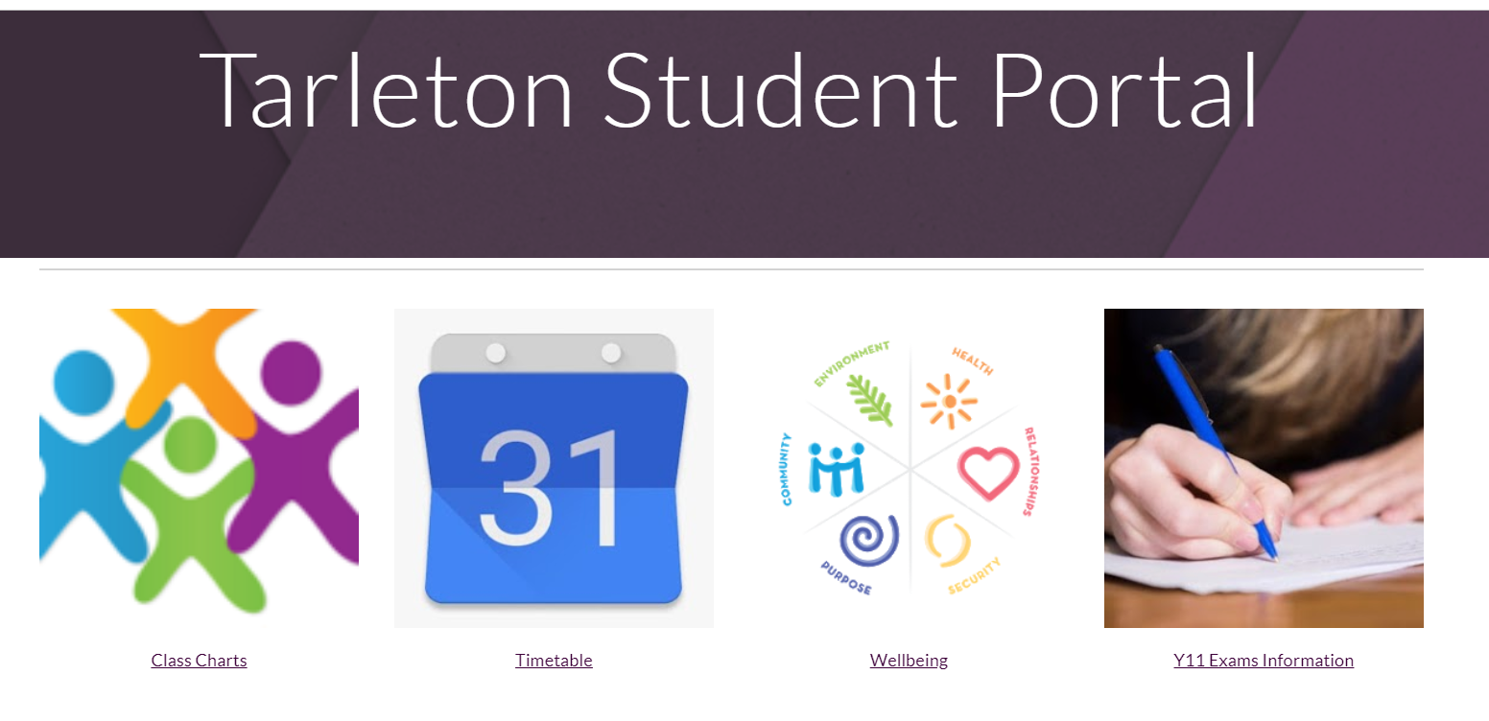
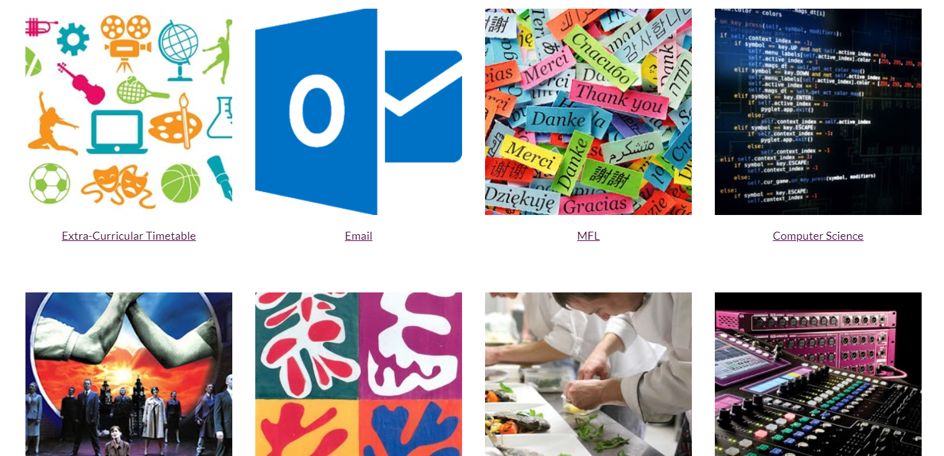
How to Access Your Email Account
Then select the ‘Student Portal’, here you will find subject pages, your timetable, Classcharts and a link to access your email.

Slide 12
How to Sign in to Your Email Account
Sign in by entering your email address.
You can work out your email address as follows:
20smithk@tarletonacademy.org
The year you started school
surname
First name initial

Slide 13
How to Sign in to Your Email Account
Enter your password
If you cannot remember your password you need to request a password reset via your form tutor.

Slide 14
How to Access Your Email Account via your Chromebook
Select Tarleton Academy Bookmarks on the top left of your taskbar, select ‘School email’.

Slide 15
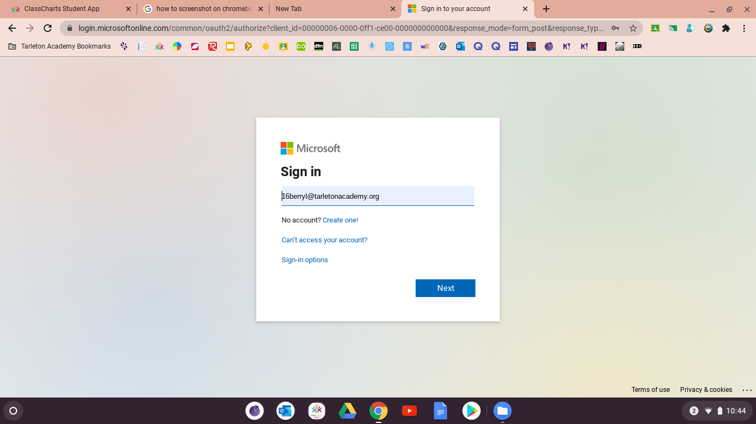
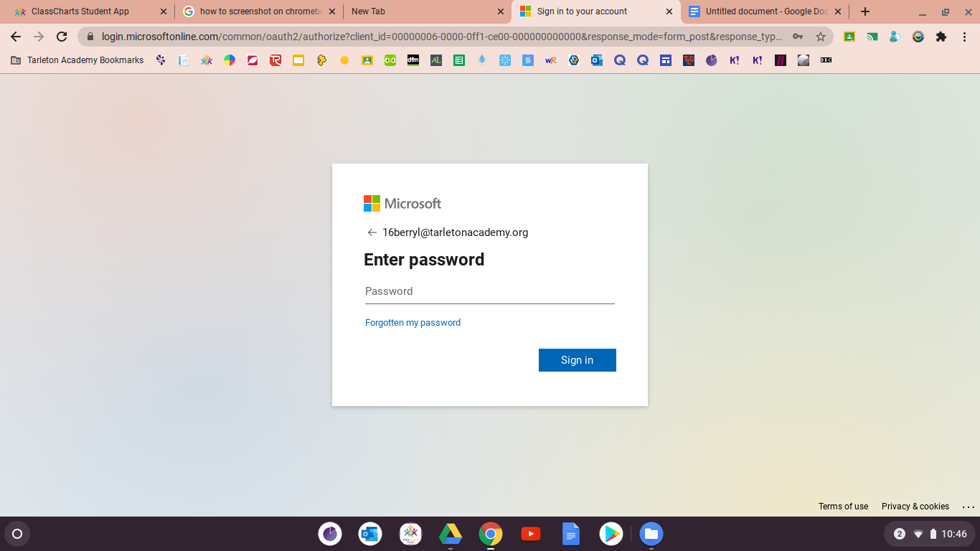
How to Access Your Email Account via your Chromebook
It will then prompt you to sign in with your email address and password

Slide 16
How to Access Your Email Account via your Chromebook
You are now logged onto to your Office 365 account. Select ‘Outlook ‘ from the left hand tab
Did you know you can also access web based versions of Word, Powerpoint, Teams, One Drive, One Note and Excel too via this tab?

Slide 17
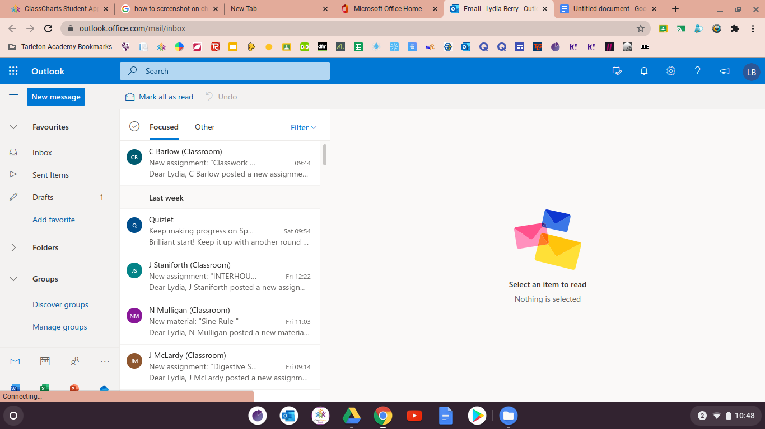
How to Access Your Email Account via your Chromebook
And you are in!

Slide 18
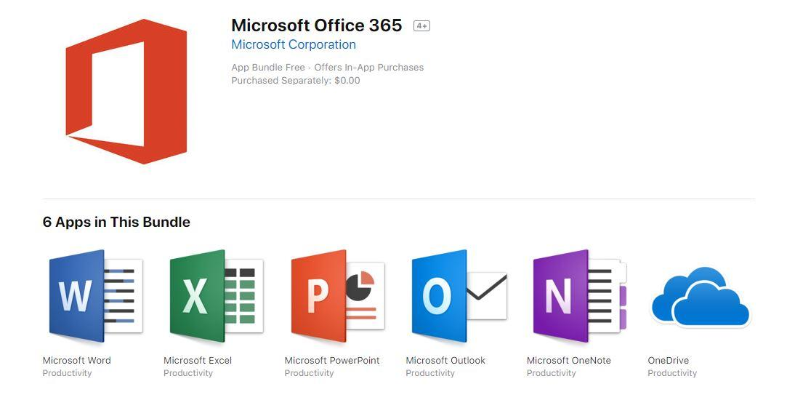
You could also get the App…
You can download the office 365 app on both apple and android devices. This will allow you to receive notifications when an email is received.

Slide 19
Staff Contact Details
Mr McLardy has send all students an announcement on Classcharts which lists all staff email addresses should you need to make contact.
Please remember...

