Slide 1

16 to 22 November 2025
Road Safety Week is the UK’s biggest road safety event. It happens every year.

Slide 2
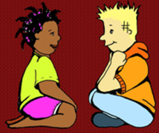
What do you think the
Road Safety Week
is about?
While it's not nice to hear, every year, more than 1,700 people die on UK roads. Another 30,000 receive serious, life-changing injuries. These crashes have a devastating effect on families and their communities.

Slide 3

16 to 22 November 2025
Road Safety Week is the UK’s biggest road safety event. It happens every year.

Slide 4

Let’s start with the safety in our school
It is great to see that so many children are actively travelling to school! Well done!
However, we have noticed that number of you are using your bikes and scooters on school premises and often are putting other people in danger.
We will put the posters around the school to remind you not to ride your bikes and scooters to keep everyone including yourself safe.

Slide 5


Safety in our school
Similarly to last year, we would like to introduce a volunteer one-way system through year 5 and 6 gate.
Next Monday, we will put up the signs. The arrows will show you the way and guide you safely in/out.
To get to school, you will be using the right side of the path and to leave the school, you will use also the right side.
When walking through the gate, do not ride your bike or scooter, but please walk next to it.
Please, also encourage your younger siblings to do so.

Slide 6
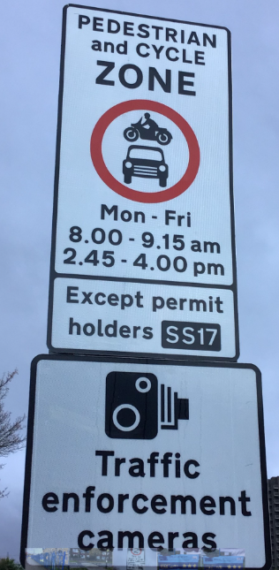
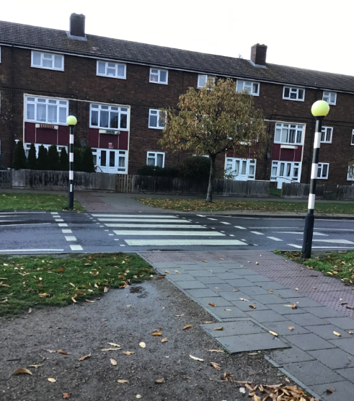
Safety in our school
The Samuel Ferguson Place is a school street. This means that the cars are not allowed to drive there at certain times.
There are cars that have exemption so please, be careful.
Pedestrian crossing across Bastable avenue
We have noticed that many year 5 and 6 children are running across without even looking! Please, make sure you always stop and check both sides – even if the car on one side stops.

Slide 7
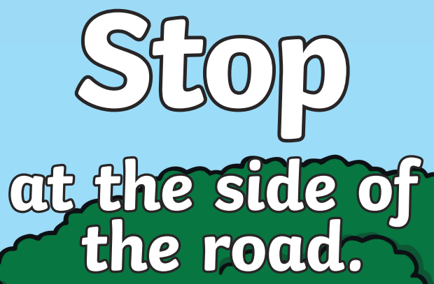
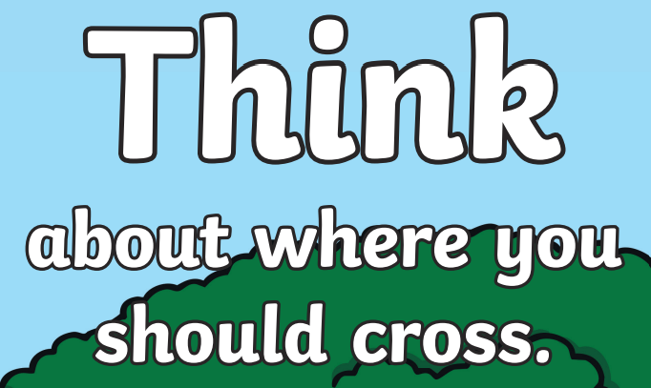

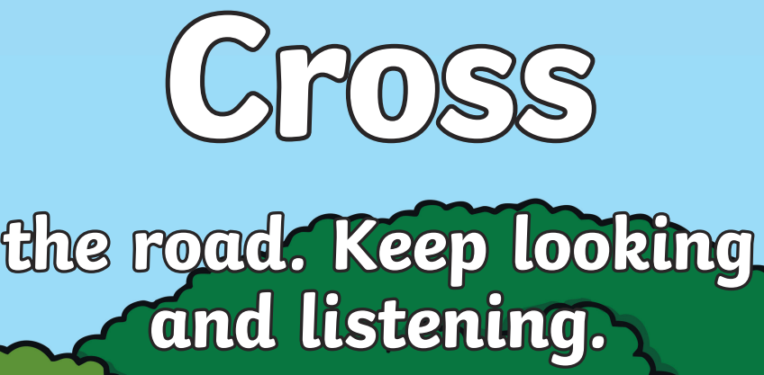

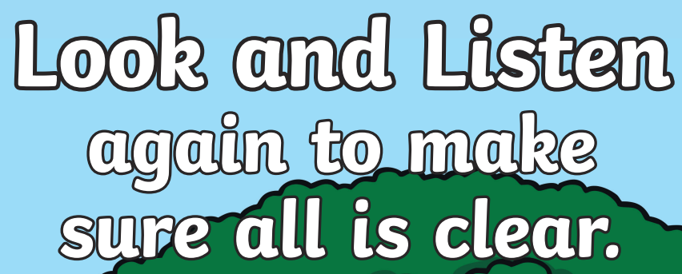
Crossing the Road safely

Slide 8
Cycle safety
What are the advantages of cycling?
Riding a bike is great fun. It’s good for our bodies and good for the planet as well.
But cycling can be dangerous, and drivers and cyclists need to take proper care to keep each other safe. Cyclists are some of the most vulnerable road users, and children are at particular risk.
About 100 children under the age of 11 are killed or seriously injured in cycling collisions every year.

Slide 9
Cycle safety
Let’s watch a short video about cycling.
Brake recommends that children under the age of 10 should always ride with a grown up and should only cycle on safe, segregated paths away from motorised traffic.
All children should wear a helmet to protect their head if they fall off.
Wearing bright clothes can help drivers to see cyclists.

Slide 10
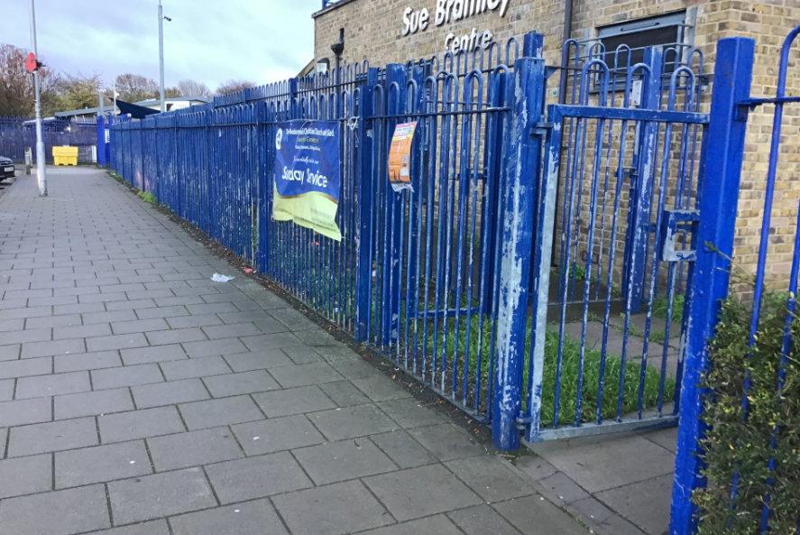
Cycle safety
When cycling on the safe pathway, remember that unless there is a cycle lane, the pedestrians have priority.
Unfortunately, many children are cycling from school in between the parents and children walking towards TVI. Please, be mindful of them and keep them safe.
Also, if you riding your bike from the Sue Brambley centre, make sure you give priority to the pedestrians walking on the pavement.

Slide 11
Cycle safety
It’s important not only to keep yourself safe away from the cars, but also keep other people safe.
No cycling on school premises or through the gates.
Be careful when cycling on the road in front of the school (Samuel Ferguson Place) as there are cars and pedestrians.
Be careful when cycling across the road.
Watch out for pedestrians when cycling on the pavement.
Wear your helmet!

Slide 12
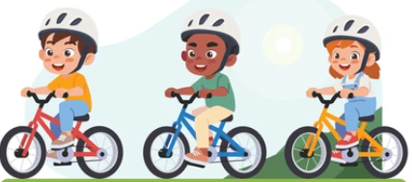
COMPETITION TIME
We have decided to launch a competition for the whole school!
Make your bike safe
Create a poster
Safety rules
The rules on the road
Who to ride with
Parts of the bike
Things to do before you ride your bike
Helmet
Notes:
Slide 5
[Add a picture of your road safety hero on the slide]
Who are our road safety heroes?
If you have completed the Art lesson in the lesson plans in your Road Safety Week action pack, prepare a few children to display the poster they have made and say who their road safety hero is, and why.
Now explain to children that you are now going to introduce someone (or more than one person) who is a real-life road safety hero.
Invite someone from your community to talk about the work they do to help make journeys or help people after a crash.
Examples could be:
Police
Fire service
Ambulance
Air ambulance
Medical staff
Local road safety officer
School crossing patrol
Cycle trainer
Introduce your visitor and ask them to give a short talk about the work they do.
Move to next slide

Slide 13
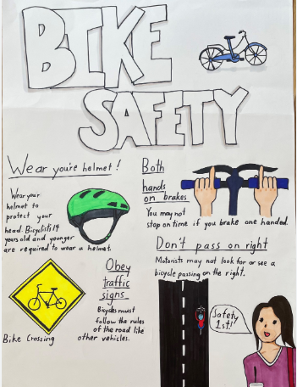
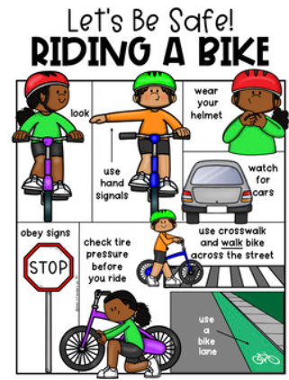
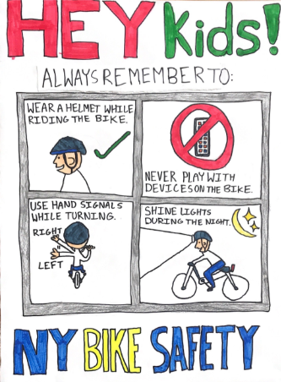
Notes:
Slide 5
[Add a picture of your road safety hero on the slide]
Who are our road safety heroes?
If you have completed the Art lesson in the lesson plans in your Road Safety Week action pack, prepare a few children to display the poster they have made and say who their road safety hero is, and why.
Now explain to children that you are now going to introduce someone (or more than one person) who is a real-life road safety hero.
Invite someone from your community to talk about the work they do to help make journeys or help people after a crash.
Examples could be:
Police
Fire service
Ambulance
Air ambulance
Medical staff
Local road safety officer
School crossing patrol
Cycle trainer
Introduce your visitor and ask them to give a short talk about the work they do.
Move to next slide

Slide 14
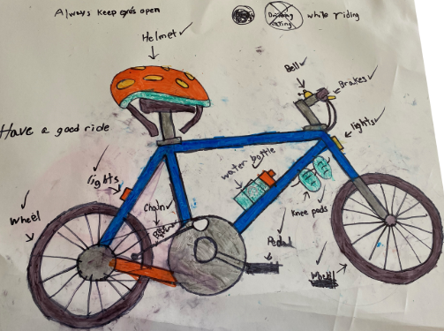
COMPETITION TIME
Make your bike safe
Create a poster
The deadline is:
Friday 5th December.
Hand in your posters to your teacher and your year group TfL Explorers ambassadors will collect them. Make sure you have your full name and the class written in the back.
THE BEST posters will be laminated and put around the school playground.
Notes:
Slide 5
[Add a picture of your road safety hero on the slide]
Who are our road safety heroes?
If you have completed the Art lesson in the lesson plans in your Road Safety Week action pack, prepare a few children to display the poster they have made and say who their road safety hero is, and why.
Now explain to children that you are now going to introduce someone (or more than one person) who is a real-life road safety hero.
Invite someone from your community to talk about the work they do to help make journeys or help people after a crash.
Examples could be:
Police
Fire service
Ambulance
Air ambulance
Medical staff
Local road safety officer
School crossing patrol
Cycle trainer
Introduce your visitor and ask them to give a short talk about the work they do.
Move to next slide

Slide 15
Video – Cycle safety
https://www.brake.org.uk/road-safety-week/cycle-safety-lesson-plan-for-lower-primary

