Slide 1
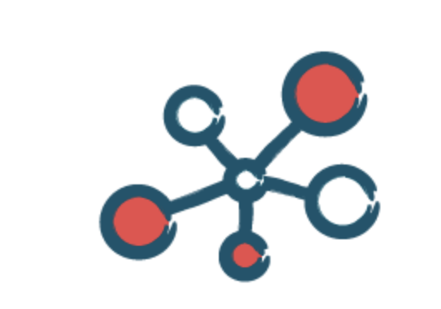
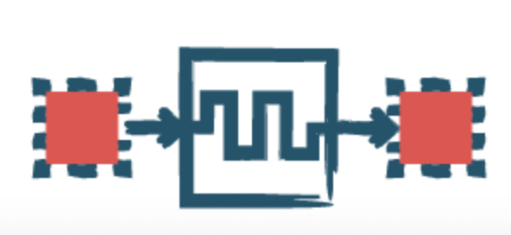
COMPUTER SYSTEMS and NETWORKS

Slide 2
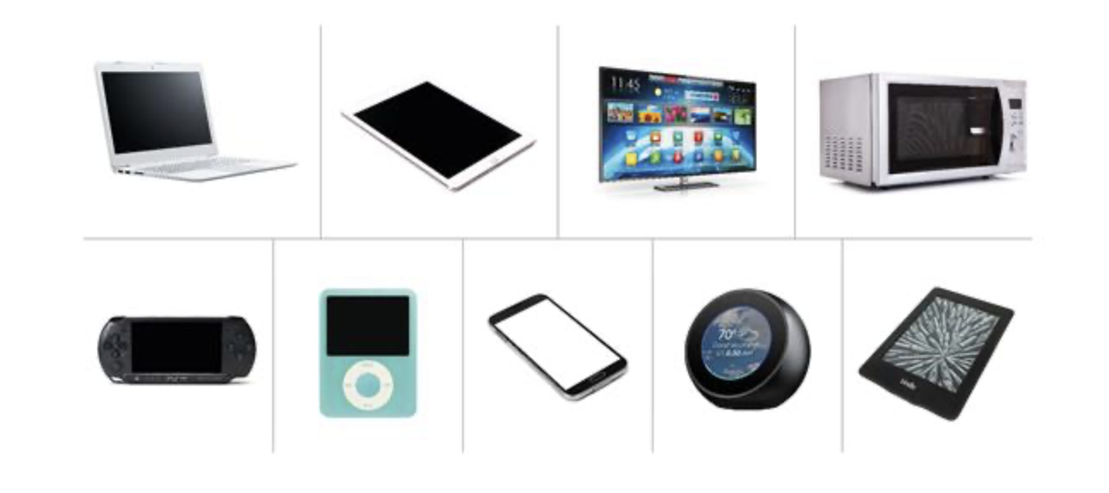
What is a Computer System?
Consists of hardware, software and a peripheral device used to operate it.
Includes PCs, laptops, tablets, smartphones, televisions, washing machines, systems on cars and programmable toys.

Slide 3
What is a Computer System?
All computer systems conform to the following criteria:
They receive information via an input
They store this information for use in processing
They process this information and store as required
They output information

Slide 4
Hardware
Hardware can include:
Inputs (Mouse, keyboard, button, camera, touchscreen, microphone etc)
Processors
Memory
Motherboards
Outputs (Screen, speakers, printer etc)

Slide 5
Software
Software enables the various hardware components to communicate and function together.
It provides the user with an interface to operate the system with.

Slide 6
Computer Systems in EYFS
Use a range of computer systems including programmable toys, PCs, laptops and tablet devices
Modified ‘large button’ peripherals
Use a variety of inputs
Create a sequence of commands to implement algorithms
Learn that computers can be connected to form a network

Slide 7
Computer Systems in KS1
Understand that algorithms are implemented as programs on digital devices
Select and use different computer systems with an awareness of their purpose
Understand inputs and outputs
Create sequences of commands to implement algorithms
Understand that information can be shared across computer networks

Slide 8
Computer Systems in KS2
Learn that computer systems can be connected to form a network to share resources and that the internet is millions of computer systems connected around the world.
Model the internet to show how it provides the world wide web
Understand that inputs and outputs exchange data.
Create programs which generate outputs in a variety of ways
Develop an understanding of data file size and its implications

Slide 9
What are Computer Networks?
A collection of interconnected computer systems
Communicate with each other by exchanging data
The internet is a network of networks
Individual networks (like in school) are called local area networks (LANs)

Slide 10
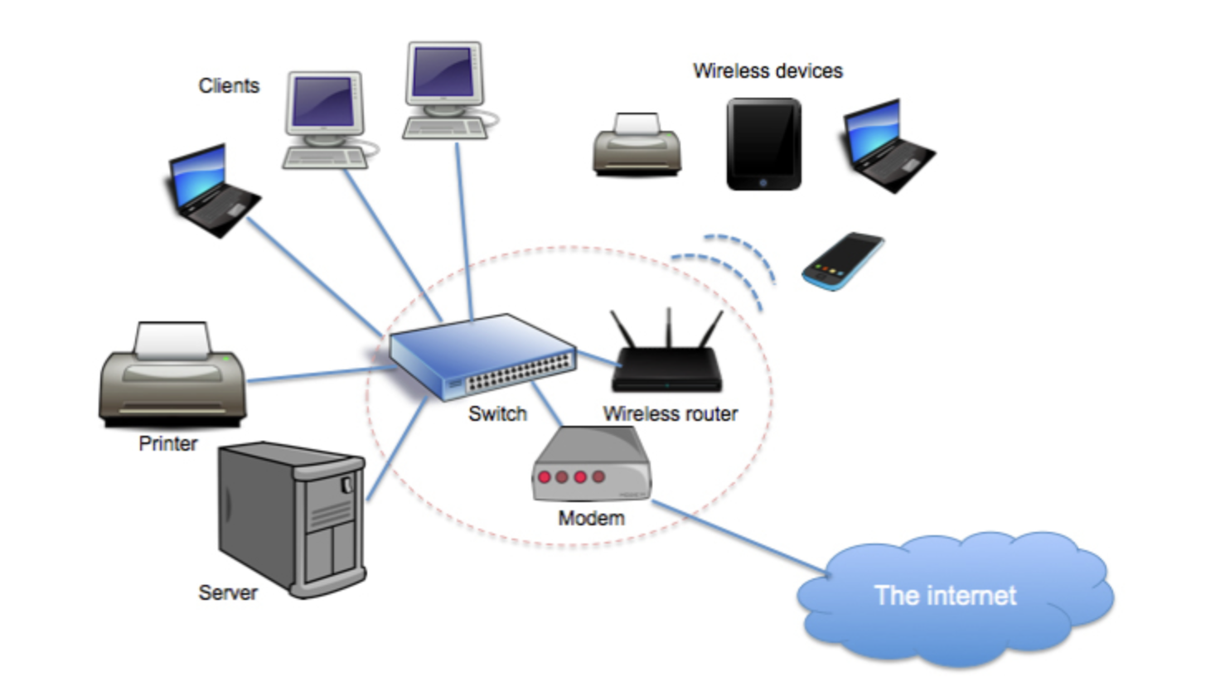
Local Area Networks
Enables shared areas, shared software, access to printers and internet

Slide 11
Computer Networks in EYFS
Not referenced until KS2 however…
Devices used in roleplay environments can be used to model sending messages across the world.
Can understand that computers are connected to each other and computers outside of school.

Slide 12
Computer Networks in KS1
Not referenced until KS2 however…
Can understand that devices are connected to each other using cables and switches
Experience logging into a network with a username and password
Understand that software can be accessed across multiple computers at the same time.

Slide 13
Computer Networks in KS2
Learn about the different hardware components of a LAN
Understand the internet is a vast network of networks connected across the world.
Underpin learning about network services such email and search engines.

Slide 14
Gap Task
Design a knowledge check activity for the Computer Systems and Networks strand appropriate for your year group.
Upload it to the folder on Sharepoint.

