Slide 1
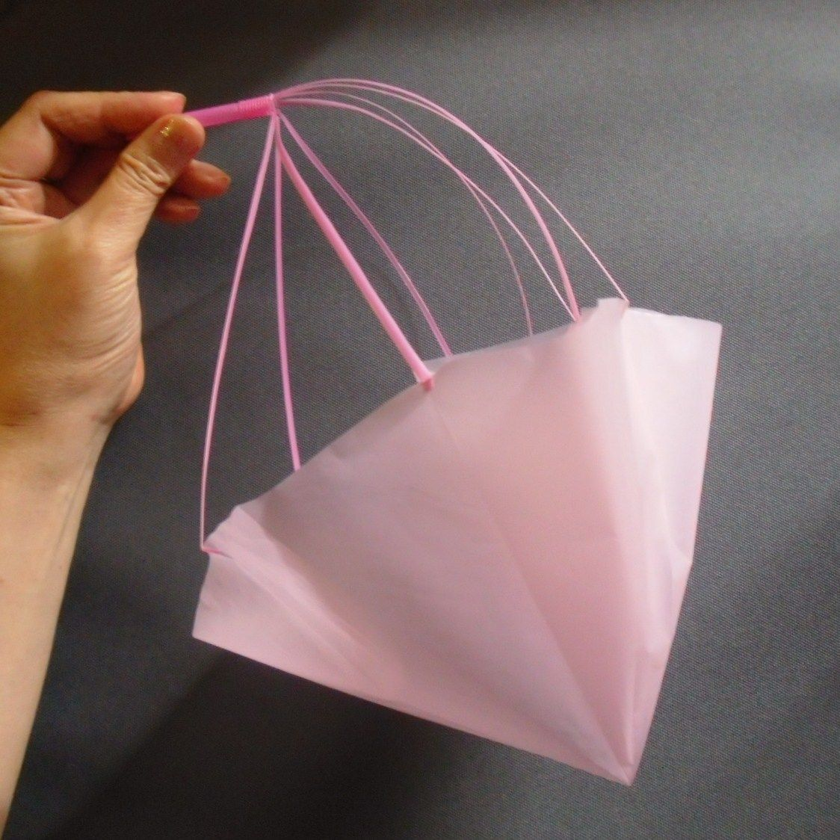
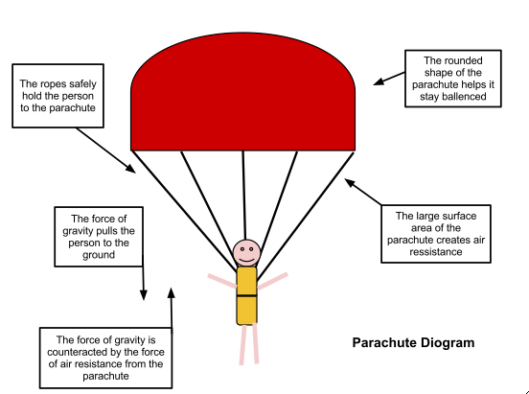
Design and Test a Parachute
Introduction
Learn about air resistance while making an awesome parachute! Design one that can fall slowly to the ground before putting it to the test, making modifications as you go.
What you'll need:
A plastic bag or light material
Scissors
String
A small object to act as the weight, a little action figure would be perfect
What’s Happening
Hopefully your parachute will descend slowly to the ground, giving your weight a comfortable landing. When you release the parachute the weight pulls down on the strings and opens up a large surface area of material that uses air resistance to slow it down. The larger the surface area the more air resistance and the slower the parachute will drop.
Cutting a small hole in the middle of the parachute will allow air to slowly pass through it rather than spilling out over one side, this should help the parachute fall straighter.
Instructions:
Cut out a large square from your plastic bag or material.
Trim the edges so it looks like an octagon (an eight sided shape).
Cut a small whole near the edge of each side.
Attach 8 pieces of string of the same length to each of the holes.
Tie the pieces of string to the object you are using as a weight.
Use a chair or find a high spot to drop your parachute and test how well it worked, remember that you want it to drop as slow as possible.
Reflection Questions
Is something confusing me?
Could I explain this to someone else?
What factors do you need to think about when designing a parachute?

