Slide 1
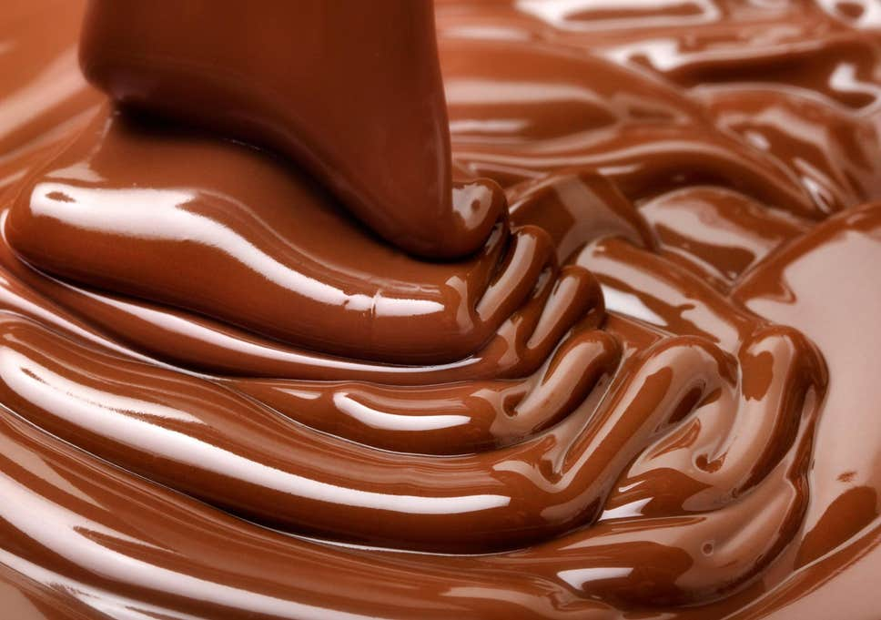
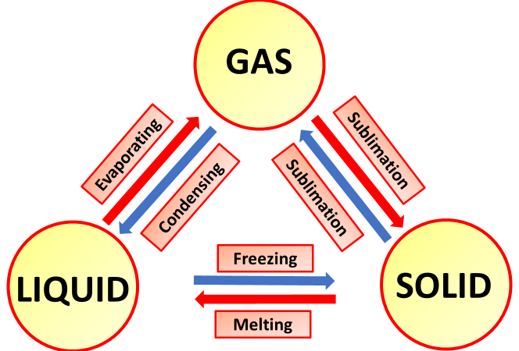
Melting Chocolate Activity
Introduction
Enjoy this simple melting chocolate experiment for kids. You've no doubt experienced chocolate melting on a hot day, so let's do some experiments to recreate these conditions as well as a few others before comparing results and coming to some conclusions.
At what temperature does chocolate go from a solid to a liquid? Is it different for white and dark chocolate? Give this fun science experiment a try and find out!
What you'll need:
Small chocolate pieces of the same size (chocolate bar squares or chocolate chips are a good idea)
Paper plates
Pen and paper to record your results
What’s Happening
At a certain temperature your chocolate pieces undergo a physical change, from a solid to a liquid (or somewhere in between). On a hot day, sunlight is usually enough to melt chocolate, something you might have unfortunately already experienced. You can also reverse the process by putting the melted chocolate into a fridge or freezer where it will go from a liquid back to a solid.
Instructions:
Put one piece of chocolate on a paper plate and put it outside in the shade.
Record how long it took for the chocolate to melt or if it wasn't hot enough to melt then record how soft it was after 10 minutes.
Repeat the process with a piece of chocolate on a plate that you put outside in the sun. Record your results in the same way.
Find more interesting locations to test how long it takes for the chocolate pieces to melt. You could try your school bag, hot water or even your own mouth.
Compare your results, in what conditions did the chocolate melt? You might also like to record the temperatures of the locations you used using a thermometer so you can think about what temperature chocolate melts at.
Reflection Questions
Is something confusing me?
Could I explain this to someone else?

