Slide 1



Year 6 Residential
Parent Information Meeting
Proud to be part of The White Horse Federation Multi-Academy Trust | www.twhf.org.uk

Slide 2
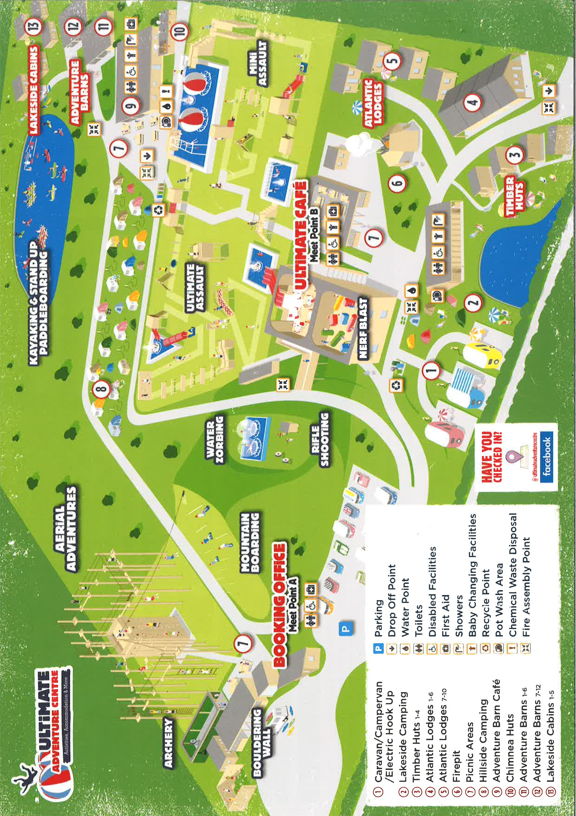
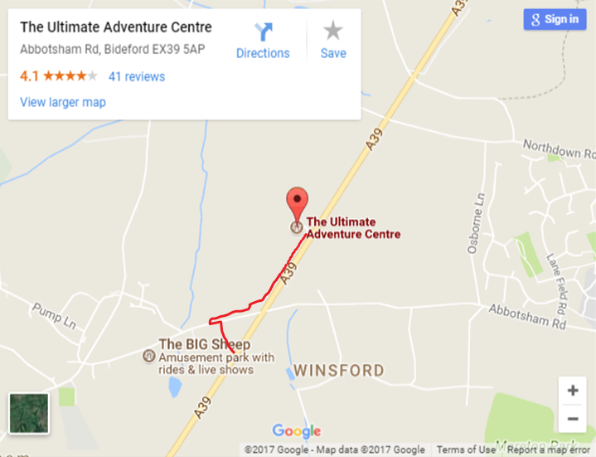
Year 6 will be heading to the Ultimate Adventure Centre, in Abbotsham, Bideford for their residential trip this year.
https://www.ultimateadventurecentre.com/

Slide 3
Timings
Medication and/or money will be collected on Friday 13th June via the office so it is ready to go on Monday morning. An adult will need to drop it off in order to complete the necessary forms and sign for it.
On Monday 16th June, we will leave school at approximately 9:30am with the aim to arrive between 12:30 and 1:00pm. Children to arrive at school via chipmunks at normal time on this day please.
We aim to leave the site at 12:30pm on Friday 20th June and should be back to school by 3:30/4:00pm for a later pick up time. Updates on timings will be sent on the day depending on traffic.

Slide 4
Activities
We will be completing a range of activities across the 5 action-packed days we are away, both during the day and in the evenings.
Children will be split into groups of approximately 12 for the activities and they will remain in these groups for the week. Each group will be accompanied by a school adult and an instructor from the activity centre. The children will find out these activity groups in the weeks prior to leaving.

Slide 5
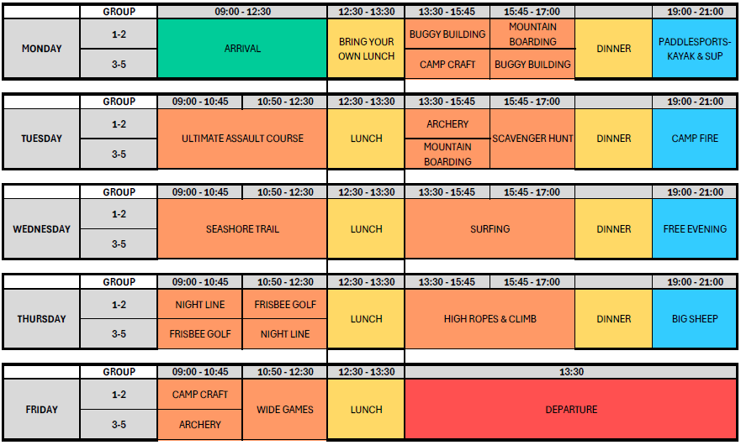

Slide 6
Accommodation
We have 49 children coming and children will be split across six, single-sex rooms. Teacher rooms are within the same block. Children will find out their rooms in the weeks before we leave.
With the exception of Monday (where dinner will be provided) and Friday (where breakfast and a packed lunch will be provided), children will receive 3 meals a day.
Please could children bring a packed lunch on Monday as this is not provided. Everything should be disposable and packed in a disposable bags please.

Slide 7
Kit List
Children must bring all of their belongings in a bag or case which they are able to carry / wheel independently.
Children are allowed 1 case/bag and 1 small backpack for the coach journey.
Bedding is provided however children are permitted to bring a pillow from home if they wish.
A full kit list will be provided alongside this presentation after the meeting.

Slide 8
What Not To Bring
Electronic devices of any kind (phones, tablets, apple watches gaming consoles etc…) are not permitted on this trip.
All medication must be signed in with an adult who will look after it for the entirety of the trip.
Sweets/other snacks are permitted within reason but these must not contain nuts. If you choose to pack extra snacks, please be mindful of the quantity children are bringing.
No jewellery or valuables.
Torches with a flashing function (standard torches are permitted)

Slide 9
Additional Information
All adults on the trip will have access to a mobile phone and are able contact parents in the event of any emergencies.
The contact number for the centre is 01237 418528. Alternatively, you can contact The Croft who will be able to pass a message on to us. This is for emergencies only!

