Slide 1
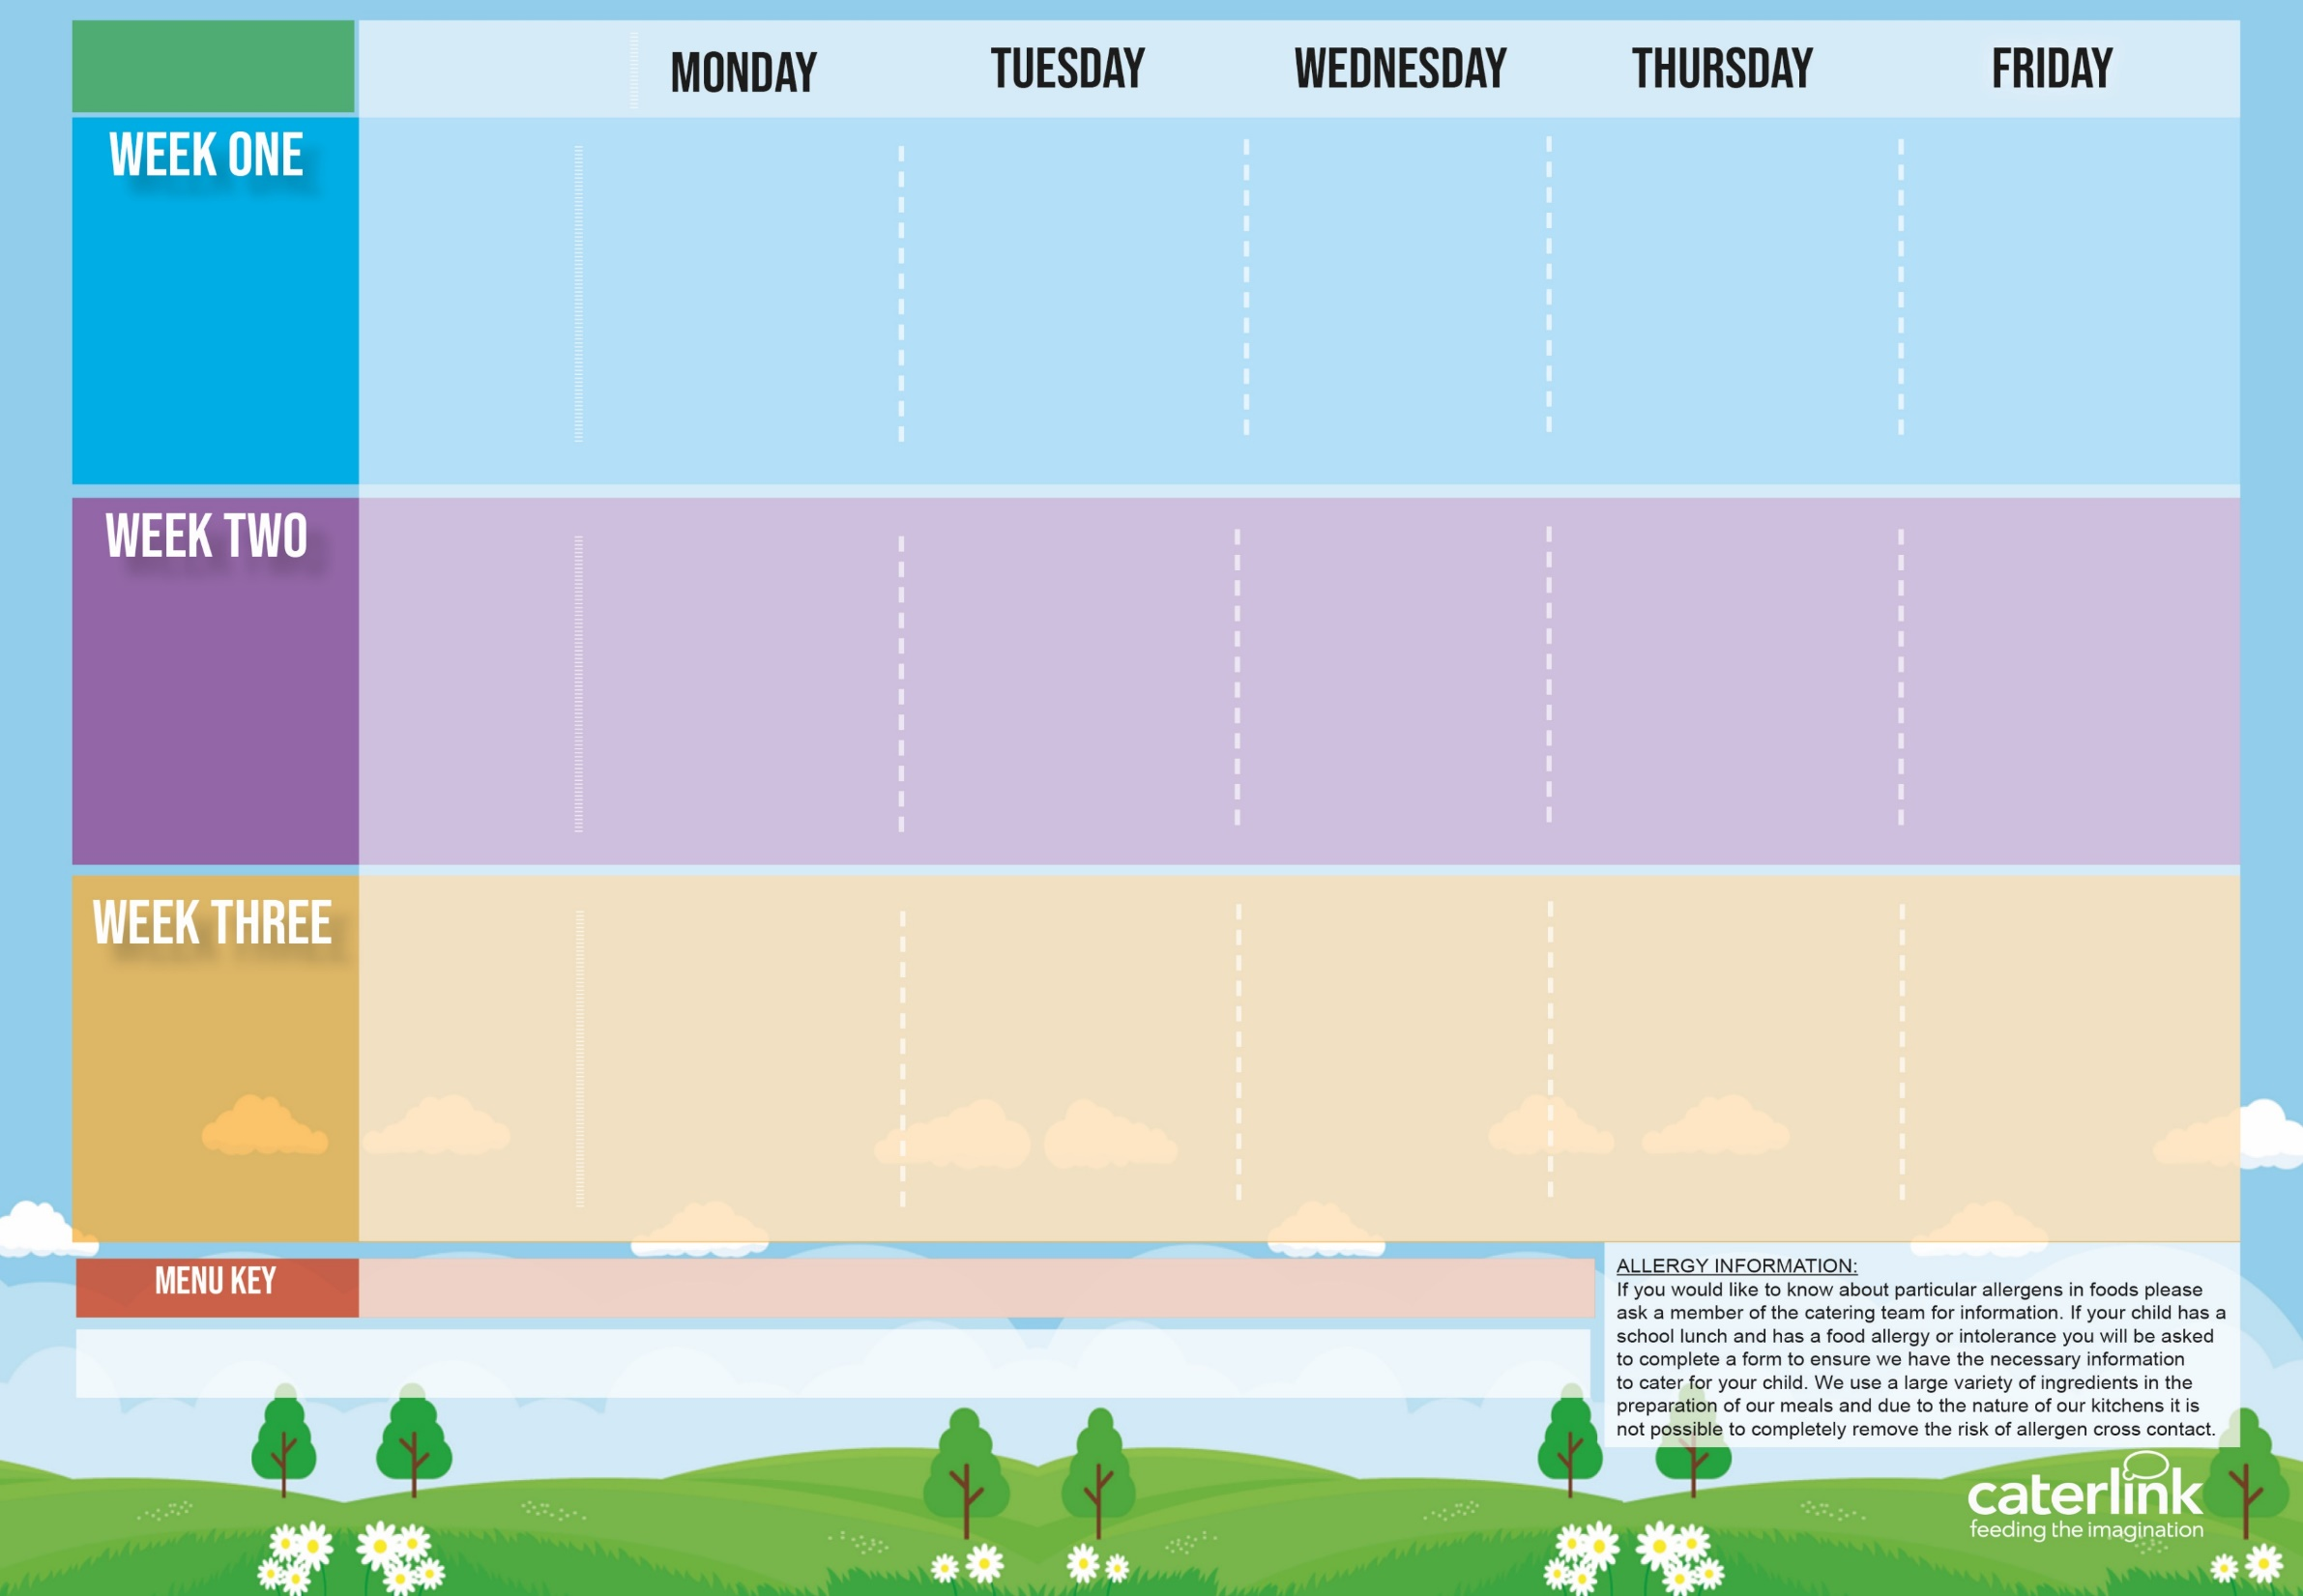
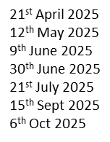
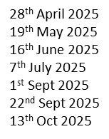
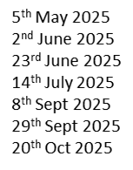
Spring Summer
2025
Option One
Option Two
Vegetables
Dessert
Macaroni Cheese | BBQ Chicken Pizza with Salads | Chicken Sausage, Roast Potatoes & Gravy | Spaghetti Bolognaise | Salmon Fishfingers with Chips & Tomato Sauce
Tomato and Lentil Pasta | Mild Mexican Chilli with Rice | Veg Wellington, Roast Potatoes & Gravy | Chefs Special Chickpea Curry with Rice | Cheese & Bean Pasty with Chips & Tomato Sauce
Vegetables of the Day | Vegetables of the Day | Vegetables of the Day | Vegetables of the Day | Vegetables of the Day
Apple Flapjack | Summer Lemon Cake | Fruit Salad | Chocolate Drizzle Cake | Strawberry Jelly with Mandarins
Option One
Option Two
Vegetables
Dessert
Lentil and Sweet Potato Curry with Rice | Chicken Hot Dog with Wedges & Tomato Sauce | Roast Chicken, Stuffing, Roast Potatoes, & Gravy | Caribbean Chicken with Rice and Peas | Battered Fish with Chips & Tomato Sauce
Cheese and Tomato Pizza with Salads | Vegan Hot Dog with Wedges & Tomato Sauce | Vegetable Soya Roast, Stuffing, Roast Potatoes & Gravy | Spaghetti and (Plant) Meatballs | Mexican Bean Roll with Chips & Tomato Sauce
Vegetables of the Day | Vegetables of the Day | Vegetables of the Day | Vegetables of the Day | Vegetables of the Day
Iced Vanilla Sponge | NEW Strawberry and Apple Crumble with Custard | Cinnamon Swirl | Peaches and Ice Cream | Vanilla Shortbread
Option One
Option Two
Vegetables
Dessert
Smokey Bean Burger with Potato Wedges | NEW Green Thai Chicken Curry with Rice | Roast Turkey, Stuffing, Roast Potatoes & Gravy | NEW Greek Macaroni Pastitsio with Greek Salad and Tzatziki | Breaded Fish and Chips & Tomato Sauce
Classic Vegan Bolognaise | vegetable Fajitas with Rice | Roasted Quorn, Stuffing, Roast Potatoes, & Gravy | Spinach and Cheese Whirl with Rice, Greek Salad and Tzatziki | Cheese and Tomato Quiche with Chips & Tomato Sauce
Vegetables of the Day | Vegetables of the Day | Vegetables of the Day | Vegetables of the Day | Vegetables of the Day
Pear & Cocoa Upside Down Cake | Cheese and Crackers | Chocolate Orange Brownie | Apple Cinnamon Sponge | Oaty Cookie
Added Plant Protein
Wholemeal
Vegan
Chef’s Special
Available Daily: - Freshly cooked jacket potatoes with a choice of fillings - Bread freshly baked on site daily- Daily salad selection – Fresh Fruit and Yoghurt

Slide 2
Spring Summer
2025
Option One
Option Two
Vegetables
Dessert
V160 Tomato and Lentil Pasta Sauce | C91 BBQ Chicken Pizza with SD92 SB8 SD126 Salads | C6 Chicken and Vegetable Sausage, SD82 Roast Potatoes & SD118 Gravy | SD8 Spaghetti B48 Bolognaise | F1 salmon Fishfingers with SD5 Chips & SD14 Tomato Sauce
V318 Macaroni Cheese Toppings PK3 PK4 V85 V216 Pasta: SD8 SD11 SD9 | V309 Mild Mexican Chilli with SD84 Rice | V232 Veg Wellington, SD82 Roast Potatoes & SD118 Gravy | NEW V321 Chefs Special Chickpea Curry with SD84 Rice | V191 Cheese & Bean Pasty With SD5 Chips & SD14 Tomato Sauce
Vegetables of the Day | Vegetables of the Day | Vegetables of the Day | Vegetables of the Day | Vegetables of the Day
D171 Apple Flapjack | D168 Summer Lemon Cake | D223 Fruit Salad | D198 Chocolate Drizzle Cake | D235 Strawberry Jelly with Mandarins
Option One
Option Two
Vegetables
Dessert
V108 Lentil and Sweet Potato Curry with SD84 Rice | C6 SD187 Chicken Hot Dog with SD6 Wedges & SD14 Tomato Sauce | C4 Roast of Chicken, SD40 Stuffing, SD82 Roast Potatoes, & SD118 Gravy | C102 Caribbean Chicken with SD188 Rice and Peas | F3 Battered Fish with SD5 Chips & SD14 Tomato Sauce
V231 Cheese and Tomato Pizza with SD92 SB8 SD126 Salads | V244 SD187 Vegan Hot Dog with SD6 Wedges & SD14 Tomato Sauce | V13 Lentil and Vegetable Soya Roast with SD82 Roast Potatoes & SD118 Gravy | SD8 Spaghetti and V237 V225 Meatballs | V161 Mexican Bean Roll
Vegetables of the Day | Vegetables of the Day | Vegetables of the Day | Vegetables of the Day | Vegetables of the Day
D177 Iced Vanilla Sponge | NEW D259 Strawberry and Apple Crumble with D2 Custard | D244 Cinnamon Swirl | D166 Peaches and D13 Ice Cream | D57 Vanilla Shortbread
Option One
Option Two
Vegetables
Dessert
V323 SD17 Bean Burger with SD6 Potato Wedges | NEW C114 Green Thai Chicken Curry with SD84 Rice | T1 Roast Turkey, SD40 Stuffing, SD82 Roast Potatoes & SD118 Gravy | NEW GR6 Greek Macaroni Pastitsio with GR4 Greek Salad and GR3 Tzatziki | F7 Breaded Fish and SD5 Chips
V233 SD11 Vegan Bolognaise | V324 Vegetable Fajitas with SD84 Rice | V204 Roast Quorn, SD40 Stuffing, SD82 Roast Potatoes, & SD118 Gravy | GR2 Spinach and Cheese Whirl with SD84 Rice, GR4 Greek Salad and GR3 Tzatziki | V113 Cheese and Tomato Quiche with SD5 Chips
Vegetables of the Day | Vegetables of the Day | Vegetables of the Day | Vegetables of the Day | Vegetables of the Day
D207 Pear & Cocoa Upside Down Cake | D56 Cheese and Crackers | D170 Chocolate Orange Brownie | D191 Apple Sponge | D85 Oaty Cookie

