Slide 1
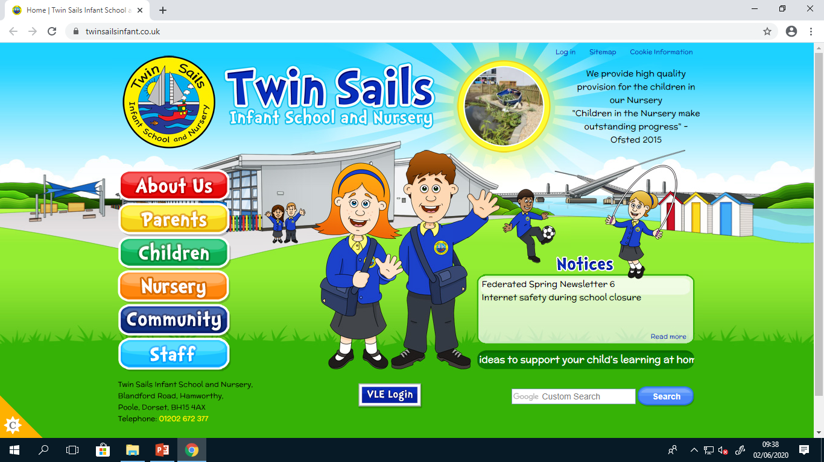

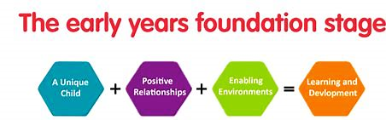
Reception Assessment
Every Child, Every Day, Every Possibility

Slide 2


Todays aims to share:
Assessment at the end of Reception
Early Learning Goals
Reporting
Emerging ELGs
Supporting at home
Opportunity to ask questions

Slide 3
Assessment at the end of Reception:
What is the EYFS?
The EYFS sets standards for development, learning and care for all children from birth to 5 years old in England. The EYFS provides the framework to ensure that children are kept healthy, safe, and given the best start in life.
What is GLD (Good Level of Development)
A ‘good level of development’ can be defined as a child reaching the ‘expected’ level of development at the end of their reception year, at the end of Early Years Foundation Stage.
Notes:
The EYFS sets standards for development, learning and care for all children from birth to 5 years old in England. The Reception curriculum follows the EYFS.
EYFS provides the framework to ensure that children are kept healthy, safe, and given the best start in life.
At the end of Reception the children are assessed whether they have achieved a good level of development. This is known as GLD.
GLD is a measure of attainment, not progress. Achieving a good level of development will help a child to make a good start in Year 1.
If a child does not achieve a Good level of development, they continue to work on their targets in Year 1.

Slide 4
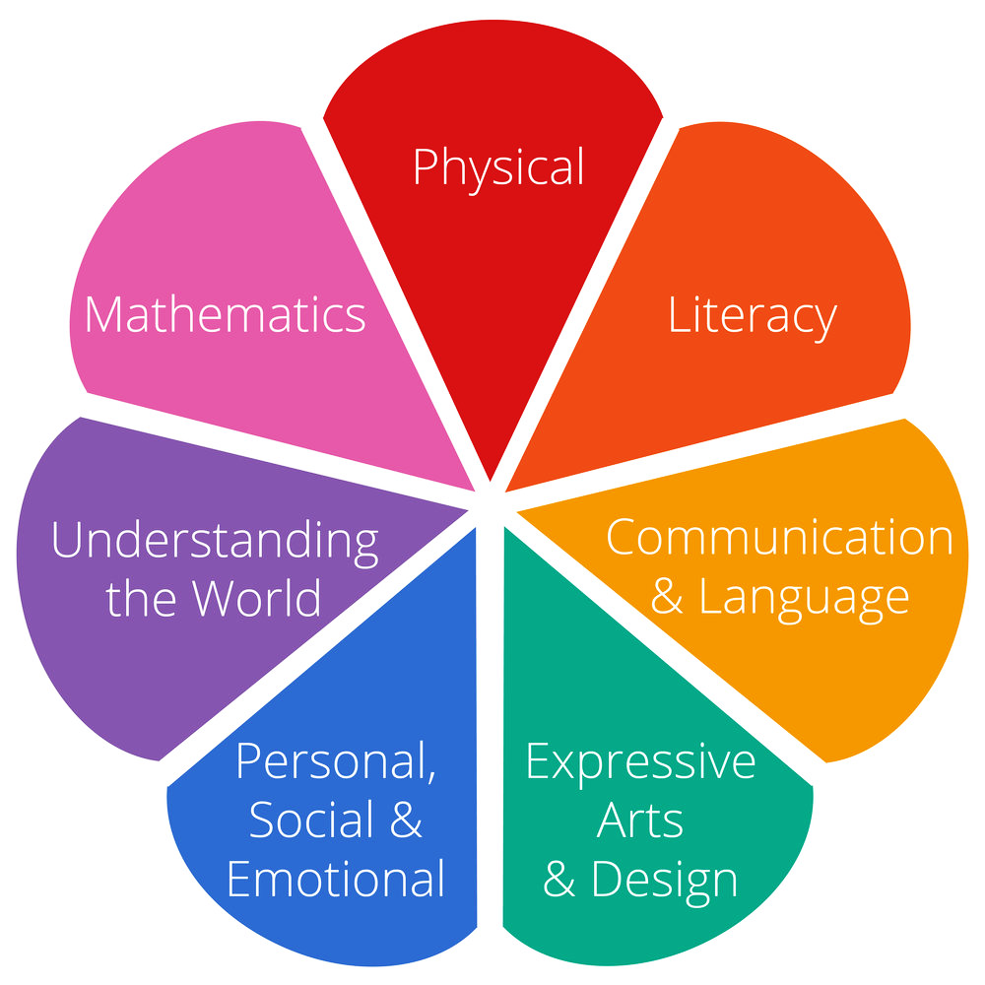
Early Learning Goals:
Notes:
To achieve the Good Level of Development, Children are assessed across 17 Early Learning Goals.
The Early Learning Goals are interconnected, and children display attainment across multiple different ELGs when engaging in a task or an activity.
The areas are split into prime areas and specific.
The Prime areas of development and learning lay vital foundations in the early years. The three Prime areas, Personal, social and emotional development (PSED), Communication and language (CL), and Physical development (PD), describe universal core aspects of early child development.

Slide 5
Early Learning Goals:
Prime
Prime
Prime
Notes:
To achieve the Good Level of Development, Children are assessed across 17 Early Learning Goals.
The Early Learning Goals are interconnected, and children display attainment across multiple different ELGs when engaging in a task or an activity.
The areas are split into prime areas and specific.
The Prime areas of development and learning lay vital foundations in the early years. The three Prime areas, Personal, social and emotional development (PSED), Communication and language (CL), and Physical development (PD), describe universal core aspects of early child development.

Slide 6
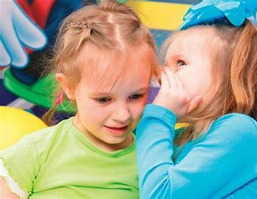
Early Learning Goals: Prime Areas:
Communication and Language
Listening, attention and understanding
Speaking
Notes:
‘The development of children’s spoken language underpins all seven areas of learning and development.’

Slide 7

Early Learning Goals:
Personal, Social and Emotional Development
Self-regulation
Manging self
Building Relationships
Notes:
Personal, Social and Emotional Development is fundamental to all other aspects of lifelong development and learning, and is key to children’s wellbeing and resilience.
For young children to flourish, we need to pay attention to how they understand and feel about themselves, and how secure they feel in close relationships: in so doing they develop their capacities to make sense of how they and other people experience the world.

Slide 8
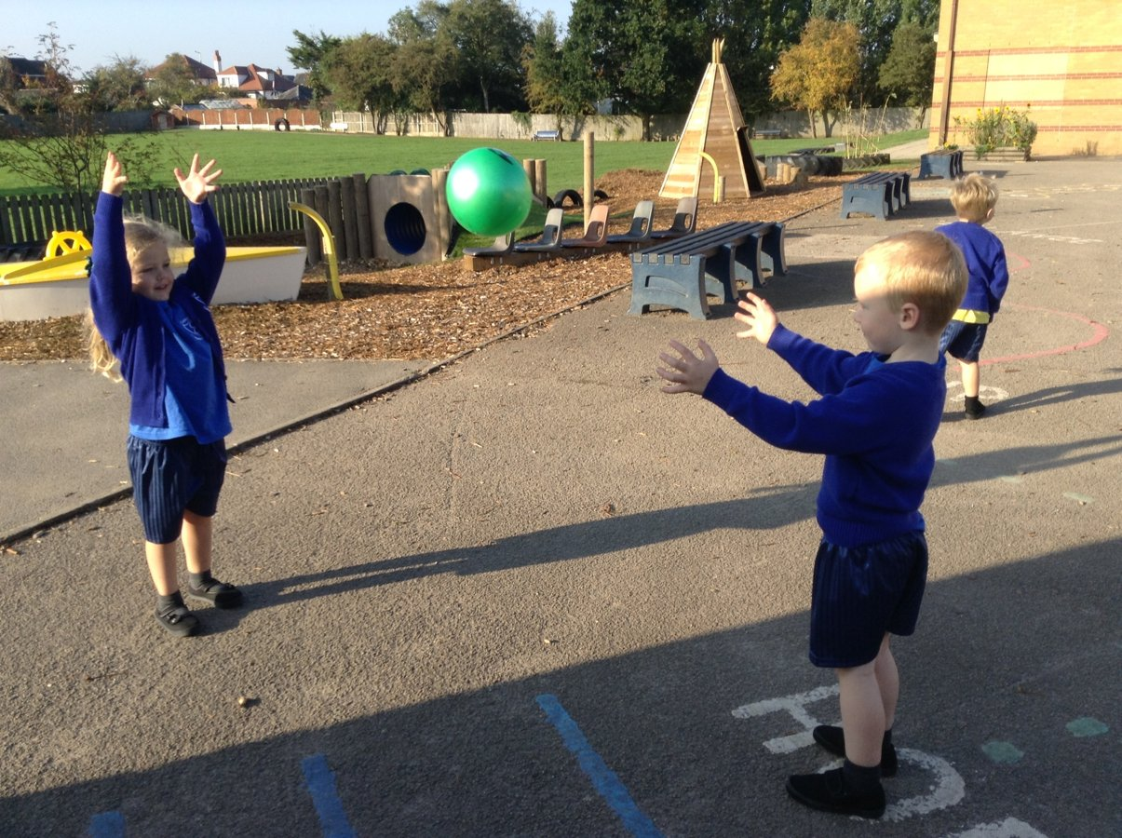
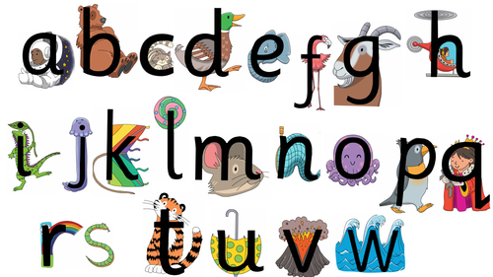
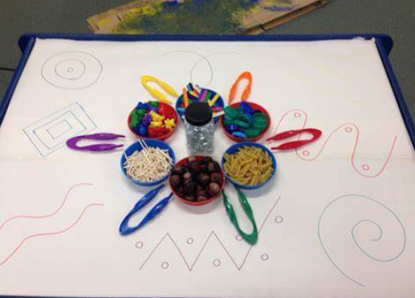
Early Learning Goals:
Physical Development
Gross Motor
Fine Motor
Notes:
Gross motor movements involve larger scale whole-body movements, such as walking or riding a bicycle. In early years settings, it's important to provide activities that support children's gross motor development, both indoors and out. This will additionally help to develop children's core strength; an important factor to successfully developing effective gross motor skills.
Whilst gross motor development involves larger body movements, fine motor development involves the smaller, more precise movements of the hands, wrists, and fingers. Fine motor skills are needed for activities, such as fastening buttons and effectively cutting with scissors.
It is important to understand the correlation between gross motor development and fine motor development. Learning in early years is a uniquely individual process, and all children will develop at different rates. However, it is usually the case that those children who have developed effective gross motor skills through frequent and varied activities will find fine motor-related activities easier to accomplish than those who have not. This is because children who have developed effective gross motor skills have, in effect, successfully laid the foundations that will support the development of their fine motor skills.

Slide 9
Early Learning Goals:
Specific
Specific
Specific
Specific
Notes:
The Prime areas of development and learning lay vital foundations in the early years. The three Prime areas, Personal, social and emotional development (PSED), Communication and language (CL), and Physical development (PD), describe universal core aspects of early child development.

Slide 10
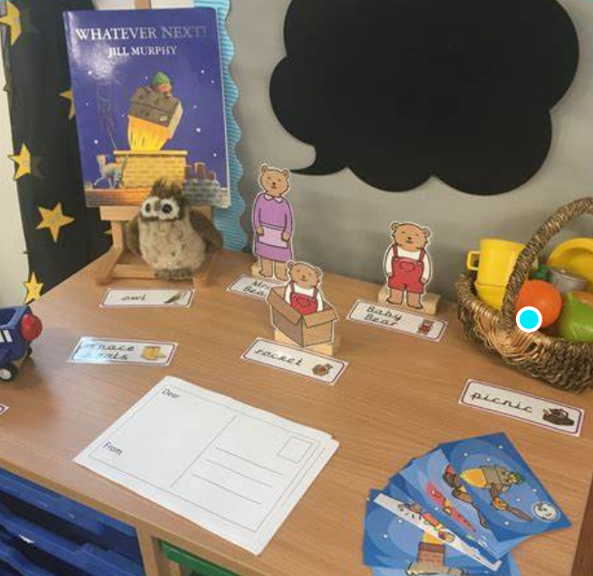
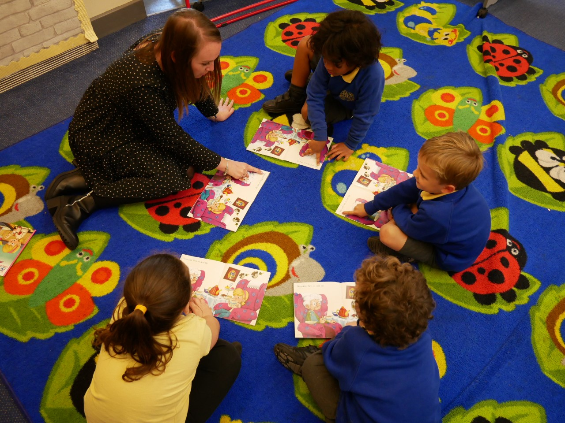
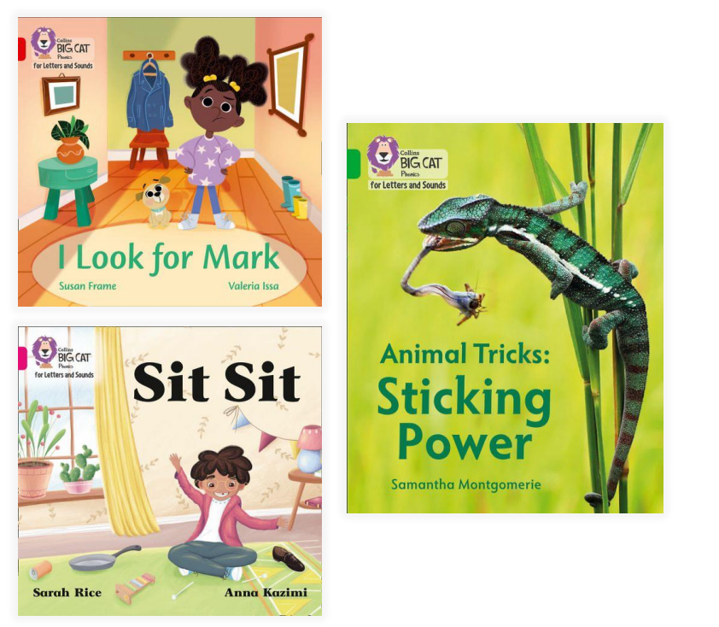
Early Learning Goals: Specific Areas:
Literacy
Comprehension
Word reading
Writing
Notes:
Writing tends to be the one that stops children from getting the GLD at the end of the year

Slide 11
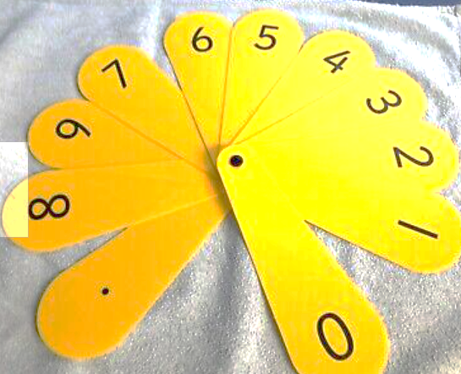
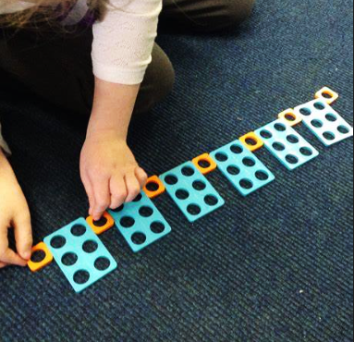
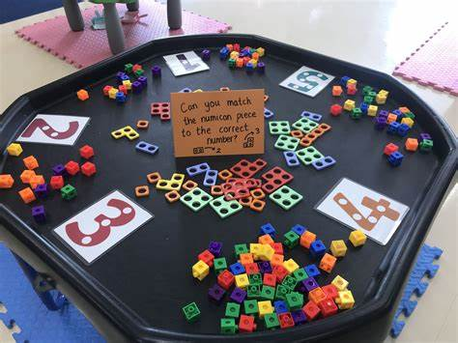
Early Learning Goals: Specific Areas:
Maths
Numbers
Numerical patterns

Slide 12
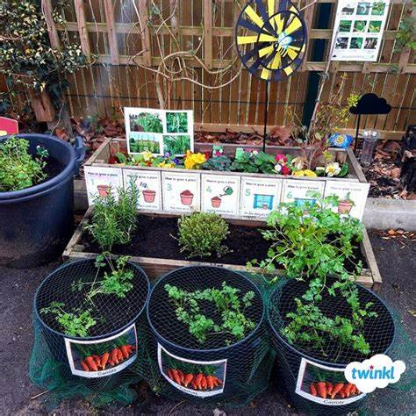
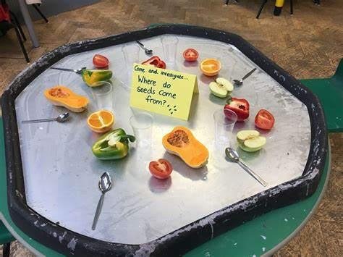
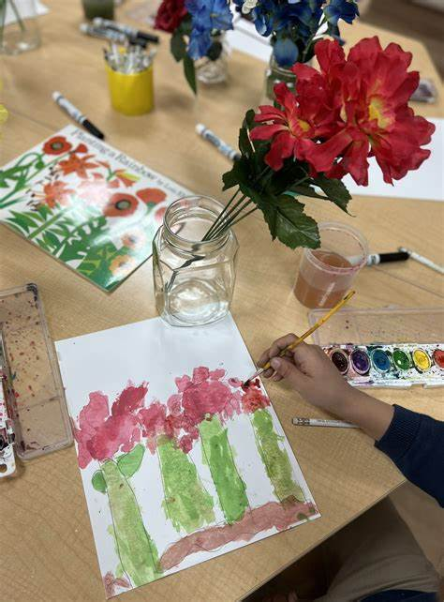
Early Learning Goals: Specific Areas:
Understanding the World
Past and present
People, cultures and communities
The natural world
Expressive Arts and Design
Creating with materials
Being imaginative and expressive

Slide 13
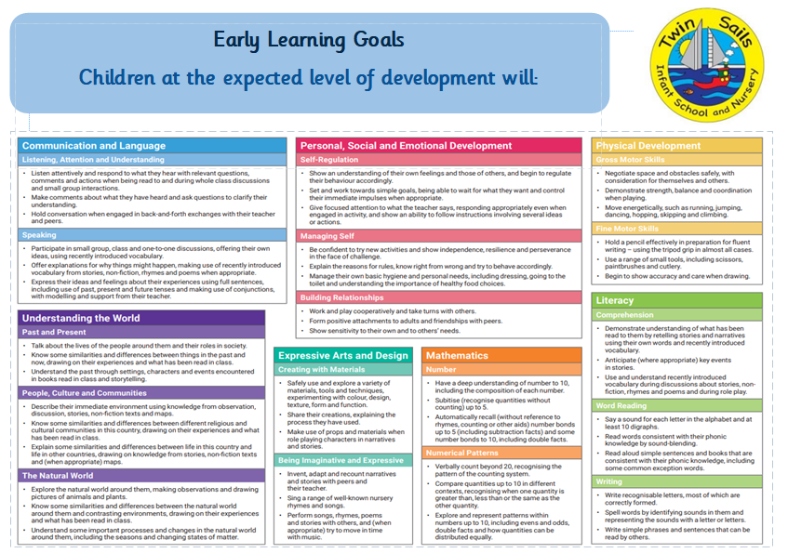

Slide 14
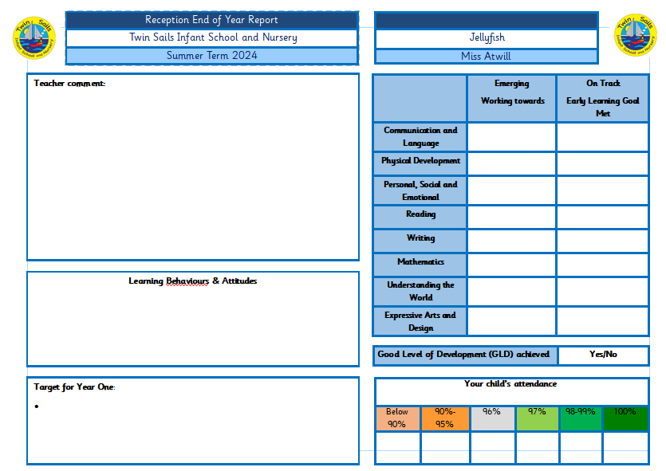
Reporting
Working towards or ELG met
GLD achieved

Slide 15
Emerging outcomes
Some children may have an outcome of ‘emerging’ for some, or all, of the ELGs.
Promotes a smooth transition, and informs the teacher of any extra support that can be provided, so every child is nurtured and catered for.
Notes:
This could be for a variety of reasons for example, children that are born later in the academic year or have been absent from school.
This absolutely does not mean that a child has ‘failed’, but more just provides useful information that can inform the professional dialogue between the practitioner and teacher. This promotes a smooth transition, and informs the teacher of any extra support that can be provided, so every child is nurtured and catered for.

Slide 16

Supporting at home
Encourage your child to read the books provided/Collins Ebooks app. Share and enjoy books together - introduce new and exciting language and promote a love of reading.
Practise writing at home using the whiteboard/sound mats provided.
Ordering and working with numbers to 10 using the maths packs.
Notes:
E.g. what you did at the weekend, shopping lists, treasure hunt games.

Slide 17
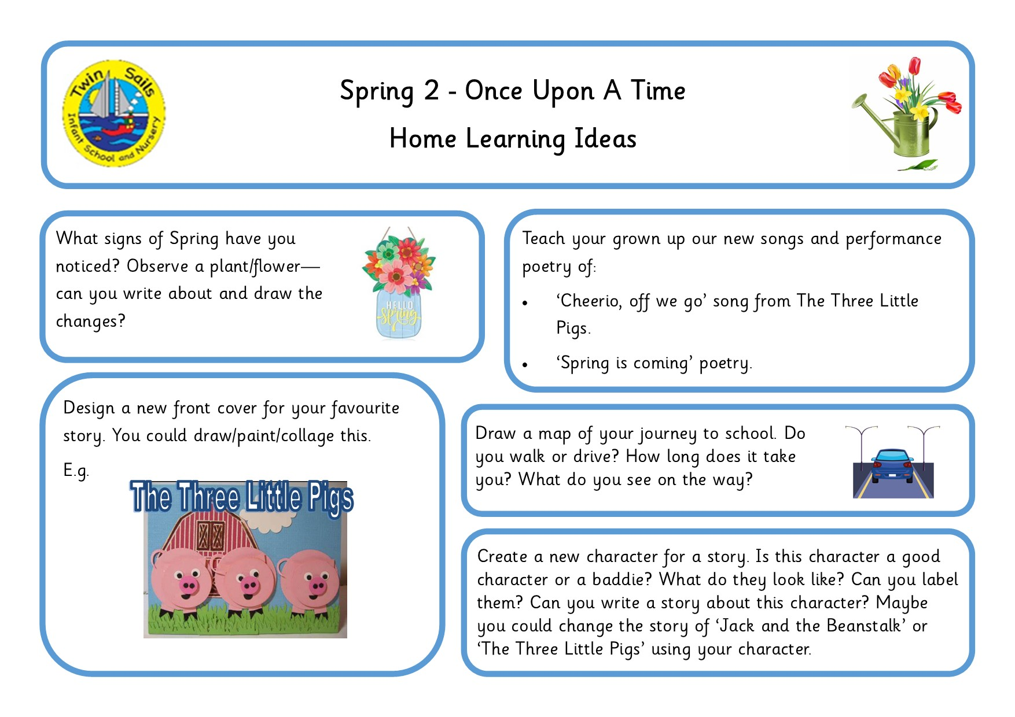
Supporting at home
Notes:
E.g. what you did at the weekend, shopping lists, treasure hunt games.

Slide 18
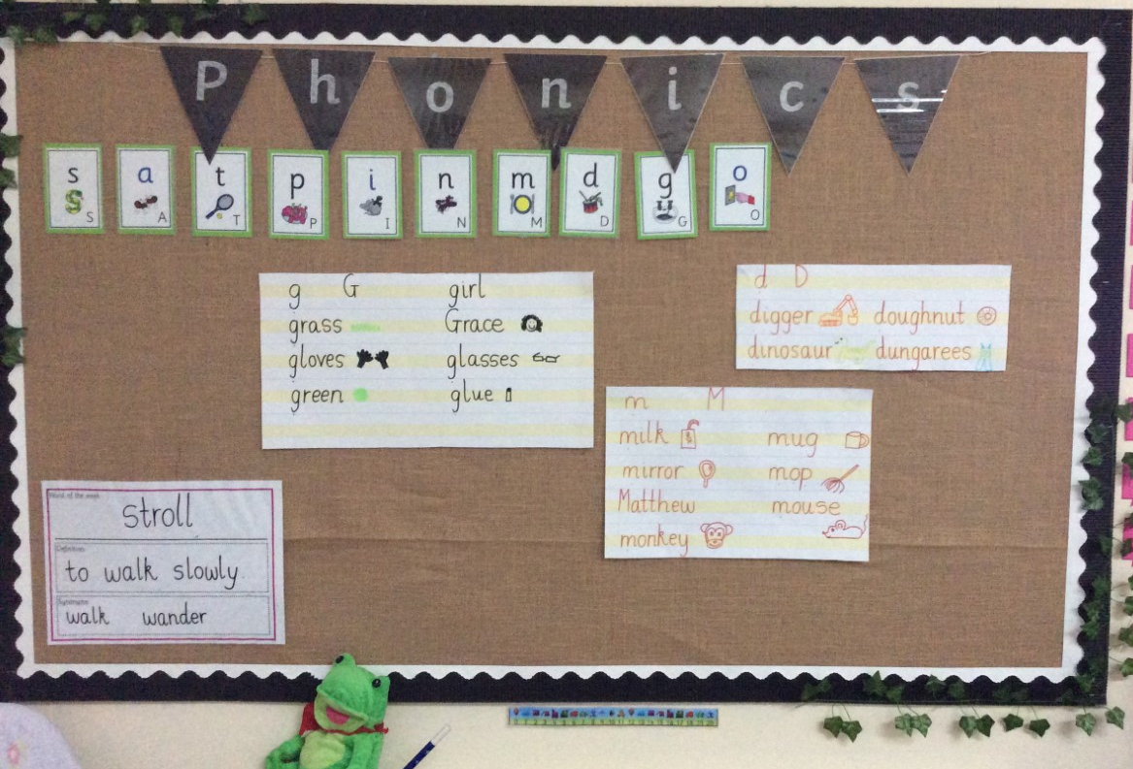

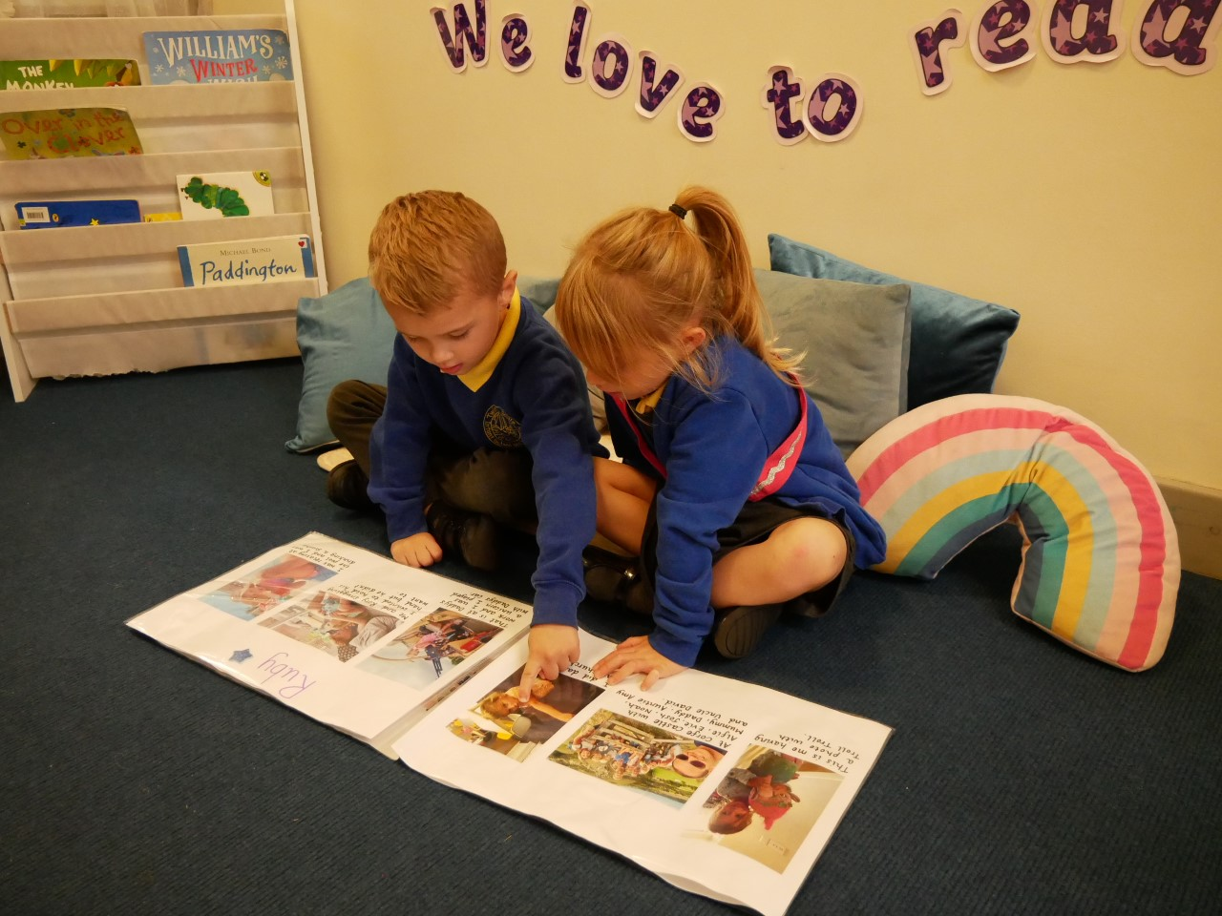
Thank you so much for coming today.

