Slide 1

Twin Sails Infant School
Phonics Information
Welcome!
Notes:
Sara

Slide 2
Aims:
To share how phonics is taught.​
To develop parents’ confidence in helping their children with phonics and reading​
To teach the basics of phonics and some useful phonics terms​
To outline the different stages in phonic development.
To show examples of activities and resources we use to teach phonics​.
To give parents an opportunity to ask questions.​

Slide 3
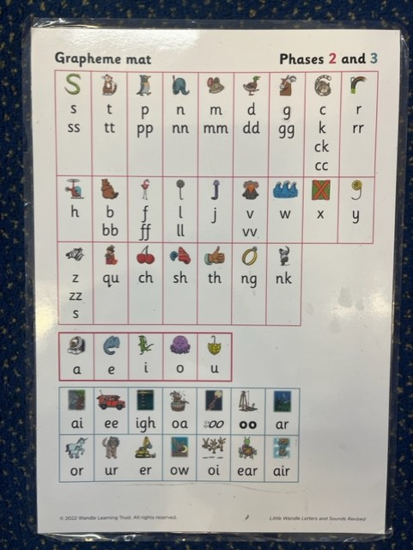
What is phonics?
There are 26 letters in the alphabet but there are 44 phonemes.
Phonics involves matching the sounds of spoken English with individual letters or groups of letters. E.g the sound K can be
c, k, ck.

Slide 4
What is phonics?
Phonics is a way of teaching children how to read and write.
It helps children hear, identify and use different sounds that distinguish one word from another in the English language.
Knowing phonics will help children to:
understand which letters to use when writing words
To become fluent readers

Slide 5
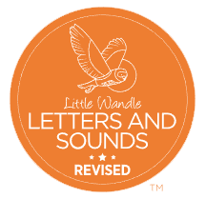
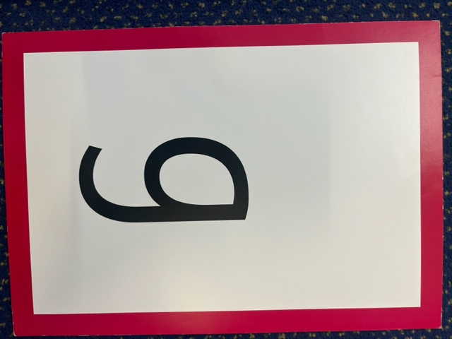
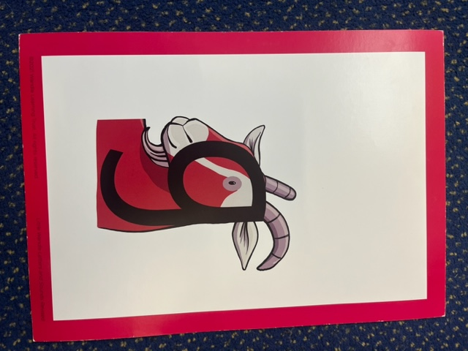
How is phonics taught?
Daily 20 minute session.
Daily phonics sessions using our new scheme - ‘Little Wandle – Letters and Sounds Revised’.

Slide 6
Phonics Words
Your children will learn to use the term:
Phoneme
Phonemes are sounds that can be heard in words. There are 44 phonemes in total and they are the smallest unit of sound.
The word c-a-t has 3 phonemes whereas the word b-ee has 2.

Slide 7
Phonics Words
Your children will learn to use the term:
Grapheme
This is how a phoneme is written down.

Slide 8
Phonics Words
Your children will learn to use the term:
Segment Blend
Children need to be able to hear the separate sounds in a word, segment and then blend them together to say the whole word .
/b/ /e/ /d/ = bed
/t/ /i/ /n/ = tin
/m/ /u/ /g/ = mug

Slide 9
Phonics Words
Your children will learn to use the term:
Digraph
This means that the phoneme is made up of two letters.
E.g. ck, ee, or, ar
Trigraph
This means that the phoneme is made up of three letters.
E.g. igh, ear, ure

Slide 10
Phase 1: Getting ready for phonics
1. Tuning into sounds
2. Listening and remembering sounds
3. Talking about sounds
- Music and movement
- Rhythm and rhyme
- Sound effects
- Speaking and listening skills

Slide 11
Phase 2: Learning phonemes to read and write simple words
Children will learn their first 19 phonemes:
Set 1: s a t p Set 2: i n m d
Set 3: g o c k Set 4: ck (as in duck) e u r
Set 5: h b l f ff (as in puff) ll (as in hill) ss (as in hiss)
They will use these phonemes to read and spell simple “consonant-vowel-consonant” (CVC) words:
sat, tap, dig, duck, rug, puff, hill, hiss
All these words contain 3 phonemes.

Slide 12
Reading
Children read the same book in school 3 times a week in a group.
Each session focuses on a different reading skill -
- session one – decoding
- session two – prosody (expression and intonation)
- session three – comprehension

Slide 13
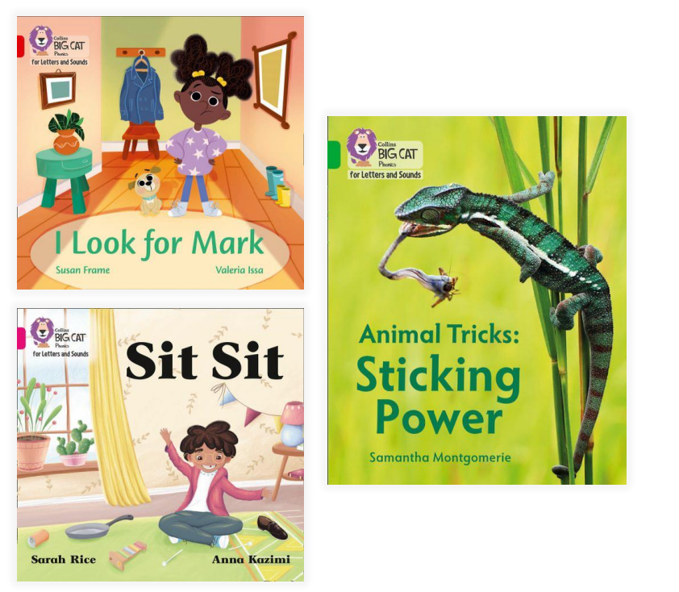
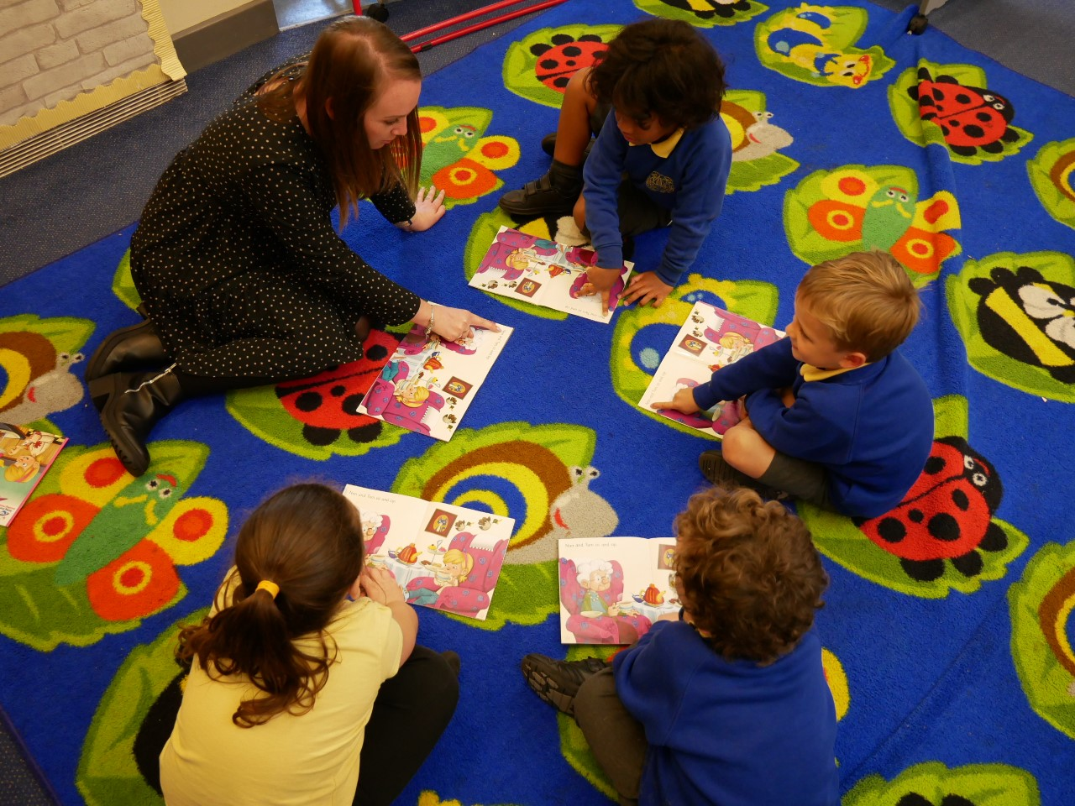
Reading
When your child reads at home, please record this in their reading record.
Your child will be read with three times a week at school.

Slide 14

How can I help at home?
Oral blending: the robot game
Children need to practise hearing a series of spoken sounds and merging them together to make a word. For example, you say ‘b-u-s’, and your child says ‘bus’.
“What’s in the box?” is a great game for practising this skill.
Reading, reading, reading!
This Photo by Unknown Author is licensed under CC BY

Slide 15
How can I help at home?
Research has shown that reading a book and chatting has a positive impact a year later on children’s ability to…
• understand words and sentences • use a wide range of vocabulary • develop listening comprehension skills.
The amount of books children were exposed to by age 6 was a positive predictor of their reading ability two years later.
This Photo by Unknown Author is licensed under CC BY

Slide 16
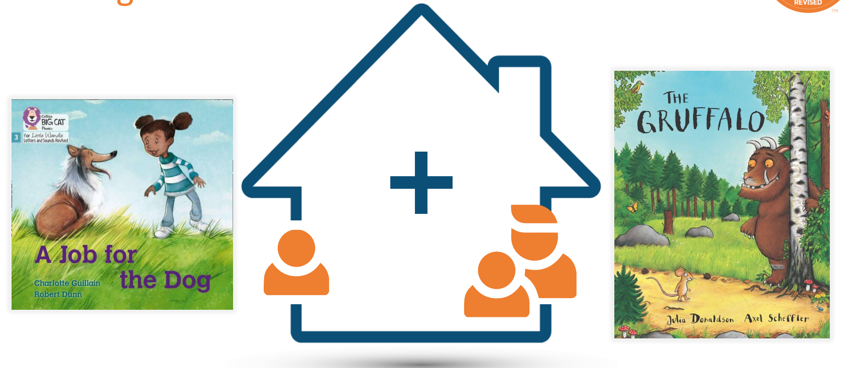

Slide 17

Learn to Read book
Your child should be able to read their book without your help.
• If they can’t read a word read it to them.
• Talk about the book and celebrate their success.
Love to Read
Your child will be able to take a love to read book home each day. These have a heart sticker on.
Share and enjoy together.
Introduce new and exciting language.
Promote a love of reading.

Slide 18
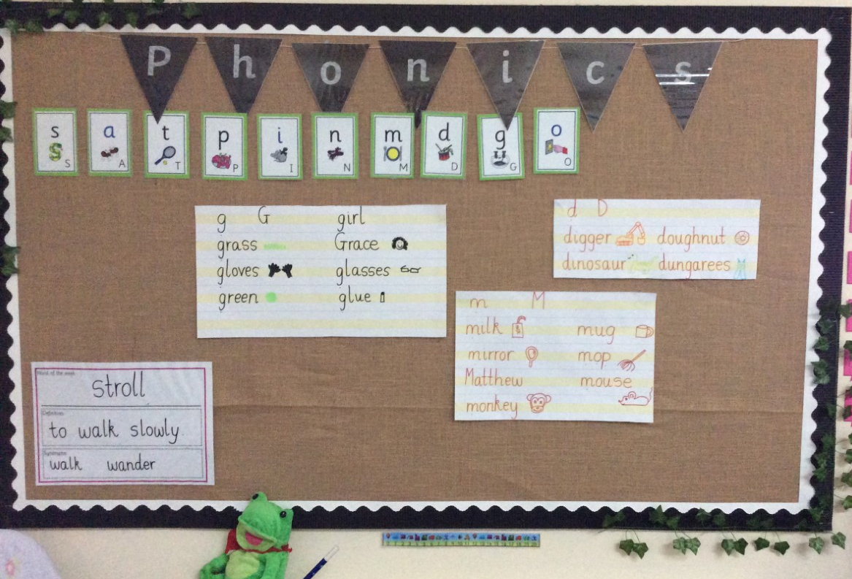
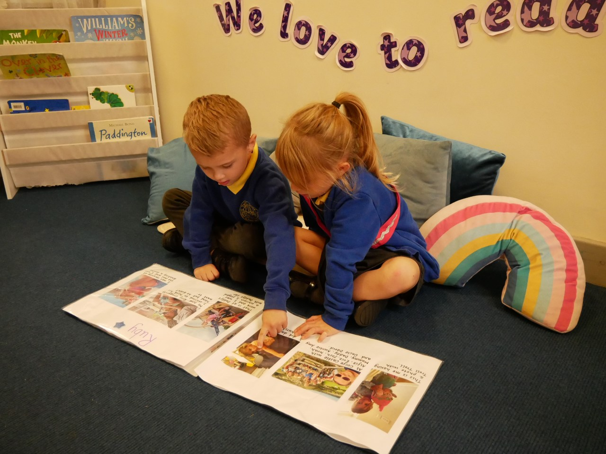
Thank you so much for coming today.

