Slide 1
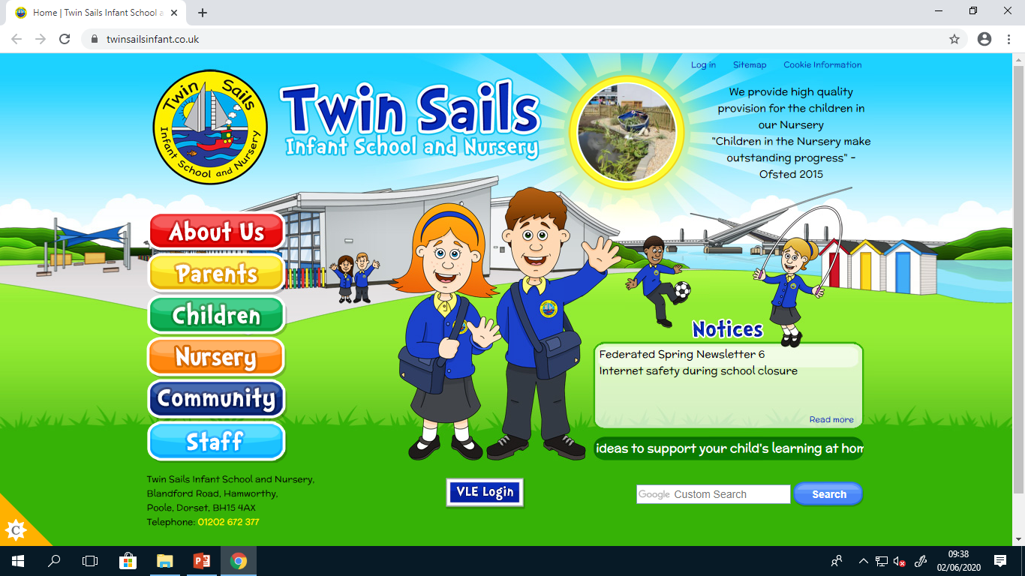

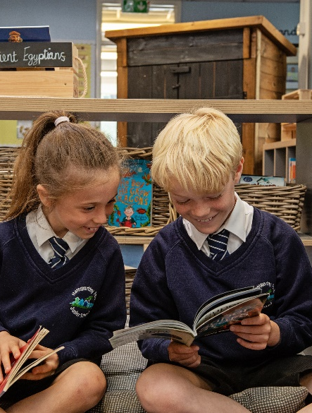
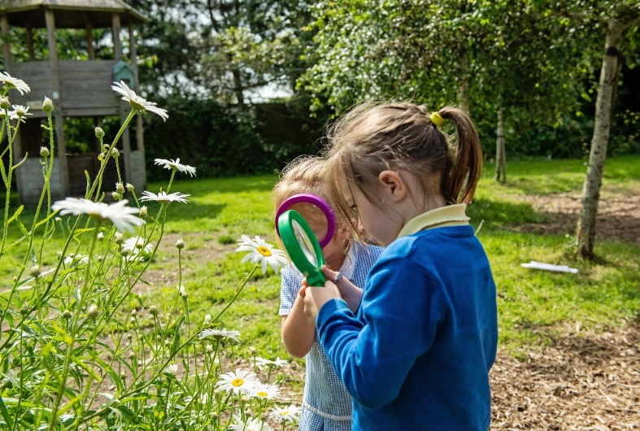
Welcome to Reception
Every Child, Every Day, Every Possibility

Slide 2



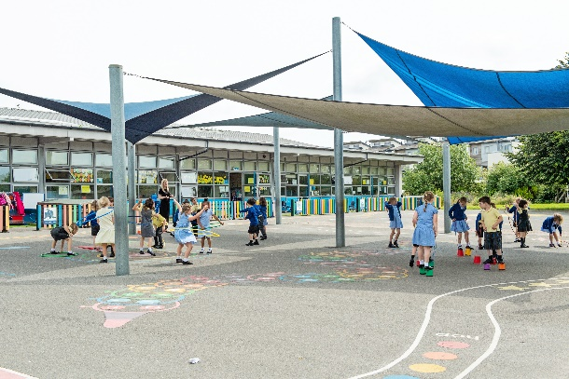
Todays aims to share:
Who’s who?
The curriculum in Reception
Reminders – attendance, uniform
Communication systems
Lunch and play
Extended day care/ offer
Additional funding for schools
Positive Behaviour systems
Getting it right form the start

Slide 3

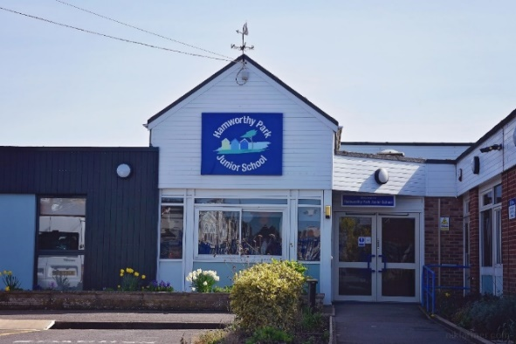

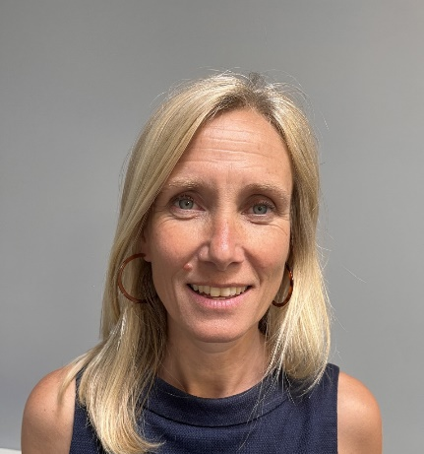
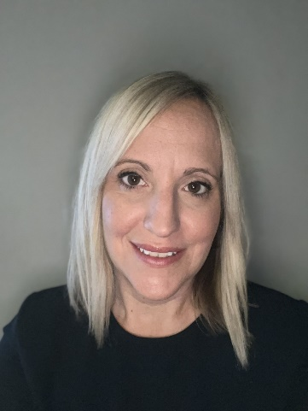
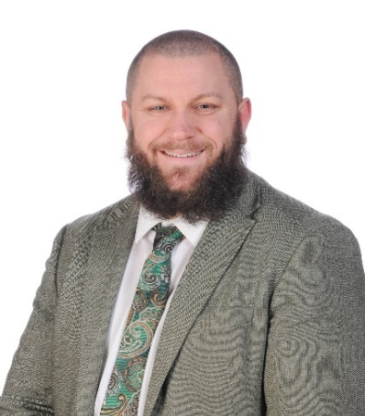
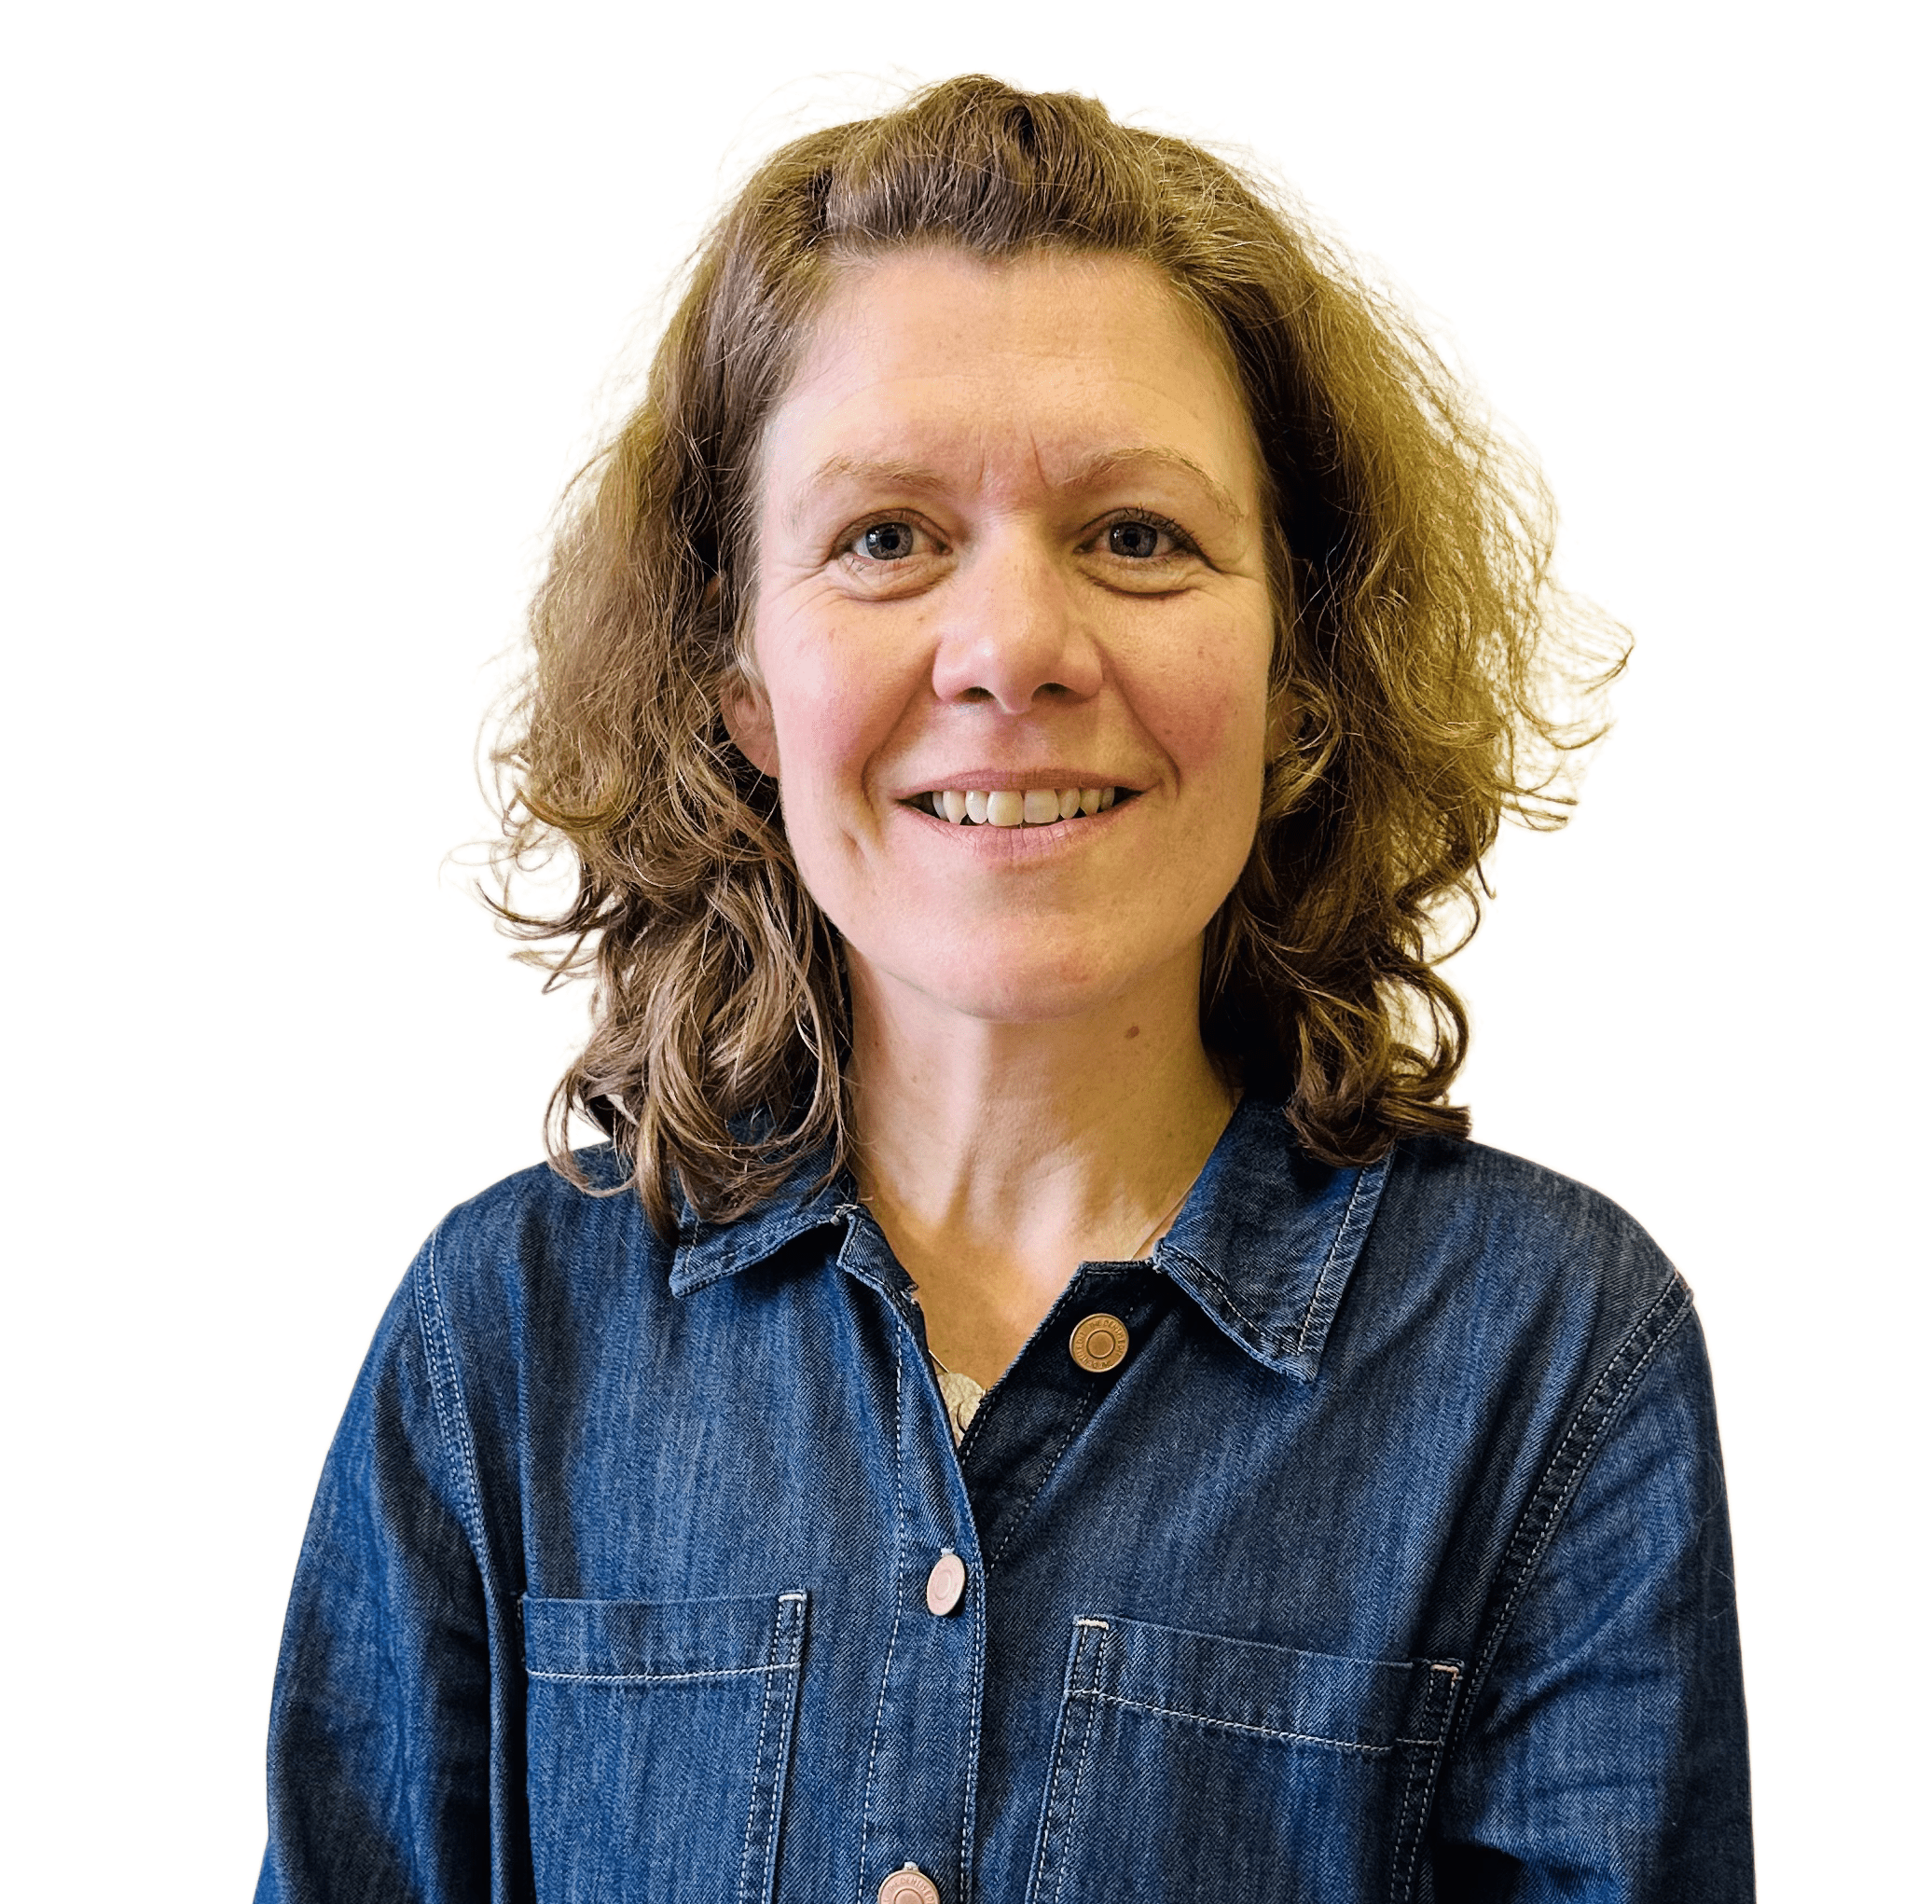
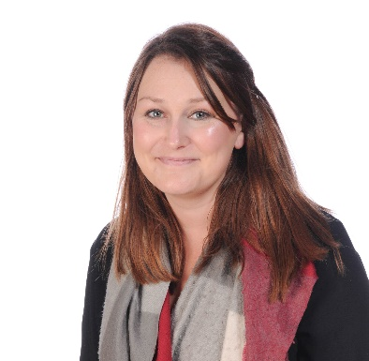
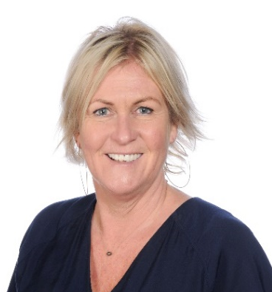

Who’s who?
Mrs Hill is the Executive Headteacher of the Federation and Mrs Williams is the Head of Schools and are the DSLs for the Federation..
Mr Winton is the Deputy Head of the Junior School and Deputy DSL.
Miss Haylock & Mr Rogers and are our Assistant Heads. Mr Rogers is also Head of Year 3.
Sarah Brown is our
SENCO
Mrs Coulter is Deputy Head of Twin Sails and is also Deputy DSL.

Slide 4
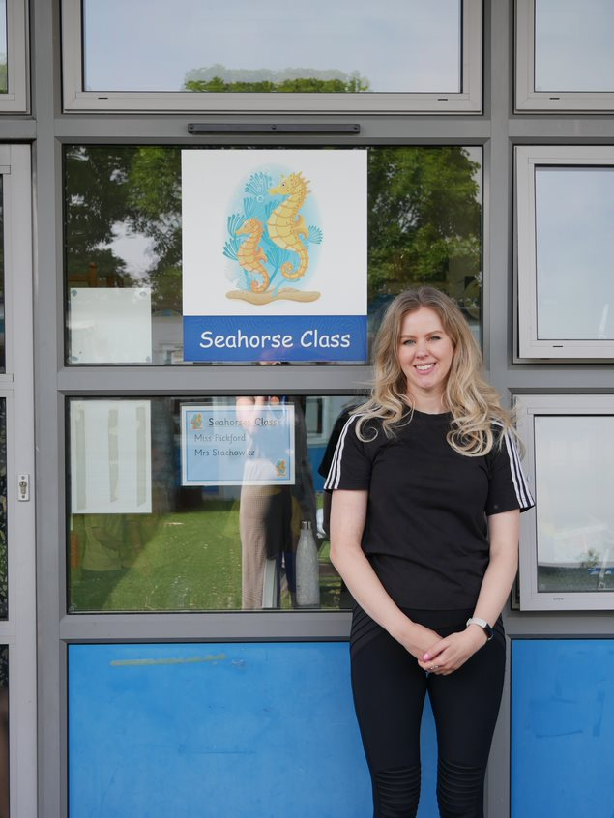
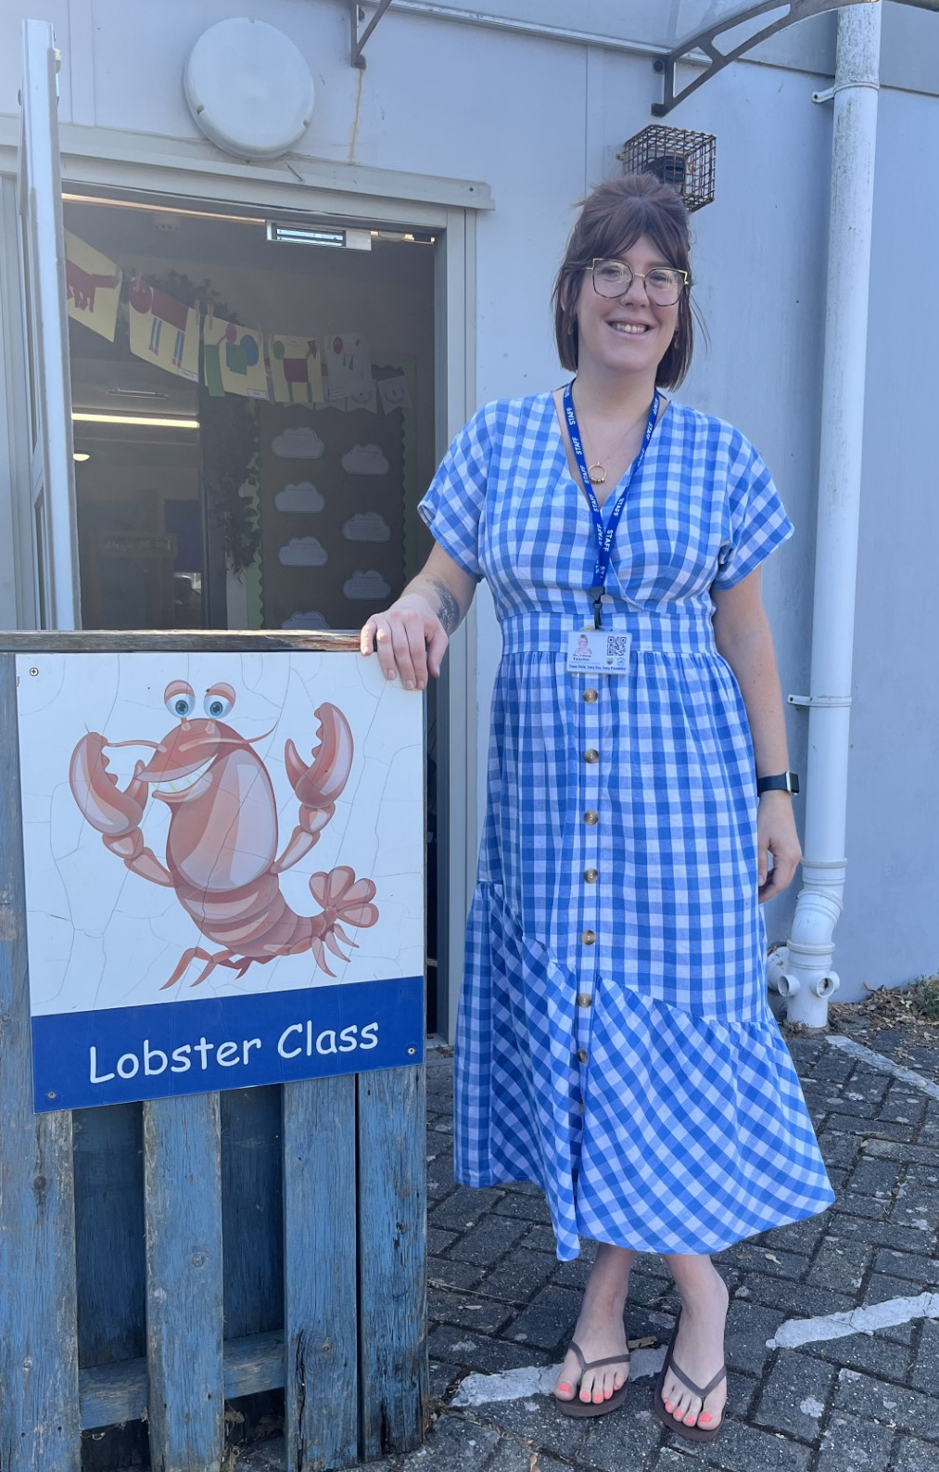
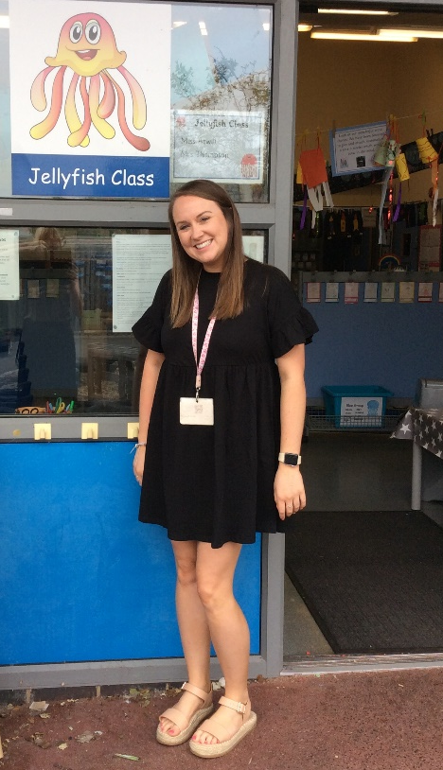
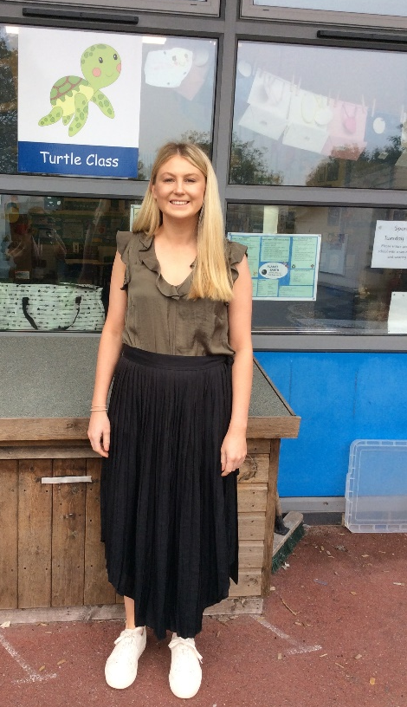

Reception Teachers
Miss Atwill
Jellyfish
Reception Year Leader
Mrs Smith
Turtles
Miss Pickford
Seahorses
Miss Watson
Lobsters
Notes:
Kayleigh

Slide 5
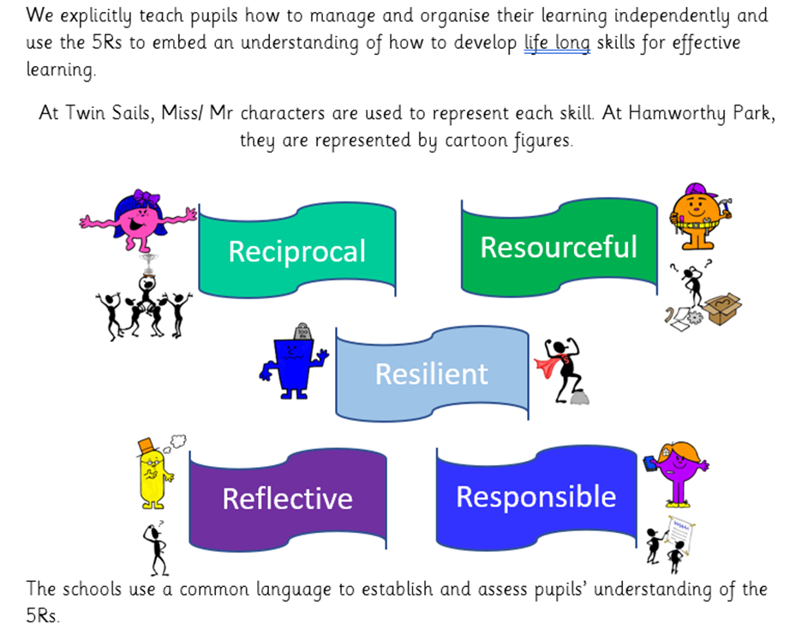
Twin Sails Infant School & Nursery and Hamworthy Park Junior School –
Hamworthy Primary School Federation
Every Child, Every Day, Every Possibility
Our ethos:
A happy, caring, nurturing school where:
every child is valued and supported for their uniqueness
every day we provide high quality education, safeguarding and care – regardless of needs, experiences, barriers
Enabling our children to develop a mindset and understanding of the many possibilities in school and for their bright future.
Alongside this we believe every child should develop key learning skills that will enable them to flourish at school and beyond. These are known as our 5Rs
We want our children to leave us feeling as confident individuals, ready for the next stage of their education, inspired by the opportunities that their adult life will bring.
Notes:
Andrea

Slide 6

The Early Years Curriculum
Play is a crucial component of early years learning, as it allows children to learn at their own pace and in their own unique way.
The adult’s role is to observe and interact if the opportunity arises to extend learning, following the child’s interests.
Children learn best when it's something a child is attracted to.

Slide 7
The Early Years Curriculum
Prime Areas
Personal, Social and Emotional Development.
Physical Development.
Communication and Language.
Specific Areas
Literacy
Mathematics
Understanding the World
Expressive Arts and Design
Early Learning Goals (ELGs)

Slide 8

The Recception Baseline
Within the first 6 weeks of starting Reception your child will be participating in the reception baseline assessment (RBA. The purpose of the assessment is to provide the starting point for a new measure that will help parents understand how well schools support their pupils to progress between reception and year 6.
The Reception Baseline Assessment (RBA) is a short, interactive and practical assessment of your children's early literacy, communication, language and mathematics skills when they begin school, using materials that most children of your child's age will be familiar with. It is statutory for all schools.
The RBA will provide an opportunity for your child to have valuable one-to-one time with their teacher at an early stage, so that the teacher can get to know your child better.
You do not need to do anything to prepare your child for this assessment.

Slide 9
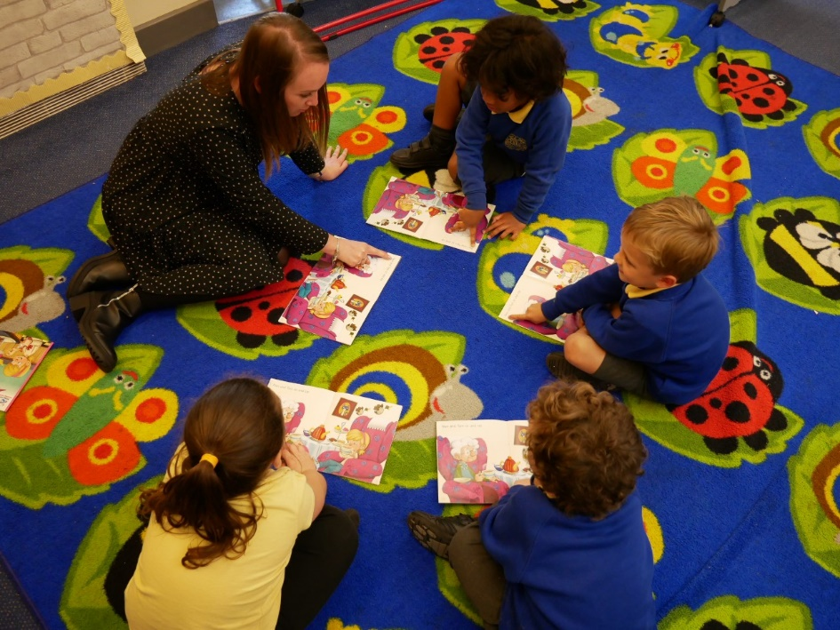
What is phonics?
Phonics is a way of teaching children how to read and write.
Little Wandle
It helps children hear, identify and use different sounds that distinguish one word from another in the English language.
Knowing phonics will help children to:
understand which letters to use when writing words
To become fluent readers.
Please keep reading records in your child’s bookbag.

Slide 10
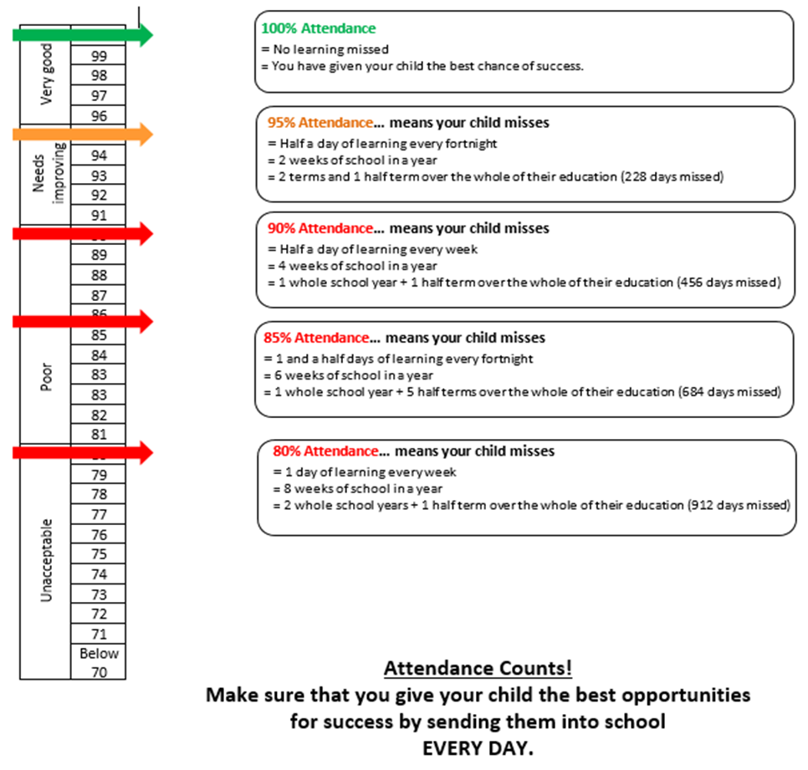
Attendance
Attendance is a national priority
All children deserve the right to attend school regularly to ensure they are able to access the full education offer, which enables them to achieve their potential.
As a school, we are highly committed to working together with families to provide challenge and support
We monitor every 3 weeks, it is our duty to highlight to parents the relationship between attendance and achievement – we do this with phone calls, a letter or invite to a meeting

Slide 11

Attendance
Therefore, please:
Bring them in on time! Late makes them feel different
Phone in every day about why your child is absent.
Only keep them at home if they have sickness / diarrhoea, temperature
Holidays in term can not be authorised by the school –however, complete a holiday form so we know where your child is and that they are safe – as your children will let us know what a great time they had!
Let your class teacher know of anything that might be impacting on your child not wanting to come to school, so we can work together to support them to build confidence and ease about attending everyday.

Slide 12

Positive Partnerships
How can we work together?
If your child is being picked up by someone new, please email the school office or the class email. In fact, do both if possible!
Any questions, worries, thoughts we are always here. I ask the team not to reply to emails after 5.30 but please know we will respond as soon as possible.
You can also catch us at the end of the day or speak to Senior Leadership Team who are usually on the school gates at the start of the day.

Slide 13

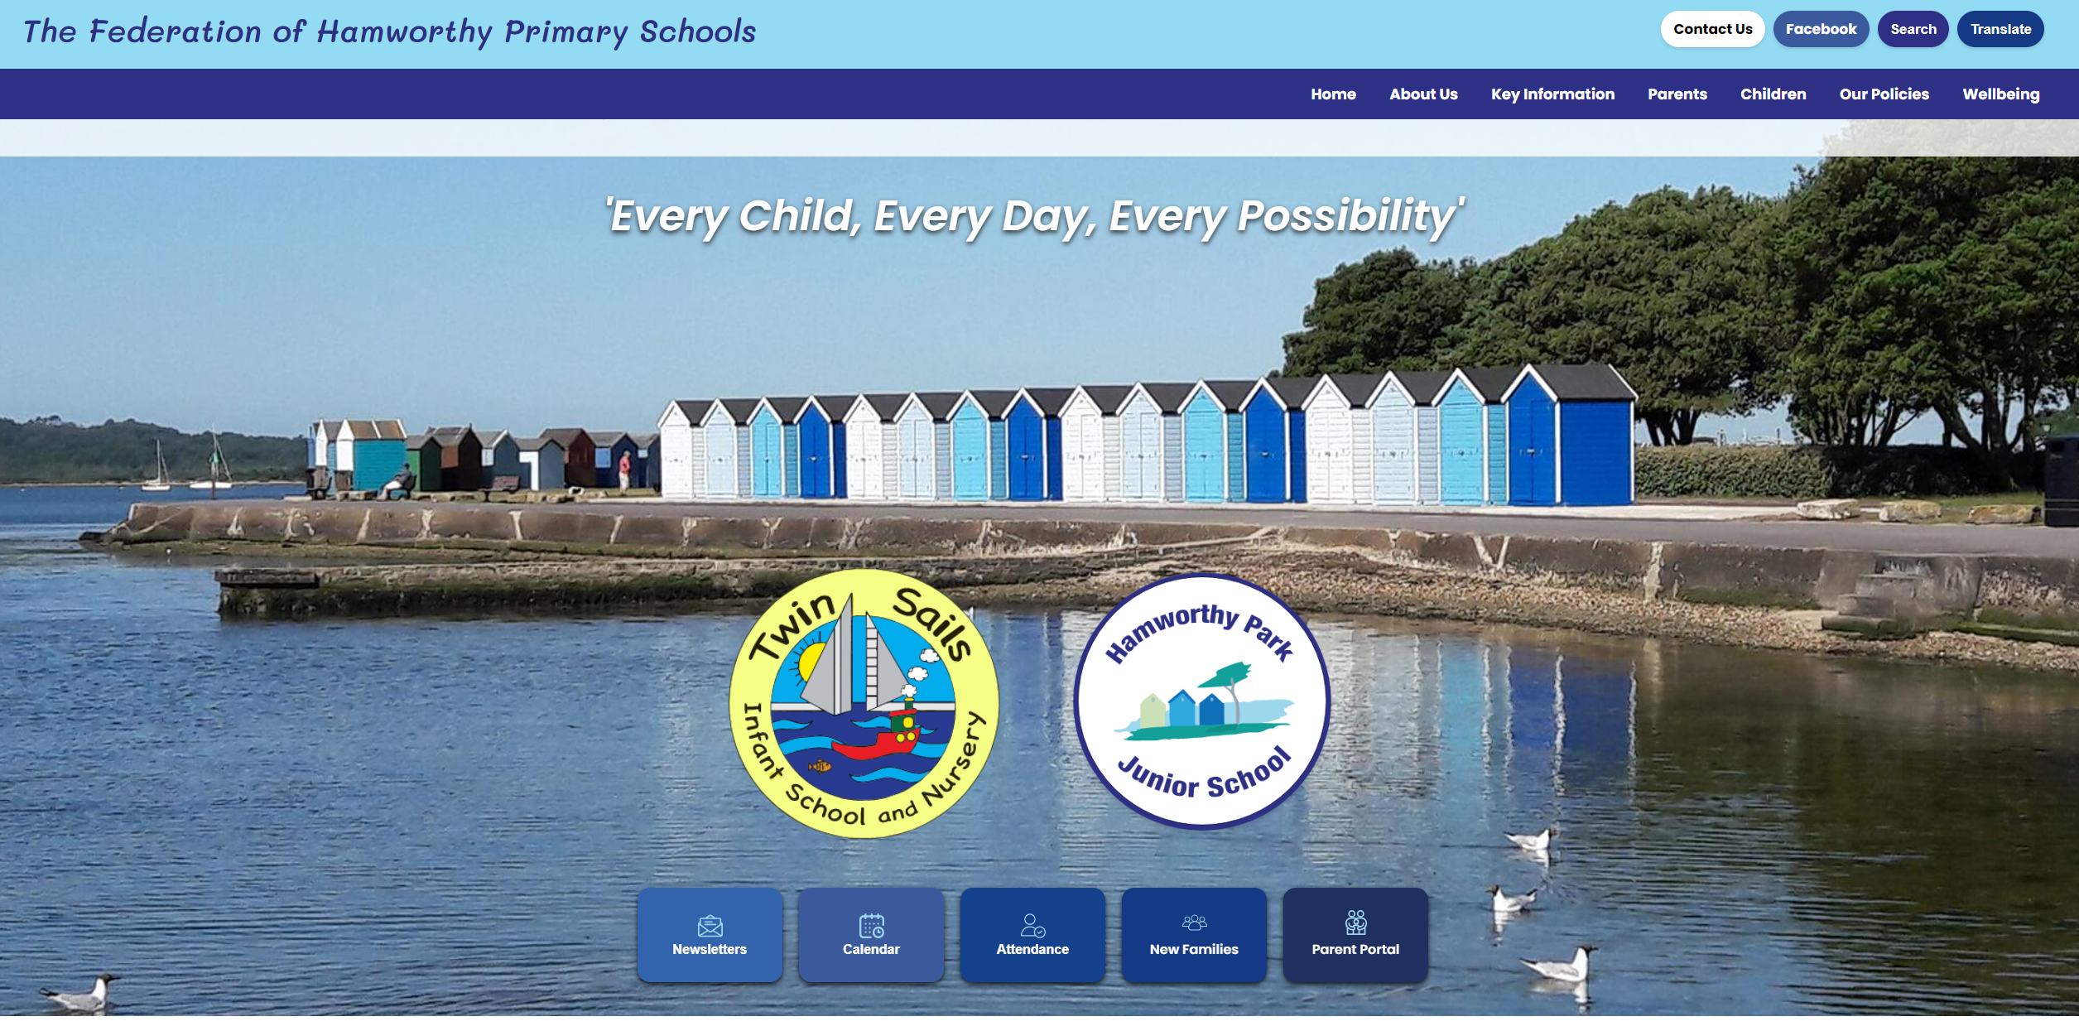

Partnerships - communication
Open door policy – don’t let small issues build, end of day is always easier
Class group email:
Jellyfish - jellyfish@hamworthyprimaryschools.co.uk
Turtles - turtles@hamworthyprimaryschools.co.uk
Seahorses - seahorses@hamworthyprimaryschools.co.uk
Lobsters - lobsters@hamworthyprimaryschools.co.uk
Communication from school will be sent via MCAS – newsletters, forms, surveys.
Other key information can be found on our Federated school website -Hamworthy Primary Schools.
The current Reception curriculum and information about the year group can be found in the Reception Class Pages, under ‘Key Information.’

Slide 14

Positive Partnerships
- Reading
Reading
Each week your child will take home a colour banded 'learn to read' book to practise.
The book should be read lots of times before changing to another book. This is to give children an opportunity to improve fluency and understanding.
When the school library is open children may also get a 'love to read' book.

Slide 15

Pupil Premium Funding – how does it help?
School receive £1385 per child to improve outcomes for those eligible
For children in care or adopted schools receive additional payments
For Service children schools receive £335
  Most funding goes towards improving teaching & learning
  Interventions
  Resources
  Pastoral support
  Enrichment – music, clubs
  Trips
  Laptops
  Wrap around care
If you think your family are eligible please apply via the BCP website

Slide 16
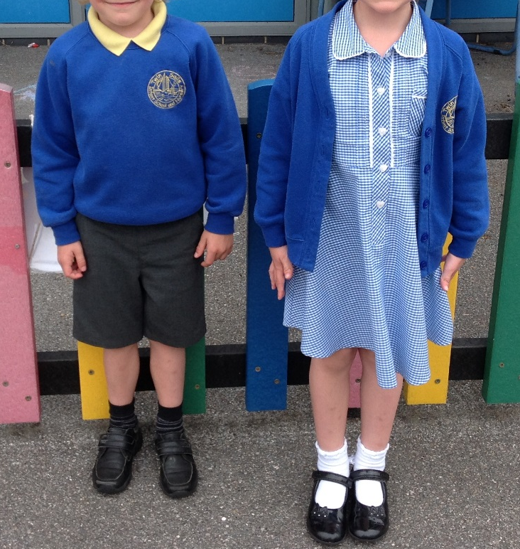
Uniform
Please ensure that every item of your child’s uniform is named.
We encourage our children to be independent, so please make sure their shoes are ones that they can take off and put on by themselves.
Notes:
Alex

Slide 17
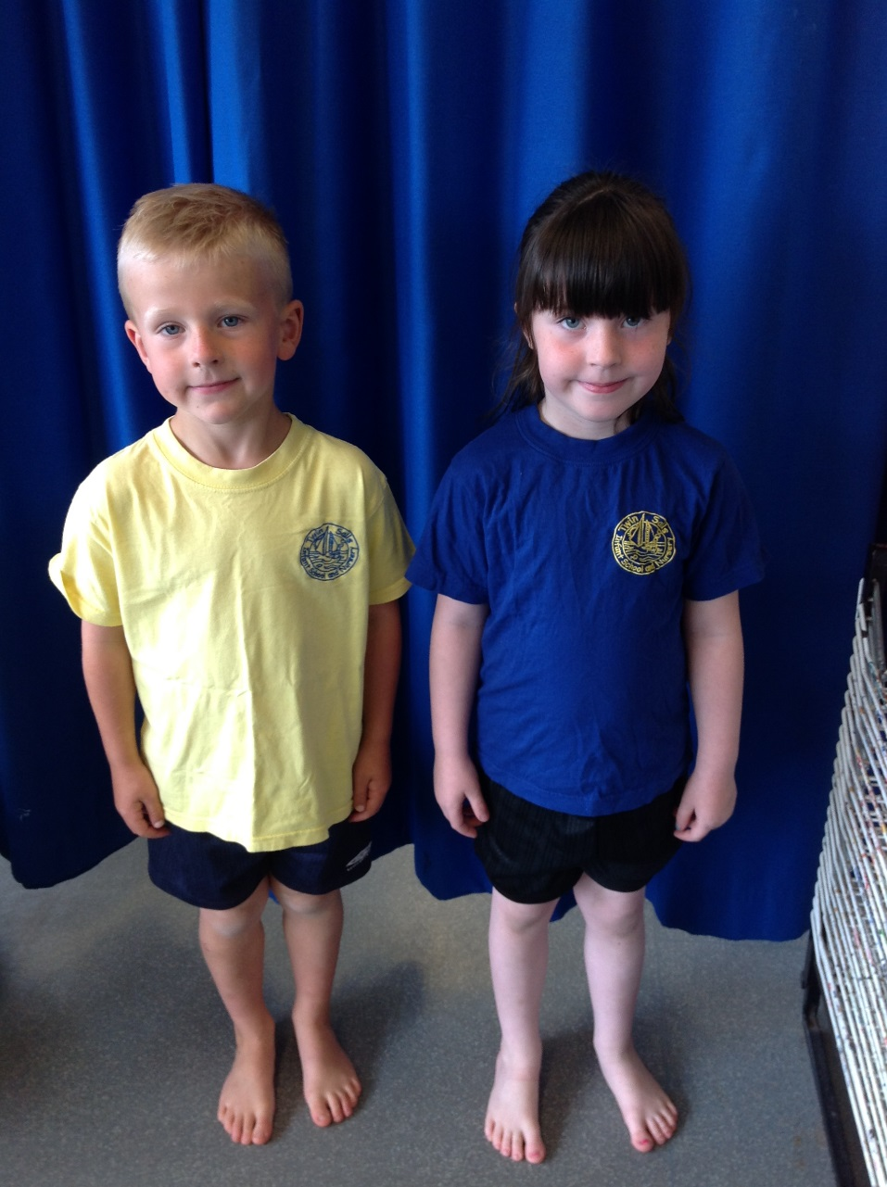
PE Kit
PE kit can be a yellow or blue t-shirt with black shorts. The t-shirts can also be purchased from a supermarket. It is not necessary for you to provide your child with trainers in September.
Please wait until your child’s teacher asks you to purchase them (usually Spring Term).
Seahorses and Lobsters – Monday and Thursday
Jellyfish and Turtles – Wednesday and Thursday
Hair tied up and earrings taken out.
Notes:
Alex

Slide 18


Extended Care Offers
Wrap Around Care:
  Both schools have a breakfast club 7.30am -8.30am £3.90
  Both schools have after school club 3.00pm-5pm £8.20
  Run by our school team – food and activities
  You will be able to book these clubs through MCAS.
Holiday Club:
  CASA also provide holiday clubs on the school site.
More information will be sent out via the school office before the end of term.

Slide 19
Thank you.
Please come and speak to any one of us if you have any questions.

