Slide 1
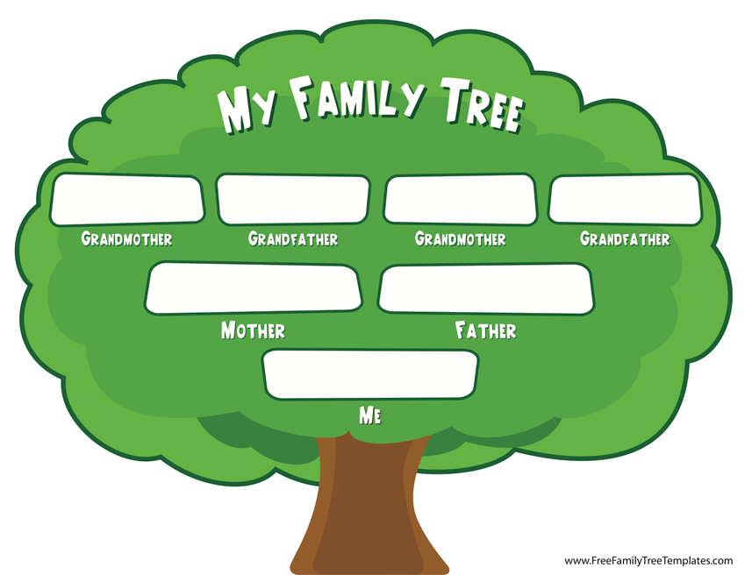
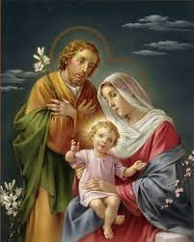
RE KNOWLEDGE ORGANISER
Year 4 – Domestic Church/People
ESSENTIAL VOCABULARY
Word | Definition
Chosen people | They have been chosen as special people by God.
Siblings | Brothers and sisters.
Relations | a person who is connected by blood or marriage; a relative.
Ancestors | Ancestor is any person from whom one is descended.
Generations | All of the people born and living at about the same time, regarded collectively.
Old Testament | First part of the bible.
Roots | Source or origin of something or someone.
Family tree | a diagram showing the relationship between people in several generations of a family.
Genealogy | a line of descent traced continuously from an ancestor.
Nomad | a person who does not stay long in the same place; a wanderer. Has no permanent residence.
Nomadic | Living the life of a nomad.
Church teachings:
The genealogy of Jesus in the Gospel of Matthew. Jesus’ human family. The story of Abraham, the father of God’s chosen people. The story of Jacob. The story of the love and fidelity of Ruth. Solomon, the wise ruler. The role of Saint Joseph in Jesus’ life.
RE CURRICULUM DIRECTORY
Area of Study 1: Knowing and loving God, the Scriptures, Creation, the Trinity, Jesus Christ, Son of God, the Holy Spirit Area of Study 2: What is the Church? One and holy, Catholic Area of Study 3: Prayer Area of Study 4: The dignity of the human person, the human community, love of God and love of neighbour.
Key questions:
Where do I come from? To whom do I belong? To which family did Jesus belong?
Scripture:
Matthew 1: 1-17 Mt 2: 13-15, 19-23, Lk 2: 40-51, Mk 1: 14-20 Genesis 12: 1-8, 18 Genesis 21: 1-7 Genesis 25: 20-27 Genesis 35: 9-15, 23-26 Genesis pages 15-17 Ruth 1: 2-7, 16, 17
Reveal
The importance of family and understanding our heritage.
LINKS TO PREVIOUS LEARNING
Year 3 - Homes - God’s vision for every family What makes a house a home?
‘As a family we live, love, learn and celebrate with Jesus.’

