Slide 1
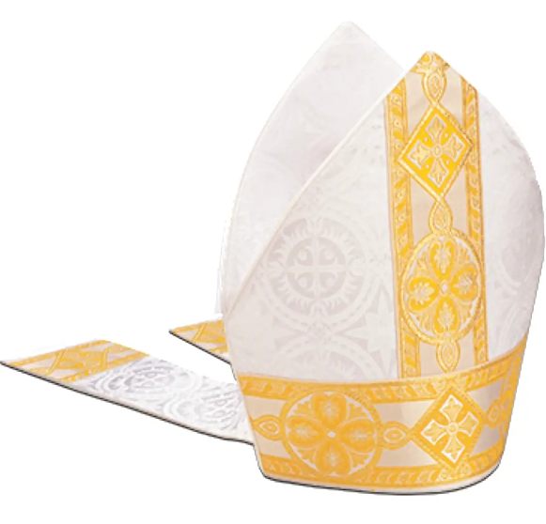
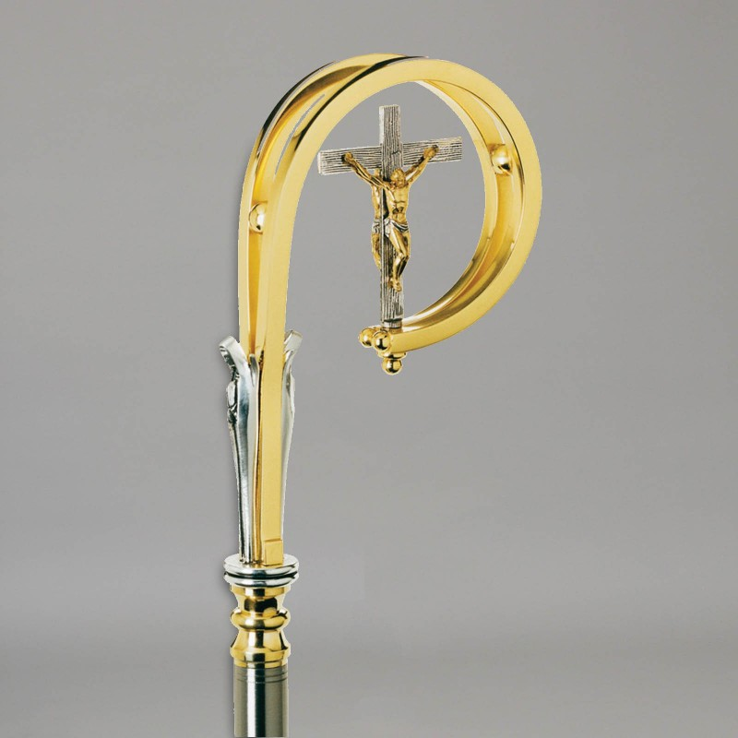
RE KNOWLEDGE ORGANISER
Year 4 – Baptism/Belonging/Called
ESSENTIAL VOCABULARY
Called | Asked to do a special job.
Chosen | one who is the object of choice or of divine favour
Response | Answering to being called
Sacrament of Confirmation | The Sacrament of Confirmation is the second of the three sacraments of Christian initiation. It completes baptism.
Oil of Chrism | The holy oil used in anointing.
Mitre | a tall, pointed hat worn by bishops in official ceremonies.
Crozier | a hooked staff carried by a bishop
Sponsor | one who presents a candidate for baptism or confirmation and undertakes responsibility for the person's religious education or spiritual welfare.
Catechist | a teacher of the principles of Christian religion, especially one using a catechism.
Bishop | a senior member of the Christian clergy, usually in charge of a diocese and empowered to confer holy orders.
Holy Spirit | The third person of the trinity.
Witness | Demonstrating the values of Jesus.
Anointing | Anointing is the ritual act of pouring oil over a person's head or entire body.
Holy trinity | The father, the son and the holy spirit.
Church teachings:
The call of Samuel and David. How Jesus altered the lives of the apostles. What happens at Confirmation. Why the baptismal promises are repeated at Confirmation. The work of the Holy Spirit in the lives of Christians. What it is to live in the light of Christ. The commitment of people who respond to the call of God. How Sean Devereux answered the call of God.
RE CURRICULUM DIRECTORY
Area of Study 1: Knowing and loving God, the Scriptures, the Trinity, Jesus Christ, Son of God, the Holy Spirit Area of Study 2: What is the Church? One and holy, Catholic, Apostolic, Mission Area of Study 3: Liturgy, Sacraments, Baptism, Confirmation, prayer Area of Study 4: The dignity of the human person
Key questions:
How does it feel to be chosen? How do people respond to being called? Why does it mean to be chosen and called?
Scripture:
1 Samuel 2: 11, 3: 3-10, 19 1 Samuel 16: 4-13 1 Corinthians 12: 31: 13: 1-8, Mark 1: 14-20
Reveal
Confirmation: A call to witness
LINKS TO PREVIOUS LEARNING
Year 3 - PROMISES – Promises we make to God. Why make promises?
‘As a family we live, love, learn and celebrate with Jesus.’

