Slide 1
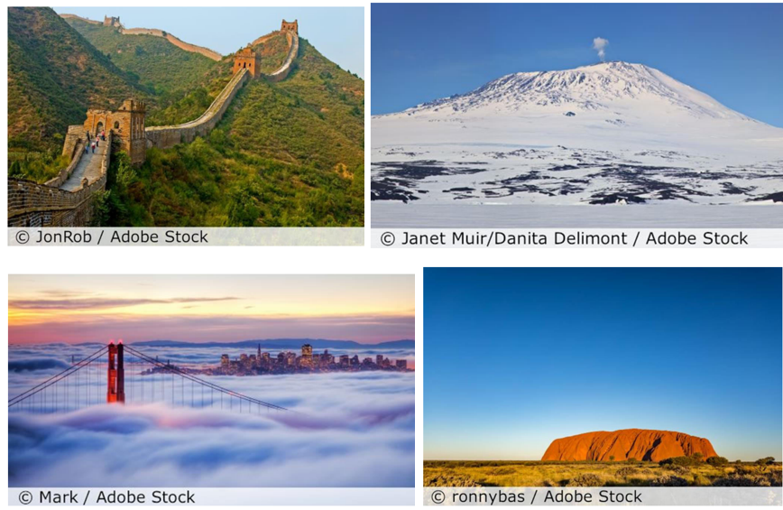
What a wonderful world
Year 2
Geography KNOWLEDGE ORGANISER
ESSENTIAL VOCABULARY
Continent | One of the 7 parts of the world.
Wonder of the world | A place or object located in the world that is considered to be very important.
Landmark | A key feature or object.
Rivers | A large natural stream of free flowing water.
Ancient | Very old.
Physical Features | Parts of the world that were naturally made/already there.
Desert | A dry and often hot or humid part of the world.
Human Features | Things that humans have built and added to the world.
Important things to know
There are wonders of the world near to us and far from us. We should value what we have locally, whether that may be a large tree or an interesting building.
There are wonders on each continent. The continents are: Antarctica, Asia, Oceania, Europe, North America and South America.
Mountains are wonders. They can be high, long, wide, deadly, freezing and covered in trees, rocks or snow and ice.
Everest is the highest mountain in the world. Some animals, such as the bar-headed goose, are wonders too, and get close to mountains including Everest.
Rivers of the world include the Danube, Yangtze, Amazon, Nile and Mississippi. These rivers are all on different continents.
The Suez Canal is a human-made wonder, carved out of the desert. It connects the continents of Asia and Europe. Christmas presents often come through here on enormous ships.
Ancient wonders are those that are older than people who are alive today; they might even be thousands of years old.
Modern means in the last 200 years.
Geographic wonders made from rock, such as Uluru, were formed millions of years ago and were originally under the sea.
By the end of this topic I will be able to
Name, locate and identify characteristics of the seven continents and oceans. • Use world maps, atlases and globes/ • Understand geographical similarities and differences when studying both human and physical geography. • Identify the locations of hot and cold areas around the world. • Use basic vocabulary to refer to physical and human features. • Develop knowledge about the world.
Key places
Asia – Great Wall of China. Antarctica – Mount Erebus North America – Golden Gate bridge San Fran Sisco. Oceania – Uluru Australia.
‘As a family we live, love, learn and celebrate with Jesus.’

