Slide 1



Our Vision and Values
1
2
3

Slide 2


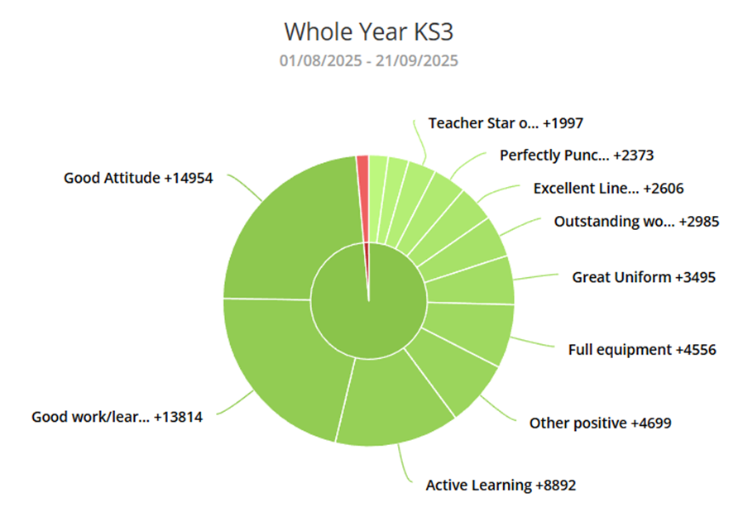
How is it going?
99% of all points awarded on Broadway are positive.
WHAT AN AMAZING START TO THE YEAR.
KEEP IT UP THIS WEEK!
Notes:
Read to form

Slide 3
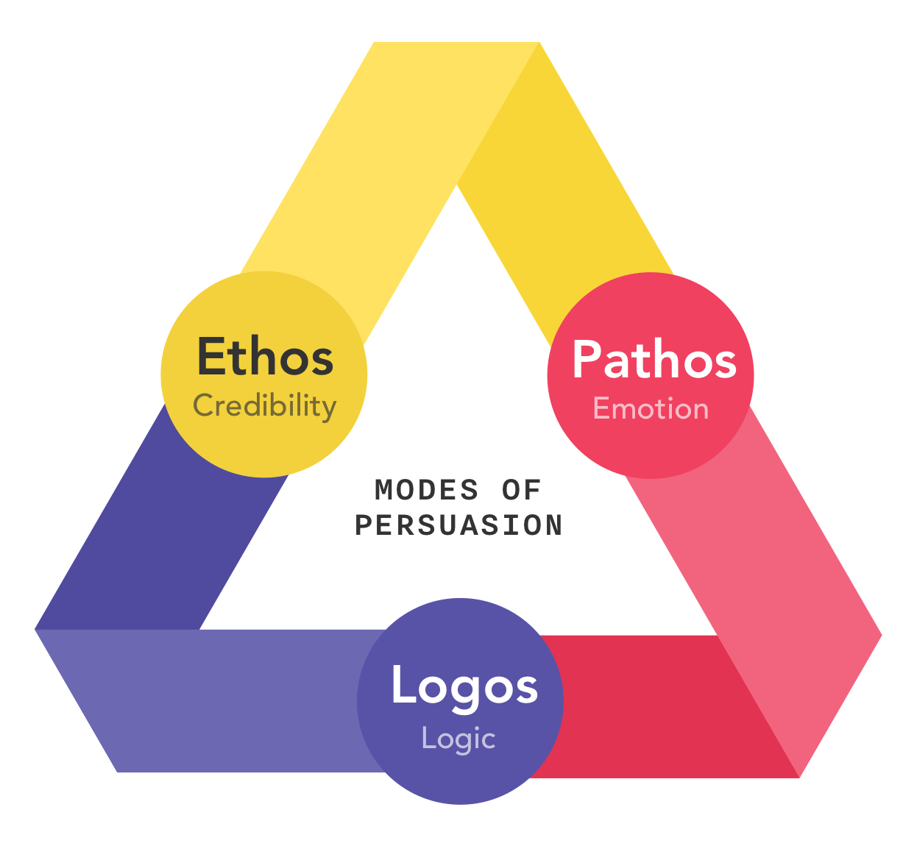

Our vision and your house system
Community
Compassion
Curriculum

Slide 4

House Standings
This week, points were awarded for:
House with highest attendance
House with most positive points
House with the most points for ‘good attitude’
House with the best punctuality
Our Overall House Standings are…
1st: 100 Points | 2nd: 80 Points | 3rd: 65 Points
LOGOS
PATHOS
ETHOS
Notes:
Read to form

Slide 5

Our vision and values
“Achieving success and transforming lives
through
compassion, community and
curriculum”
Notes:
We want all of our students to have an enriched learning experience by our academic and pastoral curriculum offer.

Slide 6



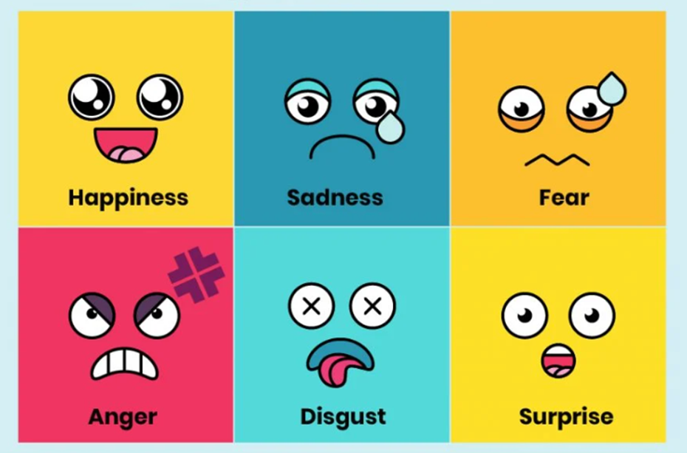


The Cornerstone Curriculum at TKS: Half-term One Our six themes (Golden Threads)
Vision and Values | Respectful Routines | Respecting Others
Managing emotions and coping with change | Restorative conversations to bring about change | Online Behaviour and Digital Etiquette
Notes:
Therefore we are delighted to be sharing with you the launch of our Cornerstone Curriculum which sits alongside our academic and personal development curriculum.This was launched to students and staff this academic year has been devised to explicitly teach our students key learning behaviours, routines and skills required to have a fully successful experience at TKS. The curriculum is delivered in form time, via dedicated assemblies and modelled in all areas of our school life.
Behind me are our 6 themes which make up the first half-term. Students have been asked to explore how our school’s vision and values can support them as learners and as members of our TKS community. We have discussed how and why routines are an important feature of our school life, noting that when we have clear routines such as Ready, espect, Safe we are able to open our minds to become better learners.

Slide 7
Objective: ?How can we create a school community where everyone matters?
Hinge Question
Prompt: Consider keywords within our school’s vision statement
Choose one of the following questions to discuss in your pair. What does achieving success mean for you? What does transforming lives look like for 3 students
SAMPLE CONTENT
Notes:
Our Cornerstone curriculum is taught largely in form time via your child’s form tutor and there is always a sample/element to the week’s curriculum focus in our Key Stage 3 Key Messages which are released to families on a Monday. This allows families to discuss key ideas with their children at home.

Slide 8

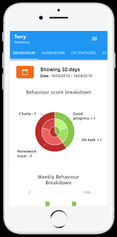

Behaviour and Culture
A good way to better understand your child’s day at school is via Classcharts:
TOP TIPS:
Check their PIE daily
What’s their % ratio?
How many positive points have they gained that day/week?
Have they been issued Teacher/Student Star of the lesson?
WATCH this SPACE: TERM 1 REWARDS ACTIVITY TO BE ANNOUNCED SOON.
You can monitor your child's behaviour daily through the classcharts parent app
Notes:
95% ratio, excellent attendance, punctual to school and lessons

Slide 9


Class of 2025 are record breakers!
 | 2019 | 2023 | 2024 | 2025
Basics 4+ | 71% | 68% | 65% | 72%
Basics 5+ | 48% | 44% | 42% | 51%
Equal highest results at 4+.
Highest ever at 5+
Improvement of 9% at 5+

Slide 10

Class of 2025 are record breakers!
Summary of School Improvement Priorities
Improve attendance across all year groups. | Achieve consistency across subject areas | Improve our family partnerships
Improve the way teachers assess learning during lessons. | Further develop a sense of community so that students achieve, belong and thrive. | Develop a tailored to support students who have barriers to their learning.

Slide 11

Curriculum Documentation
On our website, you will be able to see curriculum documentation per department and year group. This is to give you clarity on what your child is expected to acquire, apply and attain across each subject topic and by the end of key milestones.
Curriculum Intent
Curriculum Sequencing
Milestone Knowledge Trackers

Slide 12

Curriculum Intent

Slide 13

Curriculum Sequencing

Slide 14
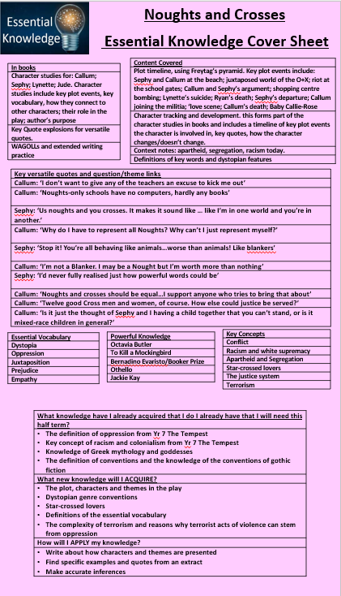
Essential Knowledge Sheets
In books at the start of every topic per subject.
Explicitly shares what students are expected to acquire and apply.
Supports revision.

Slide 15

Assessment Milestones
At TKS, you will often hear your teachers talk about your ‘learning journey’ and the key bits of ‘essential knowledge’ you will learn as you move through school.
When the moment comes for your teacher to stop more formally check what you have learned, we call these ‘Assessment Milestones’. They help you and your teacher to know that your learning is progressing in the right direction.
Moving forward, you will be reminded when these are coming up in these messages.
Notes:
Read to form

Slide 16
Achievement: Year 7
Upcoming ‘Milestone Assessments’
Subject | Topic | Dates & Details
Maths | Equality & Equivalence HT1 Skills check | Week beginning 14/10
English | ‘The Girl of Ink and Stars’: Retrieval and Inference | Week beginning 14/10
Religious Education | Arguments for and against God’s existence | Week beginning 14/10
Science | Cells & Systems OR Particles & Matter OR Force & Motion | Week beginning 14/10
Notes:
Read to form

Slide 17
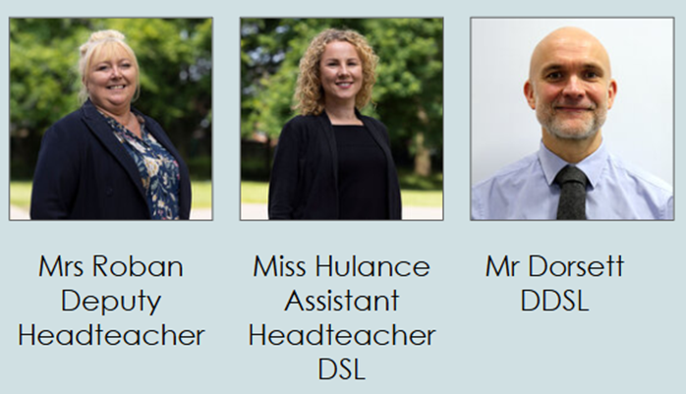

Safeguarding and Wellbeing
Three core staff: Mrs Roban, Miss Hulance, Mr Dorsett; plus Pastoral team; form tutors; all teachers and support staff.
Contactable via: safeguarding.team@kingsway.stockport.sch.uk.
Students can speak to us through Welfare station (breaks).
We have an anonymous reporting system: Whisper.
MHST - five hours per week - universal and targeted support.

Slide 18

Personal Development:
Philosophy, Politics and Economics (PPE)
EXTRACT FROM CURRICULUM INTENT: Politics, Philosophy and Economics (PPE) at The Kingsway School is a multidisciplinary subject area that incorporates both RSHE, citizenship and careers through a reflective and philosophical lens. At The Kingsway School, we believe the study of PPE is important because it helps our young people understand their place in society, encourages them to question the world around them as well as supporting them to make safe and responsible decisions. Our PPE curriculum is an aspirational feature of our whole school curriculum because it enables students to study an academic discipline which is also offered by the leading universities in the UK. | The course is also studied in leading British universities such as Oxford or Cambridge.

Slide 19




Philosophy, Politics and Economics (PPE)
Politics, Philosophy and Ethics at TKS: Our SIX Knowledge Domains
Wellbeing & Morality | Navigating the Modern World | Respectful Relationships
Citizenship & Community | Social and Emotional Learning | Preparing for the Future

Slide 20



Personal Development: Golden Threads
RELATIONSHIPS | FINANCIAL MANAGEMENT | HEALTHY BODY AND MIND
SAFETY, INCLUSIVITY AND CAREERS | RIGHTS, DEMOCRACY AND RESPONSIBILITY | CULTURAL UNDERSTANDING
DIVERSITY AND REPRESENTATION | ONLINE SAFETY | PHYSICAL, INTELLECTUAL, EMOTIONAL, SOCIAL
Notes:
EHU

Slide 21

Personal Development: Rights Respecting Schools
UNICEF UK works communities around the world to help children have the best possible childhood and empower them to know about and claim their rights (health, education, protection, non-discrimination etc.) while respecting the rights of others.
A school where children learn about rights, rights are respected, promoted and protected by everyone.
ABOUT the rights set out in the United Nations Convention on the Rights of the Child​
THROUGH rights so that everyone respects the rights of others so that everyone feels included, respected and safe. ​
FOR the rights of others so that we stand up for rights and help make our school, our local and our global community a fairer place.​
In Rights Respecting Schools students have a real say in what happens in school. ​They are treated with dignity and mutual respect is at the heart of becoming a RRS. ​
Learning about the CRC and rights in our lessons, assemblies and special events.
Exploring what ‘respect’ means and how adults and young people model it everyday
Looking for ways in which students can be actively involved in decision- making in school
Notes:
EHU

Slide 22
Personal Development:
Cultural Diploma
All students are given the opportunity to develop all aspects of their character by working towards the ‘TKS Cultural Diploma’.
This is an award unique to our school that requires our students to work towards challenges that bring together aspects of our academic curriculum, our culture of ‘Ready, Respect, Safe’, our opportunities for wider enrichment and our vision for all students to be compassionate individuals who contribute positively to society.
The key elements of ‘The Kingsway Cultural Diploma’:
In all year groups at Key Stage 3, students have a meeting with their form teacher or a senior leader to present their diploma achievements and discuss which diploma pathway they are likely to achieve at the end of the academic year.
Curriculum Requirement
Careful Reading Requirement
Community Contribution Requirement
Ready-Respect-Safe Requirement
Enrichment Requirement
Cultural Requirement
Diversity Requirement
Notes:
EHU

Slide 23
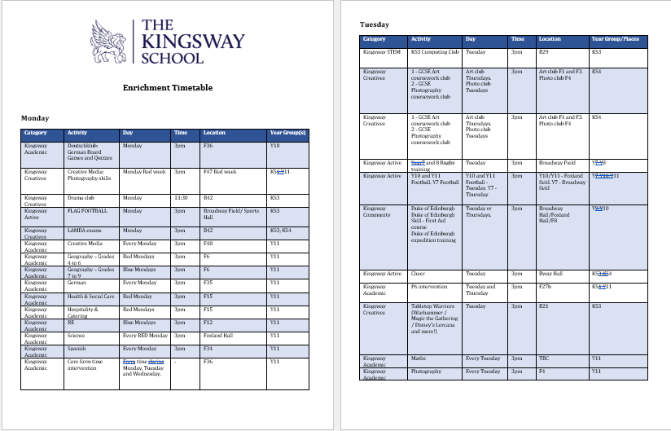
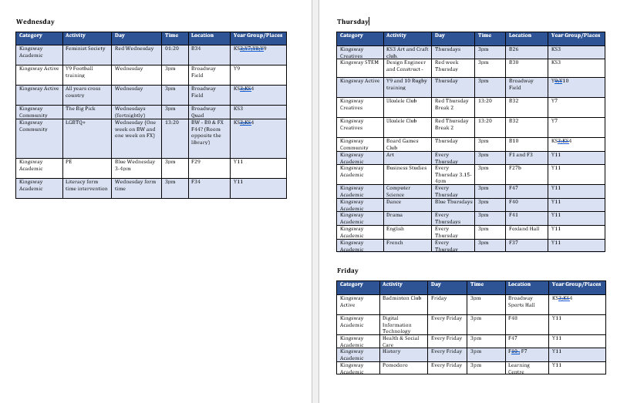
The Enrichment Timetable
This can be found on our website via the link below.
It is also on display in form rooms and some clubs have posters around school.
It will be revised regularly and updated every half term.
New clubs will be promoted on the key messages each week.
https://thekingswayschool.com/curriculum/enrichment
Notes:
Enrichment sits at the heart of a rounded education. It gives our students the chance to discover passions beyond the classroom, whether through sport, the arts, clubs, or wider opportunities. These experiences build confidence, resilience and creativity, helping young people to see themselves as part of a wider community and preparing them for life beyond school.

Slide 24
Student Leadership
We have a Broadway and Foxland Campus Leadership Team.
This has created over 100 student leadership opportunities across the school, including:
Head Students
Deputy Head Students
Heads of House
Deputy Heads of House
Prefects
Form Captains
Sports Leaders
Anti-Bullying Ambassadors
Primary Ambassadors
Mental Health Ambassadors
Notes:
Student leadership empowers our young people to have a voice, to take responsibility, and to make a genuine difference in their school. Through roles the wide range of roles we offer, students learn teamwork, organisation and communication – skills that will serve them in their education and future careers. It also ensures that our school culture is shaped by the students themselves.

Slide 25
Careers Information, Advice & Guidance
Subject curriculum links to careers
‘Preparing for the future’ domain in KS3 PPE lessons
Enrichment Activities
Online careers platform - Unifrog
Careers Fair - 13th November 2026
Year 9 Options
Career Insights Programme
Student Leadership Programme
Stockport Youth Summit
Notes:
Our careers programme is about raising aspirations and opening doors. From the earliest years at The Kingsway School, we want students to understand the wide range of opportunities available to them and the pathways they can take to get there. By connecting learning in the classroom to the world of work, we help our students to see purpose in their studies and to make informed choices about their futures.

Slide 26
Communication
Letters home and key messages
Class Charts
Parent Information Evenings
Parent Consultations
Parents Evenings
If you have a question or concern about your child, please contact your child’s Form Tutor in the first instance via email.
Notes:
Clear, timely communication means we can celebrate successes, address concerns quickly, and ensure your child feels supported both at school and at home.

Slide 27
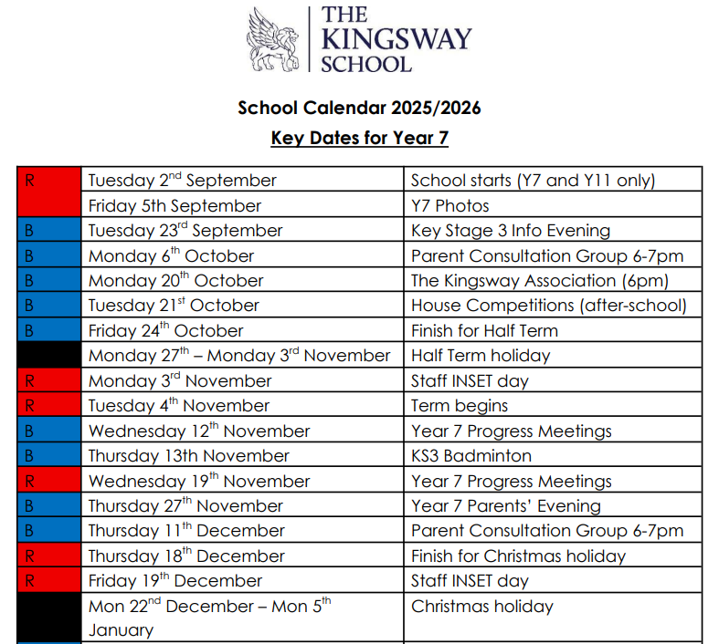
Key Dates
https://thekingswayschool.com/parents/our-calendar
Year 7 Key Dates
https://files.schudio.com/the-kingsway-school/files/documents/Y7_Key_Dates_2025-26(1).pdf
Year 8 Key Dates
https://files.schudio.com/the-kingsway-school/files/documents/Y8_Key_Dates_2025-26.pdf
Year 9 Key Dates
https://files.schudio.com/the-kingsway-school/files/documents/Y9_School_Calendar_overview_of_key_dates.pdf
Notes:
To help you plan ahead and support your child through important moments in the school year we have the key dates for each year group on our website. These include parents’ evenings, enrichment events and other opportunities where we celebrate progress and achievement.

