Slide 1


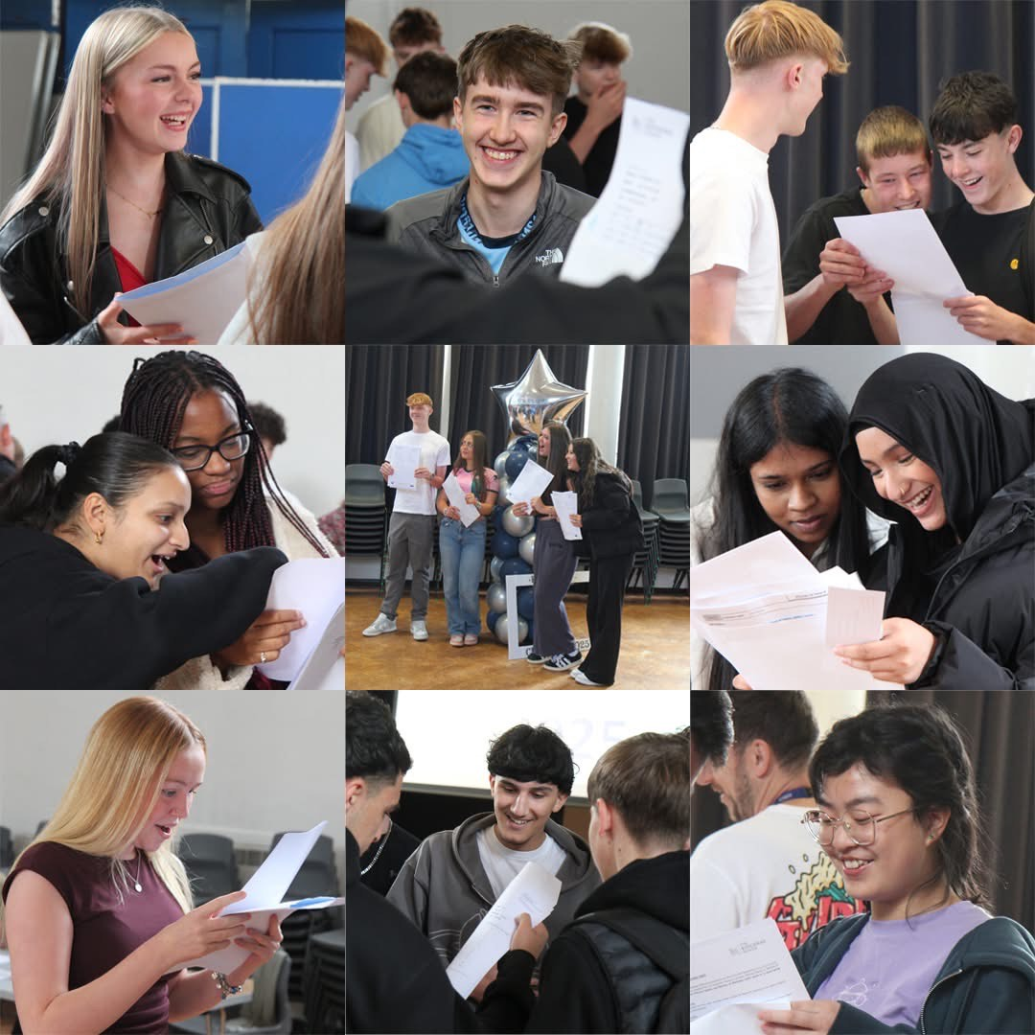

Slide 2


YEAR 11 ASSEMBLY:
THE ROAD TO GCSE
CLASS OF 2026
FIRST GCSE EXAM: 1ST MAY
FIRST EXAM FOR ALL: 11TH MAY
130 DAYS (APPROX)
26 SCHOOL WEEKS
(32 WEEKS INCLUDING HOLIDAYS)

Slide 3
YEAR 11 ASSEMBLY:
THE ROAD TO GCSE
THE LAST DAY IN SCHOOL WILL BE
JUNE 18TH 2026

Slide 4



YEAR 11 ASSEMBLY:
THE ROAD TO GCSE
Today you will hear about a range of opportunities to support you academically.
TKS has a history of success. Our alumni have gone on to:
Get ‘straight 9s’ and A*A*A*A* at A-Level
Top colleges in Greater Manchester
The best universities (including Oxbridge)
High Quality Apprenticeships
Successful Employment
Financial and Moral Success

Slide 5


Class of 2025 are record breakers:
YOU WILL BE TOO.
 | 2019 | 2023 | 2024 | 2025
Basics 4+ | 71% | 68% | 65% | 72%
Basics 5+ | 48% | 44% | 42% | 51%
Equal highest results at 4+.
Highest ever at 5+
Improvement of 9% at 5+

Slide 6


YEAR 11 ASSEMBLY:
THE ROAD TO GCSE
What if I said that your exams are like:
A RACE
Or
A COMPETITION

Slide 7

YEAR 11 ASSEMBLY:
THE ROAD TO GCSE
EXAM GRADE BOUNDARIES ARE SET USING A ‘FIRST PAST THE POST’ SYSTEM.
STUDENTS ARE LITERALLY RANKED AND THEN THE GRADES ARE AWARDED.
EXAMPLE:
MATHS
GRADE 7
2017: 124
2018: 137
2022: 126
2024: 137
2025: 156

Slide 8

YEAR 11 ASSEMBLY:
THE ROAD TO GCSE
GRADE 9: TOP 5% OF CANDIDATES
GRADE 7: TOP 21% OF CANDIDATES
GRADE 5: 50% OF CANDIDATES
GRADE 4: TOP 67% OF CANDIDATES
NOT EVERYONE THAT SITS THEIR GCSEs WILL PASS.

Slide 9
YEAR 11 ASSEMBLY:
THE ROAD TO GCSE
YEAR 11s throughout the country have started:
Training
Practicing
Working
Revising
Focusing
Learning
THEY WANT THE GRADES TO PREPARE THEM FOR THEIR FUTURE.

Slide 10





YEAR 11 ASSEMBLY:
THE ROAD TO GCSE
98%
ATTEND SCHOOL | BE LEARNING FOCUSED | GIVE 100% IN CLASS
ATTEND EXTRA CLASSES | REVISE KEY KNOWLEDGE | REHEARSE & PRACTICE

Slide 11

Attend to Achieve

Slide 12

YEAR 11 ASSEMBLY:
THE ROAD TO GCSE
ASSESSMENT MILESTONES
PPE 1: BEFORE CHRISTMAS
PPE 2: FEBRUARY - MARCH
RESPONDING TO FEEDBACK IS THE #1 WAY YOU WILL MAKE PROGRESS.
MILESTONES: HOW WILL YOU KNOW WHERE YOU ARE IN THE RACE?

Slide 13




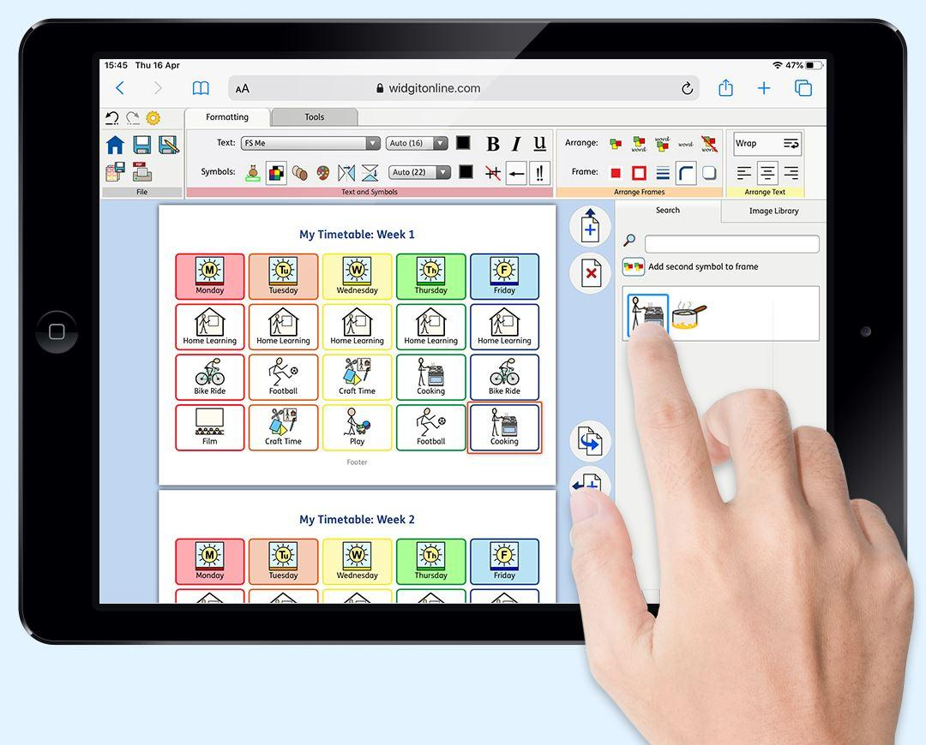

YEAR 11 ASSEMBLY:
THE ROAD TO GCSE
ENHANCED STUDY: WHAT ELSE IS ON OFFER
PERIOD 6 | FRIDAY POMODORO | STUDY CENTRE LAUNCH
MENTORING | INDEPENDENT STUDY SUPPORT | BOOSTER CLASSES

Slide 14
YEAR 11 ASSEMBLY:
THE ROAD TO GCSE
Period 6
Ran by subject teachers
Monday - Friday
After School
‘Priority’ for some
Open to all
Limited places

Slide 15
YEAR 11 ASSEMBLY:
THE ROAD TO GCSE
CORE OFFER
MONDAY | SCIENCE
TUESDAY | MATHS
THURSDAY | ENGLISH

Slide 16
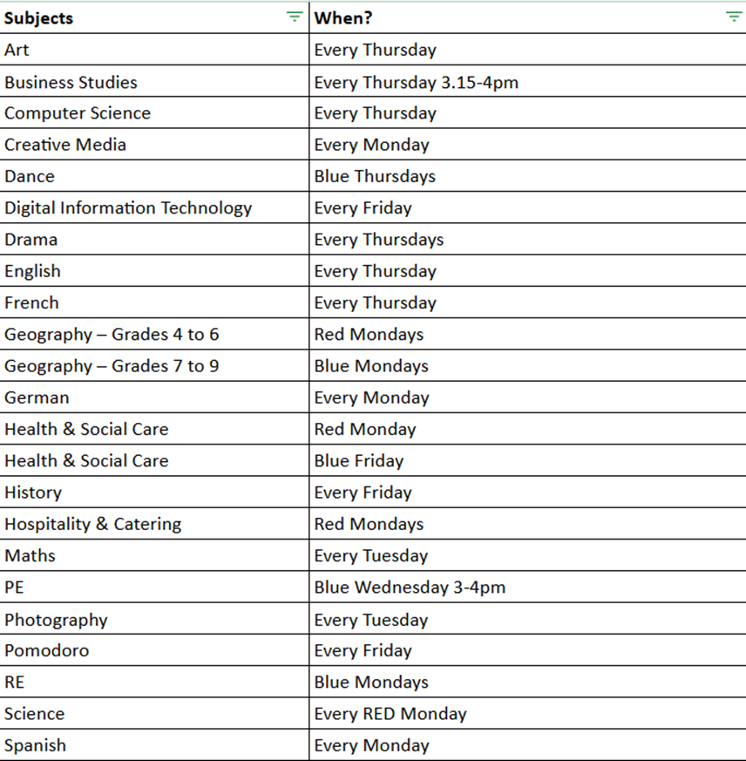
FULL
PERIOD 6 OFFER

Slide 17
YEAR 11 ASSEMBLY:
THE ROAD TO GCSE
Pomodoro Fridays:
1 hour after school
Revision Technique
Timed revision sessions
Independent Study
Bring Resources
REGULAR REVISION SUPPORTS WITH LONG TERM MEMORY

Slide 18
YEAR 11 ASSEMBLY:
THE ROAD TO GCSE
KEY STAGE 4 STUDY CENTRE:
COMING SOON
SILENT STUDY SPACE
FRIDAY POMODOROS
OPEN UNTIL 4PM
OPEN AT LUNCH TIMES
MINI-LECTURE SERIES
REVISION RESOURCE BANK

Slide 19

Revision
ACQUIRE A KEY WORD: | REVISION
DEFINITION: Going back over what you already know to ‘make it stick’ and working out what you are less sure on and need to learn. | ETYMOLOGY: From Latin. ‘Re’ meaning ‘repeat’ and ‘vision’ ‘to see’. Literally, to ‘repeat seeing’.

Slide 20
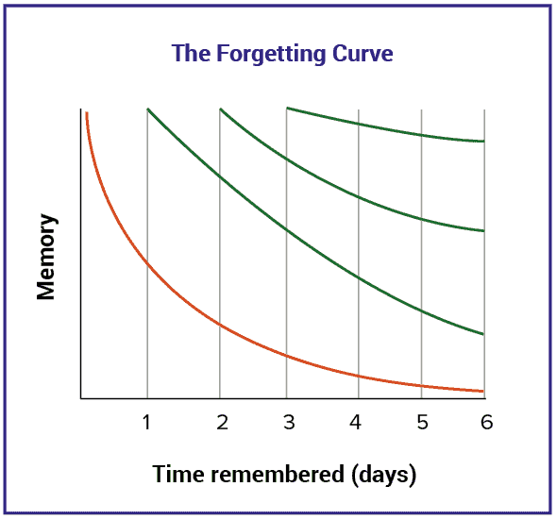
Revision
The working-memory is where new information is held. If not committed to long-term memory, new information can be easily lost and forgotten.

Slide 21

Revision
Plan revision for the long-term memory:
Look at Essential Knowledge Sheets:
What can you retrieve and recall?
What can’t you retrieve and recall?
Plan revision around the ‘red’ and ‘amber’ topic areas first.

Slide 22
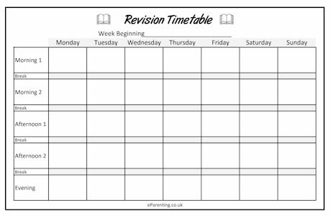
Revision Techniques
Revision timetables - advice for students
Prioritise your topics
Block out any commitments
Compile your timetable
Schedule breaks

Slide 23




Revision Techniques
Quizzes

Slide 24
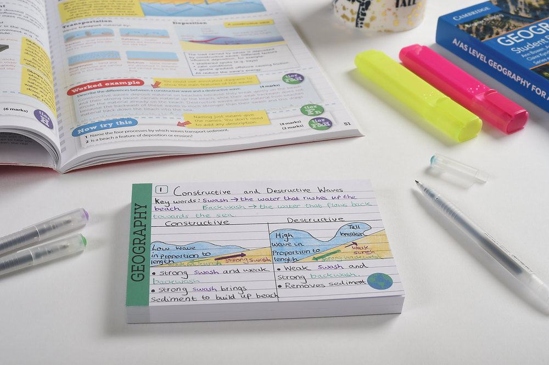

Revision Techniques
Revision cards

Slide 25
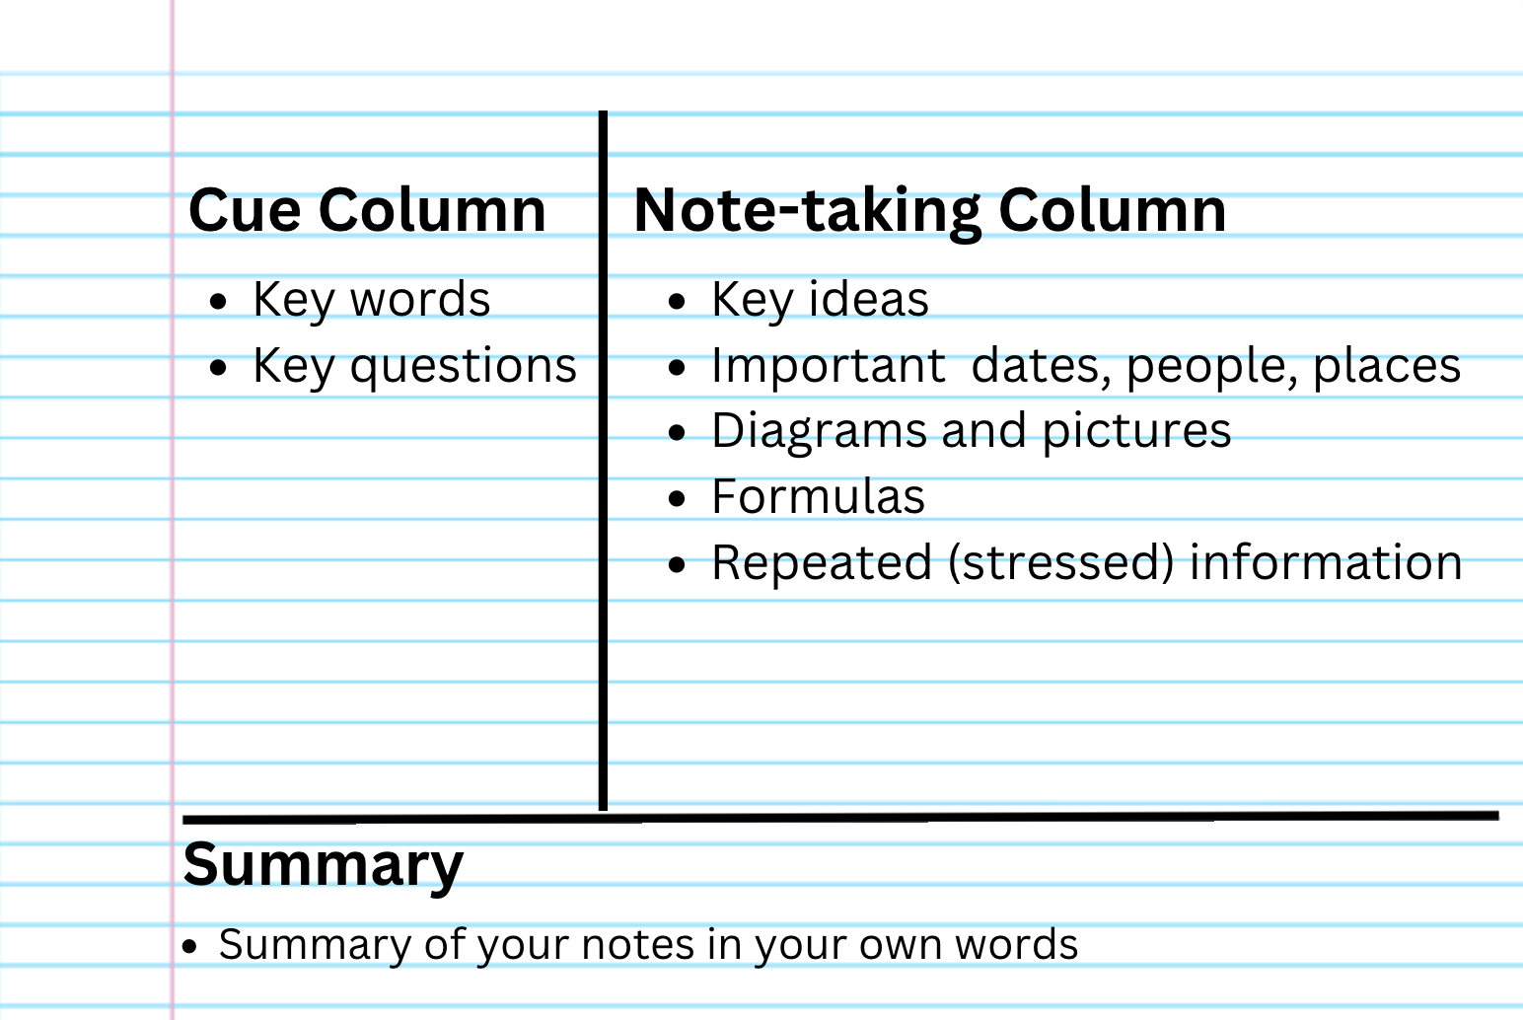
Revision Techniques
The Cornell Method

Slide 26
Preparing for the future
Year 11
September: College assemblies.
September - July : College taster sessions (Open Evenings).
September - Easter : Careers advice meetings.
October : Form tutor references are written.
October - January : College applications are submitted.

Slide 27







College Open Days

Slide 28

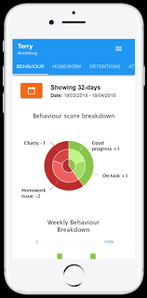
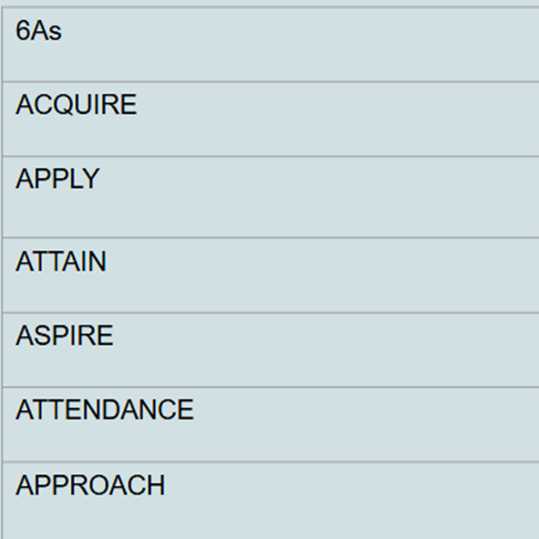
Behaviour and Culture
Year 11 are TKS Role models and set the standard for all younger students.
Our expectations are high, at TKS all year 11 students should model excellent Ready, Respect & Safe behaviour whilst demonstrating our core values.
Behaviour and attendance records are requested from colleges and apprenticeship programmes.
Exemplary behaviour and attendance will be celebrated at every opportunity.
You can monitor your child's behaviour daily through the classcharts parent app
TKS records approach to learning and attendance through the 6 a’s

Slide 29







The Cornerstone Curriculum at TKS: Half-term One Our six themes
Vision and Values | Respectful Routines | Respecting Others
Managing emotions and coping with change | Restorative conversations to bring about change | Online Behaviour and Digital Etiquette
Are you fully engaged as a learner?
Do you have an exemplary learner profile?
Do you recognise why these learning behaviours are taught?
Notes:
The Cornerstone Curriculum allows Year 11 students to understand why we do things things the TKS way. It is taught largely via your child’s form tutor and allows for rich discussion around one self and how to manage the demands of Year 11. As we progress through the curriculum, Year 11 students will be supported in key areas of school life so they are confident learners even under pressure and can cope with the demands which Year 11 brings them.

Slide 30


Behaviour and Culture: Exam Behaviour
Notes:
Use of AI for exams or inappropriate exam conduct online can result in disqualification, it is important that everyone is aware of the rules around AI, and internet use.

Slide 31
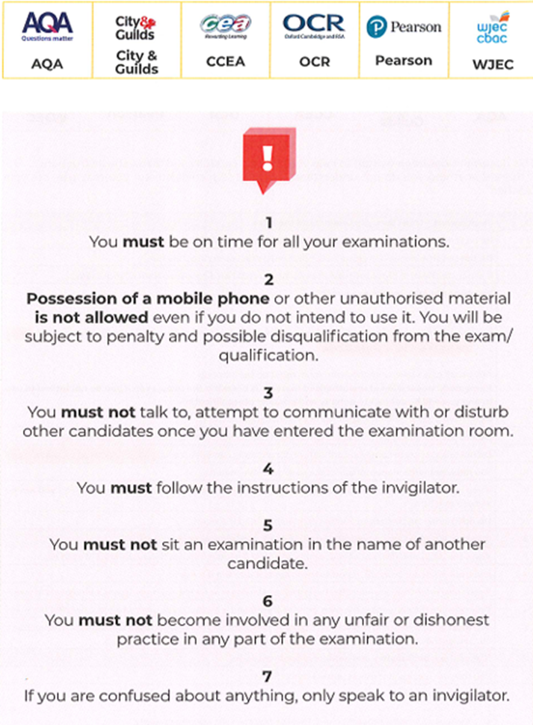

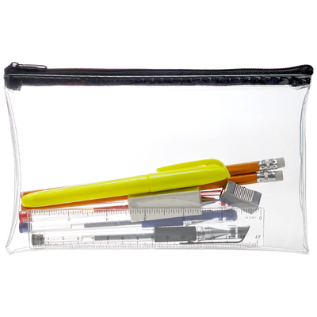
Behaviour and Culture: Exam Behaviour
There are strict regulations to adhere to in GCSE exams.
These will also be in place for all mock exams.
Please support with exam season preparation by helping your child to be fully equipped, in full school uniform and clear on the expectations.
Notes:
Exam expectations are set and modelled throughout all exams inclusive of Mocks

Slide 32

Year 11
Prom Passport
18th June: Stockport County
Every student is invited to attend but they will be required to achieve a pass in their Prom passport to guarantee a place.
Students will need to achieve points in several areas including attendance, behaviour and period 6 attendance.
It will be a points based passport so every point matters! We want everyone to attend and achieve success.
The first leg of the race has begun and launches the prom passport; criteria will be shared with students shortly about how to secure their ticket to Prom.

Slide 33
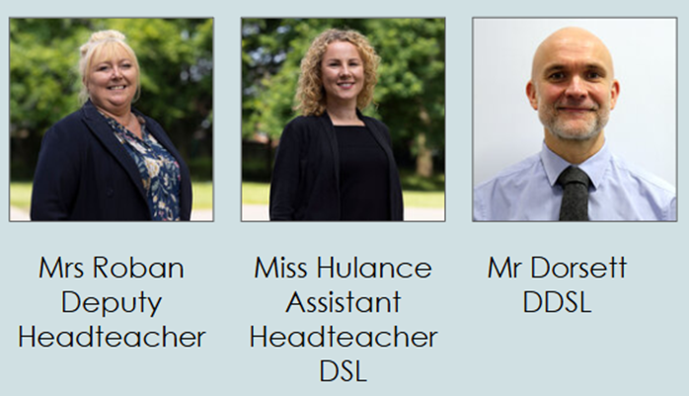
Safeguarding & Wellbeing
Three core staff: Mrs Roban, Miss Hulance, Mr Dorsett; plus Pastoral team; form tutors; all teachers and support staff.
Contactable via: safeguarding.team@kingsway.stockport.sch.uk.
Students can speak to us through Welfare station (breaks).
We have an anonymous reporting system: Whisper.

Slide 34

Exam Wellbeing
Universal: ‘Wellbeing and Morality’ strand of PPE. This term: lessons on values and motivation; reframing negative thoughts about exams and future plans.
Targeted support:
2) MMU Psychology students delivering small group sessions on mindfulness/anti-anxiety to support exam skills and recall.
MHST professional in school. Will be present for parent/carer support at Y11 Parents’ Evening.
Contact the Safeguarding team if you are concerned.

Slide 35





Enrichment
Beyond our classrooms, we strive to develop our learners as a whole by creating meaningful enrichment opportunities. In Year 11, it’s about giving students balance, purpose and opportunities to develop the wider skills that will support their success in exams and beyond.
To facilitate this we have categorised our enrichment offer into 5 domains:
ENRICHMENT AT TKS
KINGSWAY ACTIVE | KINGSWAY CREATIVES | KINGSWAY STEM | KINGSWAY ACADEMIC | KINGSWAY COMMUNITY
Sport The Arts Sci/DT/Maths Interventions/P6 Leadership/Charity
Notes:
JSA

Slide 36
The Enrichment Timetable
The full enrichment timetable will be published on our website next week and can be found via the link below.
The Enrichment timetable will also be on display in form rooms and some clubs have posters around school.
It will be revised regularly and updated every half term.
New clubs will be promoted on the key messages each week.
https://thekingswayschool.com/curriculum/enrichment

Slide 37
Year 11
Access Arrangements
You will have been notified if your child has been granted access arrangements in exams. Please encourage them to use the adjustment(s) and discuss with you if they need further adjustments.
Access arrangements will be used in the forthcoming mocks.
This will allow students to:
practice the arrangements, so that they do not become a barrier to success in May/June.
provides proof of the need and normal way of working. Without this, approval for the arrangements in GCSE’s cannot be gained from the JCQ.
Please check that your child feels they know what their arrangements are and how to use them. Any queries or concerns, please get in contact with the Exams Team.
Notes:
KCL

Slide 38

Have you got any “gently used” uniform?
Maybe KS3 items?
If so, please send them in a bag, labelled “Pre Loved” (to Foxland Reception with your child).
We will wash and redistribute after half-term.
You may also benefit from this swap.

Slide 39


