Slide 1

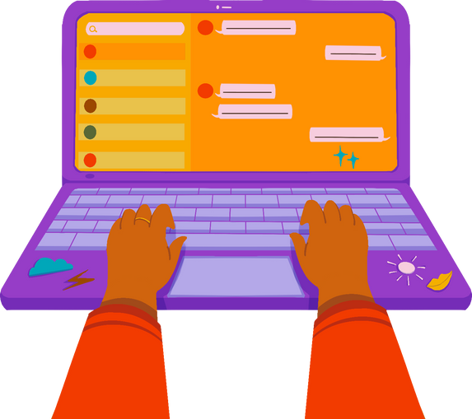

January 2023 Online Safety Update.
This month's Online Safety theme is 'Social Media and Mental Health'
As you may be aware, there is lots of evidence to suggest that social media has a negative impact on young people's mental health - particularly girls and young women. This can be linked to several reasons including comparisons with other people's images and updates, pressure to look a certain way, and feeling bombarded with information.
This is no different for children with SEND who may be accessing social media, with or without help from their parents/carers.
There are lots of fantastic things about using social media and it can be a great tool for helping our children to feel less isolated and to keep up with friends and family.
The following video is a really good one from YoungMinds - the mental health charity for young people. Why not try having a watch of this with your child and chatting through the themes mentioned and/or working out how you could support your child's mental health when online.
https://www.youtube.com/watch?v=MO0MX3LCcQg&t=1s
Top Tips:
  limit their time online by using apps and controls such as 'App Limits' which can be found in Settings on an IPhone for example.
  Set a rule that devices cannot be in bedrooms overnight =- so your child gets a rest and a break from social media
  Work with your child to 'Own Their Feed' as mentioned in the video - work out what sort of content makes them feel good, and help
them to follow more of that!
As always, if you have any concerns about your child’s Online Safety (or any other safeguarding matter),
please do not hesitate to contact the pastoral team on 0121 569 7080

