Slide 1
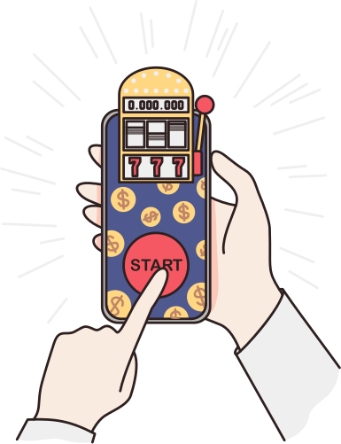


July 2024 Online Safety Update
This month's Online Safety theme is ''Online Gambling'.
Did you know, in a recent survey, it was found that 37% of 11-16 year olds in England and Scotland have gambled online in the last 12 months. Indeed, gambling companies have come under fire for seeming to target their advertising at children, using bright colours, slot-machine style games and even taking out advertising space next to the YouTube videos of influencers who are most popular with young people.
It is illegal for under-18s to gamble in the UK and yet, all children, including children with SEND can be vulnerable to getting into gambling - and potentially racking up hundreds of pounds worth of debt easily.
It's important that your child does not have access to your bank cards as they can use these to easily register on gambling websites. They may not even realise that what they are doing is risky.
Top tips:
1) Talk to your child about the risks of gambling and about how 'the house always wins'.
2) If appropriate, try to give your child some of their own money such as a small amount of pocket money so they can understand
exactly what things are worth
3) Keep your bank cards out of sight and reach so they cannot be used.
4) Download YouTube Kids so that adult advertising is filtered out.
As always, if you have any concerns about your child’s Online Safety (or any other safeguarding matter),
please do not hesitate to contact the pastoral team on 0121 569 7080

