Slide 1
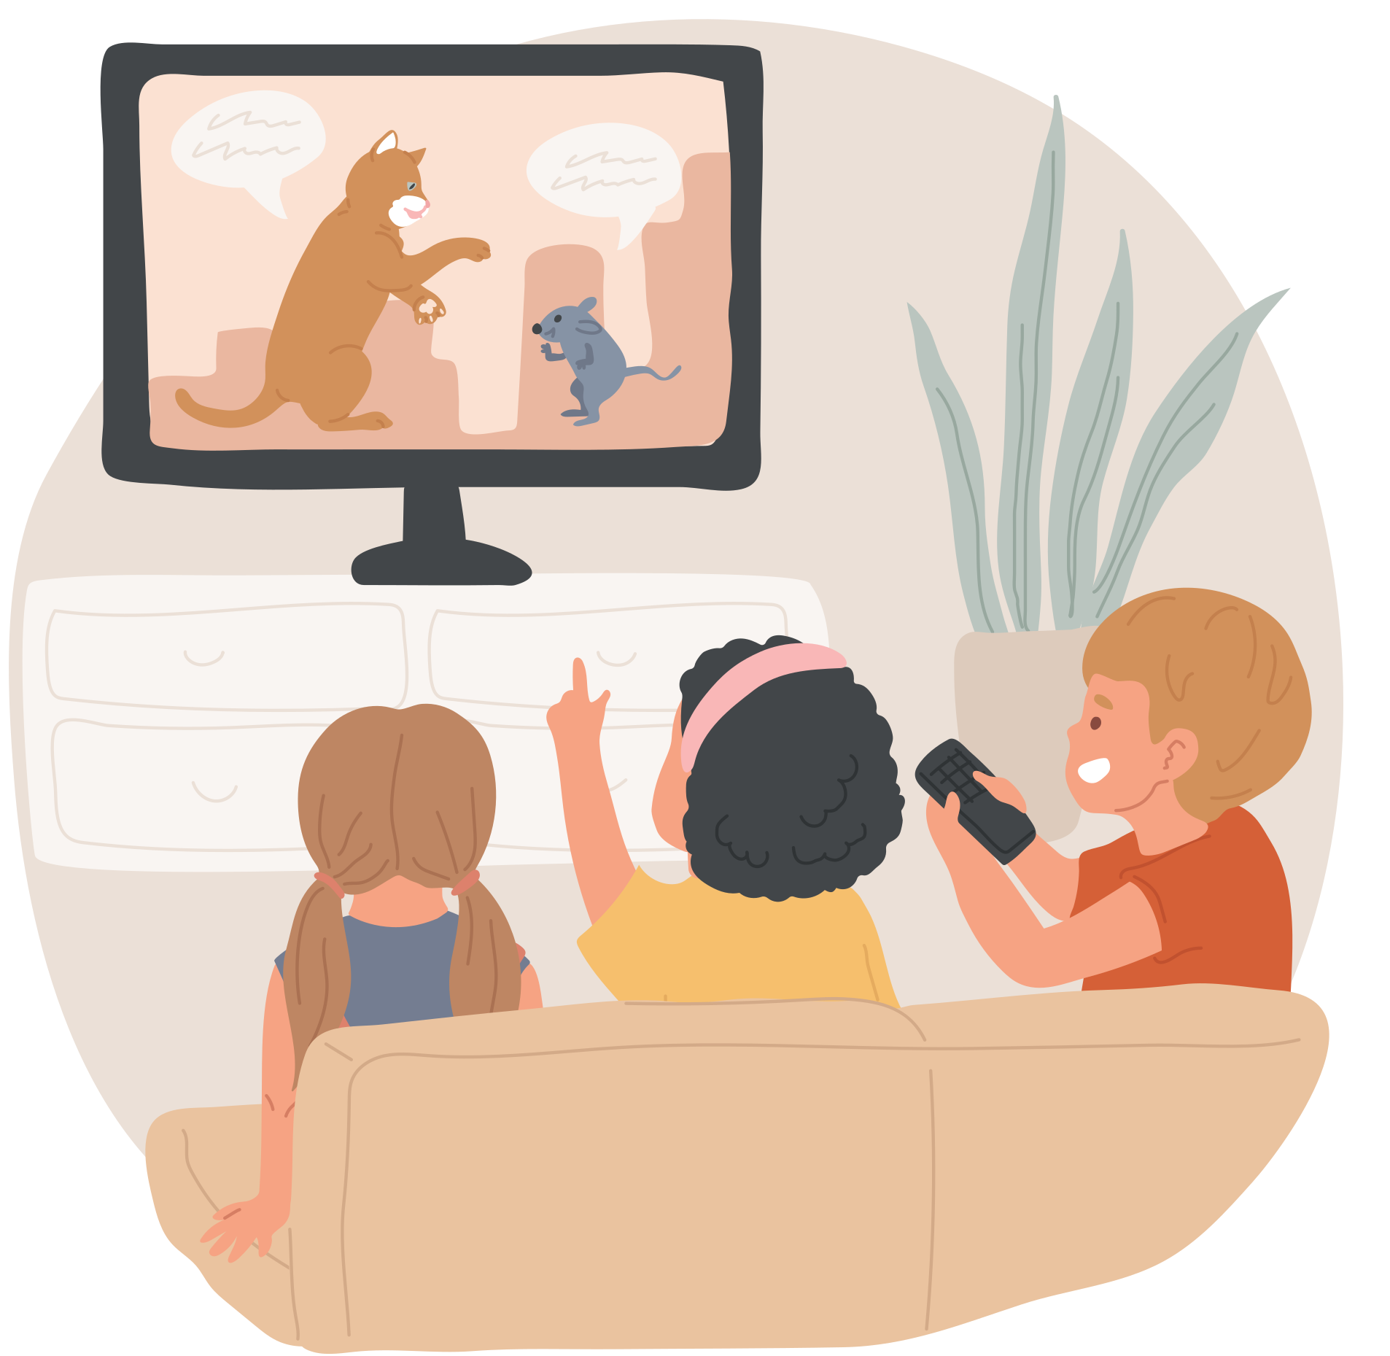


November 2023 Online Safety Update.
This month's Online Safety theme is 'Age-appropriate Content.
As the nights are drawing in, chances are we spend more time inside - hopefully snuggled up on the sofa with some snacks. Your child also probably has their own favourite programmes and online content they like to watch.
It can be difficult to work out what is appropriate for your child - particularly for those with SEND who may have a difference in their chronological age versus their developmental and emotional age. Something that might not bother another child their age could make them feel shocked, scared or confused for example.
Try the following tips for ensuring you are happy that what your child is watching is safe and appropriate for them:
  Download YouTube kids rather than regular YouTube as inappropriate and adult videos are filtered out.
  Try setting up their own kids Netflix account so they are less likely to click on adult programmes
  Check out this website for the PEGI ratings of online and video games - PEGI ratings are like the age certificate for games and can help you to avoid inappropriate, violent or sexual games for example: PEGI game ratings | Parent Zone
  Remember that no filtering service is 100% perfect and inappropriate content can sometimes slip through - the best thing to do is monitor what your child accesses - and talk to them about what they like to watch!
If you have any concerns about your child’s Online Safety (or any other safeguarding matter), please do not hesitate to contact the pastoral team on 0121 569 7080

