Slide 1

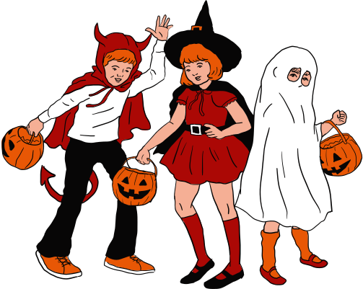


October 2023 Online Safety Update.
This month's Online Safety theme is 'Online Challenges and Pranks'
Many of us may have tried out some online challenges - remember the Ice Bucket Challenge? Many of them are fun, harmless and might even raise money for charity.
However, others on social media can challenge young people to take part in pranks and challenges which can be more risky and even harmful.
Some online pranks and challenges have even sadly led to children losing their lives.
This month, Halloween and the run up to Bonfire Night can sometimes lead young people to do silly pranks. The ability to film and post these on social media can then lead to even sillier pranks being done in the hope of gaining attention, followers and likes.
Why is this relevant for us?
Children with SEND can sometimes lack inhibitions or the ability to think ahead to te consequences of their actions. They may also be more vulnerable to others trying to lead them astray, especially if they struggle with feeling 'different' or feel isolated.
A few top tips:
  Monitor your child when they're out and about trick or treating or attending events
  If they have a mobile or device, ask to regularly check their photos and videos before they post anything online
  Talk to them about the risks of doing silly or dangerous pranks
  If they use social media such as Snapchat or TikTok, try joining yourself so you can see any current viral challenges and support your child to engage in fun, safe ones if they wish to.
If you have any concerns about your child’s Online Safety (or any other safeguarding matter), please do not hesitate to contact the pastoral team on 0121 569 7080

