Slide 1
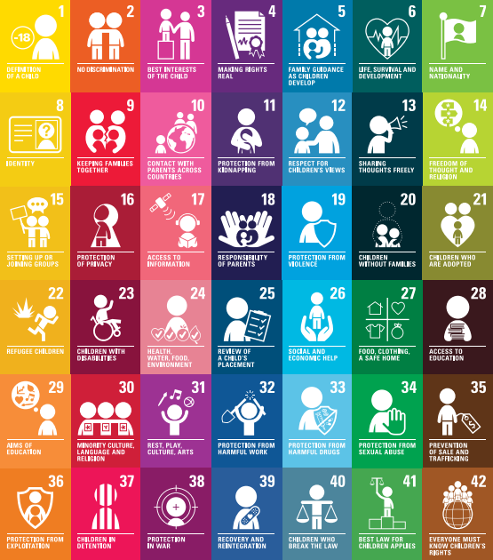

Welcome to our Rights Respecting Schools workshop

Slide 2

Introducing the Rights Respecting Schools Award and our journey so far

Slide 3
What is the Rights Respecting Schools Award?
The Rights Respecting Schools Award (RRSA) is an initiative by UNICEF that aims to put children's rights at the heart of schools. The award acknowledges schools that promote understanding of the United Nations Convention on the Rights of the Child (UNCRC) and demonstrate a commitment to ensuring rights are respected in the school environment.
The Convention has 54 articles in total. Articles 43–54 are about how adults and governments must work together to make sure all children can enjoy all their rights.

Slide 4
UNICEF AND THE UN CONVENTION ON THE RIGHTS OF THE CHILD
Unicef is the world’s leading organisation for children and their rights
UNCRC is a universally agreed set of non-negotiable standards and obligations, built on varied legal systems and cultural traditions​
​

Slide 5

Children’s rights are fundamental to their development and wellbeing. Understanding these rights encourages schools to create safe and inclusive environments. By embedding these principles, schools foster respect, dignity, and a sense of belonging among all students, which is essential for effective learning.
The Importance of Children's Rights
Article 29 – Aims of Education

Slide 6
Why implement RRSA?
RRSA is not just‘another award’
It is a catalyst for further school improvement
It will support us to move to a Rights Based Approach
The whole school community will learn about rights…..through rights……..and for rights
It provides a platform for learning about global citizenship and sustainable development

Slide 7

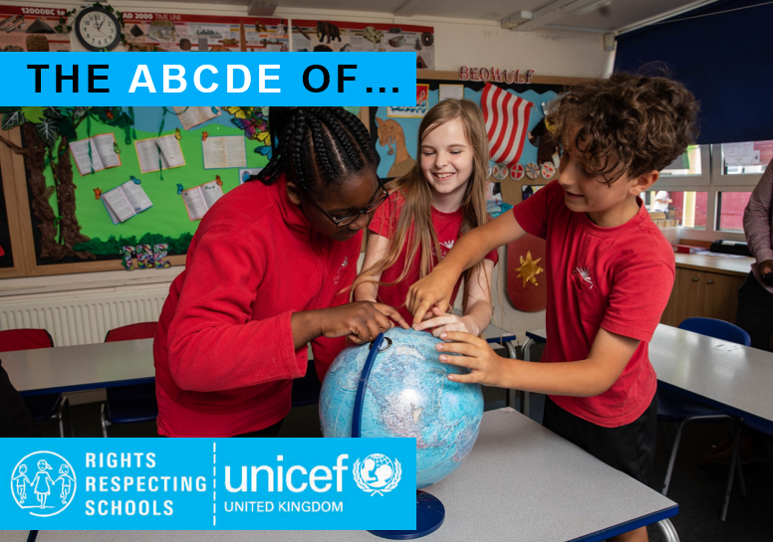
A, B, C, D, E of Rights
Rights are for All Children - Universal
Rights are there at BIRTH - Inherent
Rights CANNOT be taken away - Inalienable
Rights DO NOT have to be earned - Unconditional
All Rights are EQUALLY important - Indivisible

Slide 8




Key Principles of RRSA
The four key principles of the UNCRC
Non-discrimination – Article 2
Best Interests of the child – Article 3
Life, survival and development – Article 6
Participation – Article 12

Slide 9
Assessment Criteria for Silver Award
To achieve the Silver Award we have to:
Demonstrate that the principles of the UNCRC are embedded across the school
Involve pupils in decision-making
Ensure all staff receive training
Ensure rights are respected and promoted within our curriculum

Slide 10

The Journey​ TO SILVER so far…………
Bronze Rights Committed School – October 2023
Rights Respected articles embedded into planning
Rights Respecting articles linked to assembly themes
RRS linked to school values

Slide 11
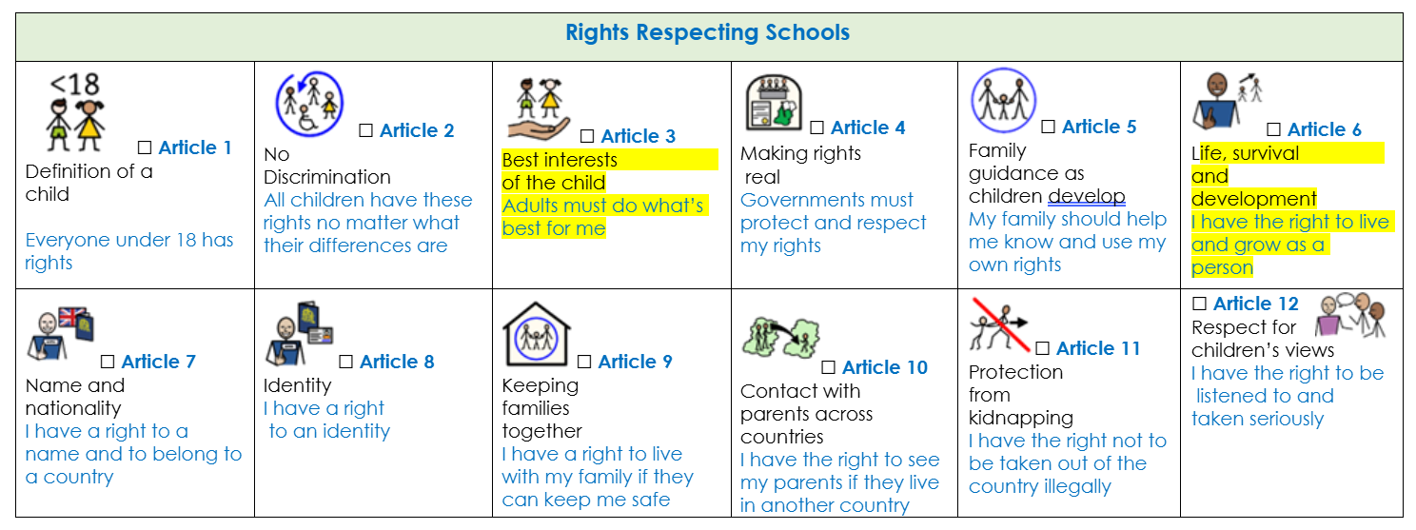
Rights are captured in Schemes of Work and Medium Term Planning

Slide 12
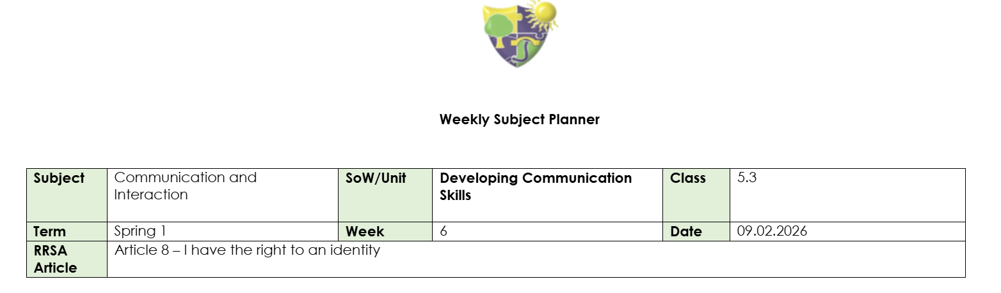
Rights are also captured in weekly English and Maths planning

Slide 13
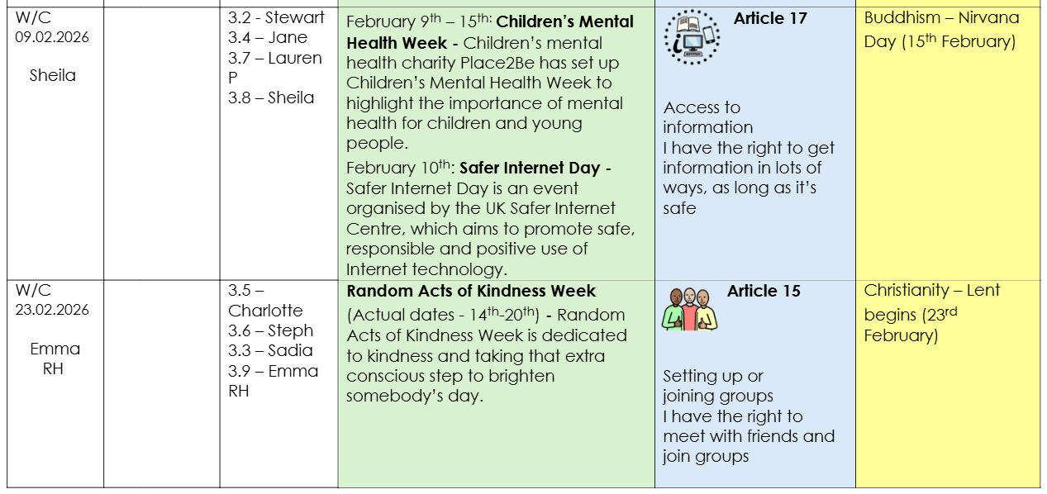
Example of our Assembly plan including Rights

Slide 14







The Meadows School – Rights Respecting School
We work collaboratively to ensure children’s rights are learned, taught, practiced,
respected, protected and promoted. Young people and
the school community learn about children’s rights by
putting them into practice every day.
Our rights respecting approach ensures a sense of security as the language and
behaviour is used and communicated consistently throughout the school.
Through teaching children about their rights, we aim to support our learners to be confident, happy individuals who are able to make informed, independent decisions around all things that affect them.
We teach about rights to provide our students with a wider and deeper understanding of the world in
which they live so that they develop understanding and respect of religions, cultures,
beliefs and abilities different to their own.
Through embedding children’s rights we aim to Increase levels of respect for each other, leading to
improved relationships with other pupils and with staff.
We ensure that
the UN Convention on the Rights of the Child is at the heart
of our school’s ethos and culture to improve well-being
and develop every child’s talents and abilities to their full
potential.

Slide 15
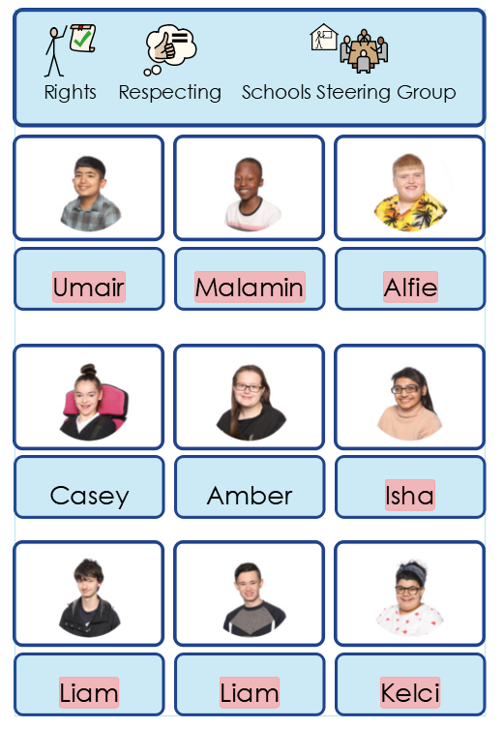
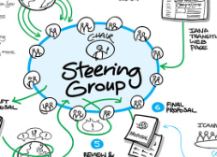
The steering group is a group of studentsfrom across the school
community who lead the schools’ Rights Respecting work.

Slide 16
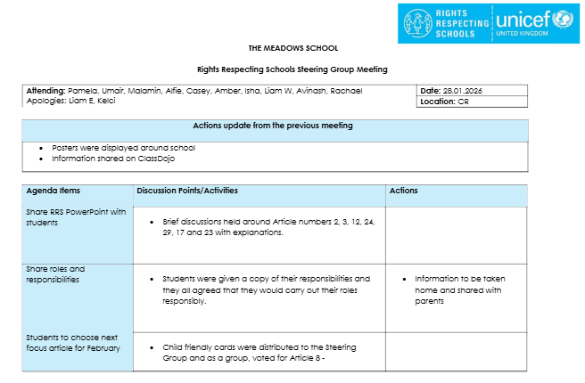
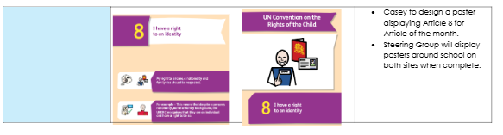
Minutes from last Steering Group
meeting

Slide 17
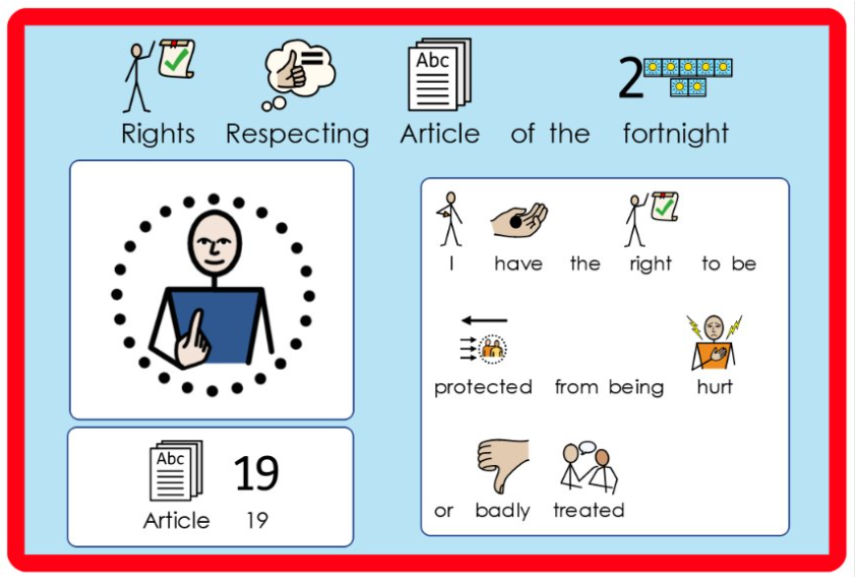
Poster created by members of the Steering Group

Slide 18



Slide 19

Quiz time!

Slide 20
Governments must do all they can to make sure every child can enjoy their rights
True
Every child has the right to do what they want
False
Every child has the right to meet with other children and to join clubs and organisations
True
Every child has the right to an adequate standard of living
True
Every child has the right to reliable information
True
Every child has the right to leisure time
True
Every child has the right to be happy
False

