Slide 1
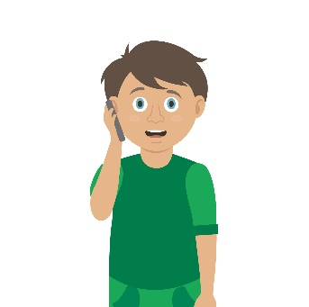
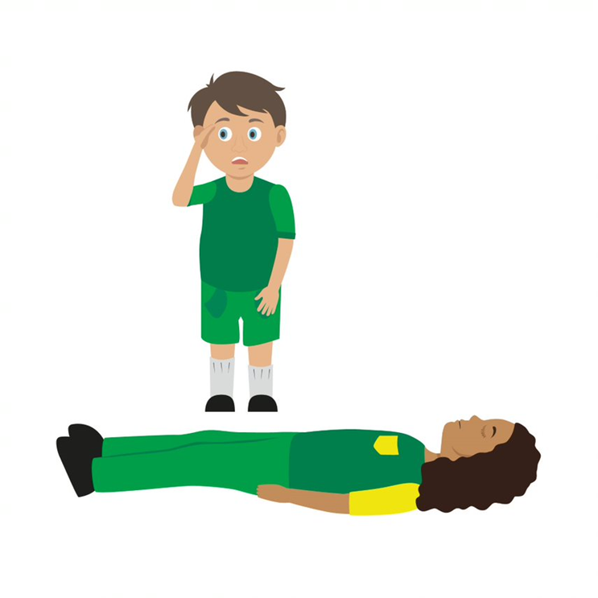

Complete the first aid steps
Number the images to show which step they belong to
Primary Survey
Use your current first aid knowledge to explain what you could do for each of the 6 steps below
Step 1.
Step 2.
Step 3.
Step 4.
Step 5.
Step 6.
NB
At this time do not put your face near to theirs to check for breathing, instead look at chest rising and falling only
If the casualty is not breathing normally call 999/112 then start CPR
If the casualty is breathing normally place them in the recovery position then call 999/112

Slide 2
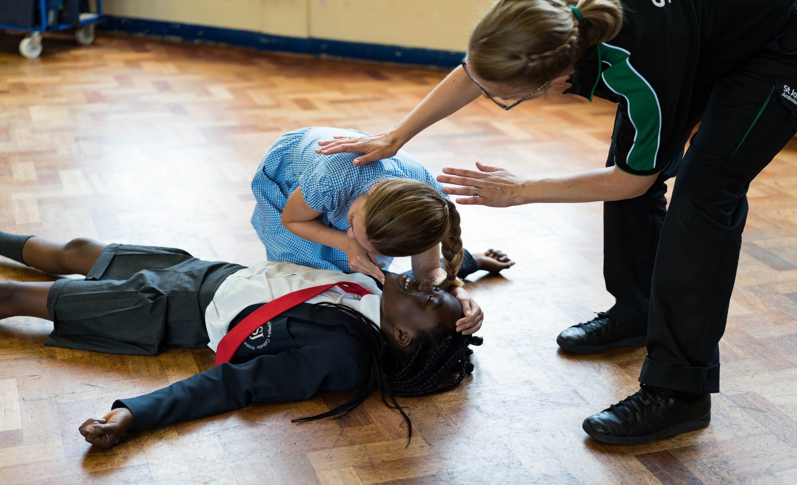

Basic life support
KS2 – Basic life support

Slide 3
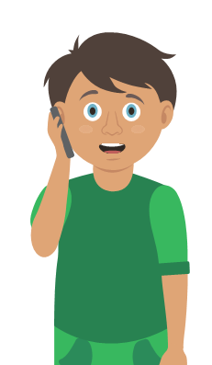
A short course to learn…
How to conduct a Primary survey
How to place an unresponsive casualty, who is breathing normally into the Recovery position
CPR Awareness (only if +year 5)

Slide 4
Learning outcomes
I am able to conduct a primary survey
I can place an unresponsive casualty, who is breathing normally, in the recovery position
I know when and how to deliver CPR to an unresponsive casualty who is not breathing normally
I can seek medical help
Notes:
Teacher should refer to ground rules for the session at this stage

Slide 5
Casualty care A17
There are lots of things to remember when taking care of somebody.
Which three of these casualty care actions do you think are the most important?
Remain calm
Treat the casualty with dignity and respect
Get help
Reassure the casualty
No food or drink
Communicate well
Prevent the condition from worsening
Keep the casualty warm
Notes:
ALL the answers are correct and ALL very important- answers and opinions from students will differ- use material a talking point rather than correct/ incorrect answers.
Card sorting activity can be made if preferred.

Slide 6
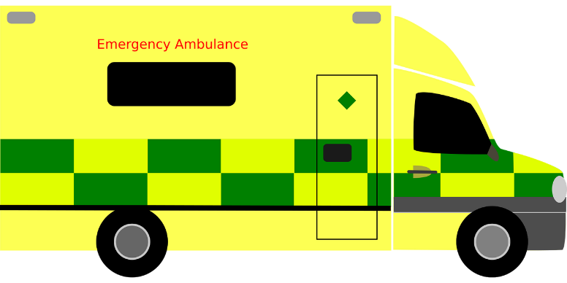
Calling for help
If there is an e_ _ _ _ _ _ _ y you can dial 999 or 112 to get the emergency services
The call operator will ask, “Which service do you require?’’ F_ _ _,
P_ _ _ _ _ or A_ _ _ _ _ _ _ _?
You will need to tell them which service you need
It is really important that you give information to help them arrive at the correct location i.e. address
KS2 - Basic Life Support
Notes:
Options: call out answer or use whiteboards or paper to write answers
Answers
Emergency
Fire, Police or Ambulance

Slide 7

Remember LIONEL
Location. Tell them where the emergency is and where you want them to arrive
Incident. Tell them what has happened
Other services. Do you need more than one?
Number of people that are involved
Extent of the injuries. What types of injuries do people have?
Location. Repeat again where they need to arrive
Question:
Do you know the correct addresses for two or three places you often visit?
KS2 - Basic Life Support
Notes:
Explain the acronym of LIONEL and the importance of this information

Slide 8

999/112 calls
Thumbs up
if the information is
key to a 999/112 call
Thumbs down
if it is not relevant information
  What you had for tea last night
  What happened
  What football team you support
  Where you are
  What is wrong with the casualty
KS2 - Basic Life Support
Notes:
Can be stand up and sit down/ thumbs up / down if needing an energiser to focus group select what works best.
Questions:
Age and gender of the casualty?
What team you support?
Is the casualty breathing?
What’s happened?
How tall you are?
The address of the incident?
Last night’s tea?

Slide 9
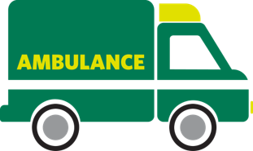
When things go wrong A12
Think of something that may have happened to make someone unresponsive.
Notes:
Explain the heart needs air (oxygen) and it’s a muscle that pumps blood around the body.
What can go wrong to cause a problem to the air and blood circulating? (circulation = "circling" the body)
Brief explanation and onto worksheet
Consider optional activity A13 here – chain of survival

Slide 10
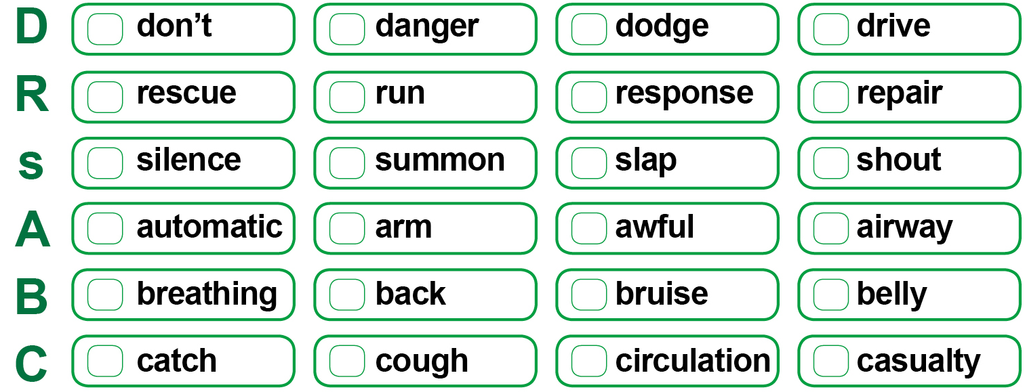
Primary survey
Choose the correct word for each part of the primary survey
Challenge: Why is it important we use DRsABC?
KS2 - Basic Life Support
Notes:
Use the DRSABC to get the students to guess the correct words for the acronym. Can be a hands up/down activity or can be used as a table top activity using A3 laminated sheets and a counters

Slide 11
Primary survey
Check your answers
Challenge: Why is it important we use DRsABC?
KS2 – Basic Life Support
Notes:
Answers to previous slide

Slide 12
Watch this video
https://youtu.be/lCMhuRM0cIU
KS2 – Basic life support

Slide 13
Your turn: Primary survey
1. Check for danger
Always make sure the area is safe
2. Response
Check the casualty’s response. Ask questions and gently tap shoulders. Say “open your eyes!”
3. Shout for help
Anyone nearby can assist you
5. Breathing
Check for normal breathing. Do not put your face next to theirs, instead look at chest rising and falling only. (Remember 10 seconds!)
4. Airway
If not clear, then open by tilting the head back, use one hand on forehead and two fingers under the chin
6. Circulation (only if breathing normally)
Check the casualty for bleeding
NB
At this time do not put your face near to theirs to check for breathing, instead look at chest rising and falling only
If the casualty is not breathing normally call 999/112 then start CPR
If the casualty is breathing normally place them in the recovery position then call 999/112
KS2 – Basic Life Support
Notes:
Scenario cards are available which the teacher can use to make the practical activity relevant in a certain context for students.
Trainer demonstrates then gets the students to practice using either the PP slide as a prompt or the sheet in the workbook. Trainer circulate and correct as necessary

Slide 14

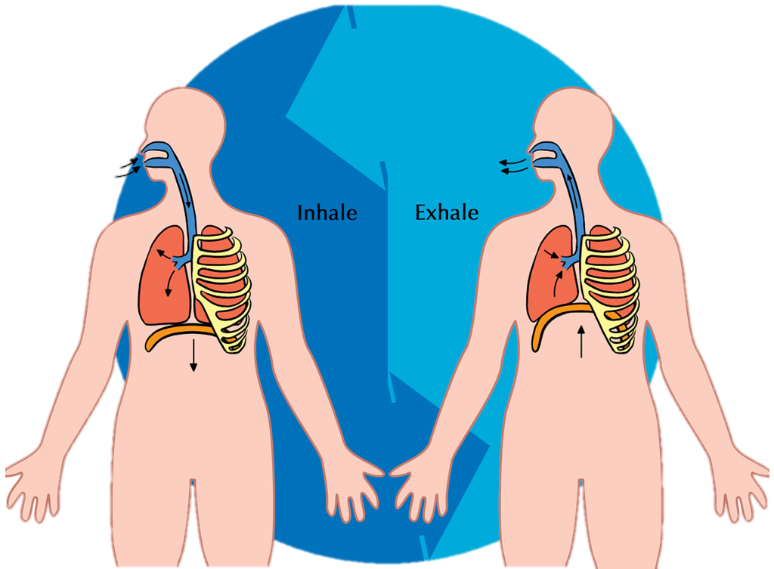
Recap
Danger
Response
Shout
Airway
Breathing
Circulation

Slide 15
Watch this video
https://youtu.be/ubbZU15-ETM
KS2 – Basic life support

Slide 16
Your turn: Recovery position
1. Kneel
By the side of your casualty
2. Angle arm
Put the arm nearest to you to make a right angle. Palm facing upwards
3. Hand to cheek
Bring the arm furthest away across the chest and place the back of their hand against the cheek nearest to you
Hold it there
4. Knee bend
With other hand, bend their far knee up so that the foot is flat on the floor
5. Knee pull
Pull on the knee to roll the casualty towards you onto their side
Adjust them as necessary
6. Ensure airway is open
Recheck breathing
Call 999/112
Stay and monitor casualty until help arrives
KS2 – Basic Life Support
Notes:
Scenario cards are available which the teacher can use to make the practical activity relevant in a certain context for students.
Trainer demonstrates then gets the students to practice using either the PP slide as a prompt or the sheet in the workbook. Trainer circulate and correct as necessary

Slide 17
Watch this video
https://www.resus.org.uk/watch
KS2 – Basic life support

Slide 18
CPR
If you are a young person , you may not be strong enough to do CPR. That’s OK, you can tell someone else what they need to do
It’s important to know that sometimes even CPR cannot help someone if they are really poorly
Anything you can do to help, even just calling for help, will be really useful
Never do CPR on someone if they are awake and breathing normally

Slide 19

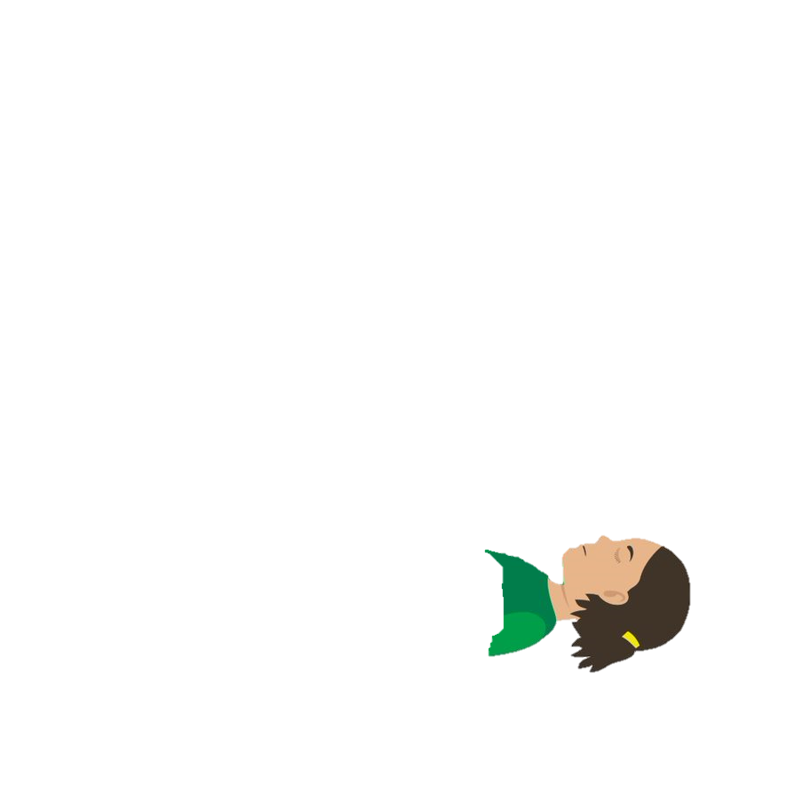

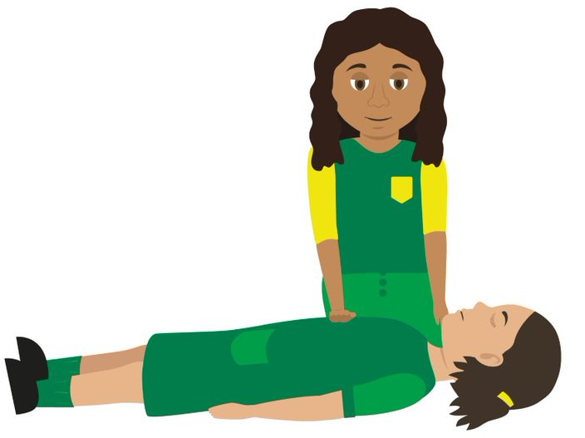

Your turn: CPR
1. If you find someone collapsed, you should first perform a primary survey. Do not place your face close to theirs.
If you have established from this that they are unresponsive and not breathing, you should ask a helper to call 999 or 112 for emergency help while you start CPR. Ask a helper to find and bring a defibrillator, if available.
Ask your helper to put the phone on speaker and hold it out towards you, so they can maintain a 2m distance.
If you are on your own, use the hands-free speaker on a phone so you can start CPR while speaking to ambulance control.
Do not leave the casualty to look for a defibrillator yourself. The ambulance will bring one.
2. Before you start CPR, use a towel or piece of clothing and lay it over the mouth and nose of the casualty.
Start CPR. Kneel by the casualty and put the heel of your hand on the middle of their chest. Put your other hand on top of the first. Interlock your fingers making sure they don't touch the ribs.
Keep your arms straight and lean over the casualty. Press down hard, to a depth of about 5-6cm before releasing the pressure, allowing the chest to come back up.
The beat of the song "Staying Alive" can help you keep the right speed
Do not give rescue breaths.
3. Continue to perform CPR until:
emergency help arrives and takes over
the person starts showing signs of life and starts to breathe normally
you are too exhausted to continue (if there is a helper, you can change over every one-to-two minutes, with minimal interruptions to chest compressions)
a defibrillator is ready to be used.
4. If the helper returns with a defibrillator, ask them to switch it on and follow the voice prompts while you continue with CPR.
Wherever possible, the helper should keep a distance of 2m.
NEVER do this on someone if they are responsive!
Notes:
Stress NOT doing this on someone who is breathing normally

Slide 20
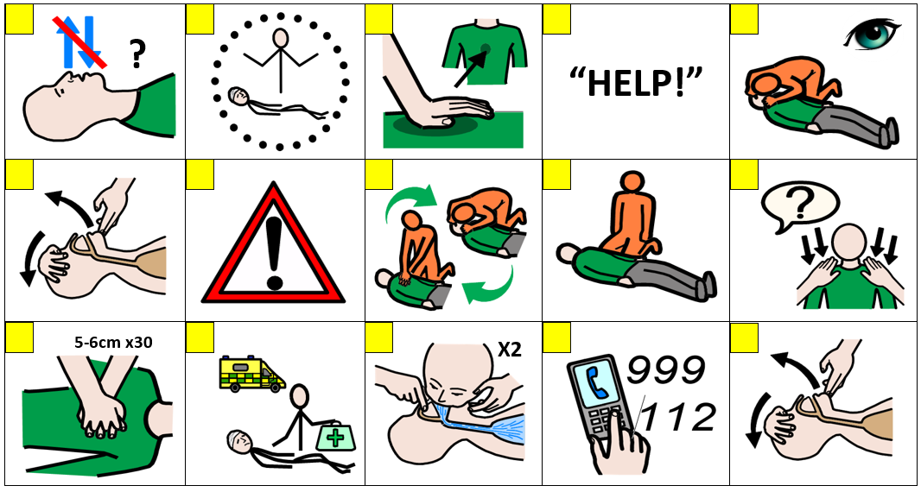
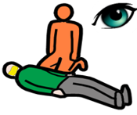
CPR sorting A15 (COVID-19 version)
At this time please do not put your face next to theirs to check for breathing, instead only look carefully for the chest rising and falling.
When giving CPR place a cloth over the face of the casualty
Notes:
Use sorting activity as an option if no mannequins or a large group

Slide 21
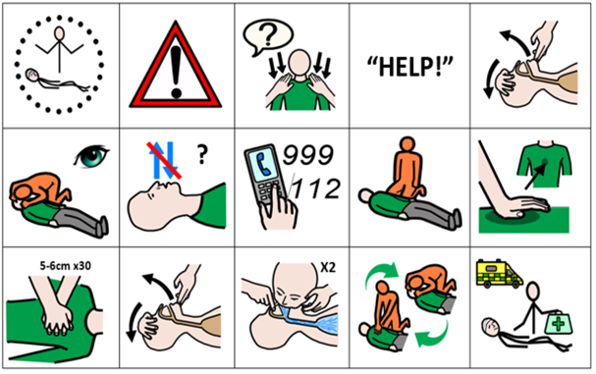
CPR sorting answers A15 (COVID-19 version)
At this time please do not put your face next to theirs to check for breathing, instead only look carefully for the chest rising and falling.
When giving CPR place a cloth over the face of the casualty

Slide 22



Recap
Primary Survey
Breathing normally
Not breathing normally
Recovery position
Call for help and send a bystander for an AED if available
Make sure help is coming and give the casualty care
CPR
Notes:
Just a recap, quick Q and A around room to check learning informally

Slide 23
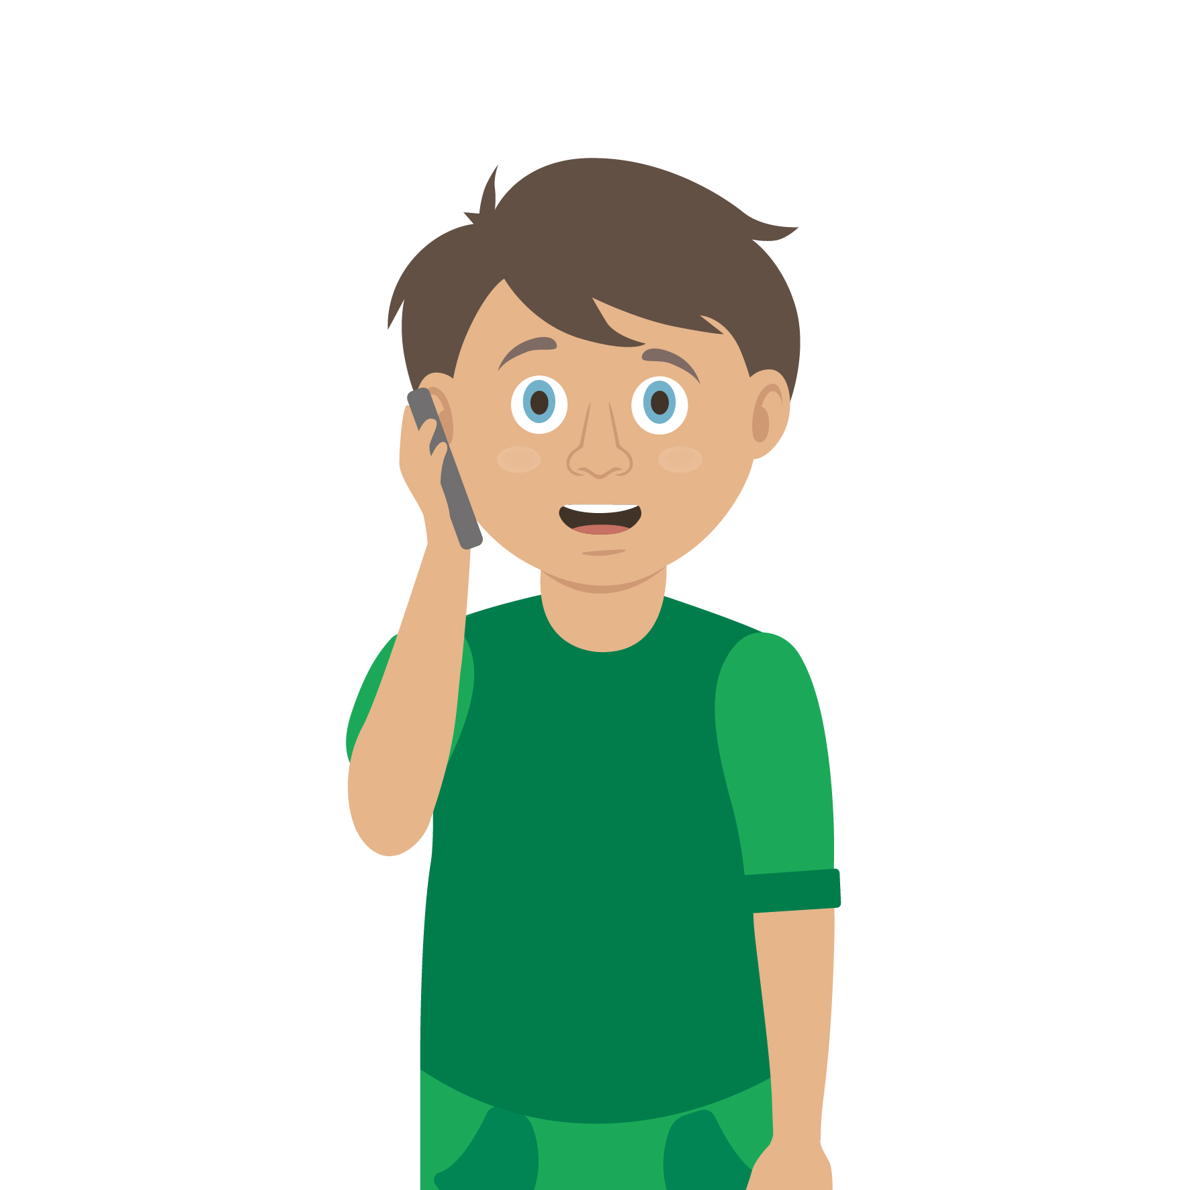
Casualty care
Pause for thought...
Which actions do you think are most important when caring for a casualty?
Get help
No food or drink
Prevent condition worsening
Remain calm
Keep warm
Treat with dignity and respect
Reassure casualty
Communicate well
Notes:
Opportunity to discuss common casualty care skills which are necessary in all first aid situations.

Slide 24


Check your learning
I am able to:
I am able to do a primary survey
I can place an unresponsive casualty, who is breathing normally, in to the recovery position
I know when and how to deliver CPR to an unresponsive casualty who is not breathing normally (+year 5)
I can get help and tell someone else how to deliver CPR to an unresponsive casualty who is not breathing normally (-year 5)
YES NO

Slide 25
Information and support
If any of the content in this session has upset or concerned you please discuss this with one of the teachers at your school
Further support can be found at:
www.childline.org.uk
www.youngminds.org.uk
www.samaritans.org
Further information linked to first aid can be found at:
www.sja.org.uk
www.asthma.org.uk

Slide 26

Thank you!

Slide 27
Casualty care A17
There are lots of things to remember when taking care of somebody.
Which three of these casualty care actions are the most important?
Remain calm
Treat the casualty with dignity and respect
Get help
Reassure the casualty
No food or drink
Communicate well
Prevent the condition from worsening
Keep the casualty warm
Notes:
ALL the answers are correct and ALL very important- answers and opinions from students will differ- use material a talking point rather than correct/ incorrect answers.
Card sorting activity can be made if preferred.

Slide 28
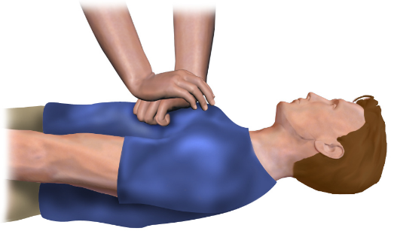
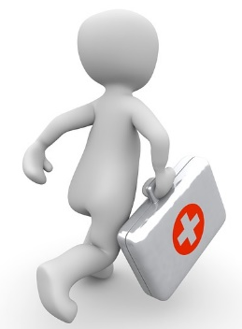
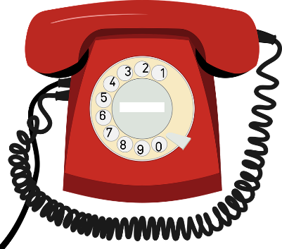

Optional activity A13
Chain of survival
Early CPR
Post resuscitation
Call for help
Early defibrillation
care
Discuss: Describe each link of the chain of survival
Challenge: Can you explain why it is important to follow these links?
Notes:
Can be used as a recap or HW exercise
Discuss the links and how they provide a casualty with effective first aid.
Students may not be able to complete the corresponding worksheet at this point so can revisit after discussion or HW.

Slide 29

Optional activity
Roll the dice
Name something you have learnt from this session
Tell me why you think what you have learnt is important
Explain the chain of survival
Tell me the first thing you would do if you found an unresponsive casualty, who is breathing normally, and why?
How confident are you now at dealing with a casualty who is unresponsive and not breathing normally, compared to before?
How could you tell if someone required resuscitation?
Notes:
Roll dice to get a question USE INTERACTIVE DICE
http://dice.virtuworld.net/
https://www.randomlists.com/dice?sides=6&qty=1

Slide 30
Optional activity A16
The human body
You now have the option to learn more about the human body and how it works. Use activity sheets A16 ‘the human body’ for both students and teacher instructions.
Downloadable worksheets can be found on the St John Ambulance website.

Slide 31
CPR sorting A15 (COVID-19 version)
At this time please do not put your face next to theirs to check for breathing, instead only look carefully for the chest rising and falling.
When giving CPR place a cloth over the face of the casualty
Notes:
Use sorting activity as an option if no mannequins or a large group

Slide 32
CPR sorting answers A15 (COVID-19 version)
At this time please do not put your face next to theirs to check for breathing, instead only look carefully for the chest rising and falling.
When giving CPR place a cloth over the face of the casualty

Slide 33
When things go wrong A12
Think of something that may have happened to make someone unresponsive.
Notes:
Explain the heart needs air (oxygen) and it’s a muscle that pumps blood around the body.
What can go wrong to cause a problem to the air and blood circulating? (circulation = "circling" the body)
Brief explanation and onto worksheet

