Slide 1
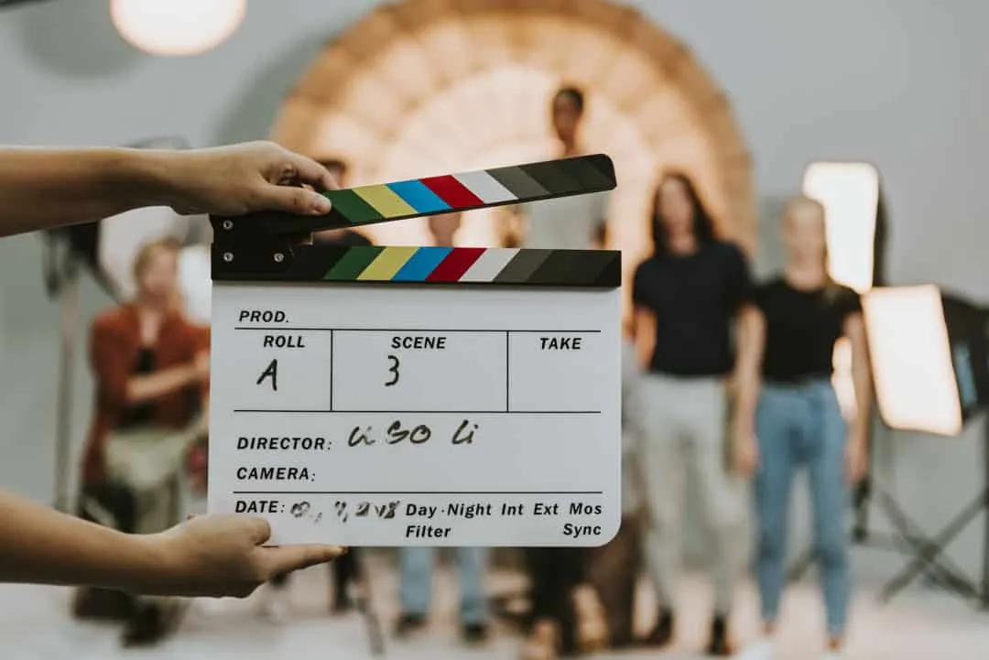
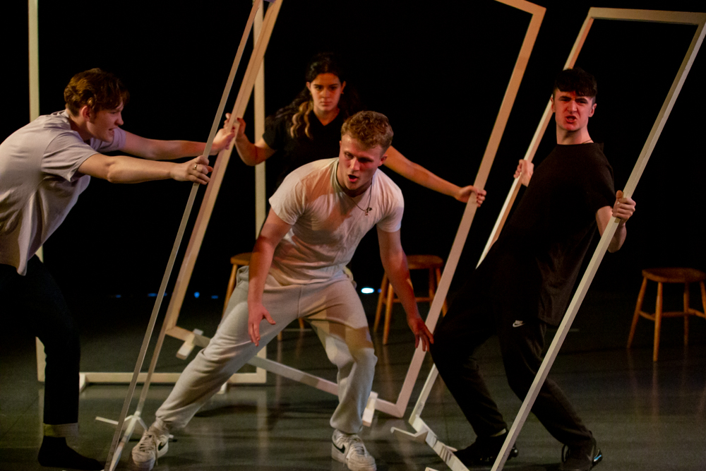
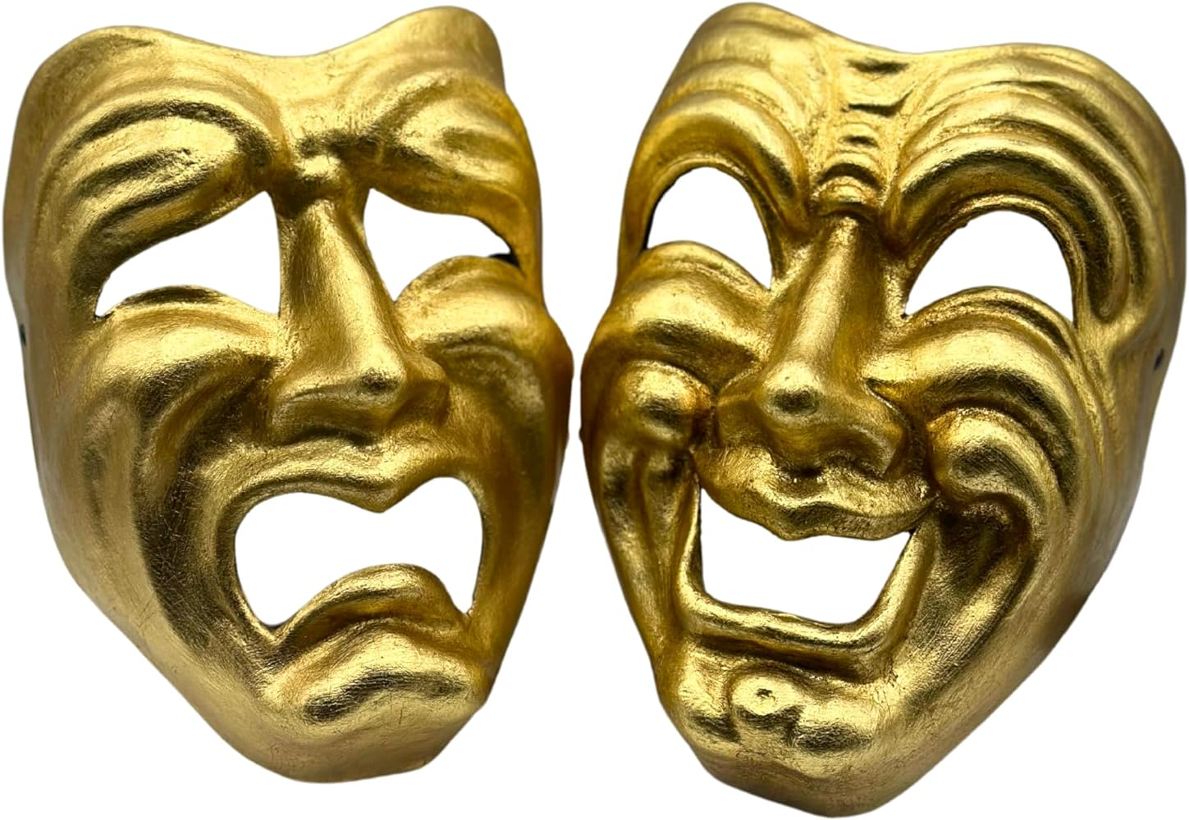
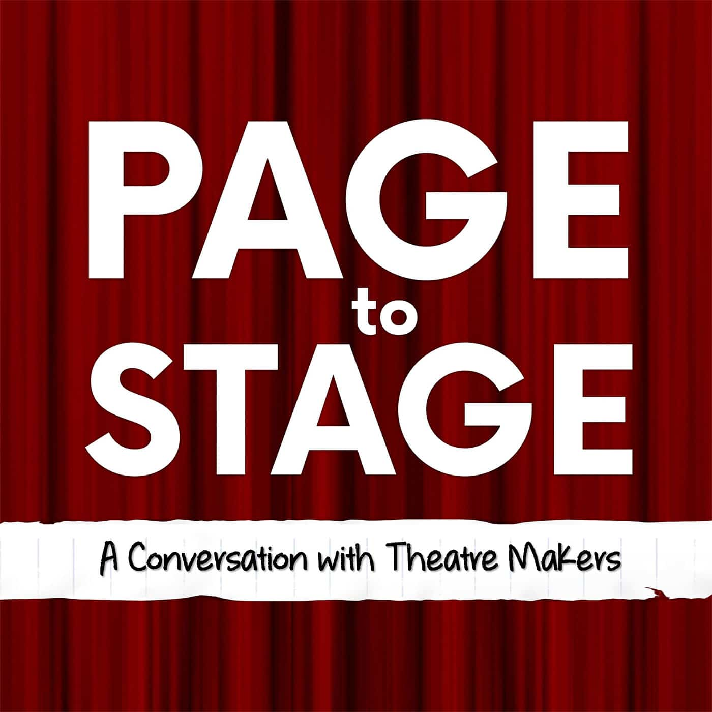
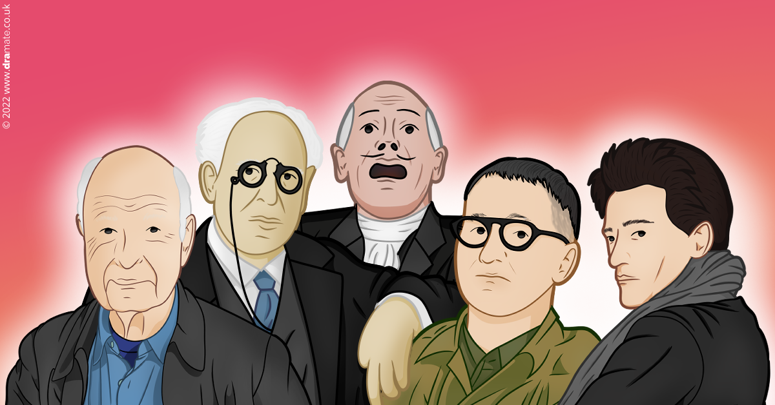
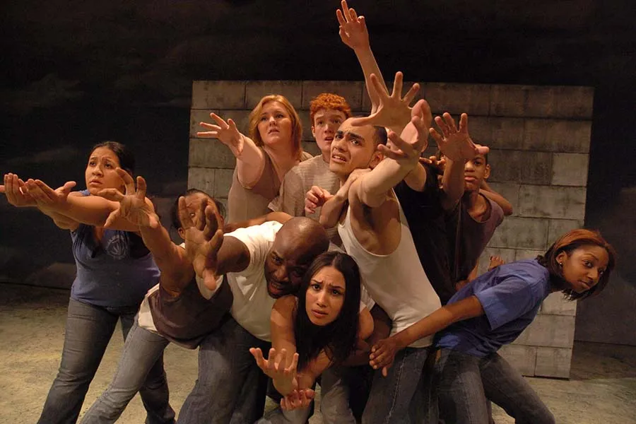
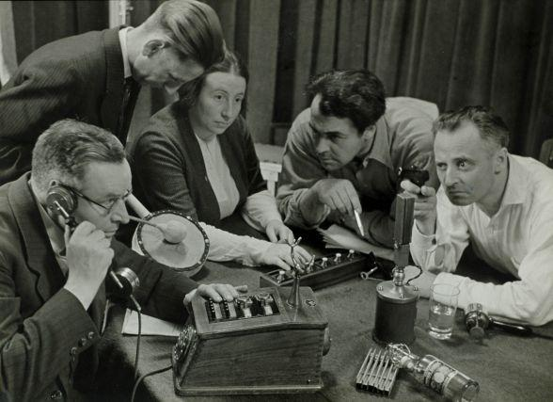
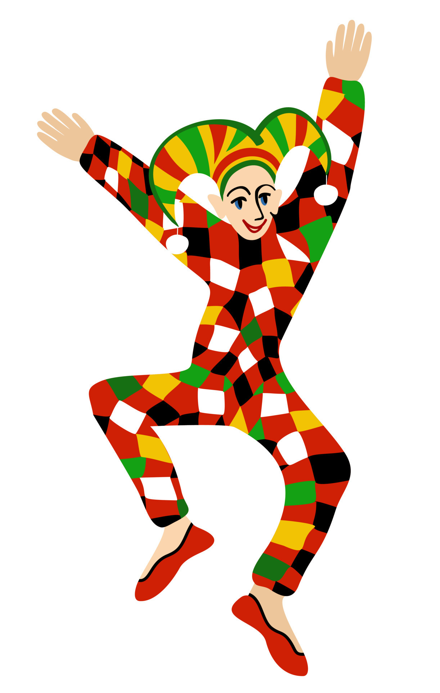
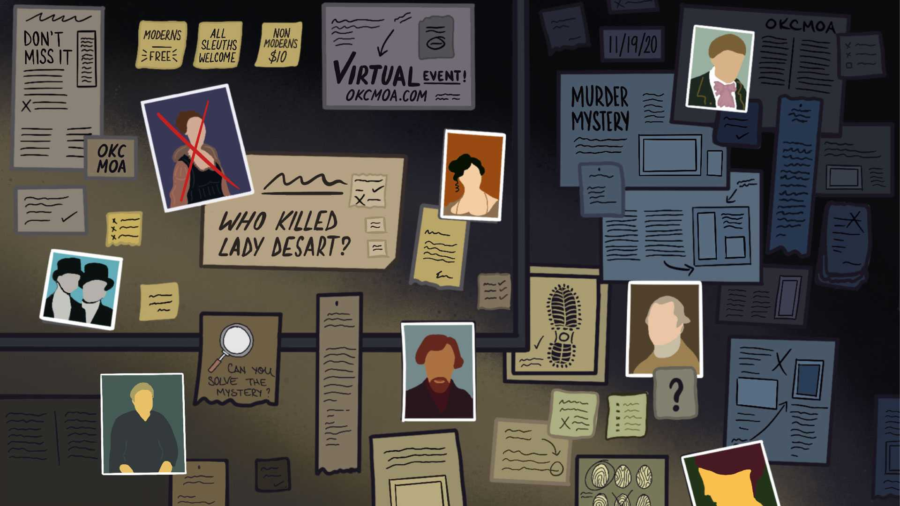
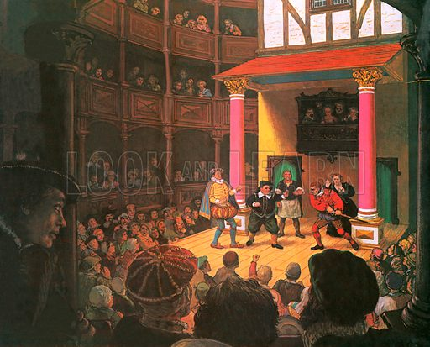
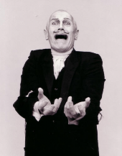
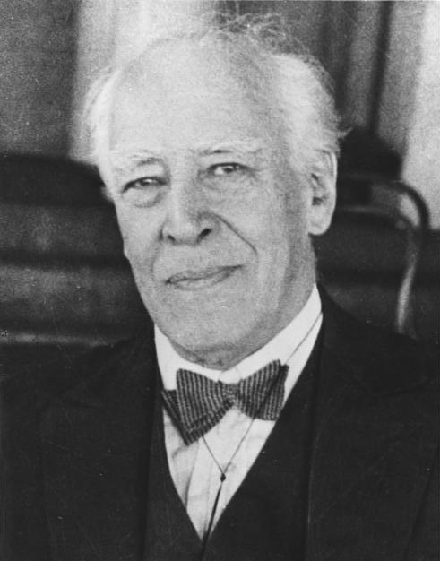
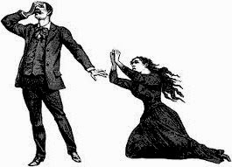
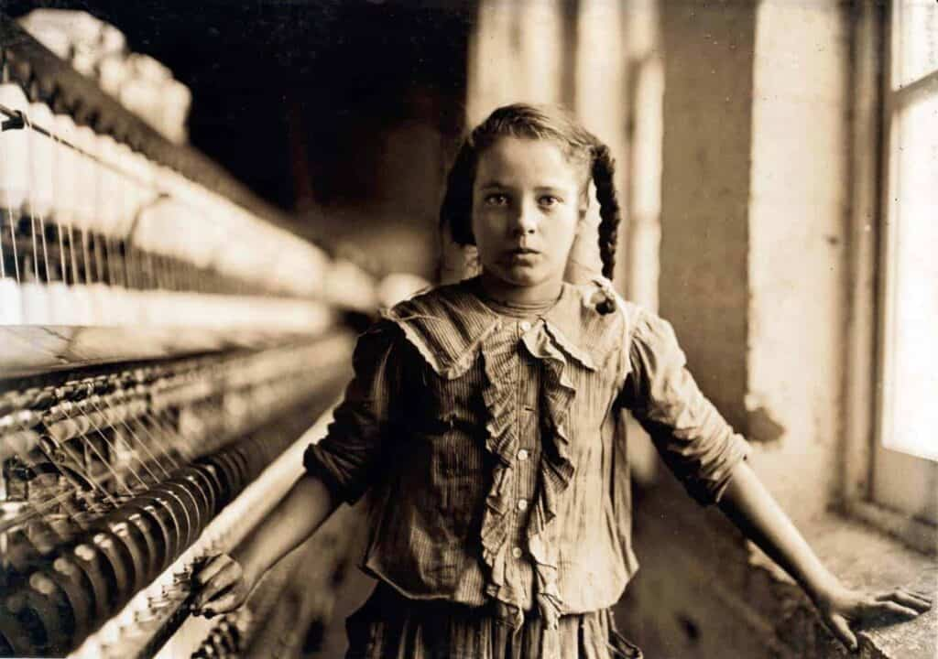
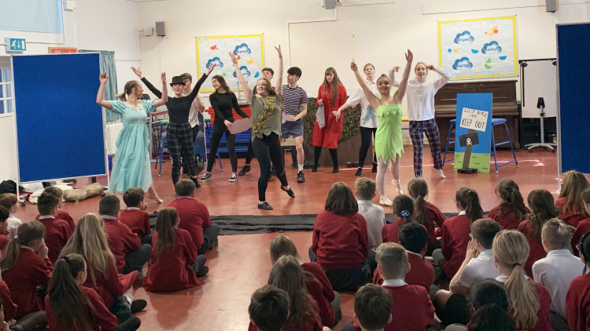
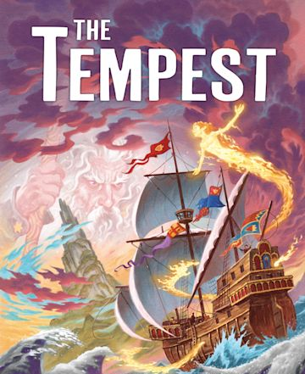
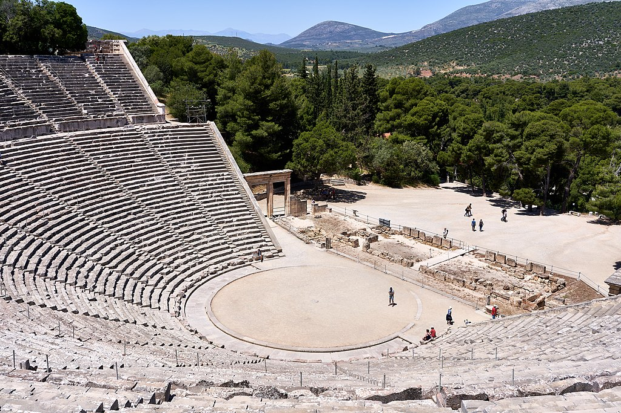
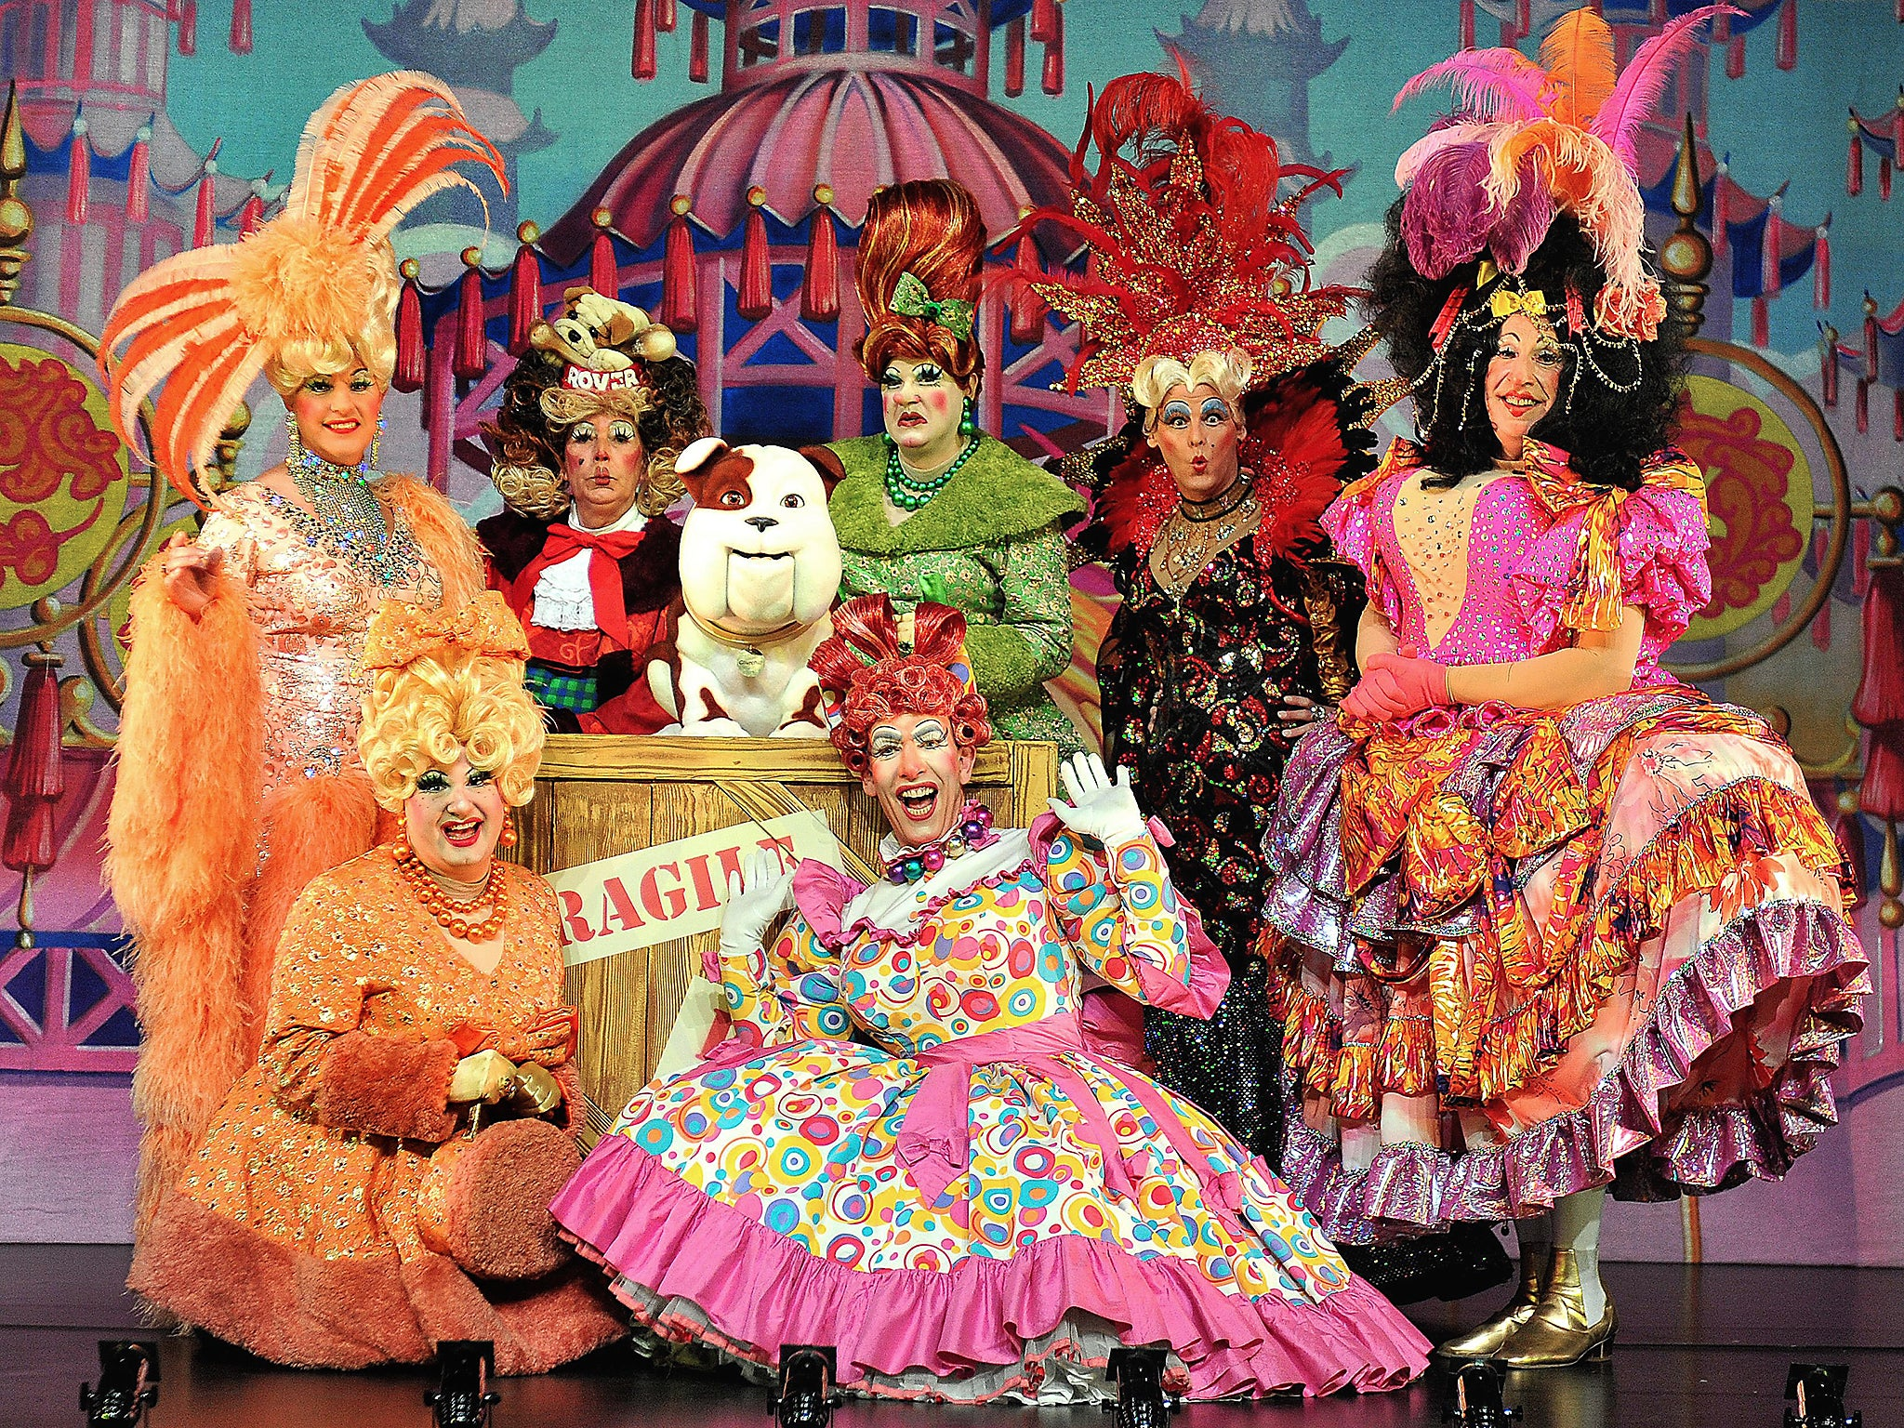
Character Virtues
Cross Curricular Links
Assessment Points
Subject Specific Skills
CEIAG Links
Drama Curriculum Map
Performing
Question: How can I apply my knowledge in responding to industry commission?
Planning
Promoting
Pitching
Evaluating
Question: How do I devise a whole performance from a single stimulus?
Unit 3:
Performing Arts in Practice
Attentiveness
Self control
Reflection
Confidence
Progression to next stage of learning:
A Level Drama & Theatre
BTEC Performing Arts
Performing Arts Colleges eg CAPA / MADD
Playwright Intentions, Deconstructing Text
Willy Russell
Social and Historical Context
How can I use a stimulus to devise a performance?
English
PSHCE
History
How can I use a style or practitioner to devise a performance?
Question: What makes good Theatre? Students will explore various stimuli/scenarios and use their knowledge of style to devise a performance
Unit 2:
Creating
Characterisation
Given Circumstances
Staging
Honesty
Kindness
Forgiveness
Question: How can I perform an extract from Blood Brothers thinking about character, setting & context?
Question: How do I bring a text to life?
Exploring
Text
Unit 1: Performing
Devising
Drama
11
Styles and
Genres
English, History, Geography & PSHCE
Response to stimuli, applying a chosen style & Devising/Creating.
Question: How do I devise my own piece of Drama?
Performing various extracts
Wide range of acting skills
Effective contribution
Question: How can I create Drama from scratch?
Attentiveness
Self control
Reflection
Confidence
Characterisation
Vocal Skills
Physical Skills
English - Novel/Play
Direct Address, Breaking the Fourth Wall, Realism & Physical Theatre
Stimulus
Creativity
Dramatic Devices
Naturalistic
Multi Rolling
Exaggeration
Foreshadowing and Dramatic Irony
Play
Attentiveness
Confidence
Teacher-in-Role, Devil and Angel Characterisation
Devising
Components of Style
10
Devising
Soap Operas and Radio Drama
Blood Brothers
Question: What are the key styles/genres/theatrical movements in Theatre History?
English, History, Music and Art
Question: How can actors maintain a role through improvisation?
Warden X
Question: How do I transfer a play from page to stage?
Characterisation
Vocal Skills
Physical Skills
First Person Perspective
Visual Imagery
Question: How can I create
an atmosphere with a script?
Question: What makes a performance of a play stylised for audiences?
Improvisation
Reacting Ability
Sustain Character
Epic Theatre
Ensemble
Brecht
Direct Address
Multi Rolling
Use of Props
Narration
Characterisation
Stimulus
Compassion
Accepting
Adaptable
PSHCE Themes
English – Prejudice
Reflection
Deliberation
Respect
Curious Incident of the Dog in the Night Time
9
Face
The Play
Commedia Del Arte
Question: How can we increase tension in a story?
Stock Characters
Exaggeration
Comedy
Mask Techniques
Characterisation
Vocal Skills
Physical Skills
Creating Tone and Atmosphere
Characterisation
English, PSHCE and Art (Costume Design)
Question: How do you create an interesting performance with no props, costumes or set?
Creating Fear & Tension
7 Levels of Tension
Trust, confidence,
self control
Question: Can I make my audience think?
English - Novel/Play
Classic Murder Mystery
Applying Total Theatre skills
Effective use of the Body
Asides
Stock Characters
Proxemics
Subtext
Magic If
Emotional Memory
Perform Believable Characters
Given Circumstances
History – Elizabethan England
Creating Tone and Atmosphere
Characterisation
Elizabethan Theatre
Total Theatre
Naturalistic Acting
Music
English - Novel/Play
Confidence
Self-control
Humour
English – The Tempest
English - Shakespeare Year 7
Responsibility
Emotional Intelligence
Relationships
Question: Can Drama educate an audience?
Melodrama Performance
Stock Characters
Stage Fighting
PSHCE – Key Themes
Educating the Audience
Question: Do audiences prefer stock characters and exaggeration to bring a story to life?
Question: Can I tell a Shakespearean story effectively?
Historical Accuracy
Creating atmosphere
Character Exploration,
Creating Tone and Atmosphere
Direct Address, Narration, News Reports and Adverts
The Tempest
A Victorian
Child
Theatre in Education
8
Melodrama
Exaggeration
Character Relationships
Atmosphere
Emotional Intelligence
Community
Bravery
Friendship
Question: Where did Theatre start?
Question: How do I transfer a play from page to stage?
Trust
Bravery
Determination
Exaggerated Characters
Ensemble Performance
Unison
Choral Speaking
Exaggeration
Slapstick and Mime
Comedy
Exaggerated Characters
Question: How can history inform my character/performance
Characterisation
Storytelling
Learning Lines
Greek
English – Greek Heroes
Theatre
Introduction to
Drama
7
Mask Theatre
Pantomime
Storytelling
Characterisation
Creation
English – Key Text
History – Pantomime
Community
Emotional Intelligence
Relationships
Movement: Levels, Gestures, and Facial Expressions
Question: How can I apply core Drama skills to a given story
Choral Movement
Ensemble
Exaggeration
Exaggeration
Narration
Flashback
Comedy
Question: How do I use performance skills to bring a character to life?
Still Image & Acting Skills
Confidence, resilience, respectful

