Slide 1
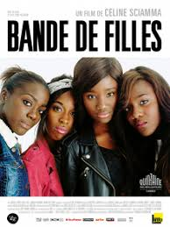
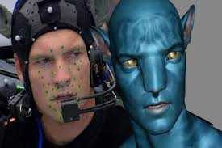
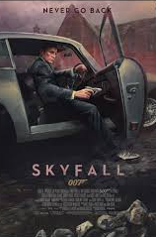
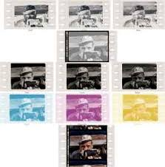
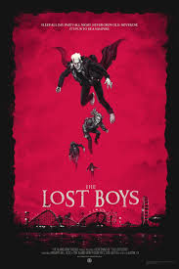
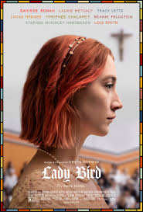
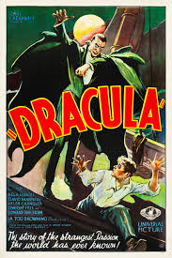
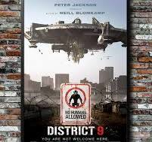
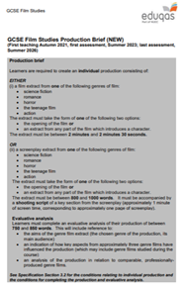
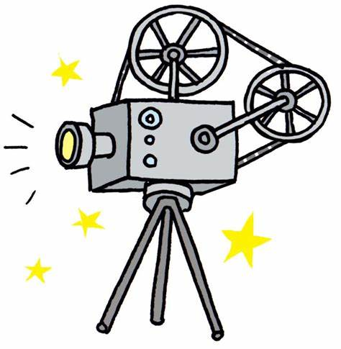
Film Studies Curriculum Map
COMPONENT 2: GLOBAL FILM REVISION
COMPONENT 1: DEVELOPMENTS IN US FILM
Individual Bespoke Revision
How has specialist film writing has changed your thoughts about the film you have studied.?
Cinematography, film review, independent film, criticism
English: critical thinking and analysing how specific techniques have been used to generate spectator responses.
QMF: Discuss what you consider to be one key idea from the specialist writing on the film you have studied.
QMS: how the specialist film writing has changed your thoughts about the film you have studied?
Resilience, trust, morality, honesty, forgiveness, responsibility
Film director/producer, journalist, cameraman, sound specialist, set designer, film/video editor, film teacher
What have been the key developments in films and film technology?
First moving images, silent film, rise of Hollywood, development of sound, introduction of colour film, emergence of widescreen technology and 3D film, development of portable cameras and Steadicam technology, role of computer-generated imagery in film
English: analysing how specific techniques have been used to generate spectator responses. Science: advances in technology. History: history of film
QMF: Answer exam style questions
QMS: talk about one key development in detail
Resilience, confidence, independence
Film director/producer, journalist, cameraman, sound specialist, set designer, film/video editor, film teacher
US IDEPENDANT FILM: LADYBIRD
KEY DEVELOPMENTS IN FILM AND FILM TECHNOLOGY
How have genre and themes developed and changed over time?
Genre, narrative, context, cinematography, mise-en-scène, editing, sound, representation, aesthetic qualities of film
English: analysing how specific techniques have been used to generate spectator responses. Geography: American filming locations. History: history of film
QMF: how is genre presented and established in the opening of a text?
QMS: how has the presentation of genre and themes changed from one text to the other?
British values, independence, morality, honesty
Film director/producer, journalist, cameraman, sound specialist, set designer, film/video editor
COMPONENT 1: DEVELOPMENTS IN US FILM
US COMPARATIVE FILM STUDY: DRACULA & THE LOST BOYS
Genre, narrative, context, cinematography, mise-en-scène, editing, sound, representation, aesthetic qualities of film, first moving images, silent film, rise of Hollywood, development of sound, introduction of colour film, emergence of widescreen technology and 3D film, development of portable cameras and Steadicam technology, role of computer-generated imagery in film, film review, independent film, criticism
English: analysing how specific techniques have been used to generate spectator responses
Confidence, independence, resilience
Film director/producer, journalist, cameraman, sound specialist, set designer, film/video editor
Create a screenplay & Shooting Script
COMPONENT 3: PRODUCTION COURSEWORK
Focus on aesthetic qualities of film – how does the film you have studied have a distinct look or style?
Aesthetic qualities of film & their significance, individual shots & their composition, mise-en-scène, momentary aesthetic effects or distinct aesthetic look to a whole film, aesthetic effects through specific film sequences
English: analysing how specific techniques have been used to generate spectator responses. Geography: British filming locations
QMF: Explore how far the film you have studied has a distinct look or style throughout (opening)
QMS: Explore how far the film you have studied has a distinct look or style throughout (action scene)
British values, trust, morality, honesty, forgiveness, responsibility
Film director/producer, journalist, cameraman, sound specialist, set designer, film/video editor
Screenplay, shooting script, genre, cinematography, lighting, camera shots, camera movement, framing, mise-en-scène, setting, props, costume, makeup, editing, visual effects, sound, soundtrack, music, context of film
English: analysing how specific techniques have been used to generate spectator responses. Photography: shot types. Music: how music is composed to fit certain moods
QMF: coursework check in – first draft of evaluative piece
QMS: coursework check in – final draft of both screenplay and shooting script after last QMS feedback
QMF: assessed on piece of evaluation from assessment brief
QMS: final draft of screenplay and shooting script - graded
Independence, confidence, resilience, integrity
Film director/producer, journalist, cameraman, sound specialist, set designer, film/video editor
COMTEMPORARY UK FILM: SKYFALL
COMPONENT 3: PRODUCTION COURSEWORK –
PLANNING
Create a screenplay & Shooting Script
Screenplay, shooting script, genre, cinematography, lighting, camera shots, camera movement, framing, mise-en-scène, setting, props, costume, makeup, editing, visual effects, sound, soundtrack, music, context of film
English: analysing how specific techniques have been used to generate spectator responses. Photography: shot types. Music: how music is composed to fit certain moods
QMF: initial planning of screenplay and shooting script
QMS: full, detailed initial plan of screenplay and shooting script
QMF: first draft of screenplay and shooting script
QMS: initial edit of screenplay and shooting script
Independence, confidence, resilience, integrity
Film director/producer, journalist, cameraman, sound specialist, set designer, film/video editor
GLOBAL NON-ENGLISH LANGUAGE FILM: GIRLHOOD
GLOBAL ENGLISH LANGUAGE FILM: DISTRICT 9
Focus on representation – how is representation presented?
Representation, gender, ethnicity, age, different cultures, context
English: analysing how specific techniques have been used to generate spectator responses. MFL: representations of culture in different countries. Geography: looking at life in France
QMF: Explore how gender is represented in the film you have studied
QMS: Explore how people and/or places are represented in the film you have studied.
British values, SMSC, trust, morality, honesty, responsibility, compassion
Film director/producer, journalist, cameraman, sound specialist, set designer, film/video editor
Focus on narrative – how is narrative constructed?
Narrative, the difference between plot & story, narrative techniques, narrative conventions, interpretation, screenwriting, screenplay
English: analysing how specific techniques have been used to generate spectator responses. History: apartheid in SA. Science: technology, biology.
QMF: How elements of film form create meaning during one key plot point in the film you have studied
QMS: How elements of film form create meaning during one key plot point in the film you have studied (different scene/focus)
British values, SMSC, trust, morality, honesty, forgiveness, responsibility
Film director/producer, journalist, cameraman, sound specialist, set designer, film/video editor
AN INTRODUCTION TO FILM STUDIES
COMPONENT 2: GLOBAL FILM
Genre, cinematography, lighting, camera shots, camera movement, framing, mise-en-scène, setting, props, costume, makeup, editing, visual effects, sound, music, context of film
English: analysing how specific techniques have been used to generate spectator responses
QMF: watch a scene from one the films to be studied and analyse how it presents genre
QMS: design a story board of how genre is established through different shots
Confidence, independence, resilience, awareness
Film director/producer, journalist, cameraman, sound specialist, set designer, film/video editor
Genre, cinematography, lighting, camera shots, camera movement, framing, mise-en-scène, setting, props, costume, makeup, editing, visual effects, sound, music, context of film
English: analysing how specific techniques have been used to generate spectator responses
Confidence, independence, resilience
Film director/producer, journalist, cameraman, sound specialist, set designer, film/video editor

