Slide 1



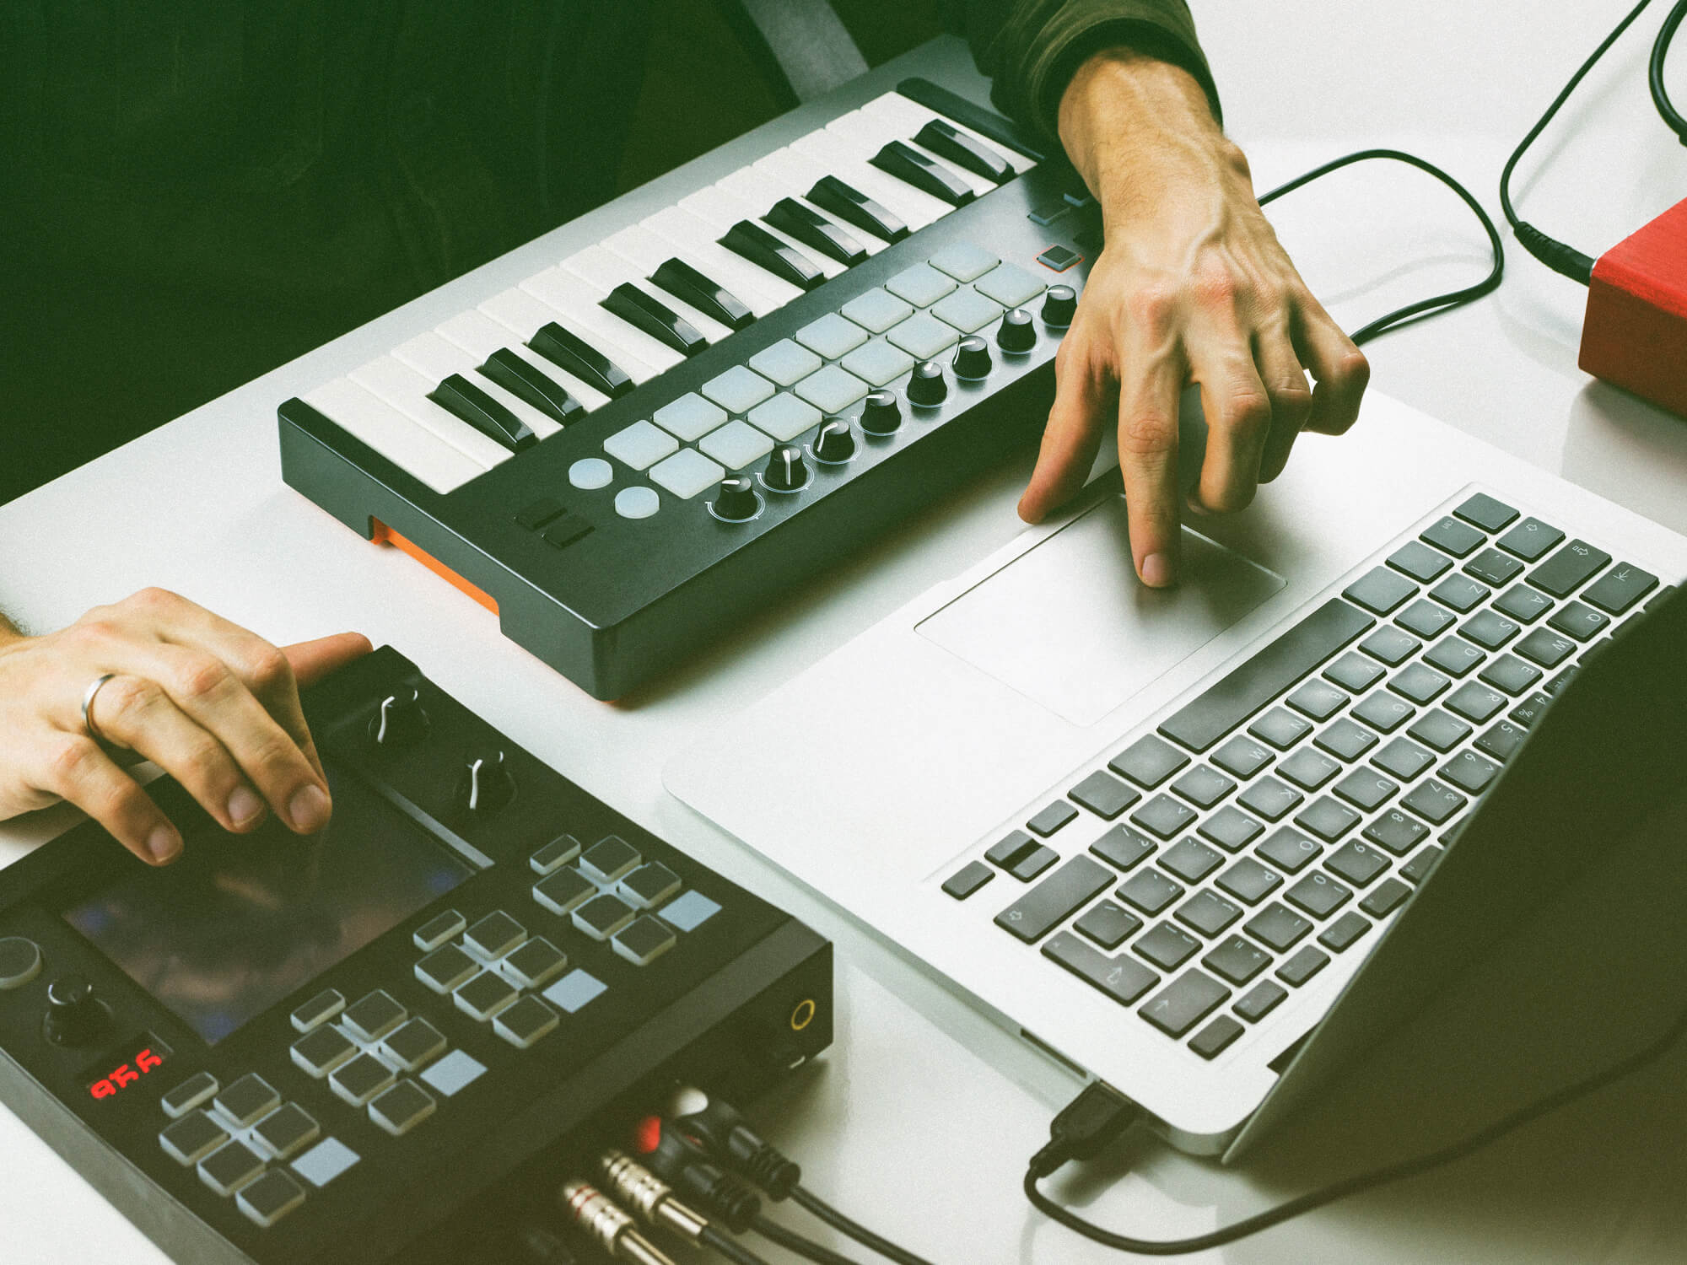
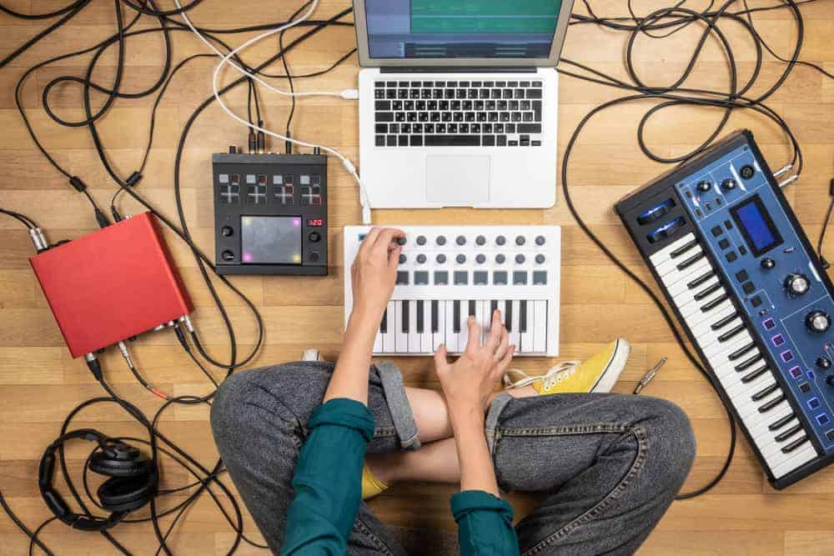
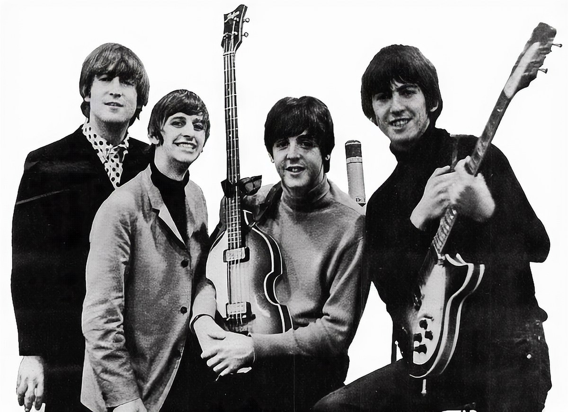
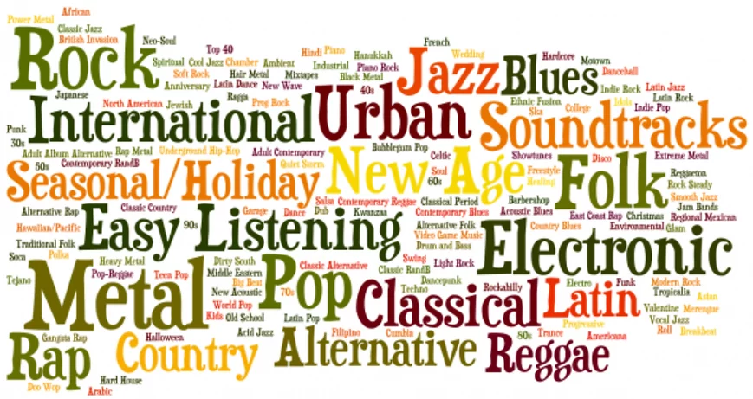
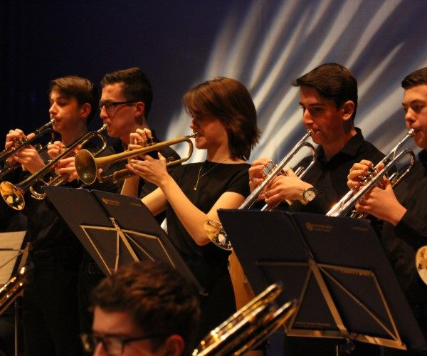
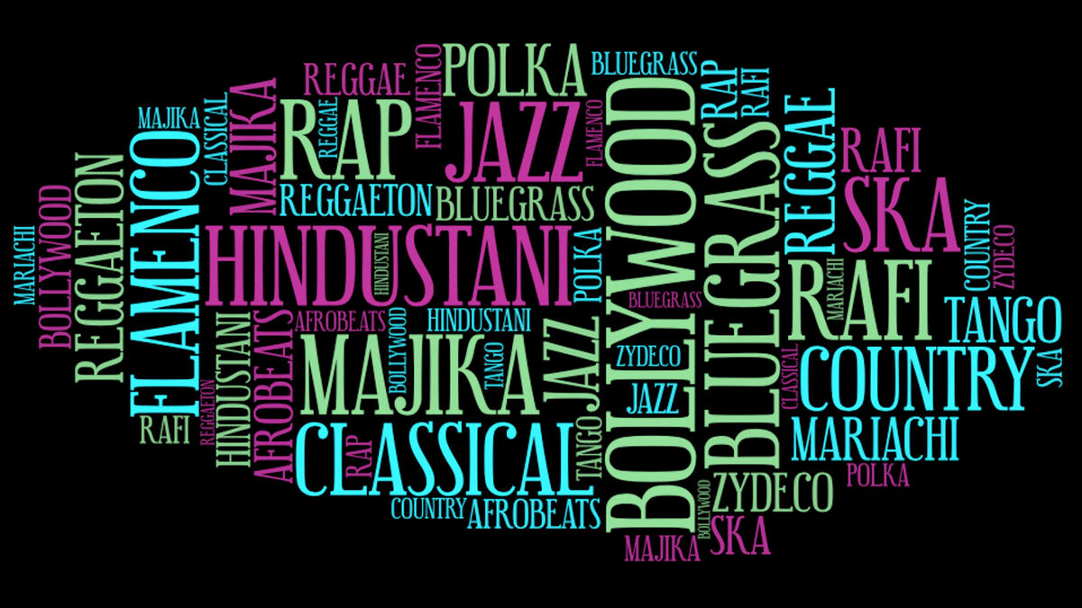

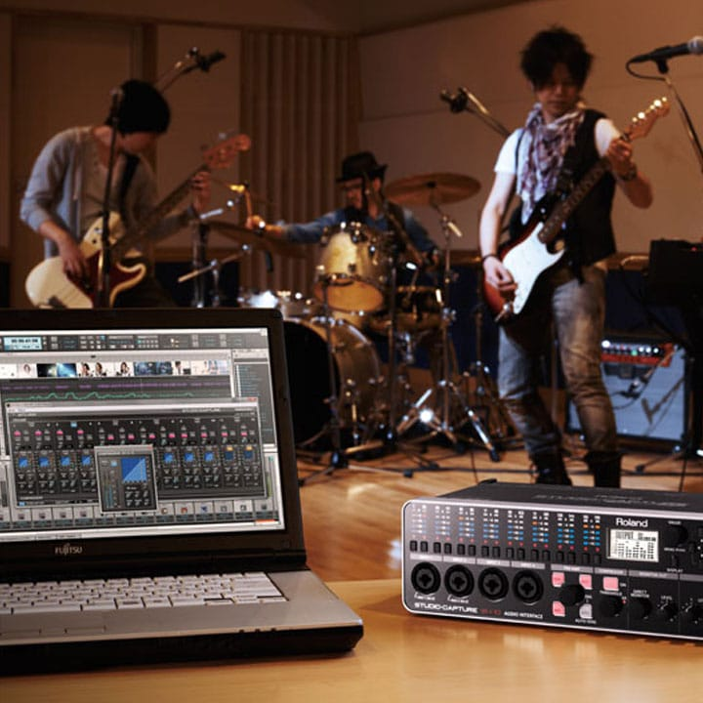

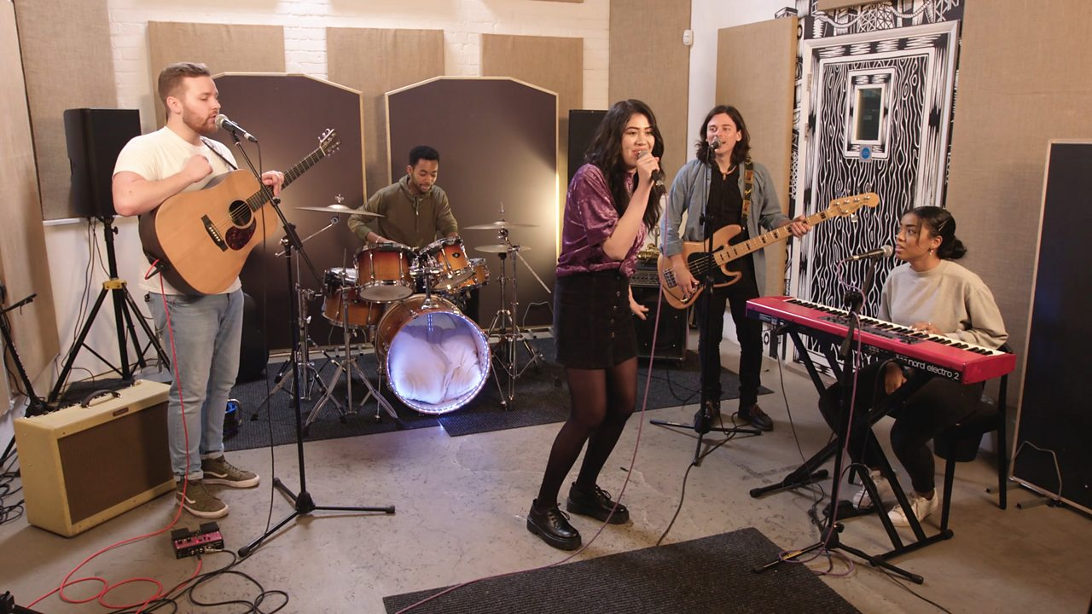
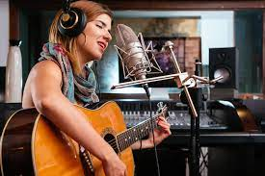

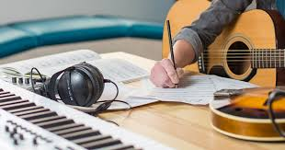
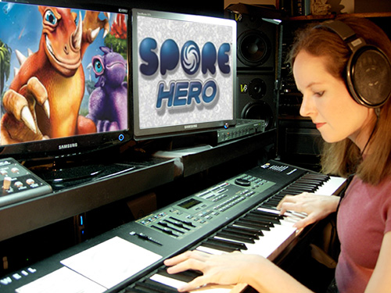
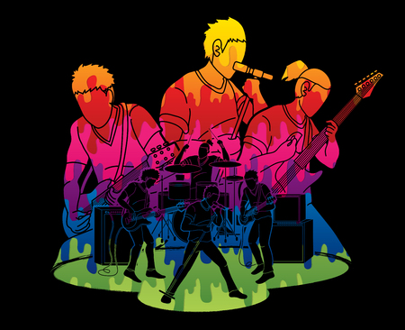


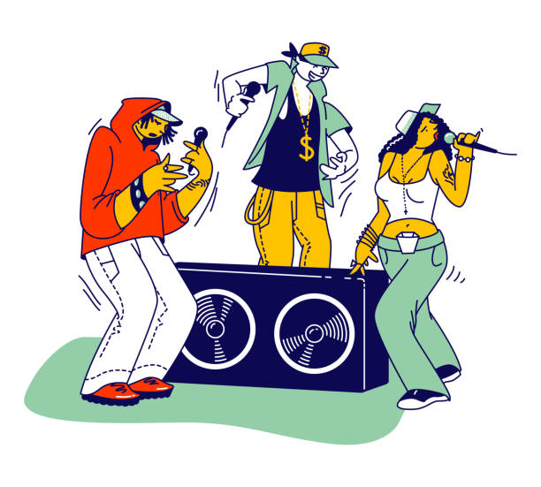


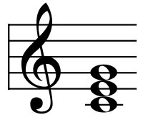

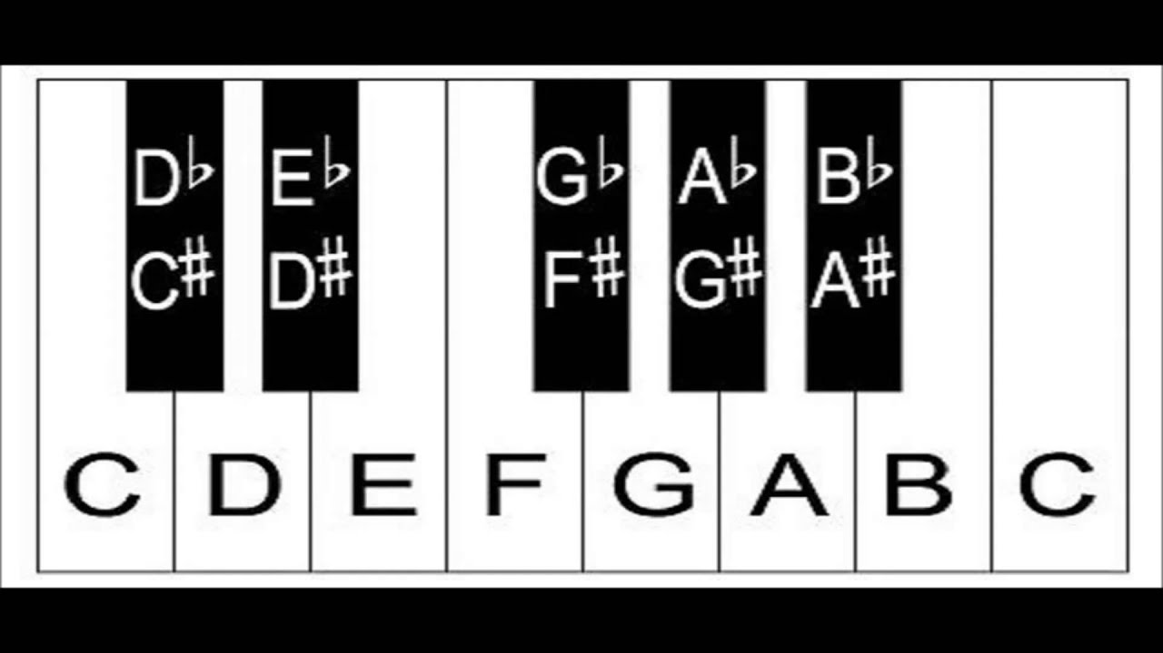
Character Virtues
Cross Curricular Links
Assessment Points
Subject Specific Skills
CEIAG Links
Music Curriculum Map
Musical Forms and Devices History
Musical Forms and Devices Characteristics
Listening Questions and Analysis
Film Music History
Film Music Characteristics
Collaboration
Independence
Resilience
Confidence Decision Making
Progression to next stage of learning:
A Level Music
BTEC Music
BTEC Performing Arts
Appraising
Exploring and Extending Ideas
Using Structure Effectively
Using Rhythmic and Melodic Patterns
Development of Harmony
Popular Music History
Popular Music Characteristics
Melody Harmony
Tonality Form and Structure
Dynamics Sonority
Texture Tempo
Rhythm Metre
Music for Ensemble History
Music for Ensemble Characteristics
ICT –
Computer
Skills
Collaboration Independence
Resilience Confidence
Decision Making
Western Classical Music History
Western Classical Music Characteristics
World Music History
World Music Characteristics
History –
Musical
Forms and
Devices
Composing
11
Instrumentation Texture Timbre Tonality Scales and Modes Harmony
Rhythmic Techniques Structure Melodic Techniques Production
Listening Questions and Analysis
Collaboration
Independence
Resilience
Confidence
Decision Making
History –
Musical
Styles
Accuracy
Fluency
Technical Control
Expression and Interpretation
Stylistic Awareness
Ensemble Skills
Free Composition Set Brief Composition
Solo Performance
Ensemble Performance
Development Routines Technical Exercises
Goal Setting Monitoring and Tracking Progress
Drama – Performance Skills
Performing
10
Creativity and Development of Ideas
Technical Control of Musical Elements and Resources
Structure and Stylistic Coherence
Collaboration Independence
Resilience Confidence Decision Making
Video Game Music Characteristics (character theme, conjunct, disjunct, staccato, legato, semitone, syncopation,
ground theme and synth effects)
Maths – Numeracy
ICT and Art – Finger Dexterity and Fine Motor Skills
Creative iMedia - Game Production
Pop Song Characteristics
(lyrics, rhyme, melody, accompaniment, time signature, unique interpretation and strophic song form
Maths – Numeracy
ICT and Art – Finger Dexterity and Fine Motor Skills
Drama and English – Narrative
English – Diction and Pronunciation
History – Popular Song
Collaboration Independence
Resilience Confidence
Decision Making
Video
Game
Music
Battle of the
Bands Listening Activity
Battle of the
Bands Ensemble Performance
Battle of
the Bands
Pop Music
Video Game Music Listening Activity
Video Game Music Composition and Notation
Maths – Numeracy
ICT and Art – Finger Dexterity and Fine Motor Skills
English – Diction and Pronunciation
History – Popular Song
Pop Music Listening Activity
Pop Music Song Writing Composition and Notation
Collaboration Independence
Resilience Confidence
Decision Making
Collaboration Independence
Resilience
Confidence
Decision Making
Ground Bass Meets Hip Hop Listening Activity
Ground Bass Meets Hip Hop Remix and Arrangement
Ensemble Performance
Maths – Numeracy
ICT and Art – Finger Dexterity and Fine Motor Skills
English – Diction and Pronunciation
History – Context in the Baroque Period and Hip Hop
9
Collaboration Independence
Resilience Confidence Decision Making
Collaboration Independence
Resilience Confidence Decision Making
Musical Theatre
Ground Bass Meets Hip Hop
Maths – Numeracy
Drama – Theatrical Performance
ICT and Art – Finger Dexterity and Fine Motor Skills
English – Diction and Pronunciation
History – Context of the Musical
Musical Theatre Listening Activity
Musical Theatre Ensemble Performance
Ground Bass and Hip Hop Characteristics (ground bass line, melody, additive texture, cyclic structure, lyrics, rhyme and remix)
Musical Theatre Characteristics (lyrics, rhyme, melody, accompaniment, storytelling and strophic song form)
Collaboration
Independence Resilience
Confidence
Decision Making
Soundtracks Listening Activity
Soundtracks Ensemble Performance
Soundtracks Composition and Notation
Collaboration Independence
Resilience Confidence Decision Making
Blues Listening Activity
Blues Ensemble Performance
Composition and Notation
Blues Characteristics
(lyrics, rhyme, 12 bar blues chord sequence, walking bass line, blues scale, improvisation and strophic song form)
8
Soundtracks
Blues
Collaboration
Independence
Resilience
Confidence
Decision Making
Maths – Numeracy
ICT and Art – Finger Dexterity and Fine Motor Skills
History – The Slave Trade
Soundtracks Characteristics (main theme, soundtrack, drone, leitmotif, semitone, melody and accompaniment)
Maths – Numeracy
Drama and English – Narrative
ICT and Art – Finger Dexterity and Fine Motor Skills
Classical Music Listening Activity
Melody and Accompaniment
Composition and
Notation
Maths – Numeracy
Drama – Theatrical Performance Skills
ICT and Art – Finger Dexterity and Fine Motor Skills
English – Diction and Pronunciation
Classical Music
Characteristics
(simple melodies and accompaniments and homophonic texture)
Melody Characteristics (steps and leaps and repetition)
Rhythmic Notation (semibreve, minim, crotchet and quaver)
Pitch Notation (FACE and EGBDF)
Chords Characteristics (triads, block, broken, 7th and suspended)
Classical
Music
Just Play
(Keyboard, Ukulele and
Vocal Performance Skills)
7
Maths – Numeracy
ICT and Art – Finger Dexterity and Fine
Motor Skills
History – Context in the Classical Period
Collaboration
Independence
Resilience
Confidence
Decision Making
Keyboard Performance Techniques (right hand melody,
left hand accompaniment, keyboard note names and finger positions)
Sharps and Flats
Vocal Performance Techniques (unison and part singing)
Ukulele Performance Techniques (strumming techniques, strumming patterns, frets, chords and palm muting)
Performance Listening Activity
Ensemble Performance

