Slide 1
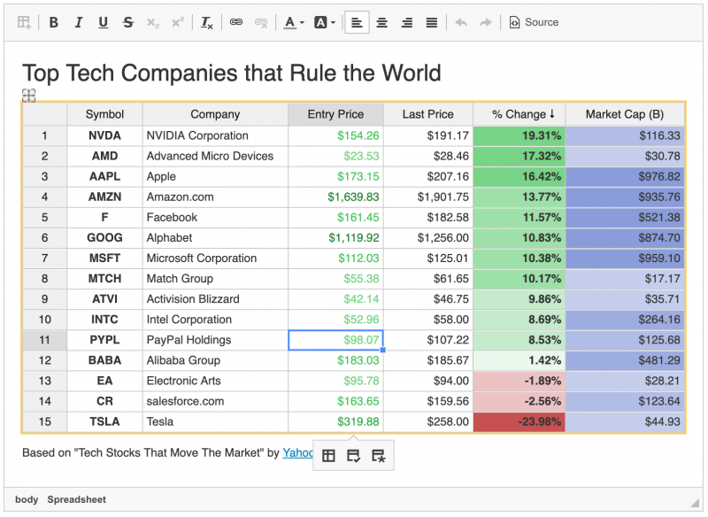
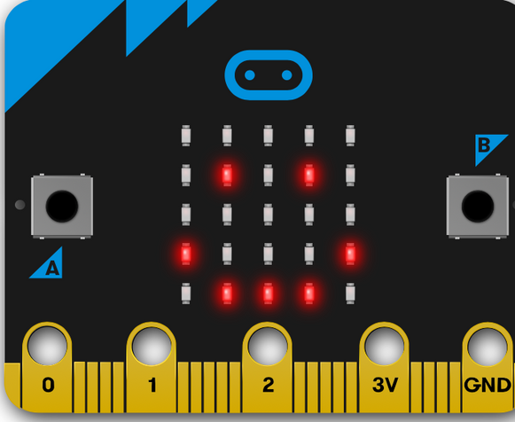
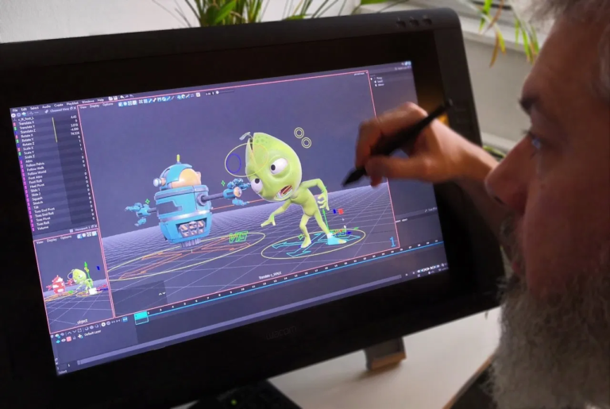
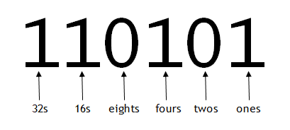
Technical Knowledge
Cross Curricular Links
Assessment Points
Subject Specific Skills
CEIAG Links
Underlined = Deeper
development of earlier skills
/ knowledge
Computing and Creative iMedia Curriculum Map
Question: How is digital media implementing into our society?
R097: Understanding interactive media- wider society links.
Creating products for a purpose
Progression to next stage of learning:
A Level ICT
Extended diploma IT
Level 3 Creative media
Digital interactive media
Analysis.
Debating skills
Verbal reasoning
Question: What are the technical element of medias? R094:– Students to have experimentation throughout the analysis of this
11
Honesty
Kindness
Forgiveness
Roles/ Media evolution
Question: What are the client requirements: Students to create their own requirements.
Creation of a product
Question: What roles are available in the media industry?
R093: Exploring the requirements and roles
Implementation
Creation of a product
The media
industry
Science- testing, implement
10
Identity and digital graphics
Question: What is the best way of planning digital media?
R093: Students to analyse a range of media from a variety of companies.
Question: What are the uses of a spreadsheet?
Exploring how to enter data and use formulae
Client
Peer to Peer
Maths- Index/lists
Python and Next Steps
Question: How are network types decided?
Developing an understanding of LAN and WAN networks.
Debating skills
Networking
Syntax
Maths- Calculations
Scientific
Editing
Implementing format
Spreadsheets
Networks
Question: What makes a functioning program? Explore a range of features within programming.
Question: How do you produce the visual and sound for a video?
Exploring how to create the visuals and sound for a video
Video Production
Health and safety, Providing justification
Question: How secure is our data?
Security issues to be explored and a variety of preventive techniques.
Being able to give secure advice of how to protect data.
Question: What is physical computing?
Exploring interactivity through displays, buttons and sound
LED lights
Sound
Physical computing
PSHCE- E safety
9
Web Development and Cyber Security
Recalling
Legal knowledge
Maths- Plotting coordinates
Data protection act
Legalisation
Microbit
Animation reviewing, Justification
Question: How secure is our data?
Security issues to be explored and a variety of preventive techniques.
Being able to give secure advice of how to protect data.
Question: Can animation be used in all areas of the media?
Animation to advertise- Exploring the use of animation within the media.
Health and safety, Providing justification
Problem solving
Creation of a product
Binary addition
Convergence
Animation
Advertising
Reviewing
Planning
Designing
Editing, Digital media
Question: How important is understanding binary?
Exploring the requirement of data to be stored as binary and the usefulness of this.
Problem solving
Conversions of binary numbers
Elements of the computer
Problem solving
Understanding Computers
Question: How does block-based coding support advanced programming skills? Transferable skills: Students will understand the foundation of coding.
Maths- Addition
Ordering of instructions
Scratch
8
Maths- Arithmetic operations
Formatting, Calculations, Formulas
Sequencing
Block-Based
Providing justification
Creation of a product
Implementing format
Vector/
Bitmap graphics
Graphics
Creative Media
Animation
Transition
Formatting
Editing
Digital media
Office Applications
7
Creation of a product
Reviewing a product
Question: How can a creator use purpose to create a product?
Using software to create a movie poster that will be
linked to a specific purpose
Using a search engine
Question: Does formatting make a document outstanding?
Exploring formatting styles and techniques- Pupils create and analyse a wide variety of formatting styles.

