Slide 1
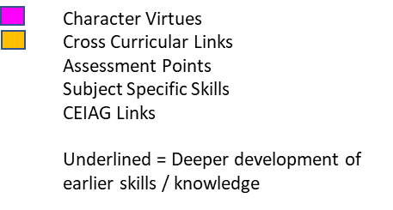
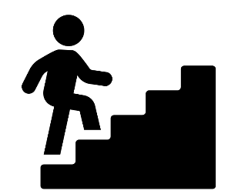
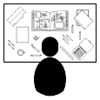
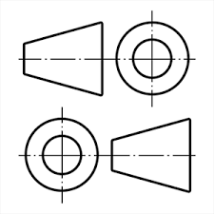
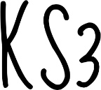
OCR Engineering Design
Section 4: Methods of evaluating ideas
Comparisons
Ranking matrices
Modelling
ACCESS FM
Specifications
Section 2: Design requirements
Wants and needs
ACCESS FM
Materials
Resubmission of R039 & R049
Where necessary, learners will be given opportunities to re-attempt and re-submit NEA components with a new NEA challenge.
Section 3: Communicating ideas in Engineering
Sketching techniques
Working drawings
Common abbreviations
Section 1: Design processes
Design strategies
Iterative design in Engineering
ACCESS FM
Core content and specialist knowledge:
Revise and practice exam papers in preparation for your final exam in Engineering.
Initial Concept Sketches:
What ideas do you have already? Can you visualize them?
FINAL
EXAM
R038: Principles of Engineering design
YEAR
11
Careers in Engineering:
Where can an Engineering qualification take you?
What roles are there?
What companies are there?
Testing / Modelling:
How do we complete a product analysis?
What can we learn from studying existing products?
Make:
Manufacture a prototype product linked to the design brief.
Read an orthographic drawing to support in the manufacture
Design:
Design a product linked to the set assignment
Use freehand and 3D sketching techniques
Companies and Engineers
What are the 7 sectors of Engineering?
How do they interconnect?
Testing/Modelling:
Create a CAD image of your product idea
Analyse and link to the specification given
Investigate the design possibilities:
What is the design context? What research can you carry out to gather ideas?.
R040: Design, evaluation and modelling
R039: Communicating designs
The Engineering world
Make:
Use a wide range of skills, materials and processes to develop a range of prototypes relating to the initial design brief/client wishes.
Design:
Focus your idea on a design context, generate own design brief and identify a real-world client.
Design:
Using removal techniques to develop an organic shaped product based on nature & biomimicry.
Make:
Addition processes & joining systems. Using skills to develop high quality craftsmanship products.
The Engineering sectors and job roles connected to the industry
Make:
Develop your design through iterative processes and modelling, testing & evaluating before making a final product.
Design:
Practicing Isometric Projection and rendering skills. Orthographic projection.
YEAR
Materials:
Working from an orthographic drawing to manufacture a product .
10
Environmental Challenges
Iterative
Design
Design:
Isometric projection, CAD development
Make:
Can you make an accurate product using machines and tools independently?
After choosing options in year 9, focus your studies on Engineering in years 10 -11, through exciting, real-life projects. Deepen your understanding of Engineering in the world around us whilst developing products that help various needs and users.
Key skills
Generating products that solve real world issues
Independence in generating and completion of design projects
Client context:
What is the design problem? How do they currently solve it? What needs to be developed further?
Evaluate:
What skills have you developed? Test your product and consider how you would improve it.
PRECISION MANUFACTURING
Design brief:
What is the clients need? How can we solve this issue creatively?
Testing / Modelling:
Will my product work? What can I do to improve it?
YEAR
9
CAD/CAM
How can technology improve manufacturing?
CLIENT BASED DESIGNS
Evaluate:
At each stage of making, how can you improve your product? Would you change any thing?
Design:
Designing for a user and client. What is an isometric projection? Develop design ideas using CAD and other design systems.
Make:
Develop independence in CAD using 2D design software to make complex design ideas. Manufacture a range of items that link to the design brief and client
Materials:
Working with timber, boards, acrylics and textile to develop a sensory garden item.
THE 6 R’S WITHIN DESIGN
Work in more depth on projects, honing your practical skills (across all materials disciplines), improving your resilience & problem solving whilst developing independence in the workshop.
Key skills
Generating own design brief
Writing a specification
Production planning
Iterative design
Make:
Choosing a specific designer, manufacture a miniature model of one of their famous products
Materials:
Working with acrylics timber and textile, cutting and finishing techniques.
Design: CAD
What is computer aided design? Learn to use the basics of 2D software to design products- generation of acrylic components
Evaluate:
How has CAD / CAM helped you make a product?
How can my manufacturing be improved?
Design:
Designing with restrictions
Orthographic Projection & Rendering
Evaluate:
Does your product work? How can you fix problems?
Make:
Manufacture of storage systems that uses CAD, textile, acrylics, timbers
CULTURALDESIGN
YEAR
Designers
What famous designers work has had a world wide impact? How do design trends impact us?
8
DESIGNER APPRECIATION
Experience a wide range of fun and exciting projects that teach you valuable skills in the workshop, understanding different materials and how they work.
Key skills
Understanding project needs from a design brief
Designing products based upon a specification
Evaluating and developing design ideas
CORE
SKILLS
YEAR
Evaluate:
What makes a good product? How can you improve your skills?
7
Make:
Generation of a range of poppies using textiles, polymers, paper and board and potentially woods
Materials:
Textiles, Polymer, Paper classification. Where do these materials come from?
Introduction to the workshop:
Health and Safety
How can I show resilience in new learning?
Design:
Designing for users, generation of a whole school sculpture for Y7 poppies
Baseline Assessment:
What do you already know about DT?

