Slide 1
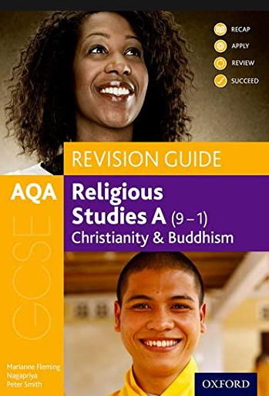
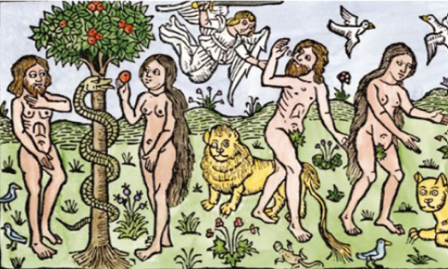
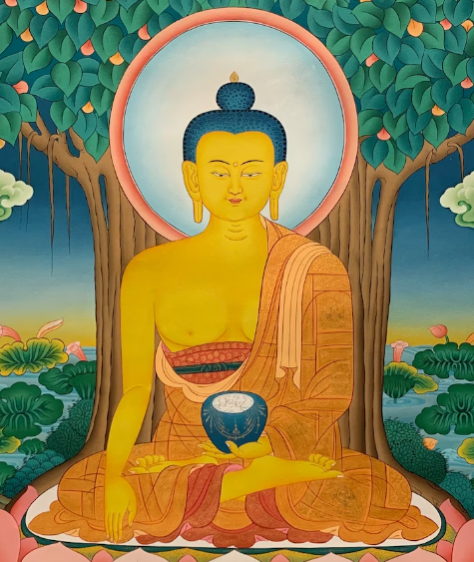
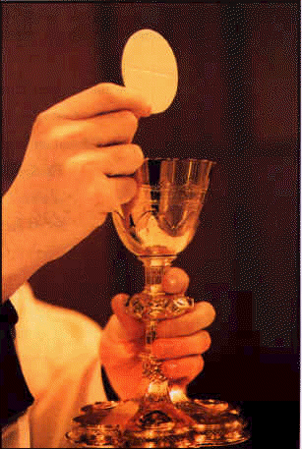
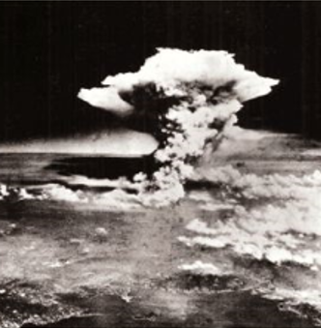
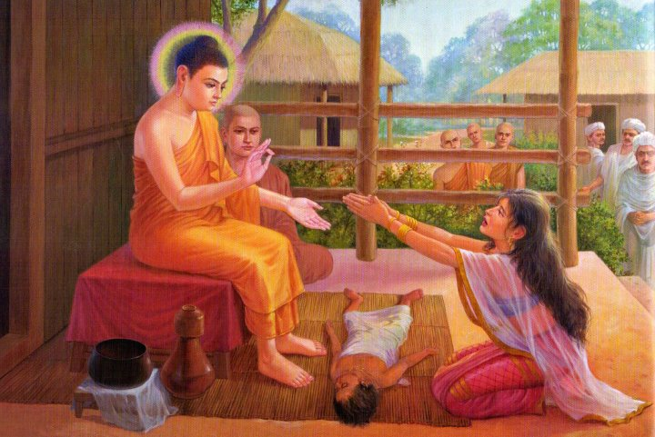
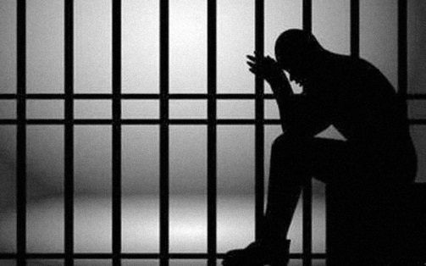
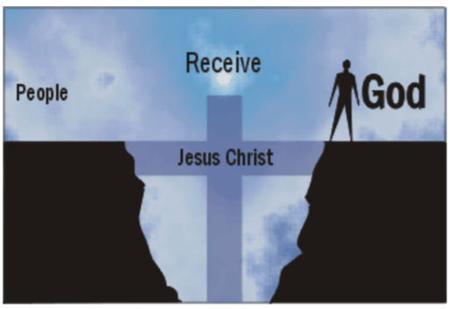
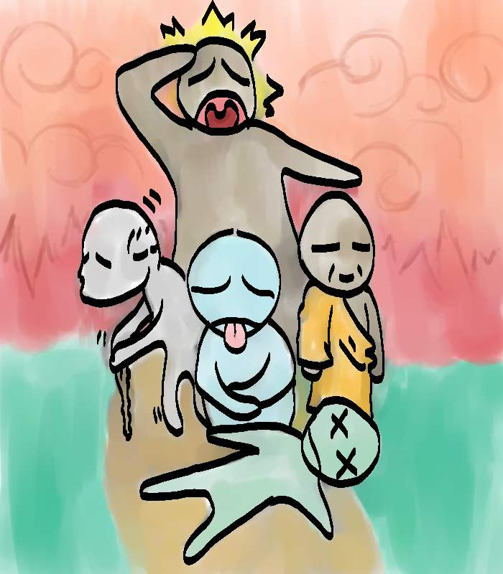
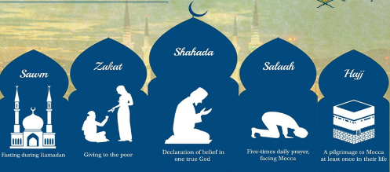
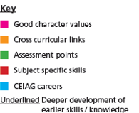
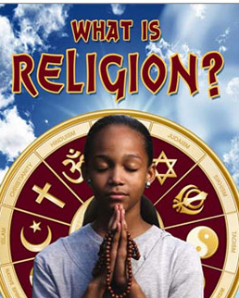
Religious Studies Curriculum Map
Lessons based on areas of strengths & weaknesses in mock 2
Lessons based on areas of strengths weaknesses in mock 1
Gender Equality
Nature of Families
Marriage & Divorce
Human sexuality and Contraception
Religious Attitudes
To criminals
Three Aims of Punishment
Exam
Revision
Mock Exam 2
Exam
Revision
Mock Exam 1
Relationship & Family revision
Reasons for Crime and Key Words
Crime & Punishment revision
What are the main Buddhist Practices?
Pupils discuss the Buddhist Worship and Meditation, festivals, ceremonies associated with death and moral commands.
Identifying key points, explaining the significance and importance, Give contrasting traditional practices, extended writing and evaluation.
Character, tolerance, Health, Emotional intelligence, relationships,
Eng Extended writing, PSHCE mental health,.
Evaluate meditation. Explain religious codes and events
Journalism, youth worker, Politics, Law, Meditation teacher
What are the main Christian Practices?
Pupils discuss the significance and importance of Jesus and Christian Beliefs of salvation.
Identifying key points, explaining the significance and importance, Give contrasting traditional practices, extended writing and evaluation.
Character, tolerance, Health, Emotional intelligence, relationships, responsibility.
Eng Extended writing, PSHCE personal wellbeing.
Evaluate Resurrection. Explain Trinity and Creation accounts.
Journalism, youth worker, Politics, Law, Priest
Just War & Holy War
What are the main Christian Beliefs?
Pupils discuss the significance and importance of Jesus and Christian Beliefs of salvation.
Identifying key points, explaining the significance and importance, Give contrasting traditional beliefs, extended writing and evaluation.
Character, tolerance, Health, Emotional intelligence, relationships, responsibility.
Eng Extended writing, PSHCE social responsibility.
Evaluate Resurrection. Explain Trinity and Creation accounts.
Journalism, youth worker, Politics, Law, Priest
11
Euthanasia
Creation and Evolution
Buddhist Practices
Christian Practices
Life Issues Revision
Peace & Conflict Revision
Violet Protest and terrorism
Abortion
Uses and Abuses of Planet and Animals
Christian Beliefs
What are the main Buddhist Beliefs?
Pupils discuss the significance of the life of the Buddha. The Theravada and Mahayana traditions.
Identifying key points, explaining the significance and importance, Give contrasting traditional beliefs, extended writing and evaluation.
Character, tolerance, Health, Emotional intelligence, relationships, responsibility.
Eng Extended writing, PSHCE mental health.
Evaluate The Four Noble truths. Explain religious beliefs
Journalism, youth worker, Politics, Law, Meditation teacher
How does religion link to Life Issues?
Pupils explore Uses of the planet and animals., Abortion and Euthanasia, Creation and the Afterlife.
Identifying key points, explaining the importance, Give contrasting religions beliefs, extended writing and evaluation.
Character, tolerance, Emotional intelligence, relationships, responsibility.
Eng Extended writing, PSHCE British values and laws.
Evaluate Abortion, Use of fossil fuels. Explain contrasting religious responses to Animals and Euthanasia..
Journalism, youth worker, Politics, Law,
Buddhists Beliefs
10
Life Issues
How does religion link to Peace and Conflict?
Pupils explore causes of war, Just war criteria, forgiveness and types of punishment .
Identifying key points, explaining the importance, Give contrasting religions beliefs, extended writing and evaluation.
Character, tolerance, Emotional intelligence, relationships, responsibility.
Eng Extended writing, PSHCE British values and laws.
Evaluate Weapons of Mass Destruction, and The Rwandan Genocide. Explain contrasting religious responses to war and a Just war.
Journalism, youth worker, Politics, Army, Law
Peace
&
Conflict
9
Crime & Punishment
Relationships & Families
Martin Luther King
How does religion link to Crime and Punishment?
Pupils explore Reasons for Crime, aims of Punishment, forgiveness and types of punishment .
Identifying key points, explaining the importance, Give contrasting religions beliefs, extended writing and evaluation.
Character, tolerance, Emotional intelligence, relationships, responsibility.
Eng Extended writing, PSHCE British values and laws.
Evaluate Capital Punishment, and three aims of punishment. Explain contrasting religious responses to crime
Journalism, youth worker, Politics, Police, Law
How does religion link to relationships and families?
Pupils explore Marriage, Divorce and the nature of families and family planning. Furthermore, we evaluate gender equality in modern society.
Identifying key points, explaining the importance, Give contrasting religions beliefs, extended writing and evaluation.
Character, tolerance, Emotional intelligence, relationships.
Eng Extended writing, PSHCE relationships and Contraception, .
Evaluate Gender Equality, Explain Marriage and Divorce.
Journalism, youth worker, Politics, Marriage Counsellor.
Who was Martin Luther King (MLK)?
Pupils explore the life of MLK and how Christianity influenced him.
Identifying key points, infer from pictures, explaining the importance, extended writing and evaluation.
Character, tolerance, Emotional intelligence, relationships.
Eng Extended writing, Art drawing, .
Evaluate MLK and Malcolm X, Explain the Bus Boycott.
Journalism, youth worker, Teacher of religion, Politics.
Life of Jesus
Buddhism
What is Christianity and who was Jesus?
Pupils explore the life of Jesus and the religion he is the foundation of.
Identifying key points, interpret art, explaining the significance, extended writing and evaluation.
Character, tolerance, Emotional intelligence, relationships.
Eng Extended writing, Art drawing, .
Evaluate Holy week, Spiral Assessment.
Journalism, youth worker, Teacher of religion, Politics.
What is Buddhism and how is it significant today?
Pupils explore the life of Buddha and Buddhist teachings.
Understanding, identifying key points, explaining the significance, extended writing and evaluation.
Character, tolerance, Emotional intelligence, relationships.
Eng Extended writing, Art drawing.
Evaluate the Three Marks of Existence, Meditation and Explain significance of Buddhist teaching today.
Journalism, youth worker, Teacher of religion, yoga instructor.
8
What are the main Jewish beliefs?
Pupils explore historic people and how they shaped Jewish beliefs..
Identifying key points, Recalling, Explaining, creative writing.
Self-control, cooperation, ​
PSHE: Working as a team,, extended writing Eng.
Creative evaluation about the life of Moses​
Writer, Journalism, Youth worker, Teacher of religion, Politics.
Semitic Religion Islam
Indian Religions: Hinduism
Indian Religions: Sikhism
Semitic religions: Judaism
What are the main Islamic beliefs?
Pupils explore Muhammad & the 5 Pillars of Islam.
Identifying key points, Recalling, Explaining, Evaluation.
Tolerance, Empathy ​
PSHE: different social culture, Extended writing.
Spiral Assessment, Evaluation about 5 Pillars.
Imam, Journalism, Youth worker, Teacher of religion, Politics.
What are the main Hindu beliefs?
Pupils explore the Trimurt, reincarnation and Diwali.
Identifying key points, Recalling, Explaining.
Tolerance, Empathy ​
PSHE: different social culture, Eng Extended writing.
Explain main Hindu beliefs
Journalism, Youth worker, Teacher of religion, Politics.
What is a Gurdwara?
Pupils explore the Sikhism through their Holy Building.
Identifying key points, Recalling, Explaining.
Tolerance, emotional intelligence
PSHE: different social culture, Eng Extended writing.
Spiral end of year Assessment, Explaining Evaluating
Journalism, Youth worker, Teacher of religion, Politics.
Greek Mythology
Introduction to Religion
7
What is Greek Mythology?
Pupils explore Greek Mythology and fables..
Understanding, interpreting, creative writing.
Character, Emotional intelligence.
Eng Extended writing.
Create a modern -day fable with a meaning.
Journalism, novelist, Teacher of religion, Politics.
What are the main six religions?
Pupils explore the basic symbols and beliefs of the major world religions.
Identifying key points. Sorting, Recalling, Explaining, Evaluating.
Resilience, self-control, cooperation, ​
PSHE: Social cohesion lessons. Working as a team Extended writing Eng.
Opinion on religious viewpoint. Evaluation on whether “Britain should ban the Burqa” ​
Journalism, Youth worker, Teacher of religion, Politics.

