Slide 1

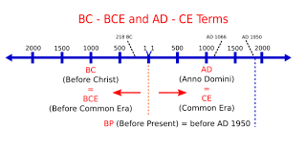
Year 7 History: 1A
How did migration shape early England?
KPIs
KPI 1: I can describe the different groups who migrated to England.​
​
KPI 2: I can explain why people migrated to England.​
​
KPI 3: I can evaluate how different migrant groups impacted England.
Key Term | Definition
Chronology | In time order.
Source | Evidence from the time period.
Invasion | Another country taking over land.
Migration | Movement from one place to another.
Infrastructure | Roads, buildings and towns that build up a society.
Agriculture | Farming to grow food.
Significant | Important / biggest / most to blame
AD / CE BC / BCE | AD – Anno Domini. CE – Common Era BC – Before Christ. BCE – Before Common Era
Causes for migration:
Sea routes to other countries
Natural resources such as tin, silver, honey and wool
Gaining power
Trade within England for wealth
Fertile land to settle and live on
Wealth such as gold to steal and sell
Impact of migration:
New developments: aqueducts, exotic food, towns and cities and ice skates
Economy: more trade within England and using sea routes, markets and towns, a coin mint created
Language: New words such as husband and July
Laws and government.
Groups of early migrants:
Romans: A powerful empire began in Rome but spread across Europe and into North Africa.
Saxons: People from modern day Germany who split England into 7 kingdoms.
Vikings: People from Scandinavia who raided and then settled in England.
Key Quote:
Anglo-Saxon Chronicles:
"the harrowing inroads of heathen men destroyed the church of God in Lindisfarne by robbery and slaughter."​

Slide 2
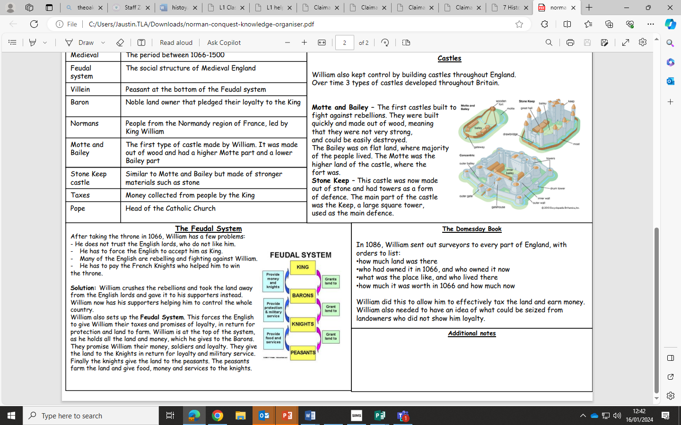
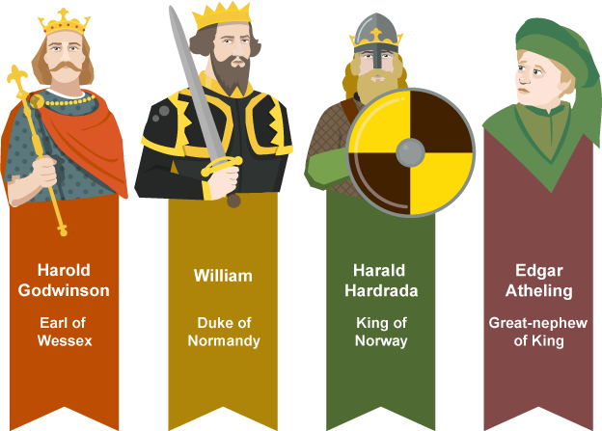
Year 7 History 1B
How did life in England change under the Normans?
Key Term | Definition
Feudal System | The way the Normans organised political society.
Hierarchy | Political society being arranged with the most powerful at the top of the triangle and the least at the bottom.
Harrying of the North | Destruction of towns and people in the North of England to keep control.
Domesday Book | A description of all towns and villages in England.
Motte & Bailey Castles | Temporary castles made of earth and wood.
KPIs
KPI 1: I can describe the different changes to England under the Normans.​
​
KPI 2: I can explain how William the conqueror gained control over England.
​
KPI 3: I can evaluate how far England changed during the Norman conquest.
Key Quotes
“I attacked the English of the Northern Shires like a lion. I ordered their houses and corn, with all their belongings, to be burnt without exception and large herds of cattle and beasts of burden to be destroyed wherever they were found. It was there I took revenge on masses of people by subjecting them to a cruel famine; and by doing so — alas!— I became the murderer of many thousands of that fine race.
William the Conqueror

Slide 3
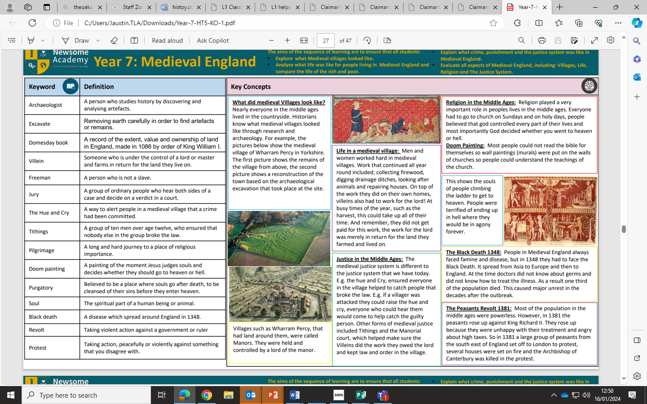
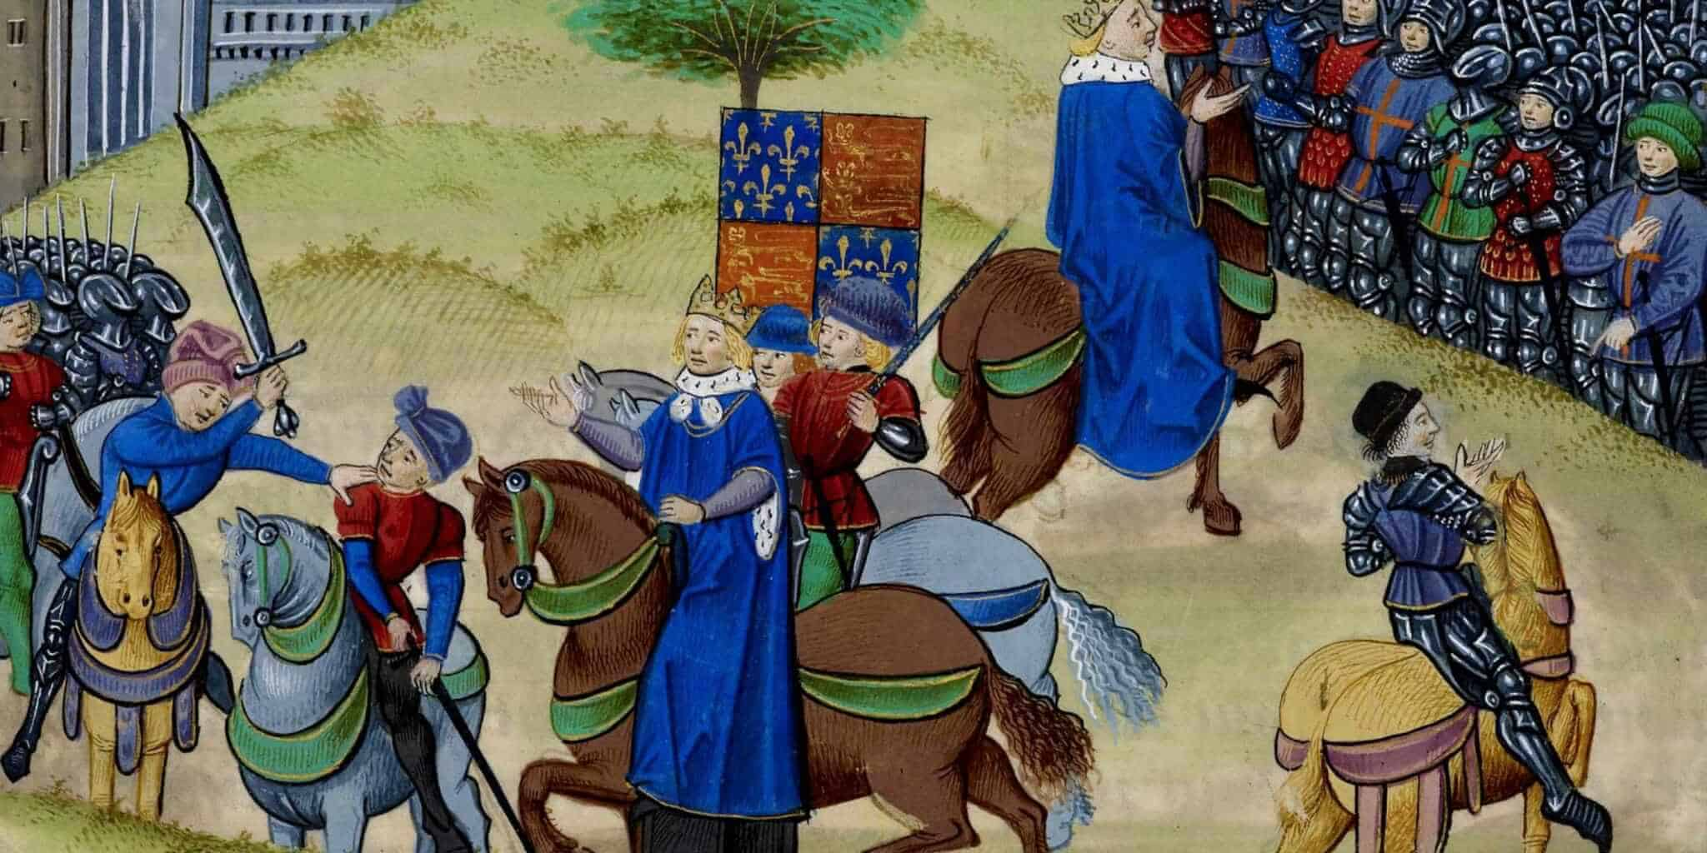
Year 7 History 2A
Why did peasants try to overthrow the king?
Key Term | Definition
Peasant | Poor people who were given land in exchange for work on the Lord’s land.
Revolt | A violent uprising against the government or leader.
Open field System | A type of farming where people shared fields.
Murdrum Fine | A fine paid by everyone in the village if a Norman was murdered.
Purgatory | A place in between heaven and hell.
Clergy | Members of the church.
KPIs
KPI 1: I can describe the different events of the Medieval period.​
​
KPI 2: I can explain what challenges peasants faced in the Medieval period.
​
KPI 3: I can evaluate the reasons that peasants wanted to overthrow the government.
Key Quotes
“Farming is a profession of hope. Every year the spring comes. And every year we plant those crops and try again. Every. Single. Year.”
Brett Brian

Slide 4
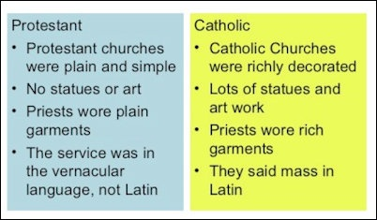
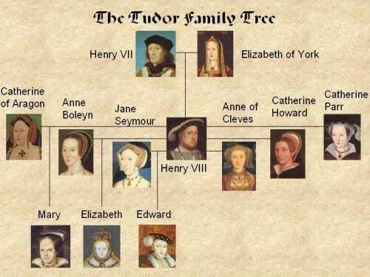
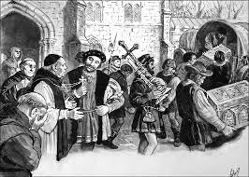
Year 7 History 2B
Why did Henry VIII change England’s religion?
Key Term | Definition
Catholic | Christian religion set up by the Romans which included most people in Europe. Still led ed by the Pope from Rome today.
Protestant | A newer type of Christian religion set up by people who protested against the Catholic Church.
Dissolution | To dissolve/break up something.
Monarch | A King or Queen.
Heir | The next person in line for the throne.
Tyrant | A cruel and oppressive ruler.
KPIs
KPI 1: I can describe the different events of the Tudor reign.
​
KPI 2: I can explain the reasons why Henry VIII changed England’s religion.
​
KPI 3: I can evaluate the significance of the English Reformation.
Key Quotes
“It is not unusual among us to see men who had spoken badly against King Henry to be hunted down, hung, quartered or beheaded..”

Slide 5
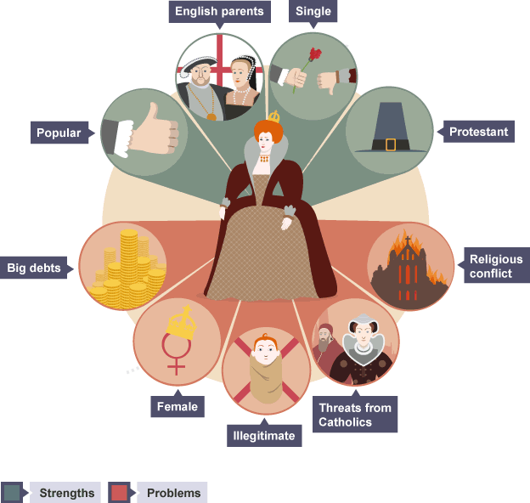
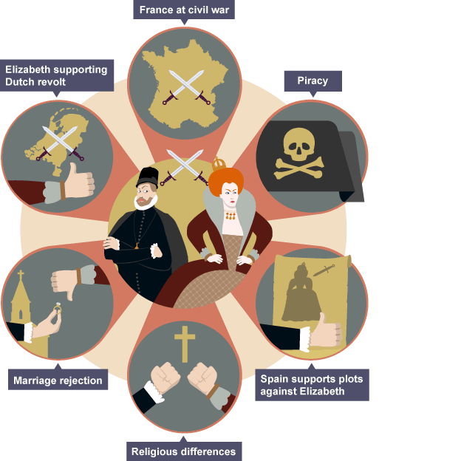
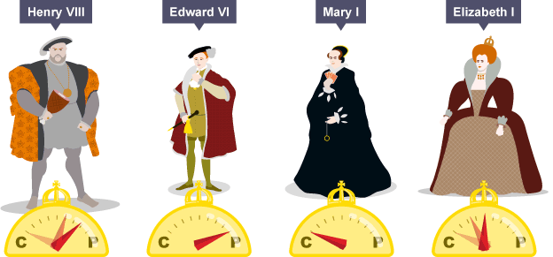
Year 7 History 3A
How did conflict between cousins lead to war?
Key Term | Definition
Legitimacy | The legal right to do something, particular to rule as king/queen.
Compromise | A middle ground between two solutions to try and solve an issue.
Heir | The person next in line to the throne.
Treason | A crime against the country, such as assassination attempts on a monarch.
Alliance | A friendship between two or more countries or groups.
Armada | A Spanish fleet of ships/navy.
KPIs
KPI 1: I can describe the different challenges Elizabeth I faced.
​
KPI 2: I can explain the reasons for conflict between Elizabeth I and Mary Queen of Scots.
​
KPI 3: I can evaluate the importance of the reasons for war between England and Spain.
Key Quotes
“I know I have the body of a weak and feeble woman, but I have the heart and stomach of a king, and of a king of England too.”
Elizabeth I

Slide 6
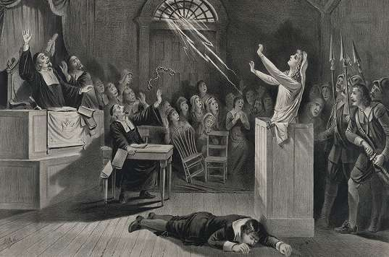
Year 7 History 3B
Why did thousands die in a witch craze?
Key Term | Definition
Renaissance | The time period of 1500-1700 showing a renewal of old ideas.
Superstition | A belief in something without factual evidence.
Argumentative | Someone who is confrontational and argues with others.
Witch Finer | A person, particularly Matthew Hopkins, who attempts to find witches to make them confess.
Torture | The act of inflicting pain until someone confesses information.
Harvest | The growing and collection of crops.
KPIs
KPI 1: I can describe the treatment that suspected and accused witches faced.
​
KPI 2: I can explain what led to a person being accused of witchcraft.
KPI 3: I can evaluate the importance of the causes of the witch crazes.
Beliefs about witchcraft:
witches were often older, poor women who wanted money or power.
Witches made deals or pacts with the devil, giving their souls in exchange for powers.
Witches could command demons and curses through giving things to the devil
On a Sunday at midnight on a full moon, witches and demons would meet up to dance, make potions and sacrifices. This was known as the Sabbath.
Protections against witchcraft:
People protected themselves against witches using religious methods such as prayer and blessings
People used witch marks to protect the threshold of their homes from witches
People used superstitious methods such as holding good luck charms
People returned insults and did not let a suspected witch have the last word
The body of a witch had to be burnt.
Key Quotes
“Innocent have I come to prison, innocent have I been tortured, innocent must I die. For whosever comes into the witch prison must become a witch or be tortured until he invents something out of his head…they first stripped me, bound my hands behind me, and drew me up in torture…I suffered terrible agony…one torture will follow after another until you say you are a witch.” Johannes Junius

