Slide 1

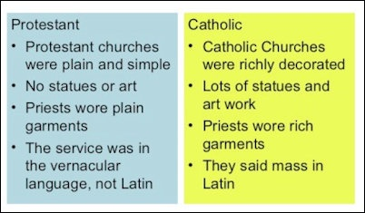
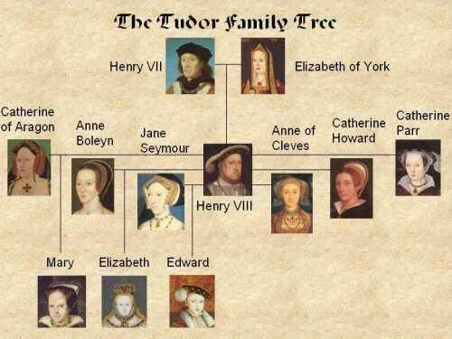
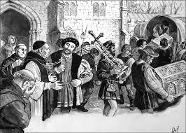
Year 8 History 1A
Why did Henry VIII change England’s religion?
Key Term | Definition
Catholic | Christian religion set up by the Romans which included most people in Europe. Still led ed by the Pope from Rome today.
Protestant | A newer type of Christian religion set up by people who protested against the Catholic Church.
Dissolution | To dissolve/break up something.
Monarch | A King or Queen.
Heir | The next person in line for the throne.
Tyrant | A cruel and oppressive ruler.
KPIs
KPI 1: I can describe the different events of the Tudor reign.
​
KPI 2: I can explain the reasons why Henry VIII changed England’s religion.
​
KPI 3: I can evaluate the significance of the English Reformation.
Key Quotes
“It is not unusual among us to see men who had spoken badly against King Henry to be hunted down, hung, quartered or beheaded..”

Slide 2
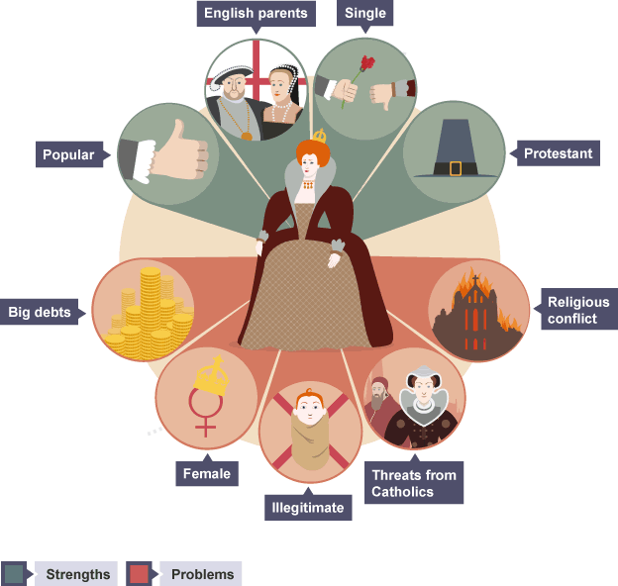
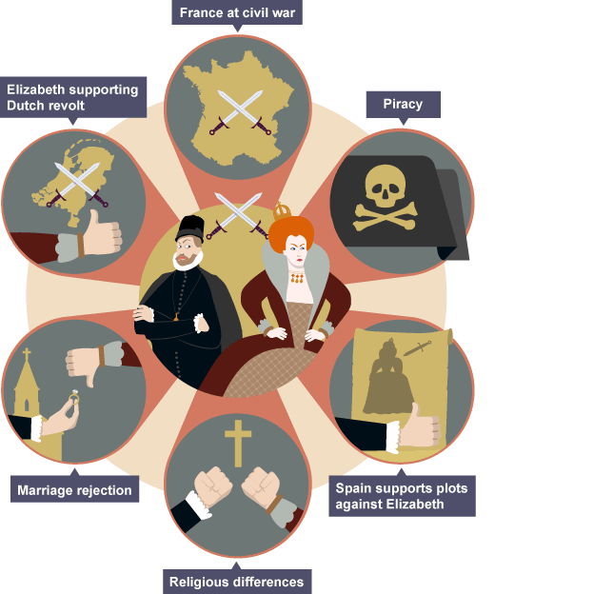
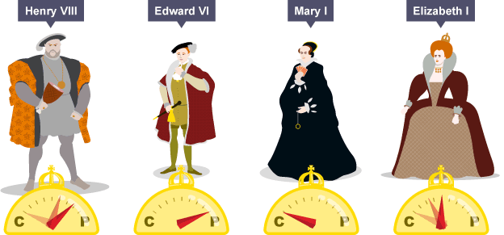
Year 8 History 1B
How did conflict between cousins lead to war?
Key Term | Definition
Legitimacy | The legal right to do something, particular to rule as king/queen.
Compromise | A middle ground between two solutions to try and solve an issue.
Heir | The person next in line to the throne.
Treason | A crime against the country, such as assassination attempts on a monarch.
Alliance | A friendship between two or more countries or groups.
Armada | A Spanish fleet of ships/navy.
KPIs
KPI 1: I can describe the different challenges Elizabeth I faced.
​
KPI 2: I can explain the reasons for conflict between Elizabeth I and Mary Queen of Scots.
​
KPI 3: I can evaluate the importance of the reasons for war between England and Spain.
Key Quotes
“I know I have the body of a weak and feeble woman, but I have the heart and stomach of a king, and of a king of England too.”
Elizabeth I

Slide 3
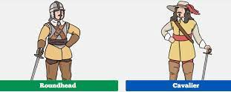
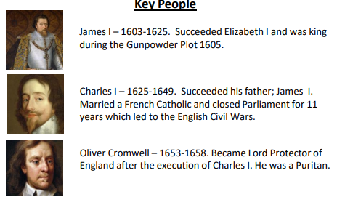
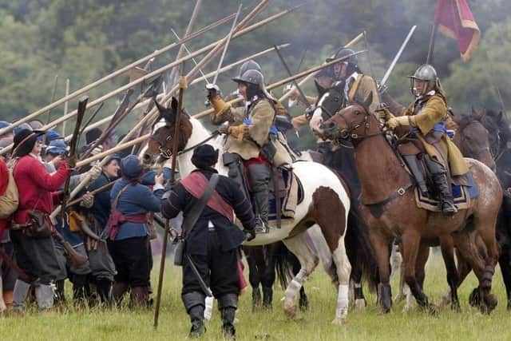
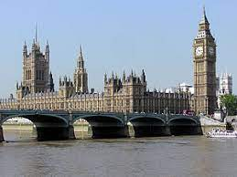
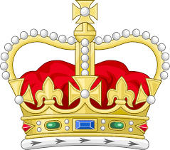
Year 8 History 2A
How far did the Civil War change England?
Key Term | Definition
Parliament | The place and organisation where politicians discuss how to run the country.
Government | A group of people who help the King to run the country or run it themselves.
Divine Right | The King’s right to rule which has been given to him by god.
Civil War | A war between two sides from the same country.
Roundheads | Soldiers who fight for Parliament to rule England.
Cavillers | Soldiers who fight for the King to rule England.
KPI 1: I can describe the two groups involved in the English Civil War.
​
KPI 2: I can explain the causes of the English Civil War.
​
KPI 3: I can evaluate how far England changed during and after the English Civil War.
Key Quotes
“I tell you we will cut off his head with the crown upon it .”
Cromwell to one of the judges at the trial of King Charles I.1648.
VS!

Slide 4
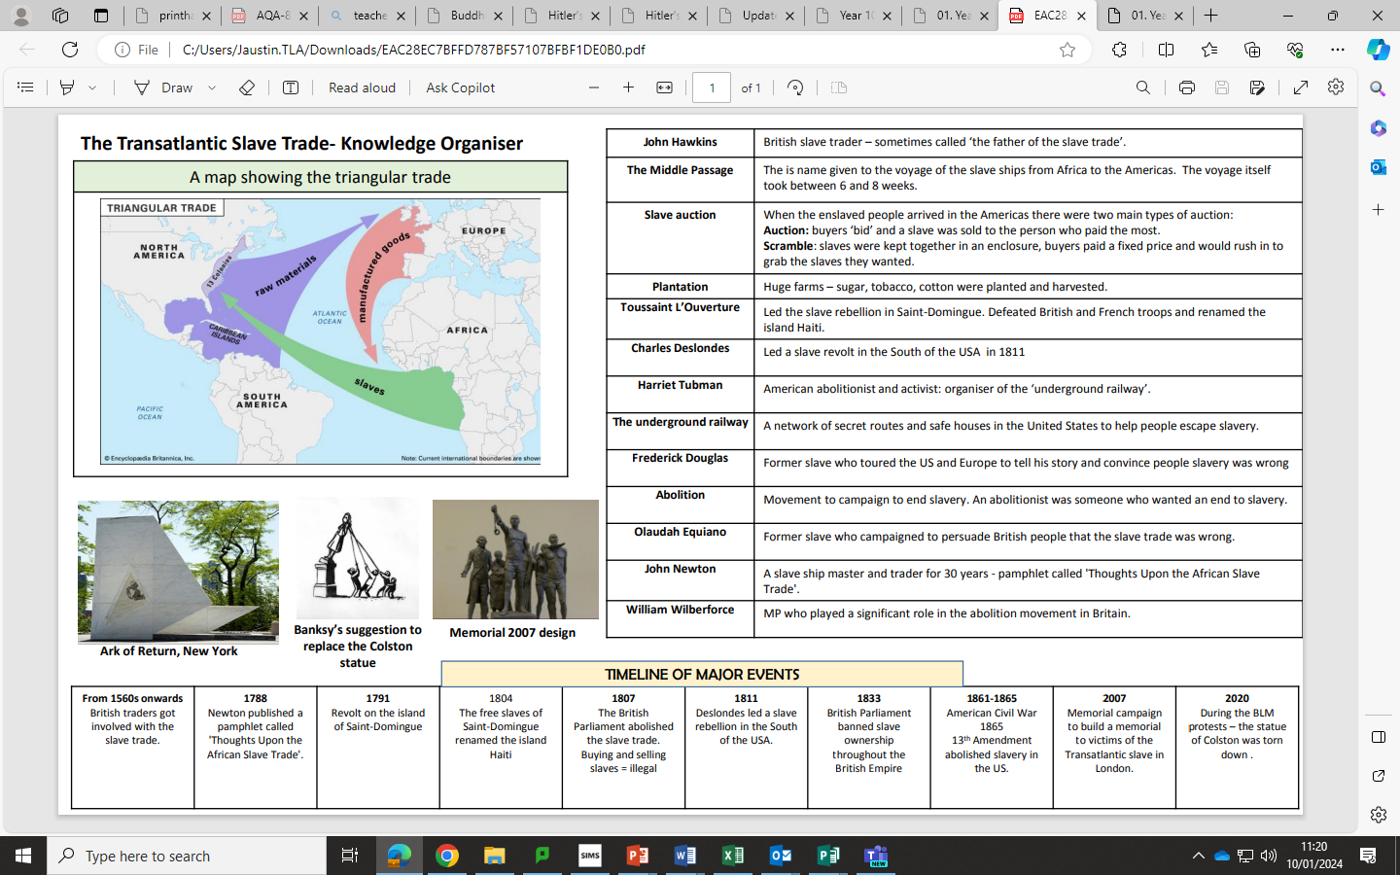
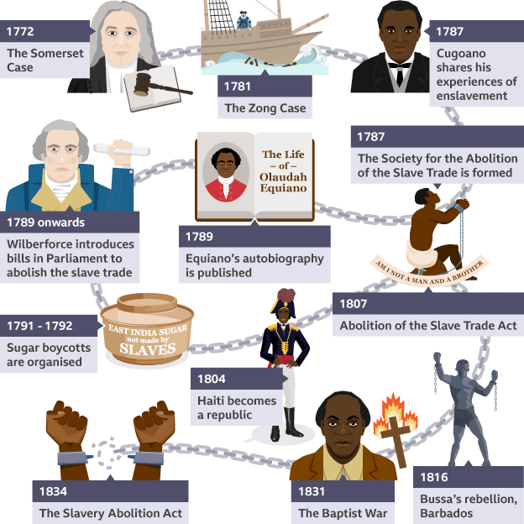
Year 8 History 2B
How did the British Empire change African society?
Key Term | Definition
Empire | A group of countries controlled by a master country.
Colony | A country which is part of an empire.
Triangular Trade | The way ships picked up people in Africa, sold them in America, bought goods there and then imported them to Britain.
Plantations | Large farms that used slave labour.
Underground Railroad | A secret network of safehouses to help slaves escape.
Abolition | To get rid of something. E.g. “Slavery was Abolished.”
KPI 1: I can explain the reasons why Britain wanted an Empire.
​
KPI 2: I can explain the reasons for the abolition of slavery.
KPI 3: I can analyse sources showing the treatment of enslaved people.
KEY QUOTES
“If slavery is not wrong, nothing is wrong.”
Abraham Lincoln

Slide 5
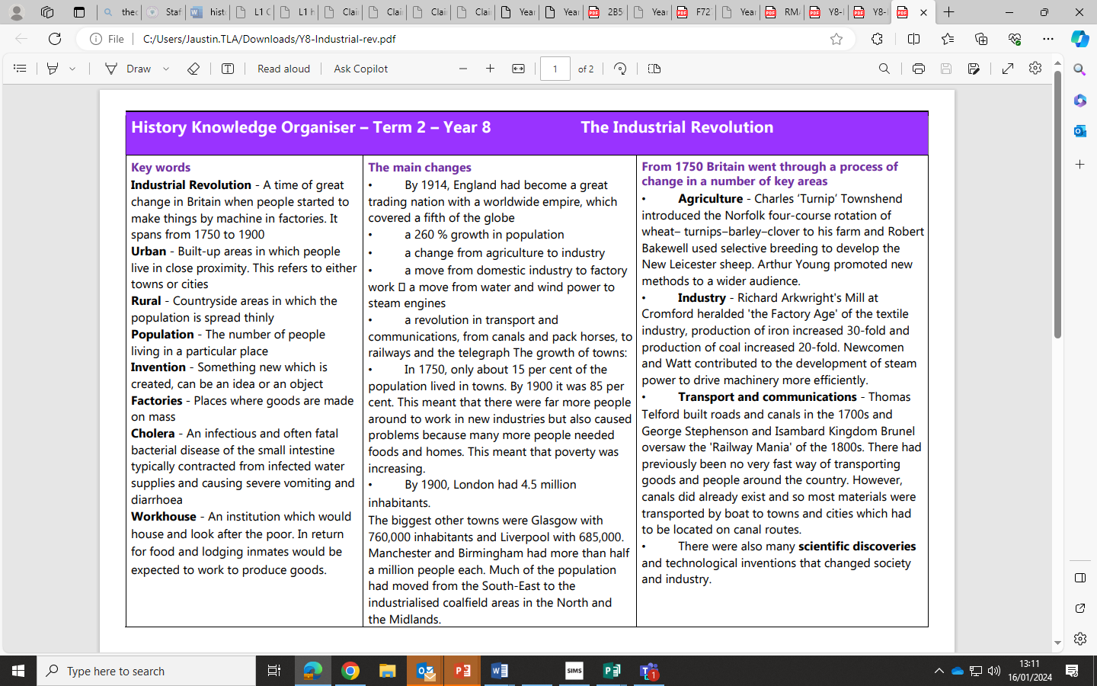
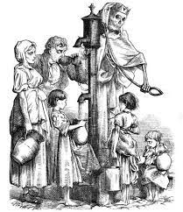
Year 8 History 3A
What was life like in the Industrial Revolution?
Key Term | Definition
Agricultural | Anything to do with farming.
Industrial | Anything to do with industry factories and mines.
Revolution | A change in the way things are done.
Migration | People moving from one place to another for work or better living conditions.
Cholera | A deadly water born disease which is caught from drinking dirty water.
Sewage | Human toilet waste.
Thames | The large river that runs through London.
KPI 1: I can describe the conditions of lives in the Industrial Revolution.
​
KPI 2: I can explain the reasons why workplaces were dangerous in the Industrial Revolution.
KPI 3: I can evaluate the most important developments during the Industrial Revolution.
Key Quotes:
“Shine forth upon our clouded hills?
And was Jerusalem builded here,
Among these dark Satanic Mills?”’
Jerusalem by William Blake

Slide 6
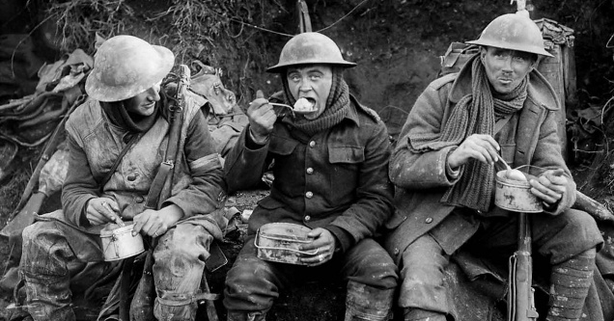
Year 8 History 3B
How did World War One change the world?
Long term causes of WW1
Militarism | An emphasis on military ideals and strength. Wanting your country to have a strong Army and navy.
Alliances | A group of counties who promise to support and protect each other. Rival groups Have rival alliances. For a number of years tension between the main European powers has been increasing. In 1914 there were two main power blocks / alliances: The Triple Entente- Great Britain / France / Russia The Triple Alliance- Germany / Italy and Austria-Hungary Each member promised to help its allies if they were attacked by a country belonging to another alliance.
Imperialism | The desire to conquer colonies, especially in Africa. This brought the powers into Conflict: Germany wanted an empire. France and Britain already had empires.
Nationalism | The belief that your country is better than others. This made nations assertive and aggressive
Short term cause of WW1-The Assassination of Franz Ferdinand
Cause: In 1914 Austria owned Bosnia. Many Bosnians hated Austria and wanted to be free- known as Nationalism .The Archduke Franz Ferdinand was to become the next Emperor of Austria, so many Bosnians wanted to kill him. Many of these were part of the Black Hand group.
Events: Archduke Franz Ferdinand was inspecting the army in Sarajevo with his wife Sophie. Seven young Bosnian Serbs planned to assassinate Franz Ferdinand as he drove along the main road in Sarajevo. The first conspirator who tried to kill Franz Ferdinand threw a bomb at his car. He missed and was arrested. He decided to abandon the visit and return home via a different route to the one planned. No one had told the driver the route had changed. Unfortunately, the car stopped in front of Gavrilo Princip, one of the conspirators, who was on his way home thinking he had failed. Princip pulled out a gun and shot at Franz Ferdinand. Both he and his wife were killed.
Consequences: Austria-Hungary immediately blamed the Serbian government for the attack. On July 28, Austria-Hungary declared war on Serbia, and the fragile peace between Europe’s great powers collapsed, beginning the devastating conflict now known as the First World War.
Key Term | Definition
Alliance System | Two groups of countries who promise to protect each other: (UK/Fr/Rus) vs (Ger/Aus/It).
Arms Race | A race to build the biggest armies and navies.
Imperialism | Having or wanting an empire.
Propaganda | Persuasive information to make people believe or do something.
Revolution | A violent overthrow of an existing government (Russa in this case).
Armistice | A peace agreement. Like the Treaty of Versailles. (See below)
Treaty of Versailles | Blame - Germany’s Fault Reparations – £6.6 Billion Army – 100,000 only Territory – Loss of land
Reparations | Compensation repayments.
KPI 1: I can describe the key battles and weapons during the First World War.
​
KPI 2: I can explain the reasons why the world went to war in 1914.
KPI 3: I can evaluate the most important changes during the First World War.
KEY QUOTES
“We're telling lies; we know we're telling lies; we don't tell the public the truth, that we're losing more officers than the Germans, and that it's impossible to get through on the Western Front.”
Lord Rothermere, 1917

