Slide 1

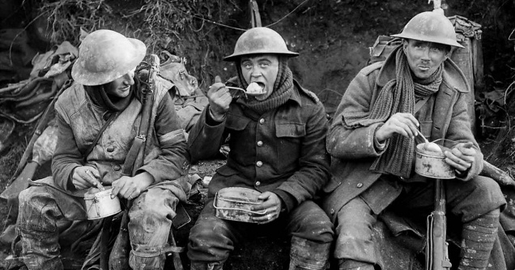
Year 9 History 1A
How did World War One change the world?
Long term causes of WW1
Militarism | An emphasis on military ideals and strength. Wanting your country to have a strong Army and navy.
Alliances | A group of counties who promise to support and protect each other. Rival groups Have rival alliances. For a number of years tension between the main European powers has been increasing. In 1914 there were two main power blocks / alliances: The Triple Entente- Great Britain / France / Russia The Triple Alliance- Germany / Italy and Austria-Hungary Each member promised to help its allies if they were attacked by a country belonging to another alliance.
Imperialism | The desire to conquer colonies, especially in Africa. This brought the powers into Conflict: Germany wanted an empire. France and Britain already had empires.
Nationalism | The belief that your country is better than others. This made nations assertive and aggressive
Short term cause of WW1-The Assassination of Franz Ferdinand
Cause: In 1914 Austria owned Bosnia. Many Bosnians hated Austria and wanted to be free- known as Nationalism .The Archduke Franz Ferdinand was to become the next Emperor of Austria, so many Bosnians wanted to kill him. Many of these were part of the Black Hand group.
Events: Archduke Franz Ferdinand was inspecting the army in Sarajevo with his wife Sophie. Seven young Bosnian Serbs planned to assassinate Franz Ferdinand as he drove along the main road in Sarajevo. The first conspirator who tried to kill Franz Ferdinand threw a bomb at his car. He missed and was arrested. He decided to abandon the visit and return home via a different route to the one planned. No one had told the driver the route had changed. Unfortunately, the car stopped in front of Gavrilo Princip, one of the conspirators, who was on his way home thinking he had failed. Princip pulled out a gun and shot at Franz Ferdinand. Both he and his wife were killed.
Consequences: Austria-Hungary immediately blamed the Serbian government for the attack. On July 28, Austria-Hungary declared war on Serbia, and the fragile peace between Europe’s great powers collapsed, beginning the devastating conflict now known as the First World War.
Key Term | Definition
Alliance System | Two groups of countries who promise to protect each other: (UK/Fr/Rus) vs (Ger/Aus/It).
Arms Race | A race to build the biggest armies and navies.
Imperialism | Having or wanting an empire.
Propaganda | Persuasive information to make people believe or do something.
Revolution | A violent overthrow of an existing government (Russa in this case).
Armistice | A peace agreement. Like the Treaty of Versailles. (See below)
Treaty of Versailles | Blame - Germany’s Fault Reparations – £6.6 Billion Army – 100,000 only Territory – Loss of land
Reparations | Compensation repayments.
KPI 1: I can describe the key battles and weapons during the First World War.
​
KPI 2: I can explain the reasons why the world went to war in 1914.
KPI 3: I can evaluate the most important changes during the First World War.
KEY QUOTES
“We're telling lies; we know we're telling lies; we don't tell the public the truth, that we're losing more officers than the Germans, and that it's impossible to get through on the Western Front.”
Lord Rothermere, 1917

Slide 2
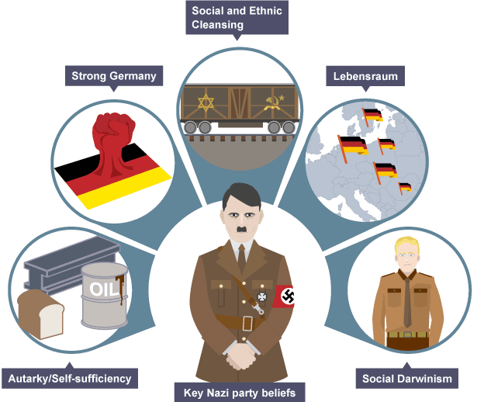
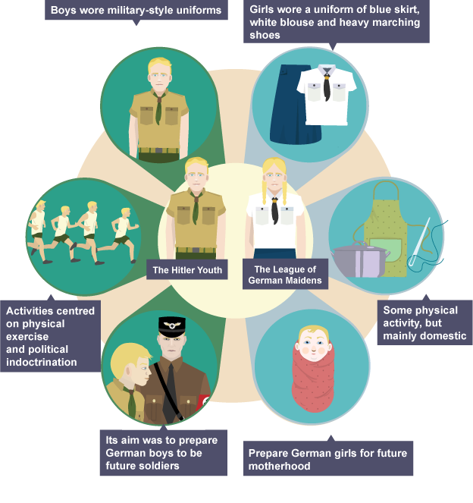
Year 9 History 1B
What was life like under Nazi Germany?
Key Term | Definition
Aryan | The group of people that Hitler saw as ideal, white, non-Jewish people of German ancestry.
Eugenics | The unsupported study of races with the goal of breeding an ideal race.
Antisemitism | Discrimination against Jewish people.
Propaganda | Persuasive information to make people believe or do something.
Censorship | The act of the government to ban certain speech and information.
Dictator | A single person in complete control of a country.
Gestapo | The secret police in Nazi Germany with power to torture, spy and arrest.
Persecution | Poor treatment of others based on race, class, gender, sexuality or other reasons.
KPI 1: I can describe the key events of life under Nazi Germany.
​
KPI 2: I can explain the methods that Hitler used to control Germany.
KPI 3: I can evaluate the extent to which people suffered under Nazi Germany.
KEY QUOTES
An extract from Hitler’s speech on May Day 1933
“When an opponent declares, ‘I will not come over to your side,’ I calmly say, ‘Your child belongs to us already. You will pass on. Your children, however, now stand in our camp.”

Slide 3
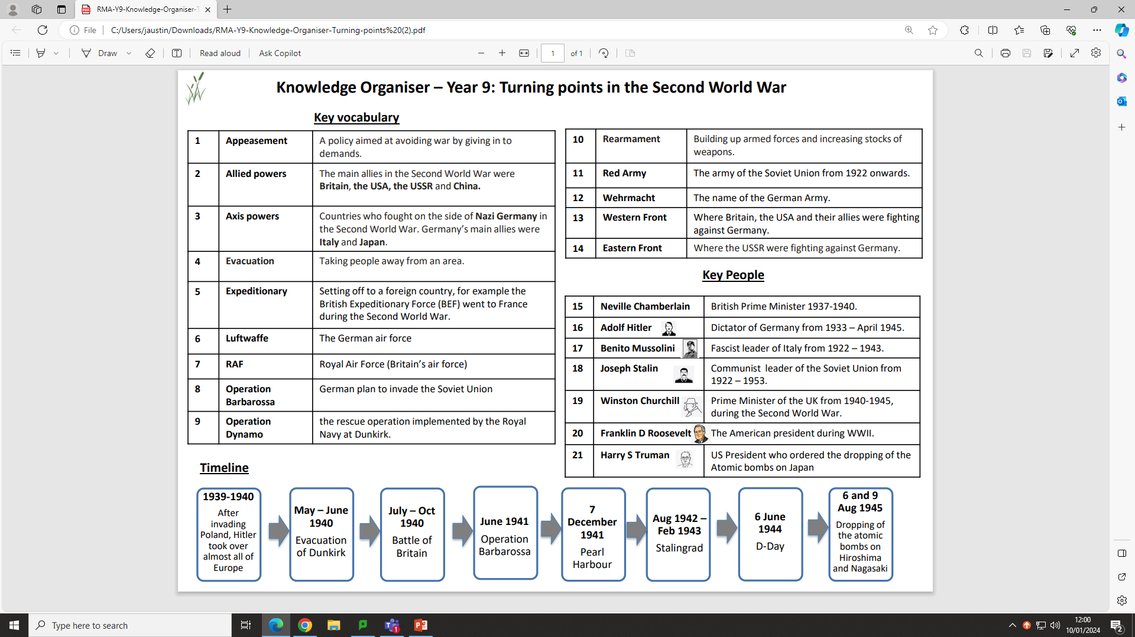
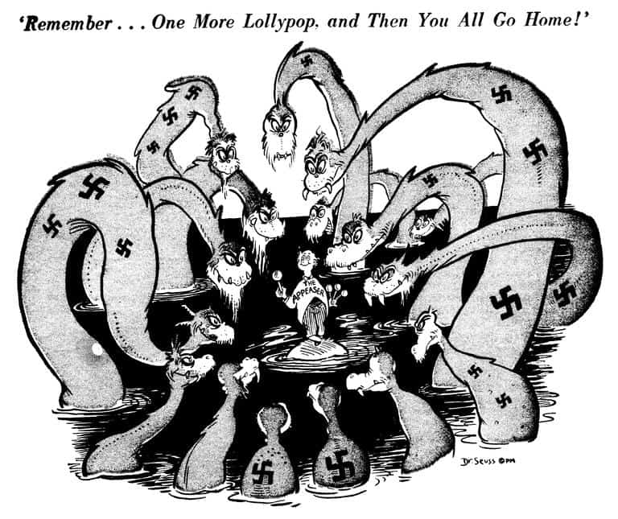
Year 9 History 2A
How was Nazi Germany defeated?
Key Term | Definition
Treaty of Versailles | Blame - Germany’s Fault Reparations – £6.6 Billion Army – 100,000 only Territory – Loss of land
Appeasement | Giving in to someone else's demands.
Communism | A political system where everyone is equal and the government own all property. No fashion/religion.
League of Nations | A large group of countries who work together to prevent wars.
Economic Depression | When businesses go bust, people lose their jobs and no one is spending any money.
Non Aggression Pact | Agreement between Stalin and Hitler not to attack each other.
Cold War | A war between capitalist USA and communist Russia where thy would not fight directly as it would cause global nuclear war.
KPI 1: I can describe the key battles and weapons during the Second World War.
​
KPI 2: I can analyse and make inferences from sources showing key events of WWII.
KPI 3: I can evaluate the most important turning points of the Second World War.
KEY QUOTES
“We shall defend our island, whatever the cost may be, we shall fight on the beaches, we shall fight on the landing grounds, we shall fight in the fields and in the streets, we shall fight in the hills; we shall never surrender.”
Winston Churchill 4 June 1940

Slide 4
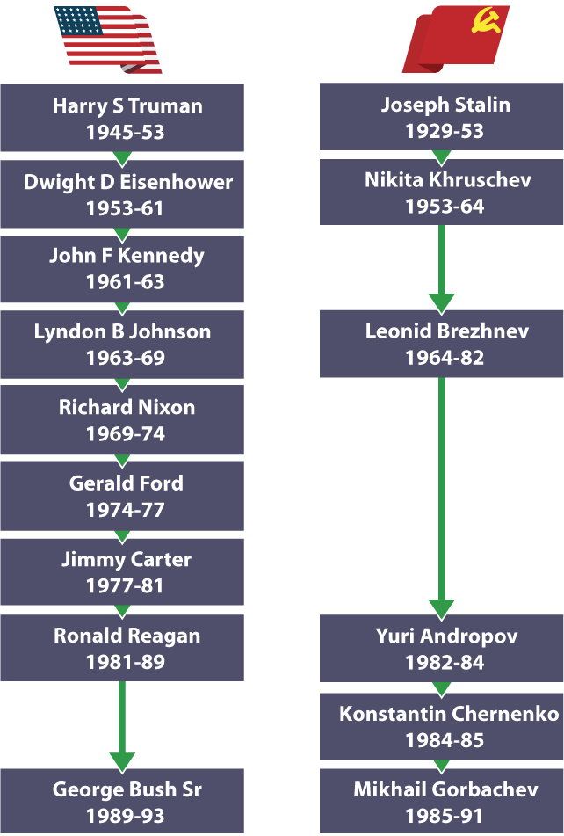
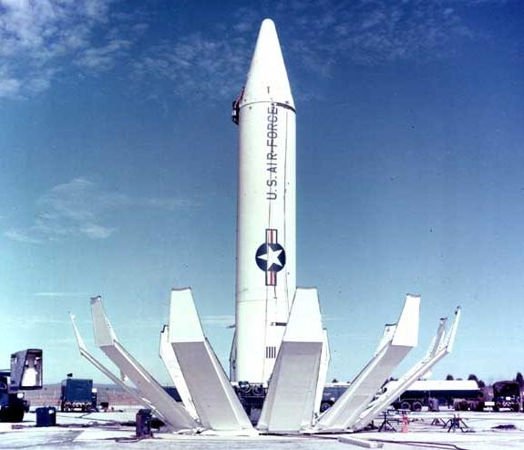
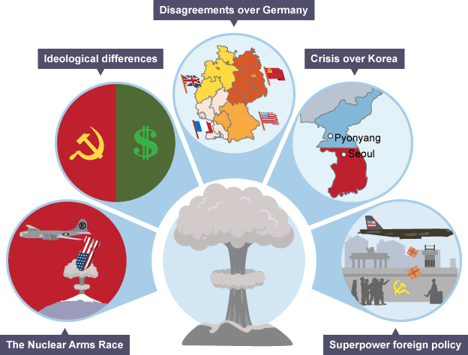
Year 9 History 2B
How did friends become enemies in the Cold War?
Key Term | Definition
Capitalism | A way of organising society with large wealth gaps and freedoms.
Communism | A way of organising society with total equality in money but lack of freedom
Ideology | A belief system.
Satellite State | A country under heavy influence of another country.
Censorship | The act of the government to ban certain speech and information.
Refugee | A person fleeing a dangerous situation to find safety elsewhere.
Missile | A weapon which is self-propelled towards a target, often holding nuclear weapons.
Cold War | Intense tension between the Capitalist West and Communist East without any direct fighting.
KPI 1: I can describe the beliefs in Capitalism and Communism.
​
KPI 2: I can explain the key reasons for tension between the East and West during the Cold War.
KPI 3: I can evaluate the most important turning points of the Cold War.
KEY QUOTES
“Today, in the world of freedom, the proudest boast is "Ich bin ein Berliner!"... All free men, wherever they may live, are citizens of Berlin, and therefore, as a free man, I take pride in the words "Ich bin ein Berliner!”
President JFK of the USA in Berlin in 1963

Slide 5
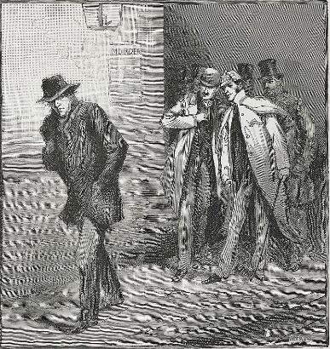
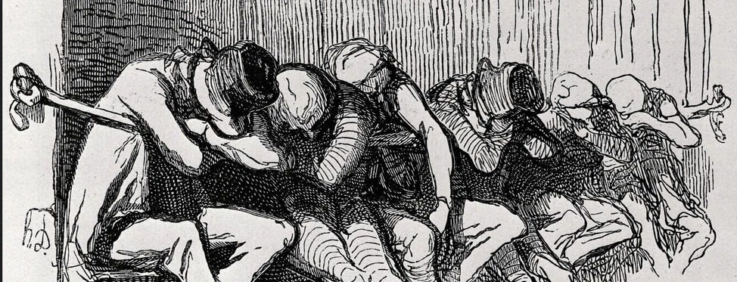
Year 9 History 3A
Who was Jack the Ripper?
Victims:
Mary Ann Nichols
Annie Chapman
Elizabeth Stride and Catherine Eddowes
Mary Jane Kelley
Key Term | Definition
Whitechapel | An area in the East End of London.
Poverty | When people cannot afford to meet their basic needs.
Two-Penny Hangover | A place where people could pay 2p to sleep over a rope for the night.
Victim | A person who suffers from a crime, for example a person who is robbed.
Suspect | A person who is thought to have committed a crime.
Perpetrator | A person who has committed a crime.
Mutilate | To damage and disfigure someone’s appearance with a weapon.
Anatomical | Relating to the structure of the human body, for example where body parts are.
KPI 1: I can describe the context of Whitechapel in 1888.
​
KPI 2: I can explain the key problems with the Jack the Ripper investigation of 1888.
KPI 3: I can evaluate the potential suspects in the Jack the Ripper case.
Suspects:
Aaron Kosminski – A Jewish Polish Barber who lived in Whitechapel
MJ Druitt – a young lawyer, trained as a doctor
Prince Albert Victor – Queen Victoria’s grandson who often visited Whitechapel
James Maybrick – A Liverpudlian cotton merchant who worked in London and hated women.
Francis Tumblety – An American doctor who fled to England.
KEY QUOTES
“I shan't quit ripping them till I do get buckled. Grand work the last job was. I gave the lady no time to squeal., How can they catch me now.”
The Dear Boss letter, claimed to be written by Jack the Ripper in 1888.

Slide 6
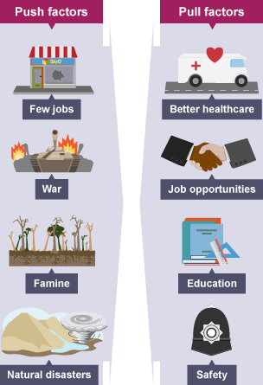
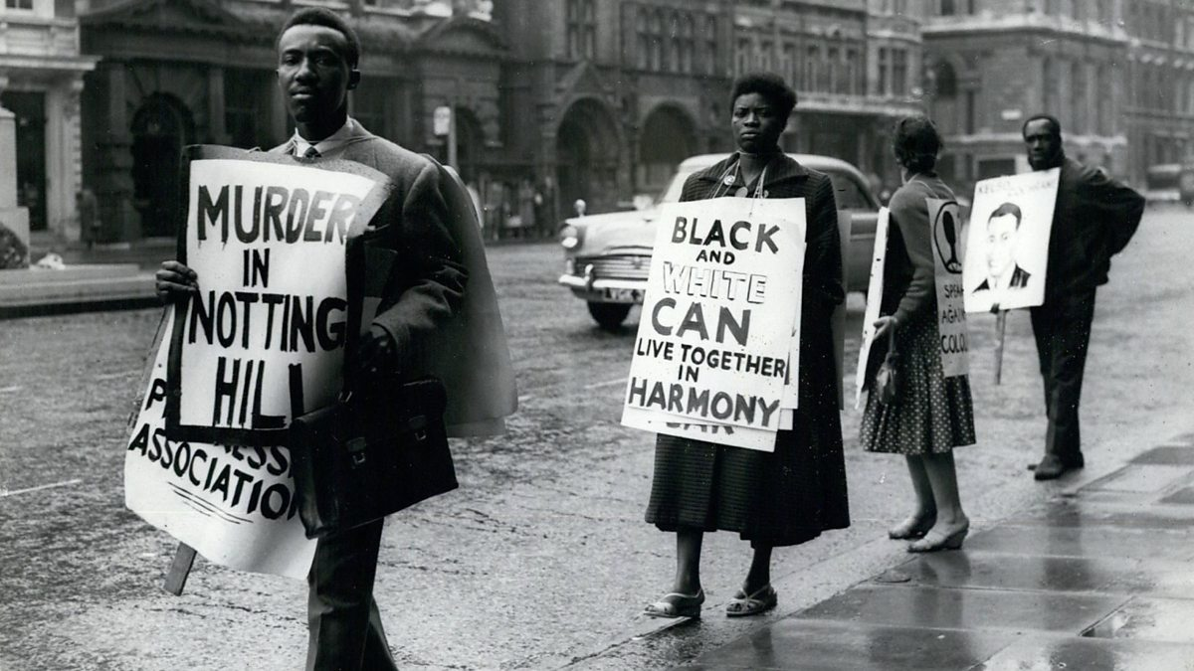
Year 9 History 3B
What was life like in Notting Hill after WWII?
Key Term | Definition
Migration | The movement of people from one place to another.
Windrush | A ship that arrived in England in 1948 from the Carribbean.
Colour Bar | The practice of a discriminatory law based on race, for example not allowing Black people in a restaurant.
Fascist | A political belief on the far right believing in a single strong leader.
Teddy Boys | A subsection of teenagers in the 1950s and 60s.
Injustice | A lack of fairness or justice, for example a guilty person being found innocent.
Activism | The method of campaigning and protest in order to change laws and behaviours in society.
KPI 1: I can describe the context of Notting Hill after WWII.
​
KPI 2: I can explain the causes of tension and conflict in Notting Hill.
KPI 3: I can analyse and make inferences from sources showing key events from migrants in Notting Hill.
KEY QUOTES
“We feel this protest is necessary as all other methods have failed to bring about any change in the manner the police have chosen to deal with Black People.
We shall continue to protest until Black People are treated with justice by the Police and the Law Courts.”
Action Group for the Defence of the Mangrove 1970

