Slide 1
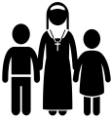
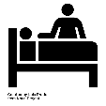
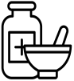
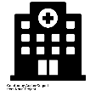
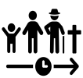
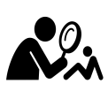
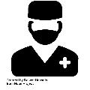
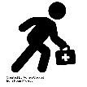
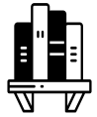
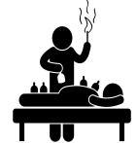
MEDIEVAL
2ND C. AD
5th C. BC
1345
1440
1500
FOUR HUMOURS THEORY DEVELOPED
ANCIENT GREEK PHYSICIAN, HIPPOCRATES DEVELOPS THEORY
THEORY OF OPPOSITES DEVELOPED
ROMAN PHYSICIAN, GALEN DEVELOPS FOUR HUMOURS FURTHER
THE BLACK DEATH ARRIVES IN ENGLAND
PRINTING PRESS INVENTED
INVENTED BY GERMAN, JOHANNES GUTENBURG
1100 HOSPITALS IN ENGLAND
30% OWNED AND RUN BY THE CHURCH
MEDICINE THROUGH TIME
VOCABULARY | DEFINITION
Apothecary | a person who studied herbs and mixed herbal remedies
Astrology | The study of the planets
Barber Surgeons | poorly qualified medical surgeons who performed small surgeries
Bathing | having a bath to improve your health
Diagnosing | looking at symptoms to decide what is wrong with a patient
Diet | what you eat
Dissection | cutting up the body to look inside it
Famine | food shortage, usually due to bad harvest
Flagellants | people who punished themselves in the hope that God would forgive them
Four Humours | An ancient Greek (Hippocrates) theory that the body was made up of four elements.
Hospitals | offered a place to stay and recover, normally for travellers and pilgrims
Humours | Elements of the body: blood, phlegm, black bile, yellow bile
King's Touch | people believed that the King (chosen by God) had the power to heal by touching (Edward I touched 2,000 people a year
Lazar House | A hospital that cared specifically for people with leprosy
Leprosy | skin disease, followed by paralysis and death
Malnutrition | an illness caused by a lack of food
Miasma | bad air filled with harmful fumes
Natural | something that can be explained by reasoning
Phlebotomy | blood-letting/bleeding to balance the humours
Physician | someone who practises medicine with little proper training
Proof of the divine | An outcome (usually somebody getting better) that proves God's existence
Purging | taking something to make yourself sick or give you diarrhoea to rid the body of anything bad
Quarantine | separating the sick from the healthy
Regimen Sanitatis | a set of instructions provided by physicians to maintain good health
Remedy | things that people would take to make themselves better, usually herbs
Scourge | something that causes great suffering
Star Chart | used to diagnose illness by looking at the alignment of the planets
Supernatural | something that is not natural i.e. it can't be explained
Surgeons | studied surgery alongside medicine and were normally highly trained
Theory of Opposites | An ancient Roman (Galen) theory that suggested balancing the humours to make somebody better.
Tithe | a sum of money (tenth of earnings) given to the church each month
Urine Chart | used to diagnose illness by comparing a urine (wee) sample with the colours on it
Vivisection | the dissection of a criminal who was alive
Wise women/Lady of the Manor
Run by monks and Nuns
Farmers
Attitudes
Education
Theory of Four Humours
Midwives
Women
HIPPOCRATES
Apothecaries
Focus on care, not cure
Hospitals
Church
Hippocrates
Barber Surgeons
King
MEDIEVAL LIFE
University Training
Physicians
HEALERS
INDIVIDUALS
Johannes Gutenberg
GALEN
Regimen Sanitatis
MEDIEVAL MEDICINE
Regular washing
PREVENTION OF DISEASE
Galen
Theory of Opposites
TREATMENTS
CAUSES OF DISEASE
Wealthy clients
GUTENBURG
God's punishment
Exercise
Enemas
Herbal Remedies
Church
Astrology
Confession & Prayer
Bloodletting
Cutting vein
Miasma
EDWARD I
Tithes
Clean towns
Leeches
Four Humours
Cupping
How did medieval people DIAGNOSE illness and disease? | How did medieval people TREAT illness and disease? | How did medieval people PREVENT illness and disease? | What influenced people’s beliefs and thinking about medicine? | What SIGNIFICANT developments impacted on medical knowledge and understanding?

Slide 2
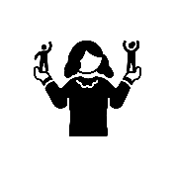
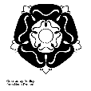
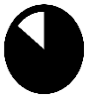
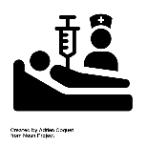
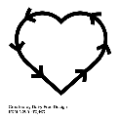
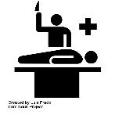
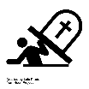
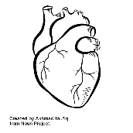
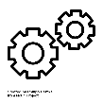
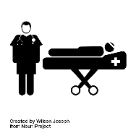
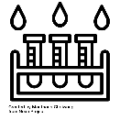
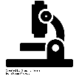
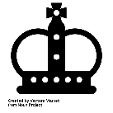
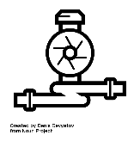
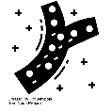
RENAISSANCE
1536
1543
1628
1660
1665
1676
Dissolution of the Monasteries
Henry VIII orders the closure of all monasteries in England
‘The Fabric of the Human Body’
Published by Italian atomist Andreas Vesalius
Harvey publishes theory on blood
‘An anatomical Account of the Motion of the Heart and Blood’
First Royal Society Meeting
Meet in London for the first time
The Great Plague come to England
‘Observationes Medicae’
Published by Thomas Sydenham, English Physician.
MEDICINE THROUGH TIME
VOCABULARY | DEFINITION
Alchemy | an early form of chemistry
Anatomy | the form and make-up of the body and its various parts
Apothecary | a person who studied herbs and mixed herbal remedies
Dissection | cutting up the body to look inside it
Dissolution of the Monasteries | when Henry VIII split from the Catholic Church, closed monasteries and took their land and money
Dysentery | a stomach bug that causes severe Diarrhoea
Epidemic | when an illness becomes infectious on a widespread and mass scale
Fugitive Sheets | individual sheets of medical information a drawings for those that couldn’t afford whole books
Hospital | a place where physicians would now observe and treat symptoms
Humanism | a move towards education, studying and learning to develop understanding and make decisions
Iatrochemistry/medical chemistry | modern chemistry that looked to find chemical cures for diseases rather than rely on herbs
Miasma | bad air filled with harmful fumes
New World | the recently discovered North and South America
Padua | a famous medical university
Pest House/Plague House | a hospital that cared specifically for people with the plague or pox
Physician | medical experts trained at universities with more experience of dissections and better access to medical books
Printing Press | a machine that printed text and pictures to copy the same thing multiple times
Quack Doctor | somebody who didn’t have medical training but sold their services as a doctor or apothecary
Quarantine | separating the sick from the healthy
Reformation | the change of the country from Catholic to Protestant
Renaissance | rebirth (of ideas and thinking)
Royal Society | a group wanting to explain the world in secular (scientific) rather than religious terms (backed by Charles II)
Searchers | people who would go house to house looking for plague victims
Secular | not religious or in any way connected with spiritual beliefs
Syphilis | an STI that started with sores and could eventually lead to blindness, paralysis and insanity
Transference | when an illness or disease can be transferred from a person to an object
First to treat: Wife or Mother
Local treatments from wealthy ladies
Henry VIII -
1530s
One of first to treat illness
Still widely accepted and used
Handed down through family
Some success, but no explanation why
St Bartholomew's Hospital
VESALIUS
Women
Bleeding & Purging
Most: Only Food, Warmth & Prayer
Hospitals
Herbal Remedies
Curing of King's Evil
Most used cheaper alternatives
City Council & Charity
TREATMENTS
Folk remedies
Blood Circulation
Edinburgh & St Bart's London
Physicians
HEALING
HARVEY
RENAISSANCE MEDICINE
Slow Acceptance
Scientific approach
William Harvey
Dissection
INDIVIDUALS
Vesalius & Harvey
SCIENCE
English Hippocrates
AND TECH
Allowed detailed illustrations
Printing Press
Thomas Sydenham
HOOKE
First Thermometers
Scarlet Fever
Johannes Gutenberg
Royal Society
Water Pumps
Microscopes
Andreas Vesalius
Attended by Charles II
Discovered capillaries after Harvey
Proved Galen wrong
The Fabric of the Human Body
SYDENHAM
How have beliefs changed from the medieval period/Middle Ages? | How do new ideas and technology challenge old ideas about medicine? | What continuities are there i.e. what stays the same as the medieval period? | Which individuals impact on medicine? How and why? | What changes occur in society that influences the development of medicine?

Slide 3
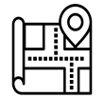
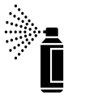
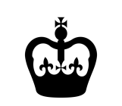
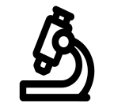
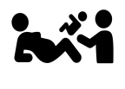
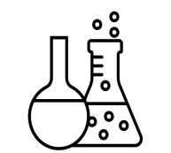
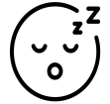
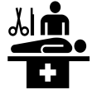
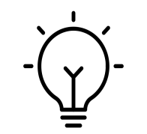
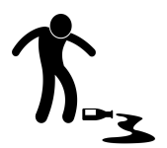
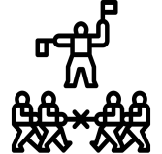
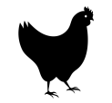
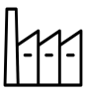
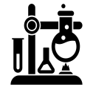
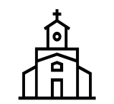
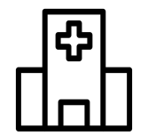
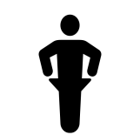
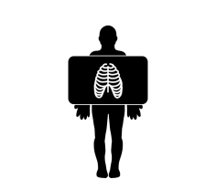
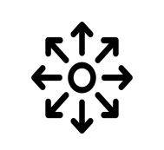
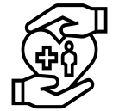
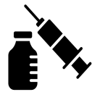
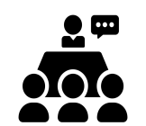
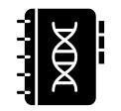
INDUSTRIAL/C20th
1803
1842
1847
1848
1854
1854
1859
1865
1878
1796-98
1861
Smallpox vaccine discovered by Jenner
Royal Jennerian Society established
Ether first used as an anaesthetic
Chloroform effects discovered by Simpson
First Public Health Act passed
John Snow links water and Cholera
Nightingale works in the Crimean War
Nightingale publishes ‘Notes on Hospitals’
Germ Theory discovered by Louis Pasteur
Joseph Lister uses Carbolic Acid
Second Public Health Act passed
MEDICINE THROUGH TIME
VOCABULARY | DEFINITION
Act | A law
Agar Jelly | A sterile jelly used to grow microbes
Anaesthetic | A chemical given to put somebody to sleep
Antibodies | Particles inside the body that can identify and fight off a disease
Antiseptic | A chemical used to kill germs
Aseptic | A germ-free environment
Aseptic Surgery | Surgery where microbes are prevented from getting into a wound
Bacteriology | The study of bacteria
Carbolic Acid | A chemical that cleared bacteria from wounds
Cesspit | A hole in the ground for storing sewage or waste
Chloroform | The chemical that Simpson discovered to work as an anaesthetic
Enlightenment | A European movement encouraging rational, secular, scientific thinking
Epidemic | A widespread outbreak of a disease
Gangrene | Death of body tissue
Germ Theory | The belief that germs are in the air all around us and cause decay
Germs | Pasteur's name for microbes
Government Intervention | The involvement of the government to help its people
Immunity | To be protected against infection
Inoculation | Giving somebody a small dose of a disease to create immunity
Laissez-faire | French for 'leave be' - a term used to describe governments who do not get involved in people's day-to-day lives
Microbes | A living organism too small to see without a microscope
Pasteurisation | To heat a liquid to kill germs
Pavilion Plan | A hospital design to allow separation of patients and good ventilation
Petri Dish | A plastic air tight container used to grow microbes
Pharmaceutical | Using drugs for medicine
Pharmacies | What apothecaries were now known as (Boots opened in 1849)
Public Vaccinators | Doctors paid by the government to vaccinate people (against Smallpox)
Spontaneous Generation | The belief that decay caused germs
Vaccination | Creating antibodies against a disease
Magic Bullet
Carbolic Acid
Aseptic Surgery
Cholera Epidemic
Antiseptic Surgery
Queen Victoria Child Birth
Photographing Microbes
Paul Ehrlich
JENNER
Microbe Hunting
& Vaccines
Germ Theory
Public Acceptance
Robert Koch
John Snow
Joseph Lister
Anaesthetics
Chloroform
Louis Pasteur
z
SIMPSON
Germ Theory
James Simpson
z
Individuals
Competition
War
Chance
SNOW
Franco-Prussian War
Accidental Discovery
Industrial
Medicine
Laboratories
Chamberland chicken cholera vaccine
NIGHTINGLAE
Government Funding
Christian Church
Objected to use of anaesthetics in child birth
Government
Religion
The Great Stink
Technology &
Communication
Legislation
PASTEUR
Bazalgette’s Sewers
Chadwick Report
Spreading Ideas
Encouraged support of Hospitals
LISTER
1848 Public Health Act
Telegraph
Encouraged philanthropy
Not Compulsory
Compulsory
1875 Public Health Act
First X-Ray
Smallpox Vaccine
KOCH
Conferences
Printed medical journals
Which individuals were significant for what developments? | Who supported and who opposed developments? Why? | What changes or developments in society helped medical progress? | How did new technologies help medicine to progress? | What had changed from the Renaissance period?

Slide 4
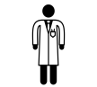
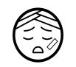
MODERN
1895
1909-10
1928
1932
1941
1948
1953
1956
1990-2000
2007
X-RAYS DISCOVERED
FIRST MAGIC BULLET, SALVARSAN 606
PENICILLIN DISCOVERED BY FLEMING
SECOND MAGIC BULLET, PRONTOSIL
FLOREY & CHAIN DEVELOP PENICILLIN
NHS LAUNCHED
STRUCTURE OF DNA DISCOVERED
CLEAN AIR ACT PASSED
THE HUMAN GENOME PROJECT
PUBLIC SMOKING BANNED
MEDICINE THROUGH TIME
VOCABULARY | DEFINITION
Antibiotic | A treatment that destroys or limits the growth of bacteria in the human body
Antibodies | Particles inside the body that can identify and fight off a disease
Biopsy | Where scientists gather samples of body tissue to study in a laboratory
Bronchoscope | A camera and cutting tool that collects cell samples from the lungs
Chemotherapy | The injection of chemicals/drugs into the body to shrink tumours before surgery
Compound | A mixture of two or more different elements
CT Scans | Use advanced x-rays to diagnose tumours and other growths
Double Helix | The twisting shape formed by DNA
ECGs | Electro Cardiograms - use electrical impulses to track heart activity
Electron Microscope | Use powerful electron beams to magnify 10,000,000 times
Endoscope | A camera on the end of a thin flexible tube that can be inserted inside the body
Genetics | The study of DNA
Genome | The complete set of DNA containing all of the information to build an organism
Hereditary Disease | A disease passed on to children by their parents or other decedents
Hypodermic Needle | Allow a precise dose to be introduced directly into the bloodstream
Laparoscopic Surgery | Keyhole surgery i.e. using cameras and tiny surgical instruments through small incisions/cuts in the body
Lifestyle Campaigns | Government backed campaigns to promote better diets, heart health, smoking awareness, etc.
Lifestyle Factors | The choices we make about how we live our lives regarding diet, smoking, sex, alcohol, etc.
Magic Bullet | The name given for the first chemical cures that would attack the disease causing microbes and leave the rest of the body unharmed
Mastectomy | Surgery where a person has one or both breasts removed
Microscope | Magnify up to 2,000 times
MRI Scans | Use magnets and radio waves to create internal images of the body (soft tissue)
National Vaccination Campaign | Government backed campaigns to vaccinate
Penicillin | The first antibiotic using microorganisms rather than chemicals
Pharmaceutical Companies | Businesses that produced and sold drugs as treatments
Prontosil | A compound used to kill bacterial infections such as blood poisoning
Radiotherapy | The use of radiation to shrink tumours
Salvarsan 606 | The first magic bullet discovered by Hata to cure syphilis
Ultrasound Scans | Use sound waves to create internal images of the body (gall stones, kidney stones)
National Insurance Act
Growth of Pharmaceutical
Industry
Used in WWII
Florey & Chain
Inspired by WWI
Attempting to cure Staphylococcus infection
Penicillin
Obesity Awareness
EHRLICH
Cancer Screening
Mass
Production
William Beveridge
Booth & Rowntree
First antibiotic
Fleming thought it was antiseptic
Education Act
Smoking Ban
Public Health Campaigns
HATA
Welfare State
Alexander Fleming
Messy Laboratory
NHS Act
Government Funding
Individuals
'5 Giants’
Legislation
Government
Chance
Accidental Discovery
MRSA
FLEMING
Liberal Reforms
Hypnotherapy
Beveridge Report
Modern
Medicine
Antibiotic Resistance
Boer War
Acupuncture
FLOREY
40% of soldiers unfit to fight
War
Religion &
Superstition
Changing attitudes
Holistic Treatment
Homeopathy
Global Conflict
Technology &
Communication
Alternative Medicine
CHAIN
Plastic Surgery
Modern Methods
Keyhole Surgery
Aromatherapy
Evacuation
World War One
Radiation Therapy
WATSON
War veterans return home
X-Ray Machines
Research into
infection
Human Genome Project
Cloning Research
World War Two
Understanding Shell Shock
Dolly the Sheep
Blood
Transfusions
Transplant
Surgery
Laser Eye Surgery
CRICK
Blood Banks
Identification of Blood Types
What is creating the change, development or advancement? | How important is individual genius i.e. the importance of the people in change? | How important is government intervention? | What other factors are causing change or encouraging development? | What continuities are there with previous periods?

