Slide 2

Accessing lessons and homework
Remote Access
At the Oaks Academy all homework and lesson content will be uploaded to Microsoft Teams
It is an individual child's responsibility to check their Teams account daily for new homework tasks. We ask that all parents and carers support with this task and check in regularly with their child account.

Slide 3

To access Microsoft Teams you will need:
A device to enable you to do this – computer, laptop or ipad
Your school email account, this is the same as your school log on details.
example
2020bloggsj@theoaksacademy.co.uk
Password1
Year you started
Surname
First initial
@theoaksacademy.co.uk
If your child cannot remember this information please email:
Remember to state your child’s full name and form
admin@theoaksacademy.co.uk

Slide 4
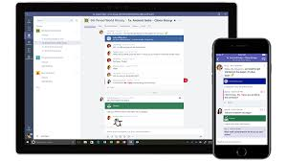
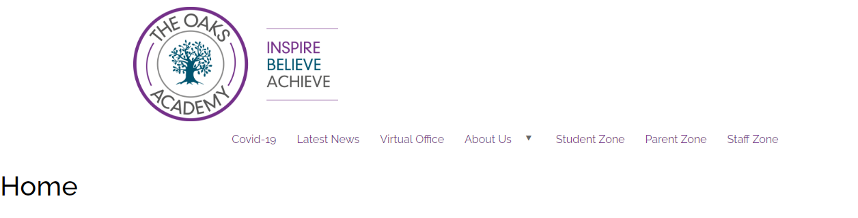
Microsoft Teams can be accessed by
using an APP on your device
We recommend that all children who have a Smart mobile phone down load the app, this will enable them to easily access tasks an get reminders about deadlines
Alternatively it can be accessed by your school email via the website
www.theoaksacademy.co.uk This can be located in the Student Zone

Slide 5
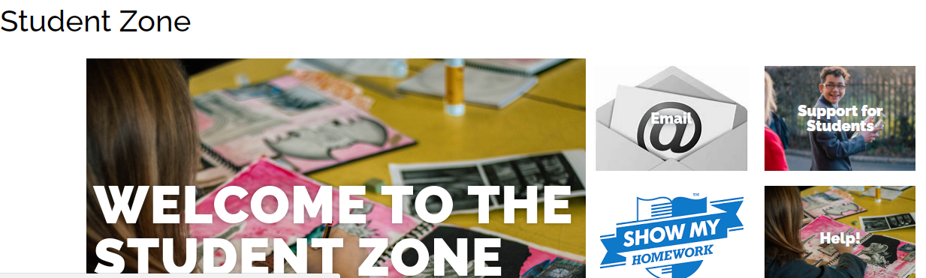
Click on email then log in using your school username and password

Slide 6
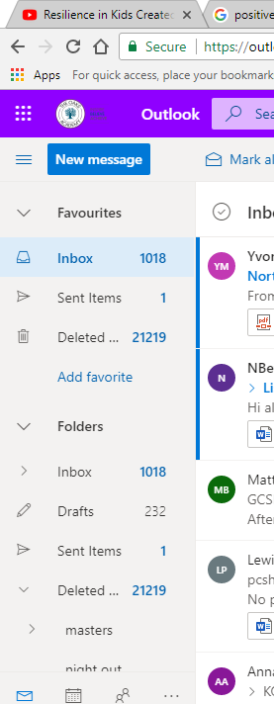
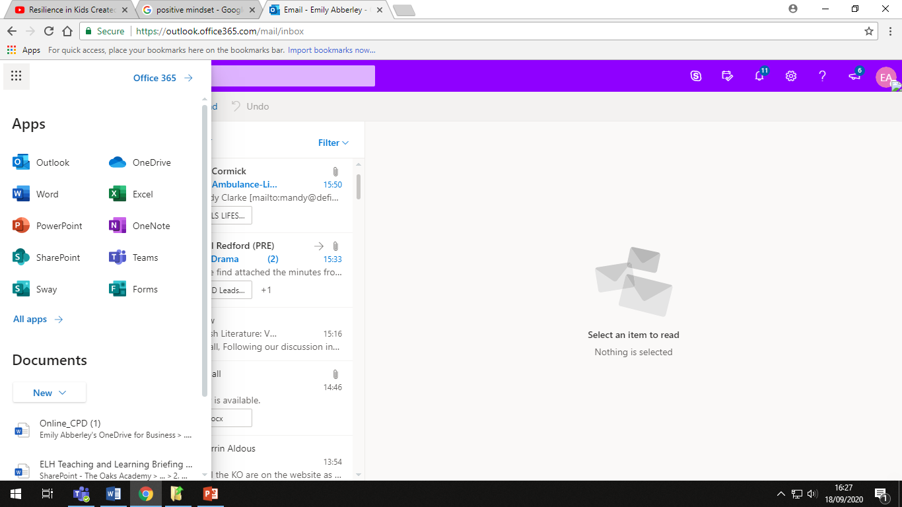
Once your emails are open you will need to click on the 9 dots in the corner
This will bring up these options.
Click on TEAMS

Slide 7
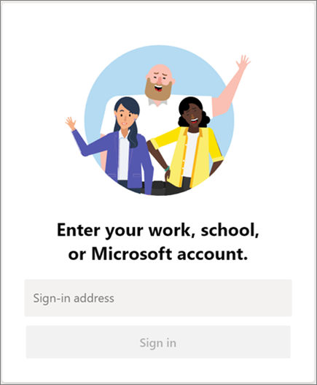
How to log on
Students will log on using their school email address
username@theoaksacademy.co.uk
The password is the same as the one you log onto the computer system with.

Slide 8
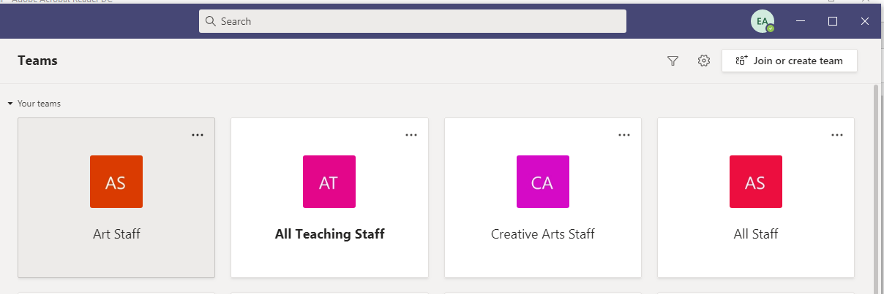
When you log into TEAMS it will display the TEAMS (class groups) that you have been added to. This will be the same classes as those on your timetable.

Slide 9
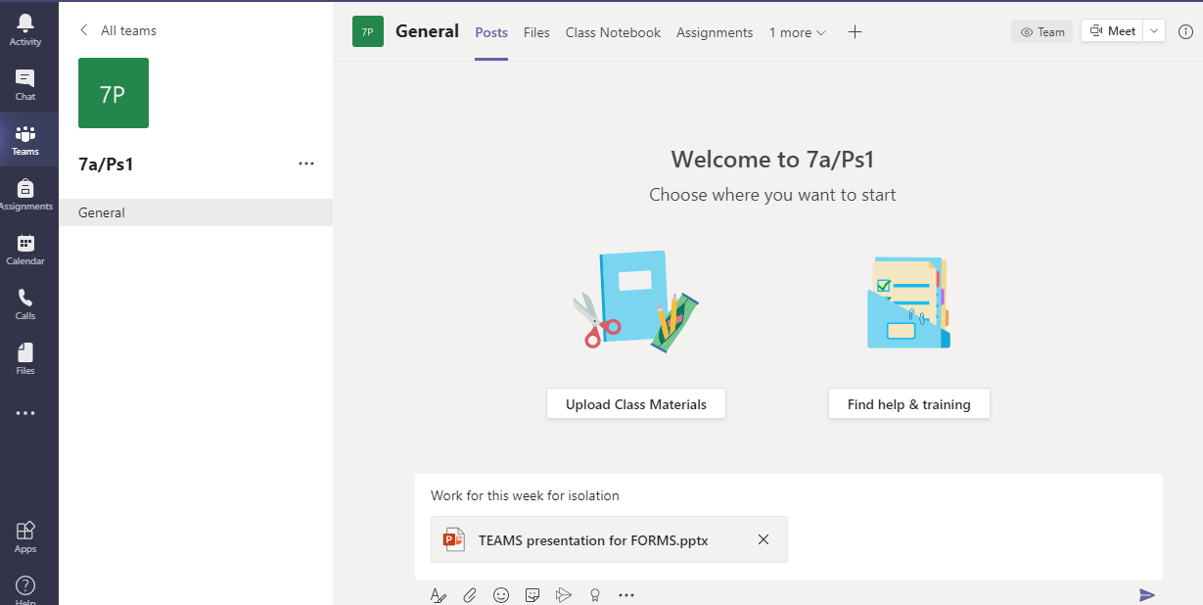
Accessing Work / lesson content
Click on the class Team to see the work uploaded by your teachers
Your teachers will post the work that is being completed in class.
Subject Knowledge Organisers will also be uploaded to the class materials so you can access these at hone to support with homework task and revision

Slide 10
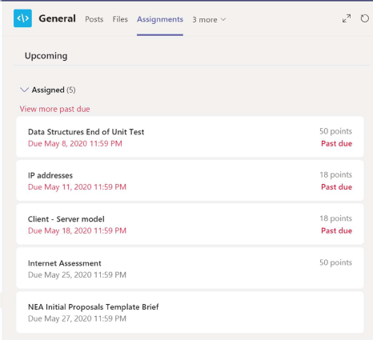
Assignments
Homework will be set by class teachers using the Assignments section on Teams
On the Assignments tab it shows what homework has been assigned including when the work is due and the marks allocated if appropriate.

Slide 11
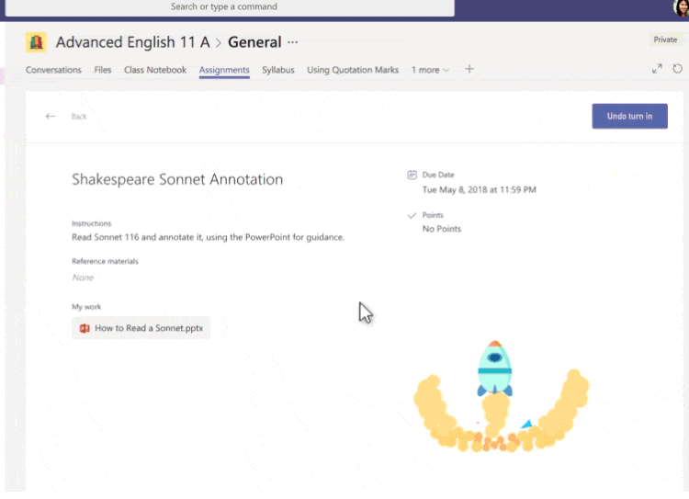
Uploading Assignments
If your teacher specified a document for you to hand in homework via Teams or you have other files to attach to this assignment, select +Add work and upload your file, then click hand in.

Slide 12
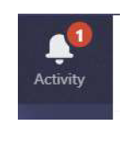
How will I know when new work is set
You will see a number next to the activity symbol to say that there have been changes made this could be work set/returned or information posted.

