Slide 1




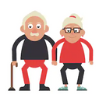

















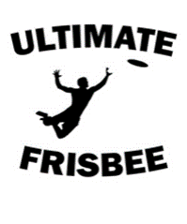

Understand the Issues which Affect Participation in Sport
User groups
Solutions
Barriers influencing participation
- Ethnic minorities
- Retired people
- Families with young children
- Single parents
- Children
- Teenagers
- Disabled
Unemployed
- Working people
Lack of role models
.
Provide positive role models
Provide accessibility, free buses
Provide suitable activities
Provide concessionary prices
Provide targeted promotion
Lack of access
Lack of provision.
Lack of time
Lack of disposable income.
For example walking football could be launched for elderly people.
Lack of awareness
Deeper Questioning …
Stereotyping
For promotion to elderly, flyers in bus stops, or opticians
Deeper Questioning …
. For example the promotion of Paralympic athletes could encourage people with disabilities to take part in sport
Recall the 8 user groups
What would be the main issue for these user groups to participate in sport?
What impact could these barriers have on participation?
What user group could this barrier apply to?
.
Success for both teams and individuals:
As sporting success is achieved, people are generally inspired to take part.
Environment/climate:
The weather in the UK can also pose a barrier to those who do not like getting cold or wet.
Emerging sports
Emerging sports
Spectatorship/media coverage:
The amount of media coverage given to a sport can affect its popularity.
Provision:
People can not participate if there is little or no provision available
Acceptability:
Culture can dictate what is deemed to be an acceptable or unacceptable sport

Slide 2


To know about the Role of Sport in Promoting Values
Sporting Values
Tolerance and respect
National pride
Fair play
Citizenship
Team spirit
Excellence
Inclusion
The Olympic Creed
Olympic & Paralympic Values
'The most important thing in the Olympic Games is not to win but to take part, just as the most important thing in life is not the triumph, but the struggle. The essential thing is not to have conquered, but to have fought well.'
Olympic values:
- Friendship
- Respect
- Excellence
Paralympic values:
- Determination
- Inspiration
- Courage
- Equality
The Olympic Symbol
The five interlocking rings represent the union of the five continents of the world which take part.
Deeper Questioning … Values
Deeper Questioning … Olympics
For sporting Values what word could you make to remember the 7 values? Ie TENT FIC/NETFICT
What word could you make to remember the 7 Olympic values? Ie FRED ICE
Can you describe an example from sport for each value?
What Feature describes the Olympic games?
can you identify past Olympic games?
What 3 statements describe the Olympic creed?
Can you link the values in events that occur in the Olympic games?

Slide 3



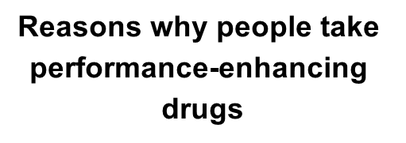






To Know about the Role of Sport in Promoting Values
The importance of etiquette and sporting behaviour of both performers and spectators
Deeper Questioning…
Can you explain the difference between sportsmanship and gamesmanship?
Can you discuss etiquette in sport, for the performer and spectators?
Can you discuss the impact that taking performance enhancing drugs can have on a performer, and their performance?
Can you explain the whereabouts rule?
Can you analyse case studies of performers for taking performance enhancing drugs?
Etiquette: The unwritten rules.
For example, kicking the ball out of play when someone is injured in football. The ball is then returned to the team that kicked it out.
Spectator etiquette: Spectators also have unwritten rules, to behave in an appropriate sporting way.
For example, being quiet during rallies in a tennis match or respecting an opponent's national anthem.
Sportsmanship: Behaving in a way that is fair and polite
For example, shaking hands before and after a game.
Reasons for observing etiquette
and sporting behaviour
- Performing in a fair way
- Promoting positive values
- Ensuring the safety of themselves and other performers
- Being respectful to those in their own team and the opposition
- Acting as a positive role model for children
Gamesmanship: This is when performers bend the rules to gain an advantage.
For example, taking a long time to collect the ball to waste time in football.
Banned drugs
Sporting initiatives
Banned performers
Aims to end
racism
in football
v
Testing methods
Encourages players
and spectators to
respect referees and
coaches
Aims to get
people of all ages
involved in netball
Reasons against taking performance-enhancing
drugs
Whereabouts Rule
Reputation of sport
Ethical Issues

Slide 4

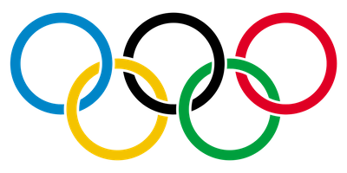
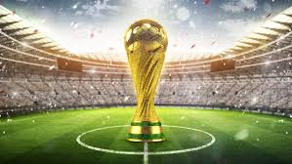












Major Sporting Events
Regularity/scheduling
Potential Legacy of major events:
The features of major sporting events
Sporting
Social
Economical
'One-off' events
One-off events are held once in a certain place or at a certain time.
For example; the Olympic
Benefits of hosting a major event:
Drawbacks of hosting major events:
:Regular events
Regular events are held annually (every year) in a different place.
For example; the UEFA Champions League Final.
Infrastructure
Sponsorship
Tourism
Jobs
Sports facilities
Status of the city
The morale of the country
-Bidding process expensive
Hosting can be expensive
Negative impact
Unused facilities
Specific sport focus
Regular and recurring events
Recurring events are held annually, at the same place.
For example Wimbledon @All England Club, in Wimbledon.
.
Deeper Questions
The links between potential benefits and drawbacks and legacy
Can you recall 3 types of one off events, regular and recurring events?
Can you recall past Major games and reflect on the legacy left behind?
Can you relate to benefits of cities who have previously hosted a major event?
Can you explain the drawbacks witnessed from major sporting games?
Developing facilities
Infrastructure
Tourism

Slide 5

The role of national governing bodies in sport
What is a national governing body?
National governing bodies (NGBs) are independent bodies that have responsibility to govern and manage their sport within a country.
The role of a national governing body:
Deeper thinking Questions:
Can you recall examples of NGBs in sport?
What is a NGB?
Can you give examples of funding you can gain in sport?
What methods can be used to promote the sport?
What are the 3 ways to develop a sport?
Identify policies and initiatives to gain equality in a sport?
How can a NGB provide support in a sport to a performer?
What are the 5 aspects that provide infrastructure in a sort?
Promotion
One major role of any NGB is to increase participation.
Providing a national directive and vision
All NGBs provide direction and vision
Development
NGBs also enable performers to develop, showing clear pathways for performers to progress through.
Development Centre's are Academy Centre's.
NGBs also develop coaches and officials.
Infrastructure
NGBs are responsible for the infrastructure of their sport.
Policies and initiatives
NGBs are responsible for the policies and procedures involved with a sport.
Performer
grants
Sports venues & facilities
Digital
Engagement
Minority
User
groups
Support
NGBs also provide information about technical advice on equipment, venues and surfaces.
NGBs generally provide location and contact details for local clubs
Education
Grassroots participation
Community engagement
National Success
Rules and Administration
Funding
NGBs have to lobby for funding from the Department of Digital, Culture, Media and Sport. NGB's also have to choose how funding should be distributed.

