Slide 2
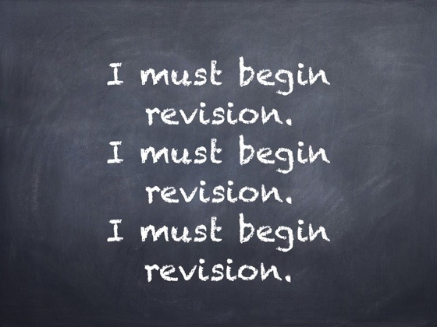

Slide 3
Home Learning and Revision Materials

Slide 5
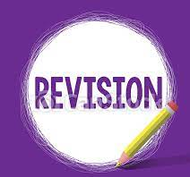
The most effective revision strategies based on robust evidence and research.

Slide 6
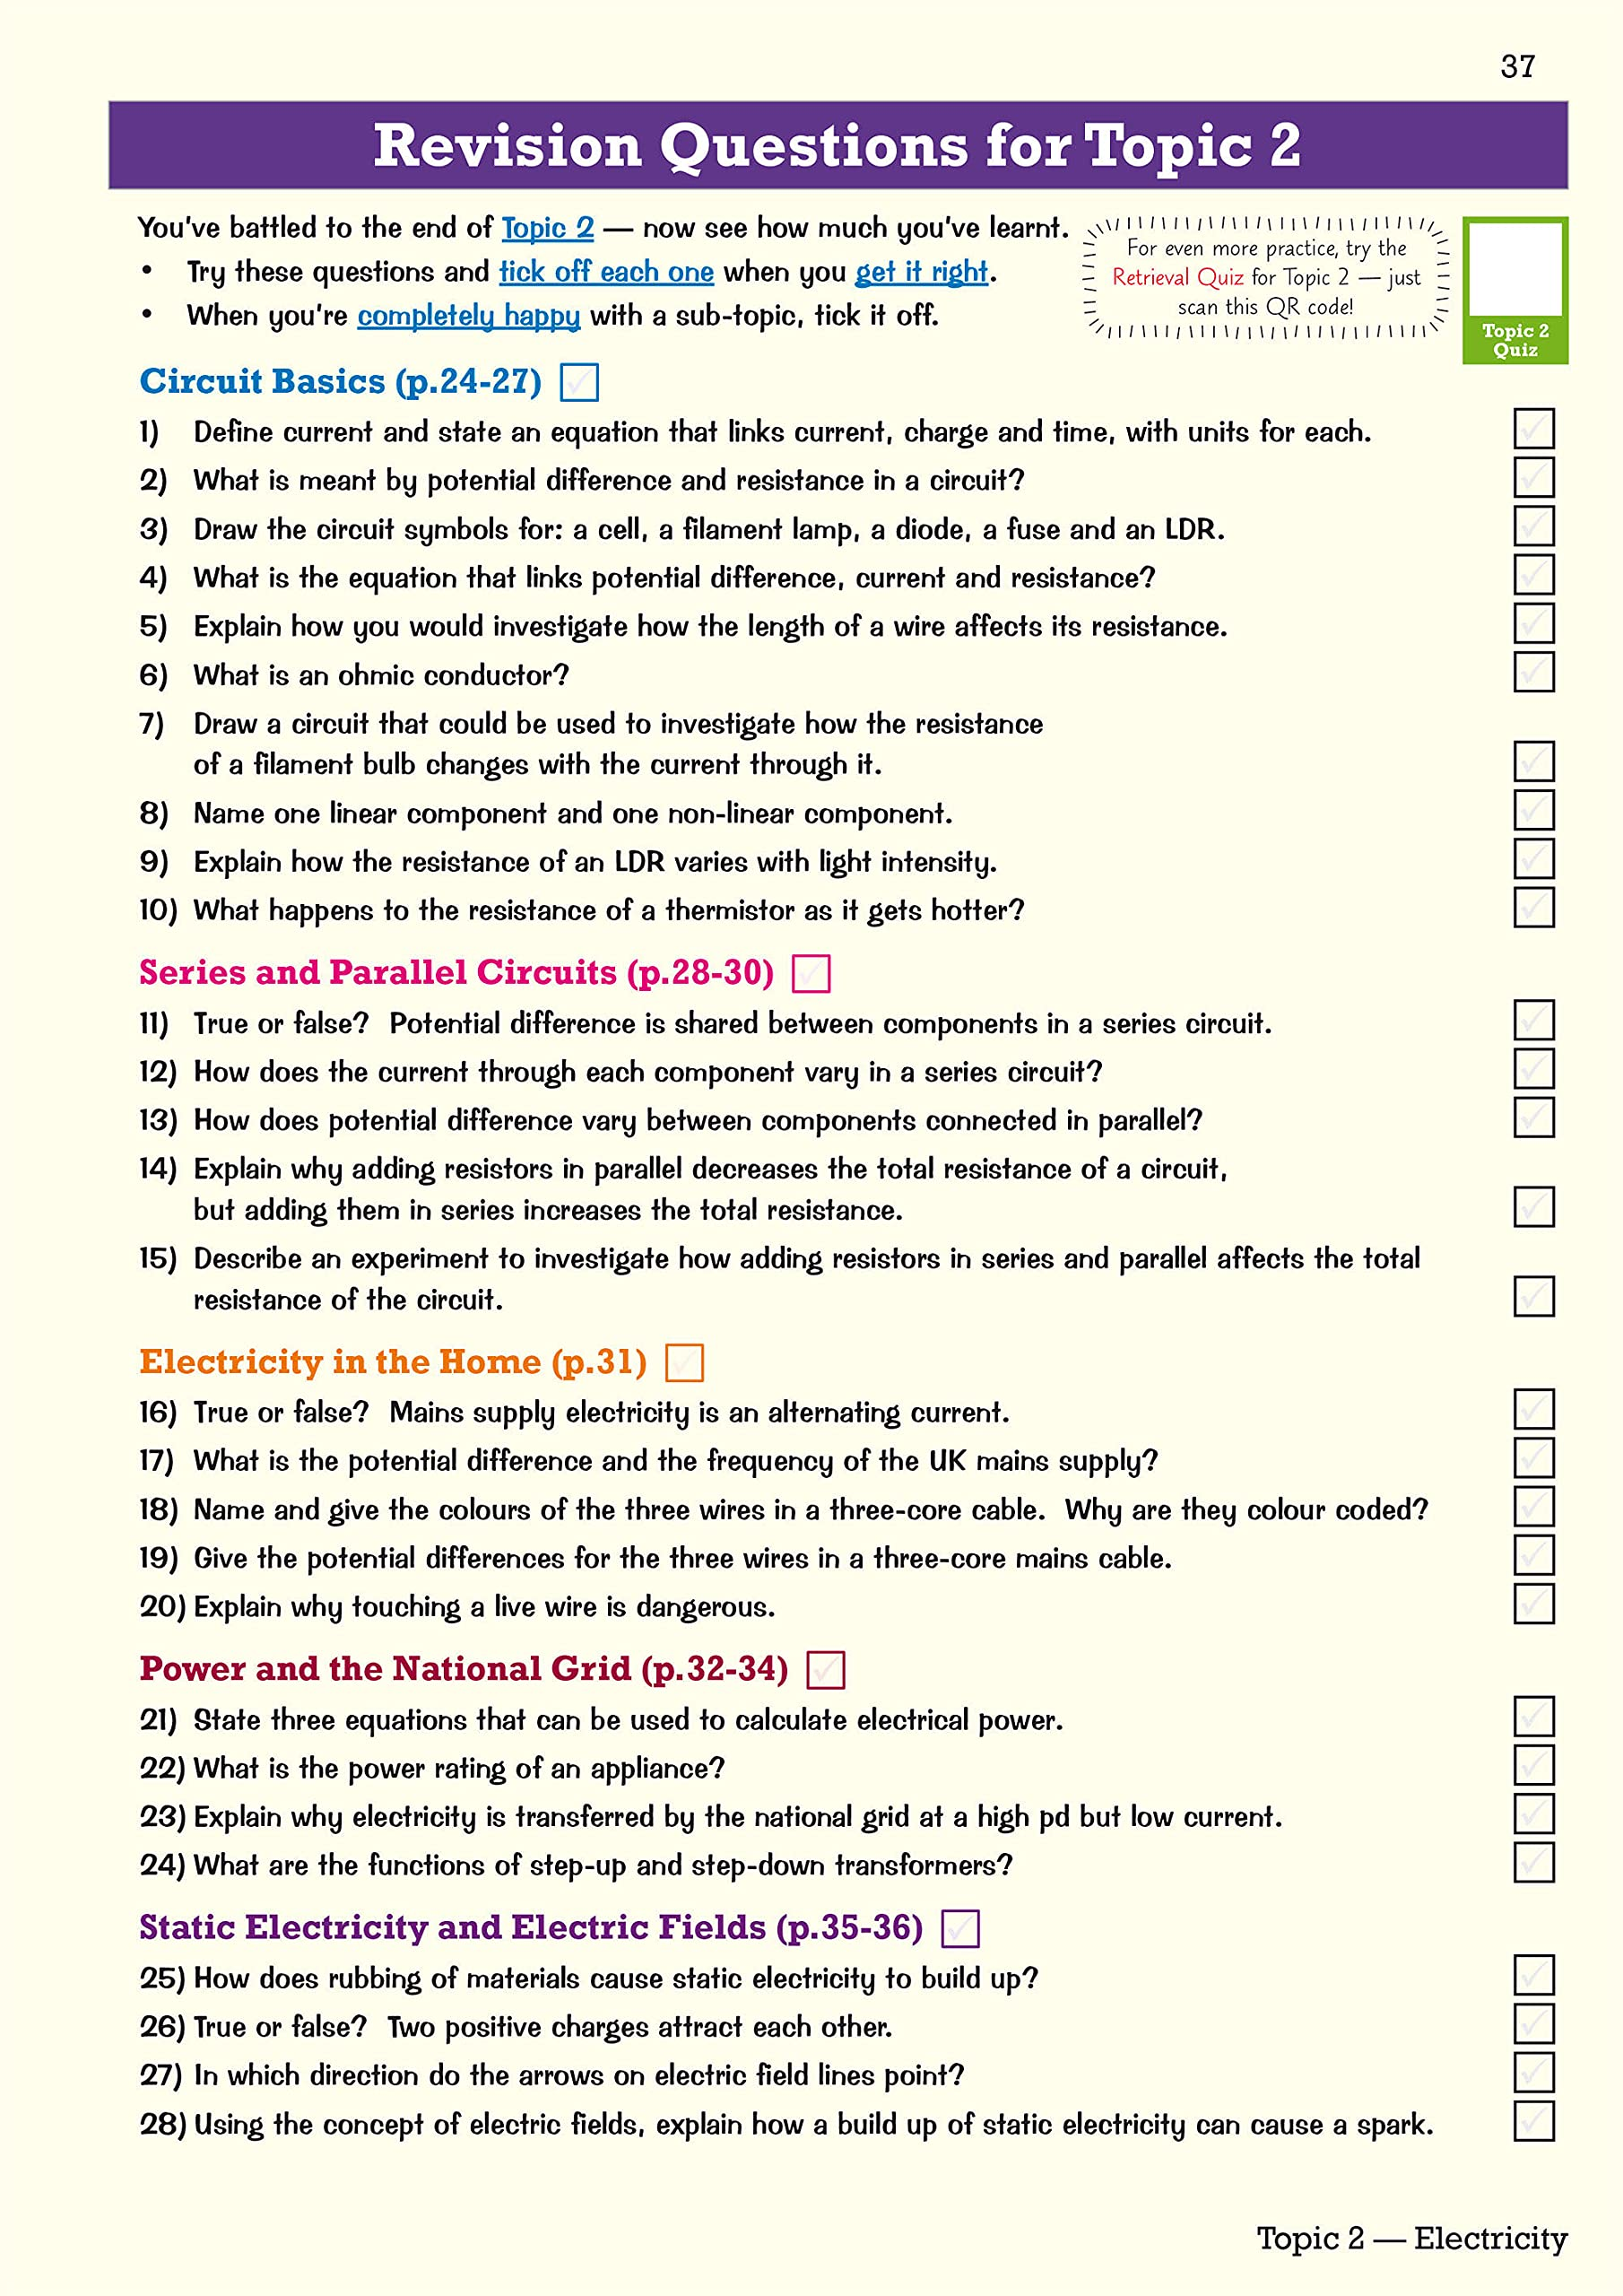
Quizzing/Testing. Good old-fashioned quizzing is an ideal vehicle to get students self-testing, which is proven to be a robust revision strategy, so that students can calibrate their knowledge and remembering. There are various types of quizzes, of course, such as short answer quizzing, multiple choice or a hybrid of the two, with different question types suiting different purposes.

Slide 7
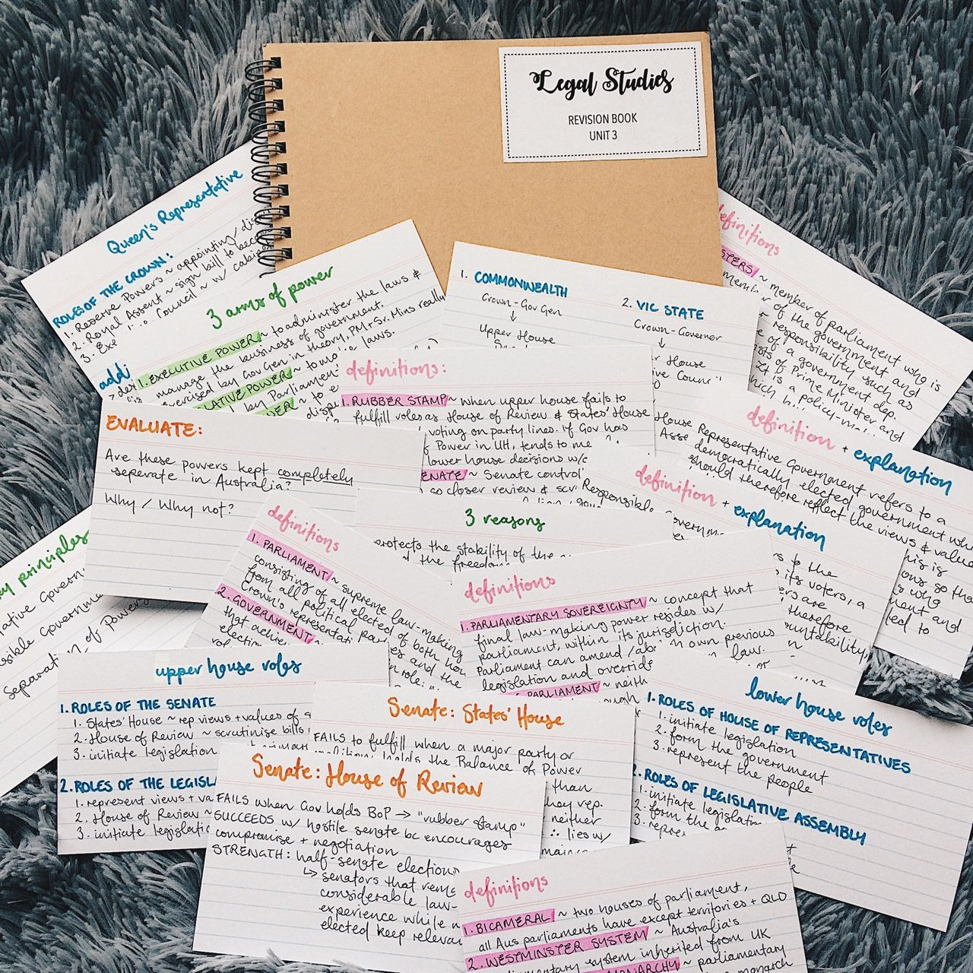
Flashcards. Flashcards are a very familiar tool used by students. Crucially, however, too many students fail to use them for effective self-testing – (only 30% in this research). Clearly, we need to train students to design, or find, effective revision flashcards, before then training them in their use. Students should also beware dropping flashcards they think they know.

Slide 8
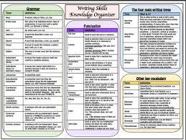
Knowledge organisers. Students need to be active in revision, not just reading their notes and doing some colouring in with a rainbow of highlighters. Graphic organisers are a handy vehicle to get students reconstructing their revision topics, making meaningful links and connections (in cognitive science, this is labelled the ‘generation effect‘).

Slide 9
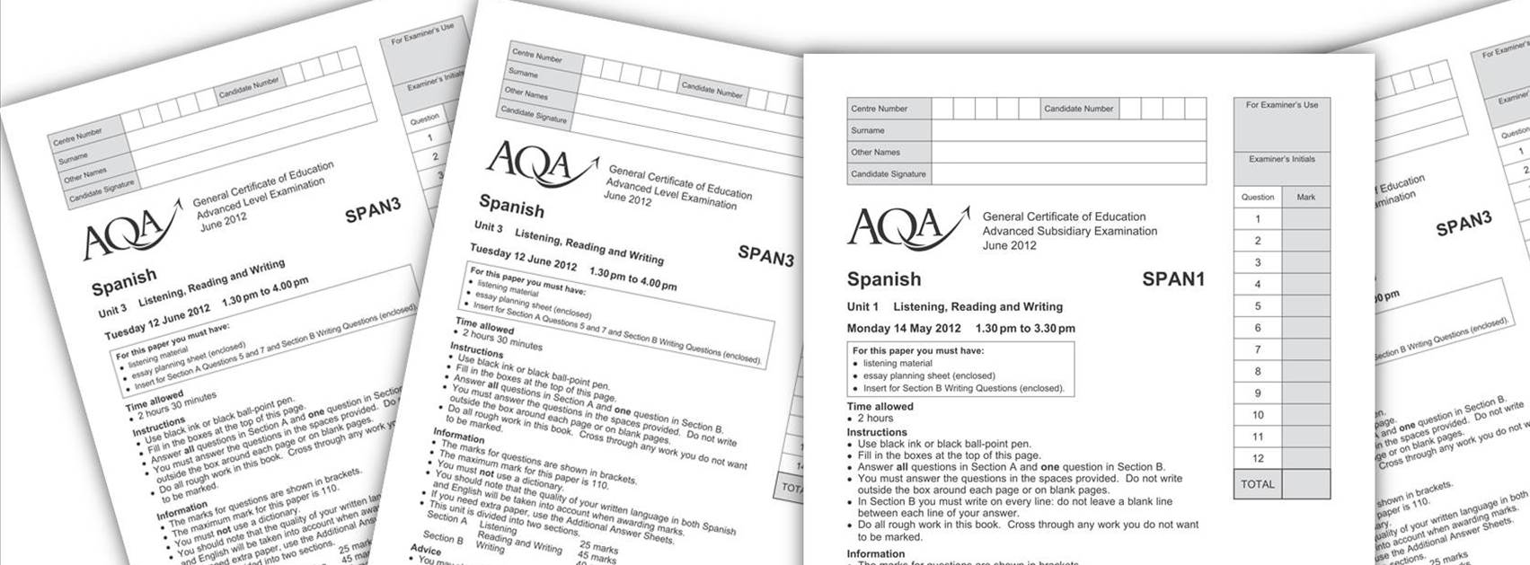
Past questions. Ok, so no rewards here for originality: students need to practice examination questions, over and over, well spaced over time. The effect of exploring worked examples or exam answers, as well as writing their own, helps students process, practice and refine their revision to meet the parameters of exam success.

Slide 10
Useful Website Links

