Slide 1
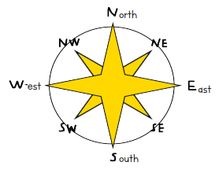
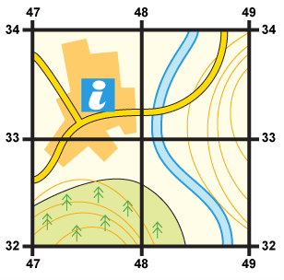
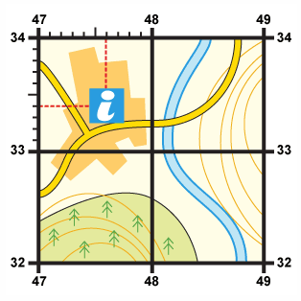
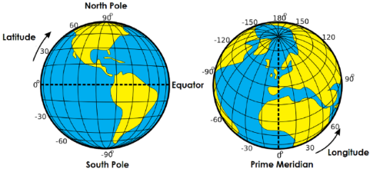
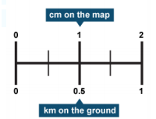
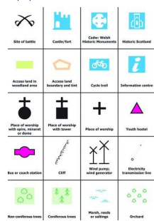
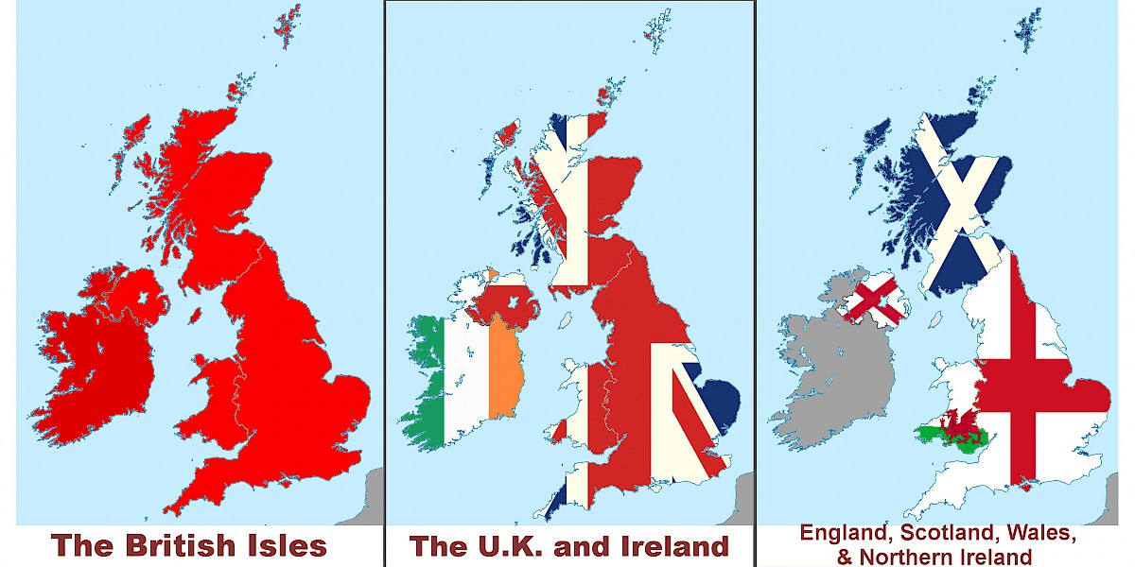
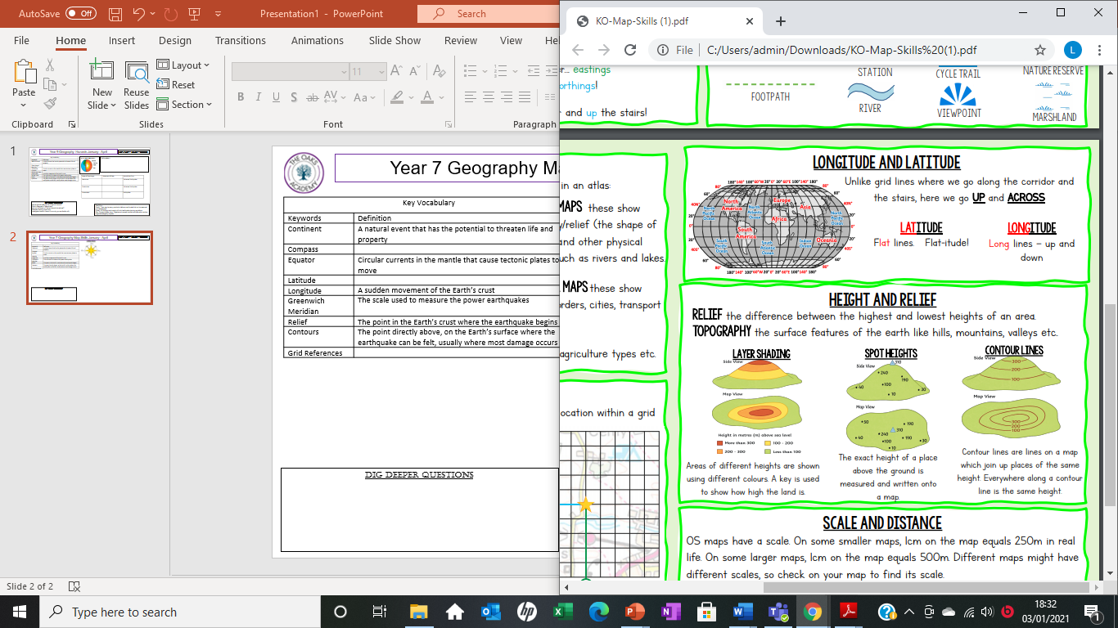
Year 7 Geography Map Skills January - April
Key new Knowledge
Key Vocabulary
Keywords | Definition
Continent | One of Earth’s large land masses, usually containing a number of different countries
Compass | Used to show the main points of direction
Equator | The line that separates the Northern and Southern Hemispheres
Latitude | Specifies the North or South position of a place
Longitude | Specifies the East or West position of a place
Greenwich Meridian | The line that separates the Eastern and Western Hemispheres
Relief | The height and the shape of the land
Contours | Lines on a map used to join places of the same height
Grid References | A map reference indicating a location
Direction
Grid References
These are used to determine a location on a map.
33 47
Rule: Go along the corridor then up the stairs.
4 Figure Grid References
Sometimes you need to be more precise.
6 Figure Grid References
334 476
Scale and Distance
Latitude and Longitude
Map Symbols
UK Geography
Relief
Dig Deeper Questions
How many different types of map are there? What do they show? Why are they useful?
What makes a good map symbol?
Extended Learning Opportunity
Google Mapzone and practice your skills

