Slide 1
History Knowledge Organisers
Year 7 History

Slide 2

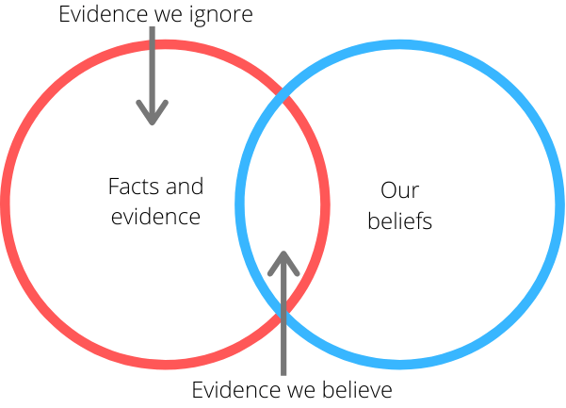
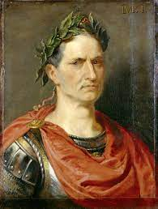
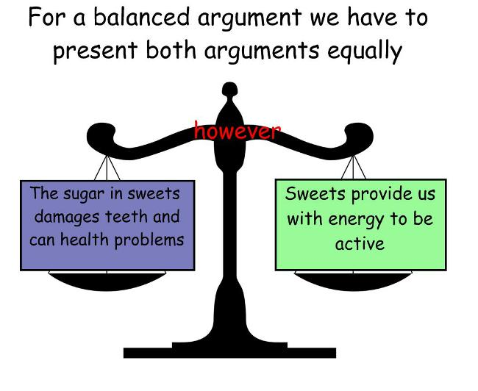
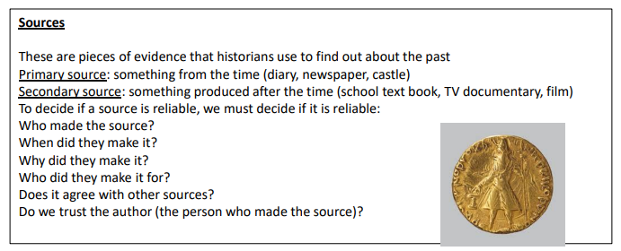
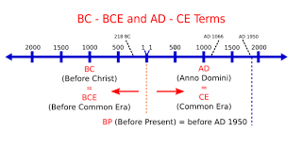
Year 7 History: Sept - Dec.
Introduction to history (skills) / Romans:
Key Term | Definition
Chronology | In time order.
Bias | One sided information.
Evidence | Information that proves what happened.
Inference | An educated guess, based on evidence.
Context | The background information to the evidence or story.
Balanced judgement | Judgement = coming to a decision Balance = not using/being bias.
Significant | Important / biggest / most to blame
AD / CE BC / BCE | AD – Anno Domini. CE – Common Era BC – Before Christ. BCE – Before Common Era
Key Skills in this unit
Develop chronology skills to be able to accurately describe the passing of time.​
​
Develop the ability to use clues to piece together the bigger picture.​
​
Understand the importance of the wider context.​
​
Assess bias in stories, accounts and evidence.​
Make inferences using multiple sources of information.​
Be able to explain the military organisation and medical abilities of the Romans.
Julius Caesar 100BC- 44BC
Key Quotes:
Julius Caesar:​
​
"Men in general are quick to believe that which they wish to be true."​

Slide 3
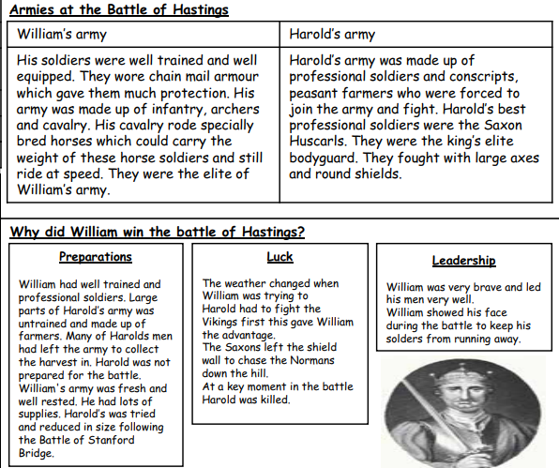
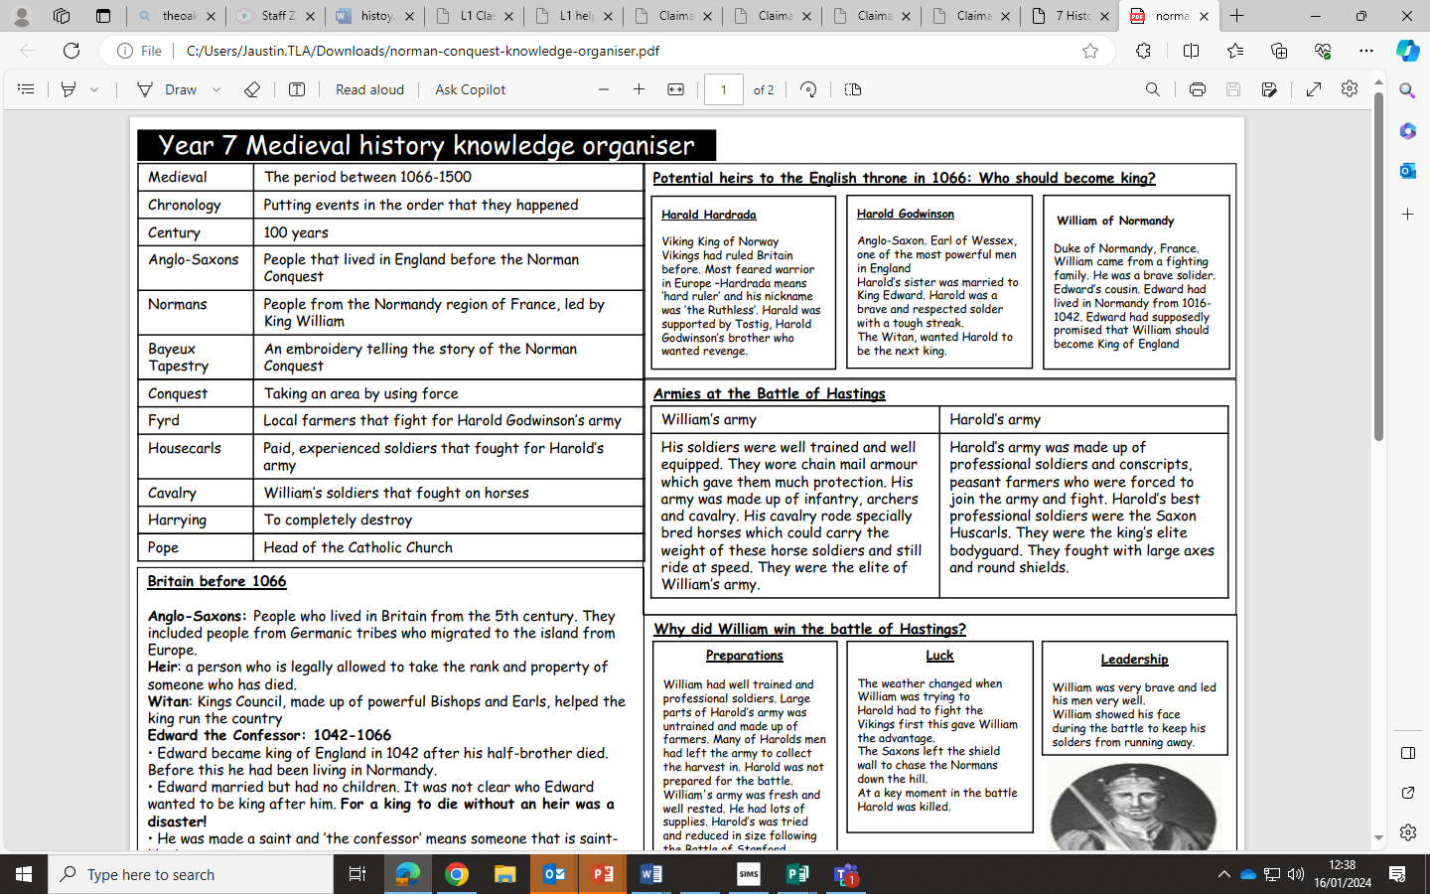
Year 7 History: January - February
The Medieval Period: Conquest
Key Term | Definition
Anglo-Saxon/ Vikings | The people who settled in England after the Romans left.
Succession | Having kingship and the throne passed down to the next ruler.
Claimants | People who claim a right to be King.
Cavalry | Horse mounted fighting soldiers.
Shield Wall | A decisive line of made up of men holding shields.
False retreat | Pretending to run away to make the enemy chase you so that you can fight them on better ground.
Key Skills in this Unit
Apply history skills previously learned to the depth study of a new topic.
Gain a chronological understanding of the events leading up to the battle of Hastings.
Assess who had the best claim from the available evidence.
Analyse each claim to the throne for bias.
Develop contextual knowledge to support analysis of the conflict for the control of England.
Explain the reasons William won the Battle of Hasting
Attempt a ‘How Far?’ question to stretch and challenge interpretations of sources.
Key Quotes:
“I will give him seven feet of English ground, or as much more as he may be taller than other men.”
Harold Godwinson 1066

Slide 4
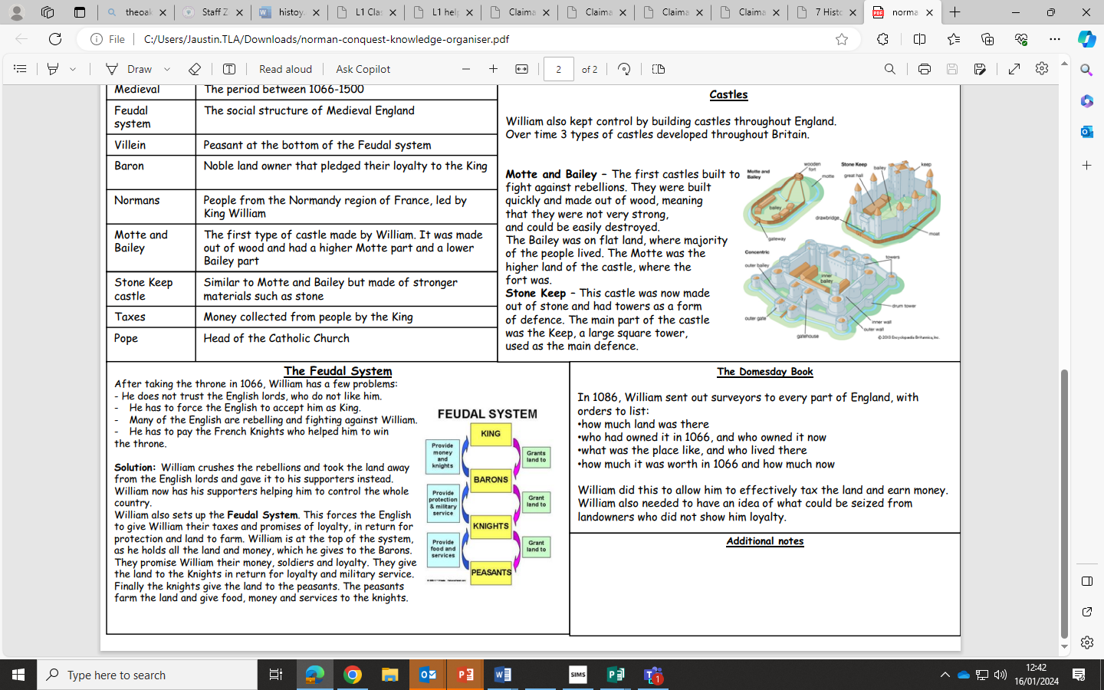
Year 7 History: February - April
The Medieval Period: Control
Key Term | Definition
Feudal System | The way the Normans organised political society.
Hierarchy | Political society being arranged with the most powerful at the top of the triangle and the least at the bottom.
Harrying of the North | Destruction of towns and people in the North of England to keep control.
Domesday Book | A description of all towns and villages in England.
Motte & Bailey Castles | Temporary castles made of earth and wood.
Key Skills in this Unit
Develop knowledge of political systems and forms of government.
Explore the different methodologies used to enforce control.
Assess methods of control using increasing contextual knowledge and understanding to make judgements.
Compare and different type of castle.
Use contextual knowledge to develop a plan to attack a castle in order to consolidate learning on control and rebellion.
Key Quotes
“I attacked the English of the Northern Shires like a lion. I ordered their houses and corn, with all their belongings, to be burnt without exception and large herds of cattle and beasts of burden to be destroyed wherever they were found. It was there I took revenge on masses of people by subjecting them to a cruel famine; and by doing so — alas!— I became the murderer of many thousands of that fine race.
William the Conqueror

Slide 5
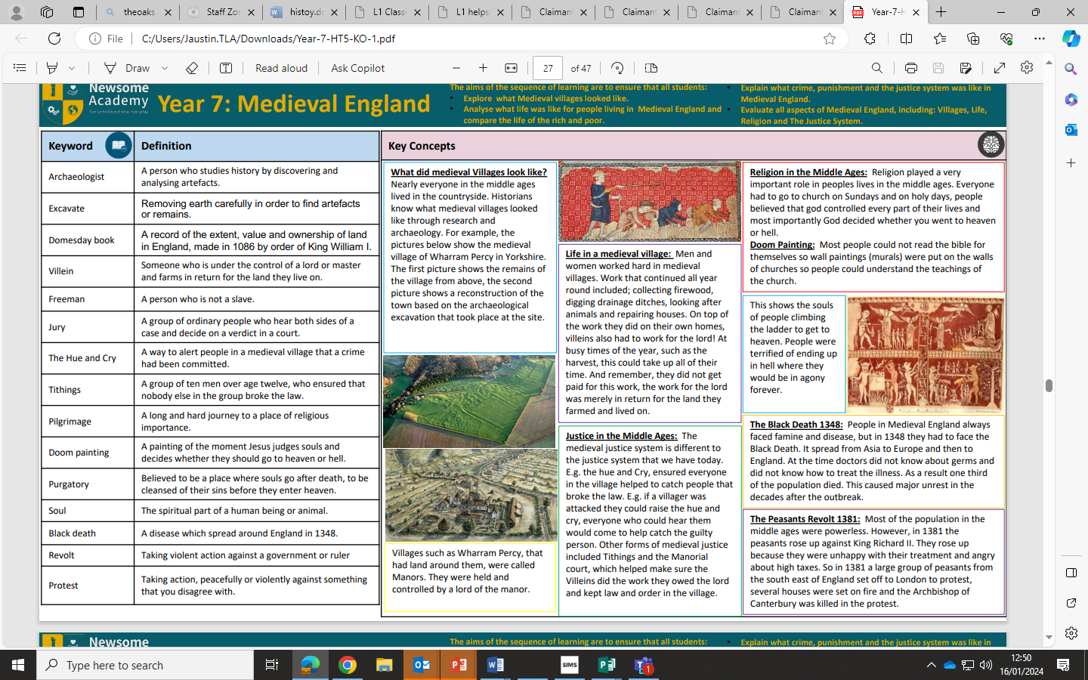
Year 7 History: April - July
The Medieval Period: Life
Key Term | Definition
Peasant | Poor people who were given land in exchange for work on the Lord’s land.
Freeman | Paid rent for land to grow crops on.
Open field System | A type of farming where people shared fields.
Murdrum Fine | A fine paid by everyone in the village if a Norman was murdered.
Purgatory | A place in between heaven and hell.
Clergy | Members of the church.
Key Skills in this Unit
Investigate and enquire into life in medieval villages and towns to show knowledge and understanding.
Evaluate the relationships that existed between the different groups of people in different social settings.
Explore the impact of the Black Death and the impact it had on the relationship between lord and peasant.
Understand the role of the church and the impact it had on the everyday lives of medieval people
Investigate the murder of Thomas Beckett and evaluate its significance between the King and the Pope.
Key Quotes:
“Farming is a profession of hope. Every year the spring comes. And every year we plant those crops and try again. Every. Single. Year.”
Brett Brian

