Slide 1
History Knowledge Organisers 2024
Year 8 History

Slide 2
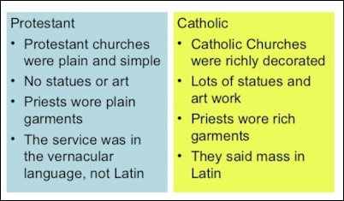
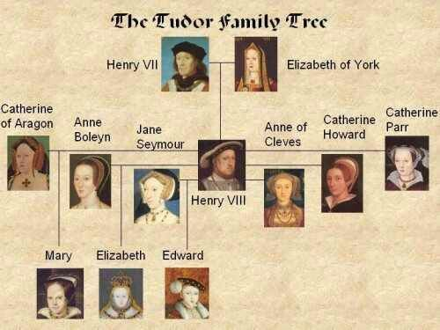
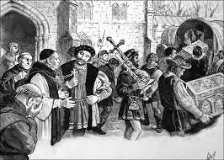
Year 8 History: September - December
The Tudors: Government
Key Skills in this Unit
Develop and understanding of the chronology of the Tudor period.
Explain Henry VIII’s problems and solutions.
Understand the importance of the wider context.
Assess bias in the accounts of Tudor monarchs and their supporters. Make inferences using multiple sources of information. Explain, analyse and assess the actions of Henry VIII and other Tudor Monarchs in order to reach a judgement about their political strategy. Dissolution & Monasteries (Below)
Key Term | Definition
Catholic | Christian religion set up by the Romans which included most people in Europe. Still led ed by the Pope from Rome today.
Protestant | A newer type of Christian religion set up by people who protested against the Catholic Church.
Dissolution | To dissolve/break up something.
Monarch | A King or Queen.
Lord Protector | A man who runs the country if the King is too young.
Tyrant | A cruel and oppressive ruler.
Key Quotes
KEY QUOTES
I know I have the body of a weak and feeble woman, but I have the heart and stomach of a king, and of a king of England too.
Elizabeth I
Dissolution of the Monasteries

Slide 3
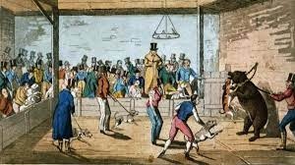
Year 8 History: January - February
The Tudors: Life
Key Term | Definition
Pirate | A person who steals from others at sea.
Privateer | Same as a pirate but with a licence from the King or Queen.
Sturdy Beggar | A person who is fit for work but chooses to beg instead.
Vagrant | A homeless person.
Bear Baiting | Setting dogs on to a bear chained to a post for sport.
Tudor Football | Football with no rules played over a pitch up to 2 miles long and wide.
Key Skills in this Unit
Gain and understanding of the different role held by different people in Tudor England.
Explain the differences between criminal and legitimate activities which were almost identical.
Use evidence to make inferences about guilt in criminal cases.
Assess how fairly the law was applied to different members of society.
Develop contextual knowledge to support analysis of the economic development of England.
Explain the reasons William won the Battle of Hasting
Assess and reach a judgement on the utility of Tudor sports.
KEY QUOTES
“If this is how the English play sport, I would hate to go to war against them.”
An unknown Italian visitor watching Tudor football in the mid 1500s.

Slide 4
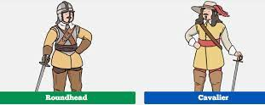
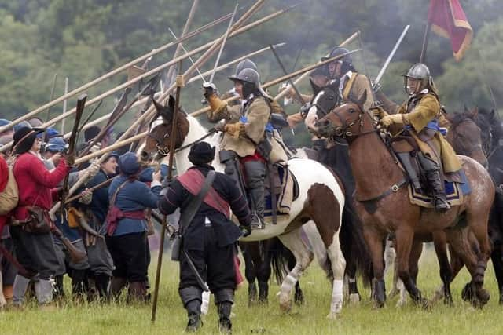
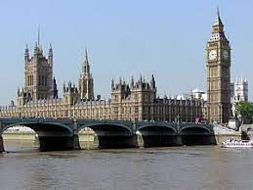
Year History: February - April
The English Civil War
Key Term | Definition
Parliament | The place and organisation where politicians discuss how to run the country.
Government | A group of people who help the King to run the country or run it themselves.
Divine Right | The King’s right to rule which has been given to him by god.
Civil War | A war between two sides from the same country.
Roundheads | Soldiers who fight for Parliament to rule England.
Cavillers | Soldiers who fight for the King to rule England.
Key Skills in this Unit
Develop a wider knowledge of different political systems and forms of government. Explore the different methodologies used to enforce control including civil war and rebellion. Assess methods of control using increasing contextual knowledge and understanding of both The King’s and Cromwell’s actions to make judgements. Use contextual knowledge with sources reach a judgement on Cromwell and consolidate learning on control and rebellion.
Key Quotes
“I tell you we will cut off his head with the crown upon it .”
Cromwell to one of the judges at the trial of King Charles I.1648.
VS!

Slide 5
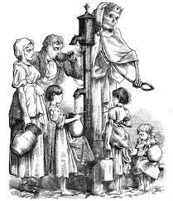
Year 8 History: April - July
The Industrial Revolution
Key Term | Definition
Agricultural | Anything to do with farming.
Industrial | Anything to do with industry factories and mines.
Revolution | A change in the way things are done.
Migration | People moving from one place to another for work or better living conditions.
Cholera | A deadly water born disease which is caught from drinking dirty water.
Sewage | Human toilet waste.
Thames | The large river that runs through London.
Key Skills in this Unit
Investigate and enquire into life in industrial towns to develop contextual knowledge. Evaluate the reasons were forced to migrate to industrial towns. Explore the living and working conditions in the industrial towns. Understand the impact of problems such as disease, poverty, crime and poor sanitation on the population Explain why the police were set up and how effective they were in dealing with complex crimes like the murders of Jack the Ripper. Compare and assess arguments which assess the impact of industrial revolution today and reach a sustained judgement.
Key Quotes:
“Shine forth upon our clouded hills?
And was Jerusalem builded here,
Among these dark Satanic Mills?”’
Jerusalem by William Blake
Cholera Epidemic

