Slide 1
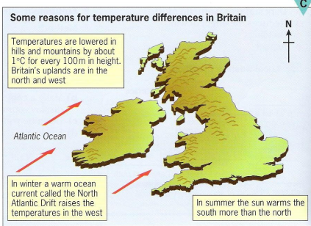
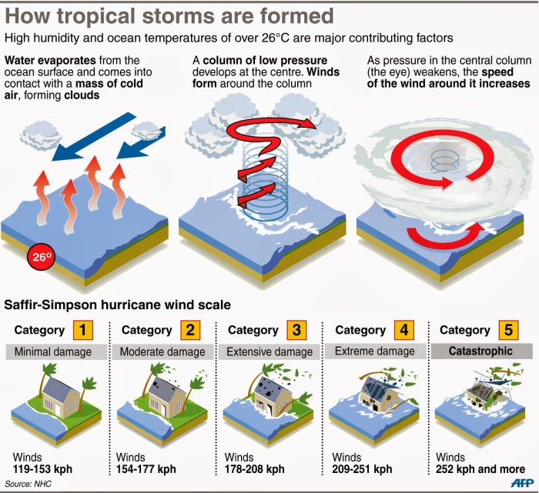
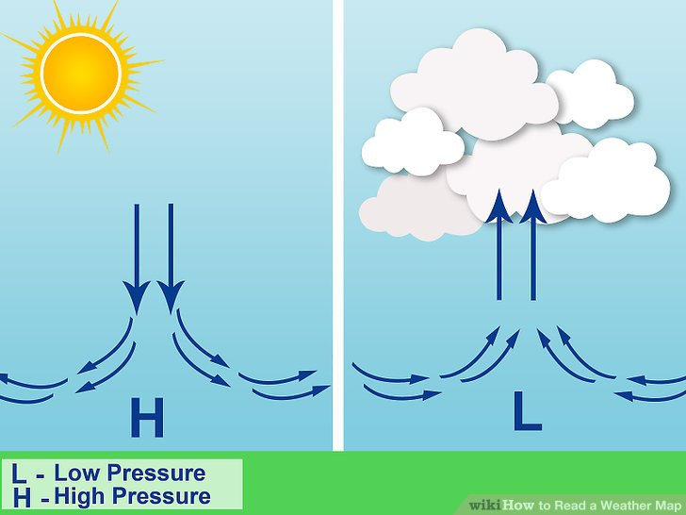
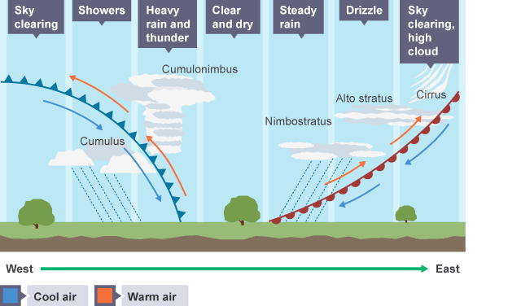
Year 9 Geography Weather & Climate May - July
Key new Knowledge
Keyword | Definition
Weather | The condition of the atmosphere, It might be sunny, hot, windy or cloudy, raining or snowing.
Climate | The average weather conditions in a particular location based on the average weather experienced there over 30 years or more.
Anticyclone | A high pressure weather system
Depression | A low pressure weather system
Convectional Rainfall | Air rises due to intense heat and as it cools it forms clouds and rain follows.
Frontal Rainfall | A mass of warm air meets a body of cold air. The warm air is forced over the cooler air which leads to clouds and rain.
Relief Rainfall | Air is forced over higher land e.g. mountains. Condensation occurs and rain follows.
Tropical Storm | A very powerful low-pressure weather system. It has strong winds and heavy rainfall that can be disruptive and dangerous.
Climate Change | Long-term, large-scale change in the planet's average temperatures and weather patterns.
Britain’s Climate
High and Low Pressure
Is weather becoming more extreme?
Many scientists believe that the UK's weather is becoming more extreme. Some examples of extreme weather include:
heavy rain/ heavy snowfall/ flooding
Gales/ tornadoes
heat waves/drought
Climate change can increase the frequency and intensity of extreme weather events.
Dig Deeper Questions
What social/ economic and environmental impacts can the weather have?
Extended Learning Opportunity
Investigate an example of extreme weather you are familiar with/ have heard about.
Depressions

