Slide 1

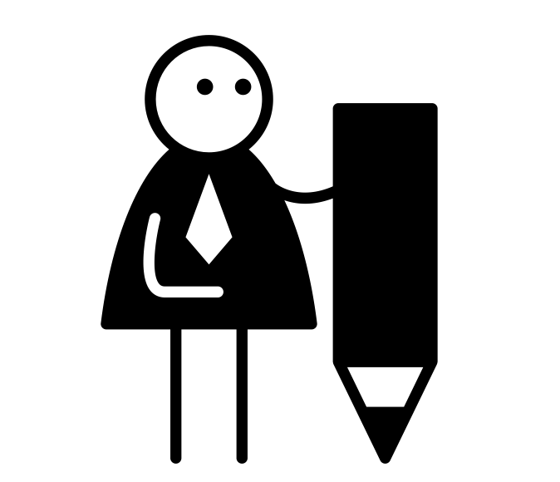





Eduqas Paper 1 – A: Reading
Time: 1hr 45 mins Marks: 80 overall Worth: 40%
Question 1:
Time: 5 minutes
AO: AO1
Worth: 5 marks
What is it asking you to do: Identify and interpret information and ideas. Demonstrate understanding by locating pieces of information within the text.
TopTip: Read the question carefully, what is the question asking you to do? Use the text to form an answer.
Question 3:
Time: 15 mins
AO: AO2
Worth: 10 Marks
Paragraphs: 2-3
What is it asking you to do: Identify and analyse how writers use words and phrases to create a particular effect. Consider how the reader may interact with the text and the emotions it may make them feel.
TopTip:
Make sure you are only working from where the text wants you to work from.
Question 4:
Time: 15 Mins
AO: AO4
Worth: 10 marks
Paragraphs: 2-3
What is it asking you to do: Explain, comment on and analyse how writers use language and structure to achieve effect and influence readers, using relevant subject terminology to support your views.
TopTip:
Think carefully how ideas or themes may change throughout the text. Consider how you would use your quote to support your views.
Question 5:
Time: 15 mins
AO: AO5 and AO4
Worth: 10 marks
What is it asking you to do: Evaluate texts critically and support with appropriate textual references. Evaluate how successful the writer has been achieving a particular effect.
TopTip:
Think about how the text changes from beginning to end – how does the author take the reader on an emotional or psychological journey? 16 marks for SPaG!
Sentence starters: Example sentence starters, you are not limited to use these…
The writer/narrator uses /
The writer/narrator builds / creates / develops…
The use of simile / metaphor … The pace / rhythm of the text increases/decreases here so that…
Question 2:
Time: 5 minutes
AO: AO2
Worth: 5 marks
What is it asking you to do:
Identify and analyse how writers use words and phrases to create a particular effect.
TopTip:
Use short quotes from the text (maximum of 6 words) Explain how the quote is effective.
Sentence starters:
Example sentence starters, you are not limited to use these…
POINT: The writer uses… to describe
EVIDENCE: This is shown through the quote…
ANALYSIS: This could suggest that..
It could also suggest…

Slide 2



Eduqas Paper 1 – B:Writing
Time: 1hr 45 mins Marks: 80 overall Worth: 40%
Layout of section B writing:
You will get a choice of which title you would like, there will be four to choose from.
Examples:
Choose one of the following titles:
Living right
A new dawn
Write about a time you moved from one place to another.
Write a story which begins:
  Everything had changed…
Once you have chosen from one of the four titles, you will need to take at least 5 mins for planning. Make sure you consider:
Audience – Who will be reading it?
Purpose – why are you writing?
Tone – How is it written?
Suggested time: 45 mins –
40 mins writing time and 5 mins planning.
What do I need to do?
Write and engaging and
imaginative text which could be based on your own experiences or made up.
Writing your answer to Section B Writing:
Try to remember to get your language devices in to move your work from basic to amazing! These lists are not exhaustive, and you may find that there aren’t some on here that you would use.
Language device bank:
Alliteration
Emotive Language
Juxtaposition
Metaphor
Personification
Zoomorphism
Simile
Punctuation bank:
.
,
?
!
“___”
…
TOPTIPS:
Look at the marks available and adapt your response accordingly. There is no point writing two pages for a five mark question and half a page for a 10 mark question.
Remember to look at implied meaning for Q1-Q4, as well as surface level meaning.
Pay attention to your spelling, punctuation and grammar. Silly mistakes may mean the difference between two grades.
Plan for Q5! Even if you don’t see the point. Planning makes for good work. An examiner can usually tell when you have/have not planned.
In this section you will be tested
on:
AO5 - 24 marks:
Communicate clearly, effectively and imaginatively, selecting and adapting tone, style and register for different forms, purposes and audiences.
Organise information and ideas, using structural and grammatical features to support coherence and cohesion of texts.
AO6 – 16 marks:
Use a range of vocabulary and sentence structures for clarity, purpose and effect, with accurate spelling and punctuation.
Remember AO6 weighs heavily on this section, check, double check and triple check all work!
16 marks for SPaG!
Example revision timetable:
Alternating weeks | Monday | Tuesday | Wednesday | Thursday | Friday | Saturday | Sunday
Week 1 | English Paper 1 | Vocational study | Rest | Maths Paper 1 | English Paper 2 | Maths Paper 2 | Rest
Week 2 | English Paper 2 | Vocational study | Rest | Maths Paper 2 | English Paper 1 | Maths Paper 1 | Rest

Slide 3
Eduqas Paper 2 –A: Reading
Time: 2hr Marks: 80 overall Worth: 60%
Question 1:
Time: 5 minutes
AO: AO1
Worth: 3 marks
What is it asking you to do:
You will be directed to a source, locate pieces of the information in this text. It is basic comprehension.
Question 4:
Time: 10 Mins
AO: AO4
Worth: 15 marks
Paragraphs: 3-4Paragraphs
What is it asking you to do:
Explore how the writer conveys a particular idea or theme and offer an informed response supported by textual evidence. Providing a critical and persuasive evaluation.
TOPTIP:
Make sure your answer refers to specially to the question. This is how you believe the writer has conveyed a theme or emotion, give your analysis!
Question 5:
Time: 5 mins
AO: AO1
Worth: 4 marks
What is it asking you to do: Encapsulate key ideas from the two sources, putting them into your own words based on evidence from the text. In your own words tell us what the sources are about.
TOPTIP:
Make sure your answer includes ideas from both texts.
Summarise the big ideas but support them with carefully chosen quotes. Write a couple of lines for each text – there’s no need to write a detailed paragraph for a four-mark question.
Question 6:
Time: 15 mins
AO: AO3
Worth: 10 marks
What is it asking you to do: Compare how the writers in both sources explore or address a particular theme or idea. You will need to make detailed comparisons between the two.
TOPTIPS:
Make sure you answer refers specifically to the question, use specific quotes from the text. Your comparison must give equal weight to both texts – don’t focus on more than the other. Look at the language and structure of both texts.
1
Question 2:
Time: 10 minutes
AO: AO2
Worth: 10 marks
Paragraphs:
Between 2-3 paragraphs
What is it asking you to do:
Usually same source as Q1. Analyse how the writer uses language to achieve tone and effect.
Sentence starters:
The writer …. Which is shown through the quote, “____”. This could suggest…
C
Suggested sentence starters:
The writer uses/refers to/employs…
The writer then builds/creates/develops… because…
The use of ____ suggests…
The STRUCTURE TECHNIQUE suggests/ implies….
The writer creates a mood or atmosphere by…
WORD BANK:
Likewise
Similarly
As well
In the same way
Just as… so…
Question 3:
Time: 5 mins
AO: AO1
Worth: 3 Marks
What is it asking you to do:
Identify ideas of themes within the source, being able to answer questions with information from the text.
TOPTIP:
Don’t give this one too much thought. It’s only worth 3 marks!
However
On the other hand
In contrast
In comparison
Scan the QR code to access Padlet resources! Updated frequently, the Padlet is a great way to revise on the go. Wide variety of past papers and mark schemes available. Happy revising!

Slide 4


Edexcel Paper 2 – B: Writing
Time: 2hrs Marks: 80 overall Worth: 40%
Section B
You will be tested on two different assessment objective for section B:
AO5 (24 marks)
Communicate clearly, effectively and imaginatively, selecting and adapting tone, style and register for different forms, purposes and audiences.
Organise information and ideas, using structural and grammatical features to support coherence and cohesion of texts
AO6 (16 marks)
Candidates must use a range of vocabulary and sentence structures for clarity, purpose and effect, with accurate spelling and punctuation.
Worth: 20 marks per question. 40 in total.
Time: 30 mins per question. 1hr in total
What do you need to do?
Complete both writing tasks requiring you to compose an engaging non-fiction piece.
It should be appropriate to the purpose, audience and from stated in each question.
The task will be on a similar theme to the sources applied in Section A of the exam.
TOPTIPS:
Make sure that your writing is carefully structured – planning is essential, make sure you give yourself 5 mins to plan. Use a wide range of vocab to gather marks. Think carefully about the tone of your piece. The questions are equally weighted, so spend an equal amount of time on them.
Sample Question:
“The dramatic arts have no place in our modern world. What do we need acting and dancing and performances of this type for? Amateur dramatics should be cancelled in all towns.”
Write a speech for a school assembly in which you explain your point of view on this statement.
[12 marks for awarded for communication and organisation, 8 marks for vocabulary, sentence structure, punctuation and spelling.]
FINAL TOPTIPS!
•Write on your copy of the text if you want to. This is your exam paper – annotate and highlight as you need. • Keep quotations short – a few words at most.
• Never criticise a writer. You can evaluate their work, using evidence from the text, but do not make sweeping statements about whether you personally like or dislike the text.
• Plan your written task – a spider diagram, list or flow chart will help you to create cohesion in your writing.
• Pay attention to your spelling, punctuation and grammar. This is worth 16 marks in Section B of the exam. Don’t make silly mistakes, such as forgetting to use capital letters correctly.
• Check your work carefully when you have finished. Use every minute you have
TOPTIPS:
There will be two questions in Section B. Come up with sample questions of your own on the same theme. Remember that you can be asked to write for a range of audiences and purposes, adapting style to form in letters, articles, reviews, speeches etc
Remember your DAFOREST techniques for Paper 2 Section :B
Direct address – using 'you' or 'we'
Alliteration – Similar sounds at the start of words.
Facts – something which can be proven.
Opinion – Your own idea.
Rhetorical question – the answer is assumed.
Emotive language – language which makes your reader feel a particular way.
Statistics – information given
Triple – rule of 3

