Slide 1

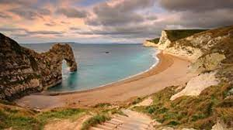

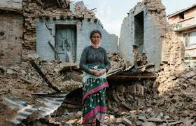

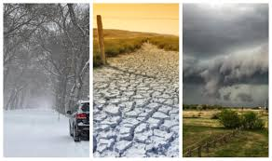
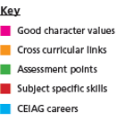
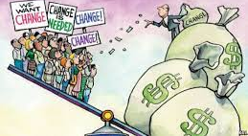
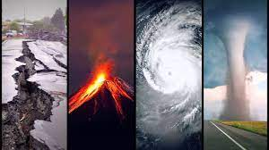
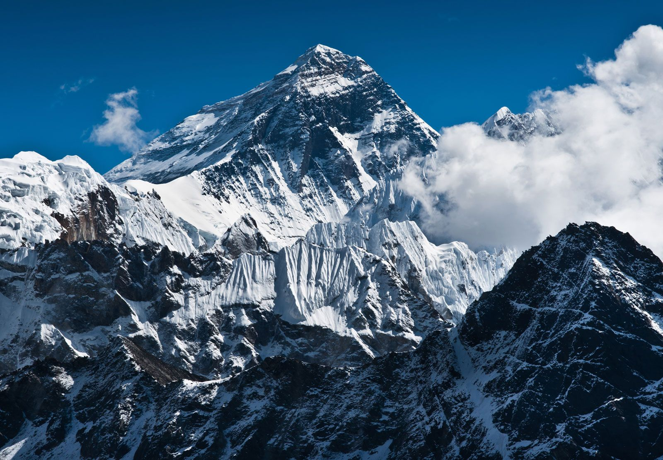

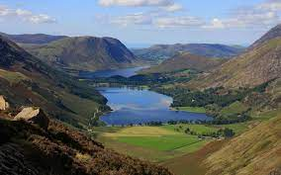

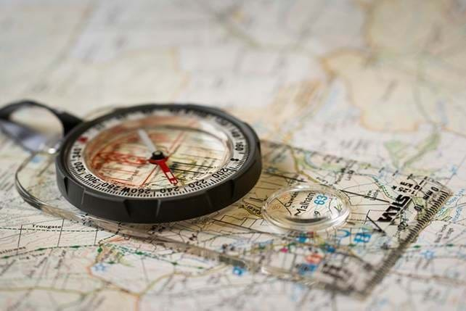
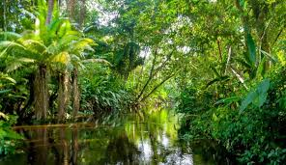
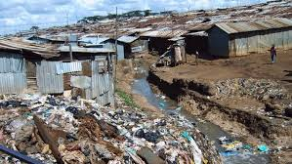
Nature of God
Geography Curriculum Map
How are the UK’s River Landscapes distinctive?
Pupils explore how river valleys change, distinctive landforms and how flooding can be managed.
Identifying key points, explaining key processes of climate change.
Resilience
Eng extended writing, Science: Erosion and weathering
Explain why our climate is changing , as well evaluating the weather hazards around the World and the UK
Teacher of Geography, Environment Agency
Fieldwork
Pupils carry out two contrasting geographical enquiries and will complete a detailed study of both enquiries.
Identifying key points, collecting data, analysing data, drawing conclusions, evaluating
Character, Resilience
Eng Extended writing, Maths: Data analysis
Explain the advantages/ disadvantages of data collection methods, What conclusions can be drawn from results, Evaluate the success of the study
Teacher of Geography,
What are the challenges of Resource Management?
Pupils explore the changing demand and provision of resources in the UK and how demand for energy is increasing globally but supply can be insecure.
Identifying key points, explaining the significance and importance, evaluating
Character, Health, Resilience
Eng Extended writing, Science: Creation of Fossil Fuels, Renewable energy
Explain how physical and human factors can contribute to energy security, Evaluate the successes and failures of a local sustainable energy scheme
Teacher of Geography, Environment Agency
Exam
Revision
Fieldwork
Paper 3 Revision
Issue Evaluation
Mock Exam 2
Social Development
Mock Exam 1
The Challenge of Resource Management
Issue Evaluation
Pupils will complete a detailed analysis of pre release material distributed 12 weeks before the exam.
Identifying key points, explaining the significance and importance, Give contrasting viewpoints, evaluating, making justified decisions
Character,
Eng: Extended writing, Maths: Data analysis
Evaluate the benefits and costs of the proposed issue
Teacher of Geography, Planner
How are the World’s economies changing?
Pupils explore the global variations in development and quality of life, the rapid economic development in NEEs and the major changes in the UK’s economy.
Identifying key points, explaining, extended writing, evaluating
Character, Tolerance, Empathy Health, Responsibility.
Eng: Extended writing, Maths: Data analysis
Explain the causes and impacts of uneven development, Evaluate the strategies used to reduce the development gap, Evaluate how economic development has improved quality of Life in Nigeria, Explain strategies used to reduce the North South divide.
Teacher of Geography, Aid worker, City Planner, Economist
Climate Change
How do people interact with the Living Word?
Pupils explore ecosystems at a range of scales including the characteristics of Tropical Rainforests and Hot Deserts.
Identifying key points, explaining, extended writing, evaluation.
Character, Resilience
Eng Extended writing, Science: Ecosystems and Biomes.
Explain economic gains and environmental losses of deforestation
Teacher of Geography, Conservationist
Tectonic Landscapes & Hazards
11
The Challenge of Natural Hazards
Physical Fieldwork
Weather, Climate & Ecosystems
What are the challenges of living in a tectonically active area?
Pupils explore effects and responses to tectonic hazards in areas of contrasting levels of wealth, the causes and impacts of extreme weather and how climate change is caused and managed.
Identifying key points, explaining the significance and importance, comparing and contrasting, extended writing and evaluation.
Character, Tolerance, Empathy,
Eng Extended writing, Science: Tectonic Processes and Climate Change.
Explain how different levels of wealth and development affect the impact of earthquakes, Evaluate the effectiveness of the responses to tectonic hazards, Describe the primary and secondary effects of a tropical storm, Explain adaption and mitigation of climate change
Teacher of Geography, Seismologist, Emergency Planner
How are the UK’s Coastal Landscapes distinctive?
Pupils explore how the coast is shaped by a number of processes, distinctive landforms and how the coast can be protected.
Identifying key points, explaining key processes and the formation, evaluating
Character, Resilience, Empathy
Eng: Extended writing, Science: Erosion and weathering
Explain the formation of coastal landforms, To what extent can the coastal management strategy be considered a success
Teacher of Geography, Environment Agency
Human Fieldwork
Rural – Urban Links
Distinctive Landscapes
10
How has urban change created opportunities and challenges in NEEs and HICS?
Pupils explore the opportunities and challenges of living in contrasting cities and discover how urban sustainability requires management of resources and transport.
Identifying key points, comparing, explaining, extended writing and evaluation.
Character, tolerance, Emotional intelligence, responsibility.
Eng Extended writing, Science: Renewable energy sources
Explain how migration has been responsible for the growth and racial make-up of the UK's population, Evaluate the effectiveness of a urban planning scheme to improve life for the urban poor, Assess the causes and consequences of social inequality in Wales Discuss the successes of the Temple Quarter regeneration, of Bristol. Evaluate the strategies employed to manage traffic congestion .
Teacher of Geography, City Planner,
What is Weather and Climate?
Pupils explore how weather and climate can impact people, the economy and environment
Identifying key points, explaining, comparing and contrasting, evaluating
Character, Resilience
Eng Extended writing, Science: Climate, Air Pressure
Explain how differences in pressure result in different weather, Evaluate the impacts of extreme weather
Teacher of Geography, Meteorologist
Weather & Climate
9
Development and Globalisation
Natural Hazards
What is Development and Globalisation?
Pupils explore how countries are at different stages of development and how globalisation has been used to promote development and hinder it.
Identifying key points, explaining the importance, graph analysis, comparing and contrasting, evaluating
Character, Tolerance, Emotional intelligence, Empathy
Eng Extended writing, History: Colonialism
Explain how development can be measured, Evaluate the impact of Globalisation on development
Teacher of Geography, Aid worker
What are Natural Hazards ad how can they be managed?
Pupils explore key tectonic processes, the impacts of earthquakes and volcanoes and how those impacts can be reduced.
Identifying key points, explaining, comparing and contrasting, extended writing and evaluation.
Resilience, Empathy
Eng Extended writing, Science: Plate Tectonics
Explain the processes at plate boundaries, Compare which earthquake was worst and why, Explain how the impacts of earthquakes/volcanoes can be managed
Teacher of Geography, Emergency Planner
Population
How has global population changed over time?
Pupils explore population growth, population structures, population policy and migration.
Identifying key points, infer from pictures, explaining the importance, extended writing and evaluation.
Character, tolerance, Emotional intelligence, Empathy
Eng Extended writing, Science: Graph Interpretation .
Explain the reasons for the population explosion, Evaluate which population structures are best, Evaluate the effectiveness of a population policy, Explain the causes and impacts of migration
Teacher of Geography, Demographer, Civil Servant.
Everest and Tectonics
The Geography of Disease
Why is the landscape so distinctive and how did tectonic shape our landscape?
Pupils explore different types of erosion, transportation and weathering and how these shape the landscape of Everest.
Identifying and defining key processes, explaining the formation of landforms, map skills and the dangers of walking Mt Everest.
Character, Resilience
Science: Rocks, Erosion and Weathering
Explain the formation of Waterfalls, Spiral Assessment
Teacher of Geography, Geologist, Planner
What is the Geography of Disease?
Pupils explore the different types of disease and how they can be prevented.
Understanding, identifying key points, explaining the significance, extended writing and evaluation.
Empathy, Tolerance
Eng: Extended writing, Science: Disease
Explain the difference types of disease, Knowledge questions about a range of diseases, Evaluate strategies to prevent the spread of disease.
Teacher of Geography, Epidemiologist
8
Ecosystems
Antarctica
Conservation
What is Conservation?
Pupils explore how humans can impact ecosystems and why should we conserve them.
Understanding, interpreting, Debating, Evaluating
Character, Resilience
Eng Extended writing.
Evaluate which ecosystem should be conserved
Conservationist, Teacher of Geography
How do we use Map Skills?
Pupils explore how to use direction and scale, grid references, map symbols and latitude & longitude to locate places on a map
Identifying key points, calculating distance
Resilience​
Maths: Calculating distances
Range of questions based on map skills
Teacher of Geography
What are the difficulties of living in Tropical Rainforests and the Tundra?
Pupils explore the climate, peoples, vegetation and animals that live in these contrasting ecosystems.
Identifying key points, Recalling, Explaining, Evaluating
Tolerance, Empathy ​
PSHE: different cultures, Eng Extended writing.
Evaluate how animals, plants and peoples adapt to the conditions
Teacher of Geography
What did Captain Scott experience in Antarctica?
Pupils explore Antarctica through Scott’s expedition.
Identifying key points, Recalling, Explaining.
Tolerance, emotional intelligence
History: Timeline Eng Creative writing.
Compare Scott’s and Amundsen’s expeditions
Writer, Teacher of Geography, Historian
Map Skills
Shanty Towns
Living in the Desert
Africa’s Climate
Introduction to Africa
7
How can life be improved for those living in Africa’s slums?
Pupils explore the challenges of living in slum settlements and how life can be improved.
Identifying key points, decision making, explanation, evaluation
Resilience, Tolerance, Empathy
PSHCE: different cultures
Evaluate strategies to improve Shanty Towns
Teacher of Geography, Aid Worker
How does climate vary within Africa?
Pupils explore climate graphs and how the climate changes across Africa.
Graph Interpretation, Graph drawing
Resilience
Maths/ Science: Graph interpretation.
Range of questions based on Climate Graphs
Teacher of Geography.
What and Where is Africa?
Pupils explore Africa’s location and physical features
Identifying key points, map skills, locational descriptions, data analysis
Resilience, self-control, cooperation, ​
Maths: Data Analysis. Eng: Extended writing.
Map work based on Africa’s features
Teacher of Geography,
What are the challenges of Living in the Desert?
Pupils explore Africa’s deserts and the plants, animals and peoples that live there
Identifying key points, explanation, evaluation
Resilience
Science: Adaptation
Evaluate the success of plant and animal adaptations
Teacher of Geography, Naturalist

