Slide 1

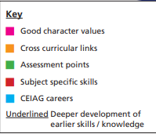
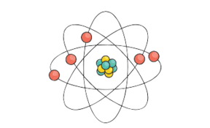
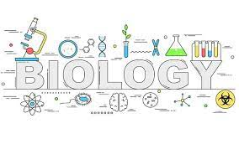
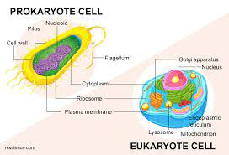

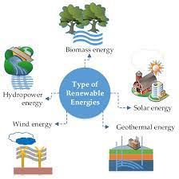
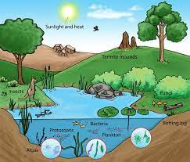
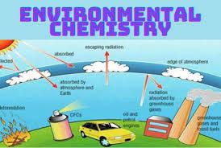
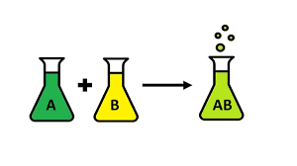
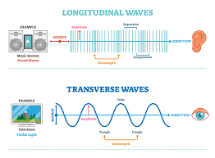
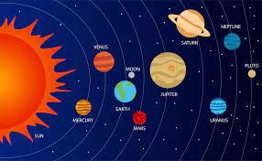
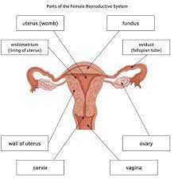

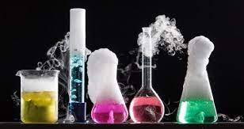
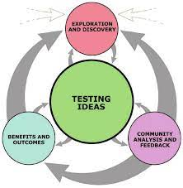
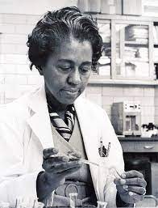
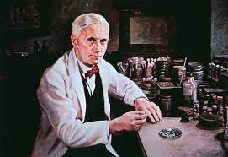
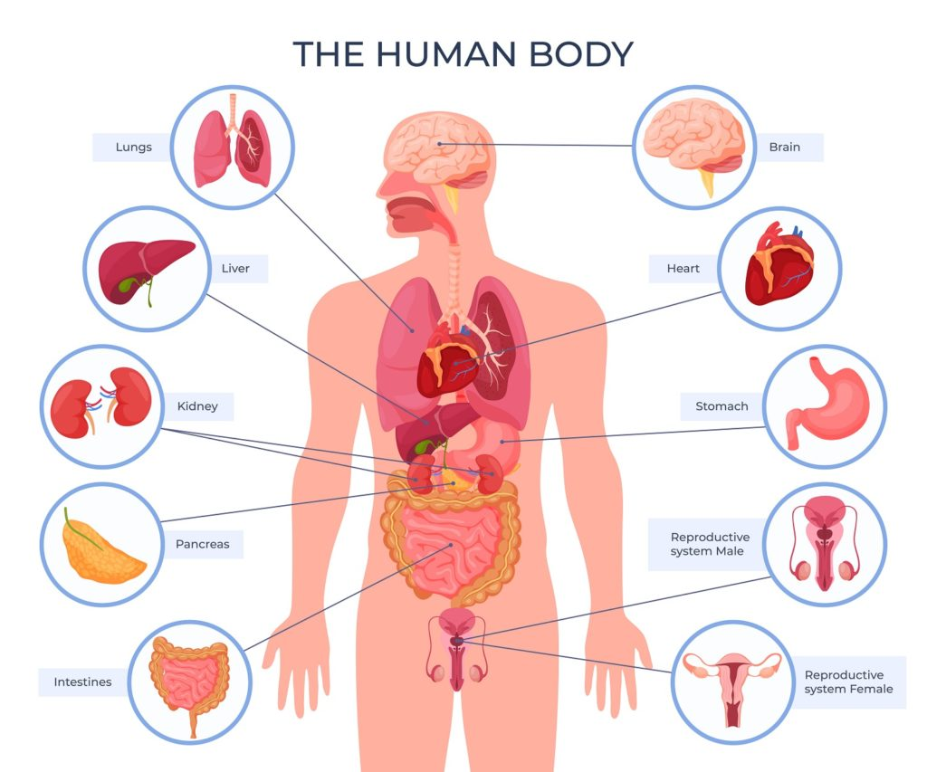
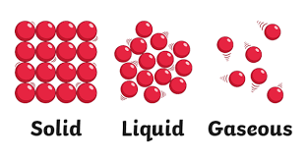
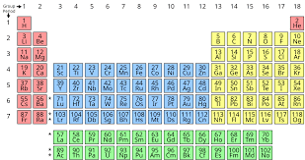
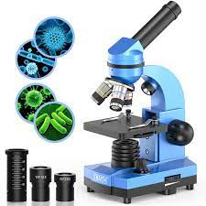
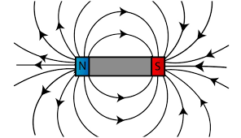
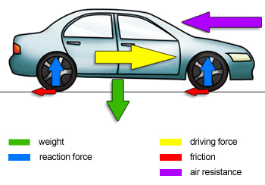
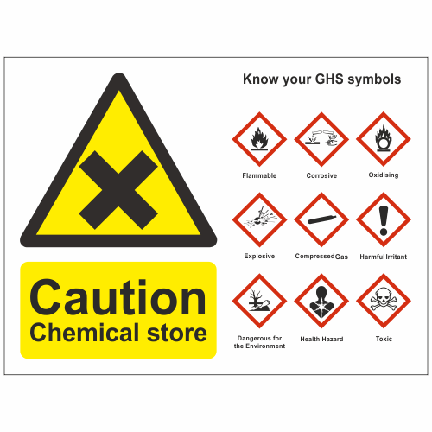
Looking at the structure of compounds and how they are held together by ionic and covalent bonds.
Resilience, perseverance and collaboration
QMF-Extended writing mini essay, QMS-End of topic test
Evaluating, describing, analysing, explaining, planning.
Link to Mathematics – Drawing graphs, analysing and processing data
The structure of the atom from ancient geeks to our current model.
Resilience, perseverance and collaboration
QMF-Extended writing mini essay, QMS-End of topic test
Describing, analysing, explaining, planning.
Science-KS3
Bonding structure and
the particle model
Atomic structure
The product of combustions and their environmental impacts
Resilience, perseverance and collaboration
QMF-Extended writing mini essay, QMS-End of topic test
Evaluating, describing, analysing, explaining, planning.
Link to geography- how human actions
impact the environment
Types of energy and a look at the future use of resources in generating electricity.
Resilience, perseverance and collaboration
QMF-Extended writing mini essay, QMS-End of topic test
Evaluating, describing, analysing, explaining,.
Link to Mathematics – processing data and drawing graphs
The biology underpinning the next steps towards GCSE
Resilience, perseverance and collaboration
QMF-assessed practical skills, QMS-End of topic test
Evaluating, describing, analysing, explaining, planning.
Link to Mathematics – Ideas of scales, accurate measurements and rearranging formulae
Fundamental biology
Living together
Exploring the environment
Generating our own energy
How to identify when chemical reaction occur and name the products of reactions
Resilience, perseverance and collaboration
QMF-Extended writing mini essay, QMS-End of topic test
Evaluating, describing, explaining
Link to Mathematics – processing data and drawing graphs
How energy is transferred by waves, the differences between longitudinal and transverse waves.
Resilience, perseverance and collaboration
QMF-Extended writing mini essay, QMS-End of topic test
Evaluating, describing, analysing, explaining, planning.
Link to Music – different types of sound and their sound waves
Who is eating who and a look at the different ecosystems which exist on our planet.
Resilience, perseverance and collaboration
QMF-Extended writing mini essay, QMS-End of topic test
Evaluating, describing, analysing, explaining, planning.
Link to geography – the importance of maintaining biodiversity
Identifying
substances
9
Waves at work
An anatomical look at the key organs involved in reproduction. How this fits into a cycle of developing life.
Resilience, perseverance and collaboration
QMF-Extended writing mini essay, QMS-End of topic test
Evaluating, describing, analysing, explaining,
Link to RE – ethical consideration of using genetic technologies
Looking at basic chemical reactions such as neutralisation. How to identify that a reaction has occurred by temperature change or formation of a gas.
Resilience, perseverance and collaboration
QMF-Extended writing mini essay, QMS-End of topic test
Evaluating, describing, analysing, explaining, planning.
Link to Mathematics – processing data and drawing graphs
Unravelling the universe
Creating
connections
Healthy humans
Real reactions
How to structure
a formal investigation
Resilience, perseverance and collaboration
QMF-assessed practical skills, QMS-End of topic test
Evaluating, describing, analysing, explaining, planning.
Health and its importance. The world or microorganisms and how we interact with them
Resilience, perseverance and collaboration
QMF-Extended writing mini essay, QMS-End of topic test
Evaluating, describing, analysing, explaining, planning.
Link to PE –Evaluating the impact of life style choices on health. Link to Mathematics – processing data and drawing graphs
From moons to stars and galaxies. How the universe is put together and its cycles.
Resilience, perseverance and collaboration
QMF-Extended writing mini essay, QMS-End of topic test
Evaluating, describing, analysing, explaining
Link to Mathematics – calculations of distance and scale
Science in action
8
Significant scientists
Basic structure and function of sub cellular organelles. An introduction to using microscopes to investigate an unseen world
Resilience, perseverance and collaboration
QMF-assessed practical skills, QMS-End of topic test
Evaluating, describing, analysing, explaining,
Link to PE – the movement of the body (muscular skeletal systems) and maintaining a healthy body Link to Mathematics – processing data and drawing graphs
Atoms as basic building blocks to compounds and their organisation in the periodic table
Resilience, perseverance and collaboration
QMF-assessed practical skills, QMS-End of topic test
Evaluating, describing, analysing, explaining
Mathematics – processing data and drawing graphs
Important scientists through out history their lives and their discoveries
Resilience, perseverance and collaboration
QMF-Extended writing mini essay, QMS-End of topic test
Evaluating, describing, analysing, explaining,
Link to history – important historical figures and
the barriers they have overcome to be successful
The different methods used to separate mixtures. .
Resilience, perseverance and collaboration, group work
QMF-Extended writing mini essay, QMS-End of topic test
Evaluating, describing, analysing, explaining,
Separating substances
Being human
Everything elemental
Building the human body from specialised cells to tissues, organs and organ systems.
Resilience, perseverance and collaboration
QMF-Extended writing mini essay, QMS-End of topic test
Evaluating, describing, analysing, explaining,
The states of matter and their properties. Looking how to alter between the states.
Resilience, perseverance and collaboration
QMF-Extended writing mini essay, QMS-End of topic test
Evaluating, describing, analysing, explaining,
Mathematics – processing data and drawing graphs
Magnetism
Fundamental forces
7
I am a scientist
Interaction of poles on a basic magnet and suitable materials to make a magnet from.
Resilience, perseverance and collaboration
QMF-Extended writing mini essay, QMS-End of topic test
Evaluating, describing, analysing, explaining,
Forces effect the world around us by changing their speed or direction. They can do this as a contact or non contact force. Looking at the forces interacting on objects.
Resilience, perseverance and collaboration
QMF-Extended writing mini essay, QMS-End of topic test
Evaluating, describing, analysing, explaining
Linking to DT – how forces effect different material, and the movement of objects
Basic lab safety and skills. Identifying equipment and hazard symbols.
Resilience, perseverance and collaboration
QMF-assessed practical skills, QMS-End of topic test
Evaluating, describing, analysing, explaining, planning.
Link to DT-the importance of carrying out risk assessments and reducing potential risk during practical's . Mathematics – processing data and drawing graphs

Slide 2
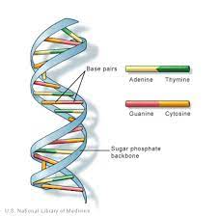
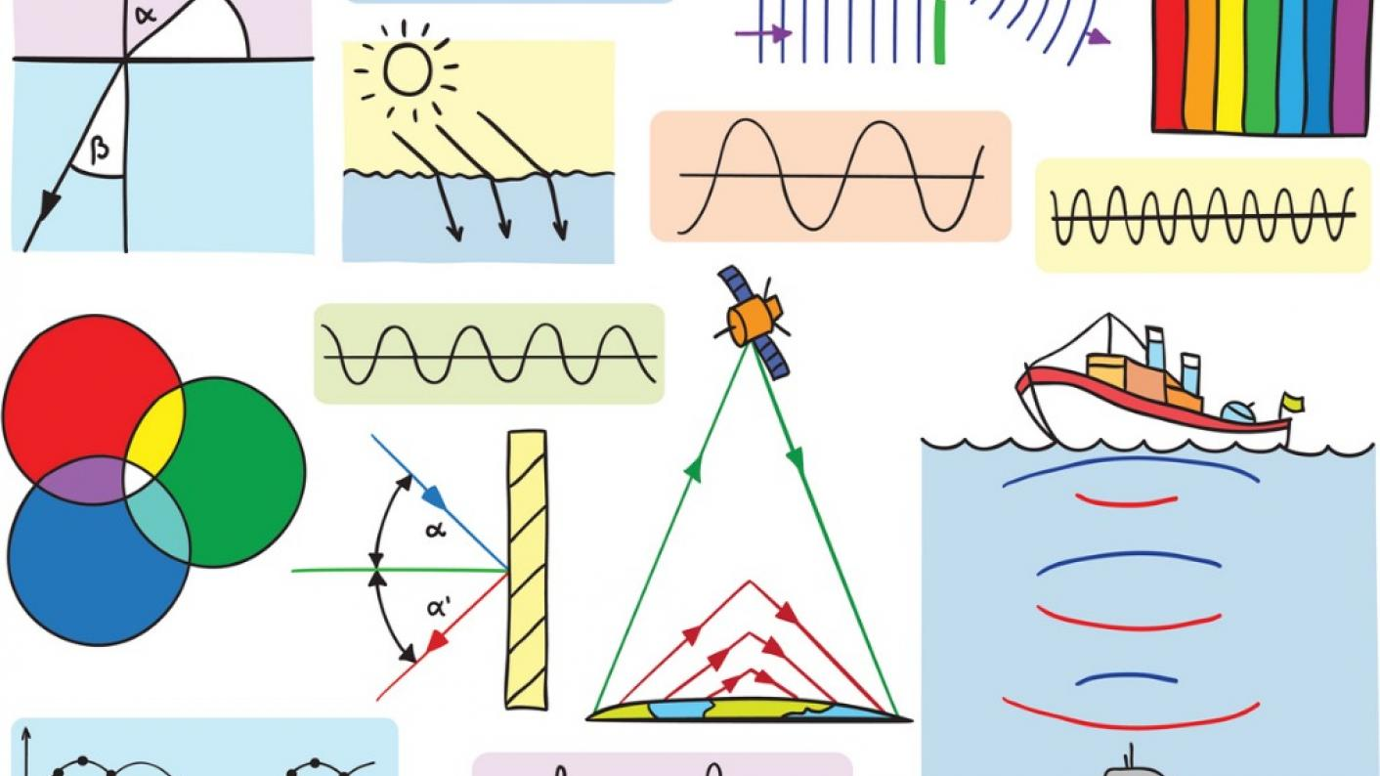
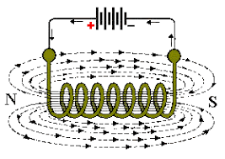
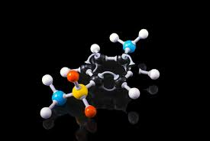
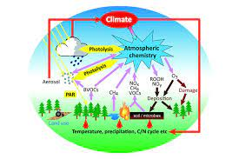
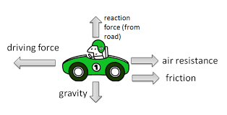
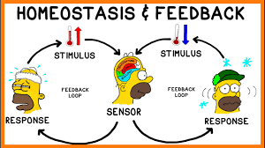
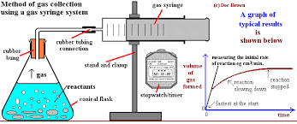

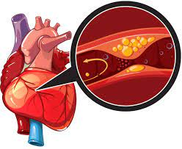
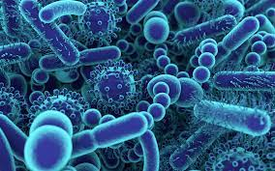
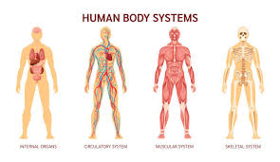
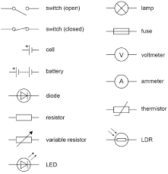
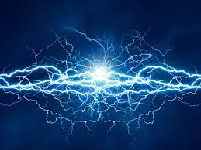
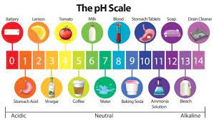
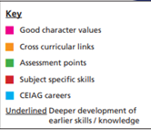
Science-KS4
Understanding why we are the way we are, factors we inherit and the influence of our environment.
Resilience, perseverance and collaboration
QMF-Extended writing mini essay, QMS-End of topic test
Evaluating, describing, analysing, explaining
Link to Re – discussing the ethical consideration of using genetic screening and other genetic technologies.
Properties of transverse and longitudinal waves. Investigating the electromagnetic spectrum its properties and uses
Resilience, perseverance and collaboration
QMF-Extended writing mini essay, QMS-End of topic test
Evaluating, describing, analysing, explaining, planning.
Link to Music – different types of sound and their sound waves
B2-Inheritance,variations and evolution
P2-Waves
Evolution of the earths atmosphere since the beginning of the planet
Resilience, perseverance and collaboration
QMF-Extended writing mini essay, QMS-End of topic test
Evaluating, describing, analysing, explaining,
Link to geography – burning fossil fuels and global warming
Properties of alkanes and alkenes, how to obtain them and utilise them in polymers
Resilience, perseverance and collaboration
QMF-assessed practical skills, QMS-End of topic test
Evaluating, describing, analysing, explaining, planning.
Link to Mathematics – Drawing graphs, analysing and processing data, rearranging formulae
P2-Magnetism and electromagnetism
C2-Organic chemistry and analysis
C2-Chemistry of the atmosphere
The interaction of magnets and their properties, the creation of an electromagnet and investigating the factors which affect this
Resilience, perseverance and collaboration
QMF-Extended writing mini essay, QMS-End of topic test
Evaluating, describing, analysing, explaining, planning. r
Link to Mathematics – Drawing graphs, analysing and processing data
,rearranging formulae
Maintaining the balance in he human body using the nervous system and the endocrine system
Resilience, perseverance and collaboration
QMF-Extended writing mini essay, QMS-End of topic test
Evaluating, describing, analysing, explaining, planning.
Link to PE – Nerves and reaction times
P2-Forces
B2-Homeostasis and response
Deeper look into newtons laws of motion and the forces that govern our existence. Calculating real life problems such impact in an accident or the elastic properties of materials.
Resilience, perseverance and collaboration
QMF-Extended writing mini essay, QMS-End of topic test
Evaluating, describing, analysing, explaining, planning.
Link to Mathematics – Drawing graphs, analysing and processing data, rearranging formulae
The damage we are doing to our planet in various ways and how this will eventually effect us
Resilience, perseverance and collaboration
QMF-Extended writing mini essay, QMS-End of topic test
Evaluating, describing, analysing, explaining, planning.
Link to geography – how human impact effect he environment and the importance of maintaining biodiversity
11
B2-Ecology
C2-Energy changes and rate of reaction
Factors effecting the rate of a chemical reaction such as concentration, temperature and pressure and how to measure them
Resilience, perseverance and collaboration
QMF-Extended writing mini essay, QMS-End of topic test
Evaluating, describing, analysing, explaining, planning.
Link to Mathematics – Drawing graphs, analysing and processing data
A study of the causes of communicable and non-communicable diseases, and the response of the immune system to pathogens
Resilience, perseverance and collaboration
QMF-Extended writing mini essay, QMS-End of topic test
Evaluating, describing, analysing, explaining,
Link to history – the roles of different scientists and doctors in the development of antibiotic and vaccinations.
Link to PE – how lifestyle choices are risk factors for coronary heat disease.
B1-Infection and response
Covering the law of conservation of energy looking at energy transfers and changes in a closed system
Resilience, perseverance and collaboration
QMF-assessed practical skills, QMS-End of topic test
Evaluating, describing, analysing, explaining,
Link to Mathematics – Drawing graphs, analysing and processing data
Link to geography – evaluating the effect of different energy resources used to generate electricity
Investigating the organ systems in the human body such as respiratory and circulatory systems
QMF-Extended writing mini essay, QMS-End of topic test
Resilience, perseverance and collaboration
Evaluating, describing, analysing, explaining, planning.
Link to PE – the anatomy and structure of the heart and lungs
B1-Organisation
P1-Energy
P1-Electricity
Learning how circuits are built using various components and looking at how the components interact with electricity, using electrical calculations.
Resilience, perseverance and collaboration
QMF-assessed practical skills, QMS-End of topic test
Evaluating, describing, analysing, explaining
Link to Mathematics – Drawing graphs, analysing and processing data, rearranging formulae
C1-Chemical changes
10
C1-Quantative
chemistry
The dynamics of a chemical reaction such as yield and equilibrium
Resilience, perseverance and collaboration
QMF-Extended writing mini essay, QMS-End of topic test
Evaluating, describing, analysing, explaining,
Link to Mathematics - Analysing and processing data
Topic examines the indicators of a chemical reaction and the products of common chemical reactions such as acids and metals
Resilience, perseverance and collaboration
QMF-Extended writing mini essay, QMS-End of topic test
Evaluating, describing, analysing, explaining, planning.

