Slide 1
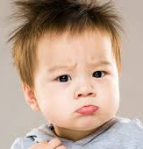
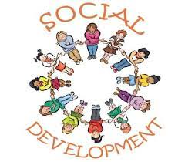
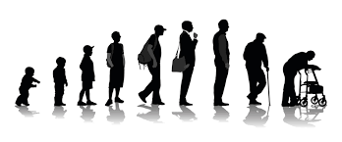
KNOWLEDGE ORGANISER HEALTH AND SOCIAL CARE YEAR 10 RO33
RO33: Supporting individuals through life event (Live assessment/course work)
KEY TERMS
Topic 1: Life Stages and development
4-10 years: childhood
11-18 years: adolescence
19-45 years: young adult
46-65 years: middle adulthood
65+ years: older adult
Task 1: You will be set a task on growth and development trough a life stage, this can be any of the 5 studied set by the exam board.
PIES: You need to know them
Physical: fine and gross motor skills, mobility, body changes, menopause, ageing characterises.
Intellectual: language development,
Emotional: Bonding, different attachments, independence, self-confidence, self image, self esteem.
Social: relationships, social skills and responsibilities.
Factors affecting growth and development across life stages
Physical factors
Social Factors
Emotional Factors
Economic Factors
Cultural Factors
Environmental Factors

Slide 2
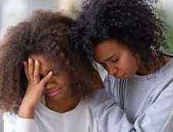
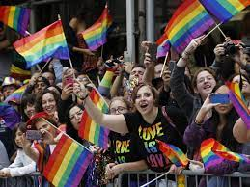
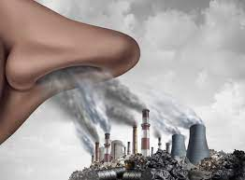
2.1 IMPACTS OF LIFE EVENTS Example of Factors
Task 2a: You will set a task on life events and sources of support for individuals. In this task you need to interview a real person.
EXPECTED AND UNEXPECTED LIFE EVENTS AND IMPACTS
Physical Factors: Diet and nutrition, activities, lifestyle choices eg alcohol, smoking, genetics, physical and mental health, disability, sensory impairment.
Social Factors: positive and negative relationships, social inclusion/exclusion, opportunities, discrimination bullying.
Emotional Factors: anxiety, fear, sadness, happiness, grief, attachments, family security.
Cultural Factors: Community, religion, race, gender, sexual orientation.
Environmental Factors: housing needs and conditions, pollution (air, noise light), neighbourhood, home environment (neglect, conflict), access to services.
PHYSICAL EVENTS: accidents, injury, illness, genetic disorders, puberty, menopause.
RELATIONSHIP CHANGES: starting/ending relationships, divorce/separation, parenthood, bereavement.
LIFE CIRCUMSTANCES: school starting/changing/exclusion, redundancy, imprisonment, retirement, bankruptcy.
IMPACTS:
Physical: illness/tiredness, pain, weight loss/gain, appearance.
Intellectual: adapting to change, learning new skills. Learning impairment.
Emotional: mental health, grief, anxiety, stress, depression, self-esteem/self-image.
Social: lifestyle choices, personal relationships with friends and family.
Financial: change in income, increases costs change in wealth.
INDIVIDUALS NEEDS EXAMPLES:
Weight gain-dietary advice and support.
Stress/anxiety-coping mechanisms, someone to talk to, mental health support.
Loss of income- financial advice and support
Learning impairment-specialist support, independent living, equipment.

Slide 3
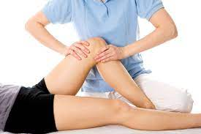
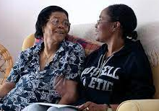
3.1 Sources of support that meet individual needs
TYPES OF SERVICES
FORMAL: Hospitals, health centres, care homes, day centres, children's services, hospices, respite care, rehabilitation centres, (addiction)
INFORMAL: family/friends, religion/culture
CHARITIES: Relate, Gingerbread, Cruse, Age UK, MIND, specialist charities
KEY WORDS
FORMAL
INFORMAL
CHARITIES
PRACTIONERS SOME EXAMPLES:
G.P
NURSE
MIDWIFE
SPECIALIST DOCTOR
PHYSIOPHERAPIST
DIETICIAN
SOCIAL WORKER
COUNSELLOR
OCCUPATIONAL THERAPIST
HEALTH CARE WORKER
CHARITY WORKERS
WHAT YOU MUST KNOW!
ROLE OF PRACTITIONERS AND INFORMAL CARERS
HOW PRACTITIONERS MEET INDIVIDUAL NEEDS AND HOW THIS SUPPORTS SERVICE USERS
Task 2b: You will be set a task on researching and recommending support to meet individual needs, this may be on a local or national level.

