Slide 1

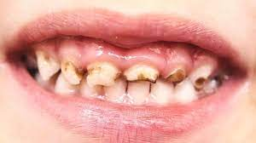




KNOWLEDGE ORGANISER
HEALTH AND SOCIAL CARE YEAR 10
RO35
RO35: Health Promotion Campaign (Live assessment/course work NEA)
KEY TERMS
Topic 1: Current public health issues and the impact on society.
Pathogens
Bacteria
Virus
Fungi
MRSA
Mortality
Eatwell Guide
Coronary heart disease
Diabetes
Emphysema
Bronchitis
Pneumonia
Possibilities depending on NEA.
Smoking cessation
Healthy eating
Child dental health
Healthy heart
Sexual health
Teenage pregnancies
Binge drinking
Cancers
Mental health
Task 1: To improve the health in your area the local authority has asked you to produce a health campaign for one of the following public health challenges …. (NEA live topic will change every year)
Reasons why a healthy society is important:
* Control of communicable diseases
* Decrease cost of care
*Decrease sickness and dependency
* Increased life expectancy
RESEARCH
QUESTIONS
RECORDING
Choosing a public health challenge: WHAT YOU NEED TO DO:
Find a target audience
Write about the Influencing factors related to the chosen target audience.
Explain the barriers to leading a healthy lifestyle.
Explain positive changes if the campaign was followed.

Slide 2


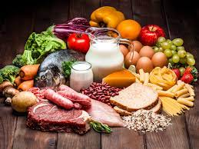




Topic Area 2 Factors influencing health
Organisations promoting public health challenges Charities National Health Service (NHS) Government Health Agencies World Health Organisation (WHO)
Lifestyle choices:
Health: Physical health, Mental health
Education and socio-economic:
Access to health services:
Location Opening times Local resources Availability
Examples of lifestyle choices may include:
Alcohol, diet, exercise, unprotected sex, smoking and self-help.
Examples of health may include: illness, stress, anxiety, and genetics. Examples of education and socio-economic may include: disposable income, employment, literacy, qualifications, culture.
Examples of health services may include: access to counselling, GP, clinics, pharmacy, wellbeing groups
What prevents individuals from being healthy Advertising/Media
Promoting unhealthy products on TV and social media
Peer pressure
Lack of support
Friends and family
Role models
Health professionals
Cost
Expense of gym membership, Healthy foods, Treatment/holistic therapies

Slide 3


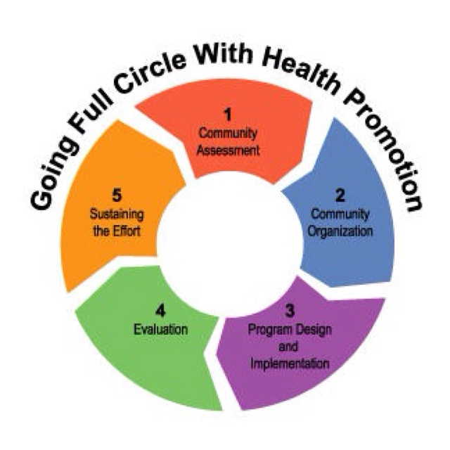

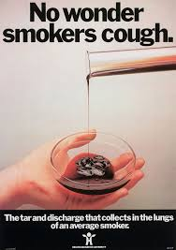
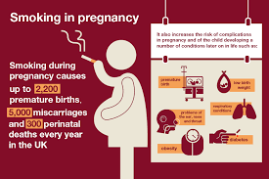
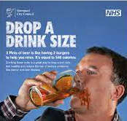

Topic 3: Factors influencing health:
TASK 2: Produce a plan for the health campaign:
YOU MUST INCLUDE:
Aims of the campaign
Timescales
Resources
Safety considerations
Communication
Methods to used engage the target audience
How to gather feedback after the campaign
POINTS TO REMEMBER
THIS IS A NEA ASSESSMENT the assessments are live and change every year.
You must use your own words in the plan
Information copied from sources to support text explanations must be referenced
It is acceptable to use templates for the plan provided with this assignment, or you can design your own plan.
But care must be taken that all information is your own words.

Slide 4





Topic 3: Plan and create a health promotion campaign:
And
Topic 4:
Evaluate the performance
of the health campaign.
Task 3: Deliver the campaign and evaluate the campaign.
EVALUATION
Remember:
Give your own opinion about your actions
To support yourself use the feedback you collected earlier
Think about what you did well and what did not go so well? Talk about how you could improve if you did it again.
TOP TIPS
Preparation is every thing: make sure you are well prepared and everything you need is at hand to deliver a successful promotion campaign.
Do not forget to hand out feedback form: (engaging the audience from task 2) to your delegates at the start of your delivery.
Recall: when you evaluate think about what you did well and what was not so successful.
How to evaluate your own performance
Use feedback
Self-reflect
Review strengths and weaknesses of
Your planning
Your communication skills
How you engaged individuals
Suggest improvements
What you would do differently and why

